Slide 1




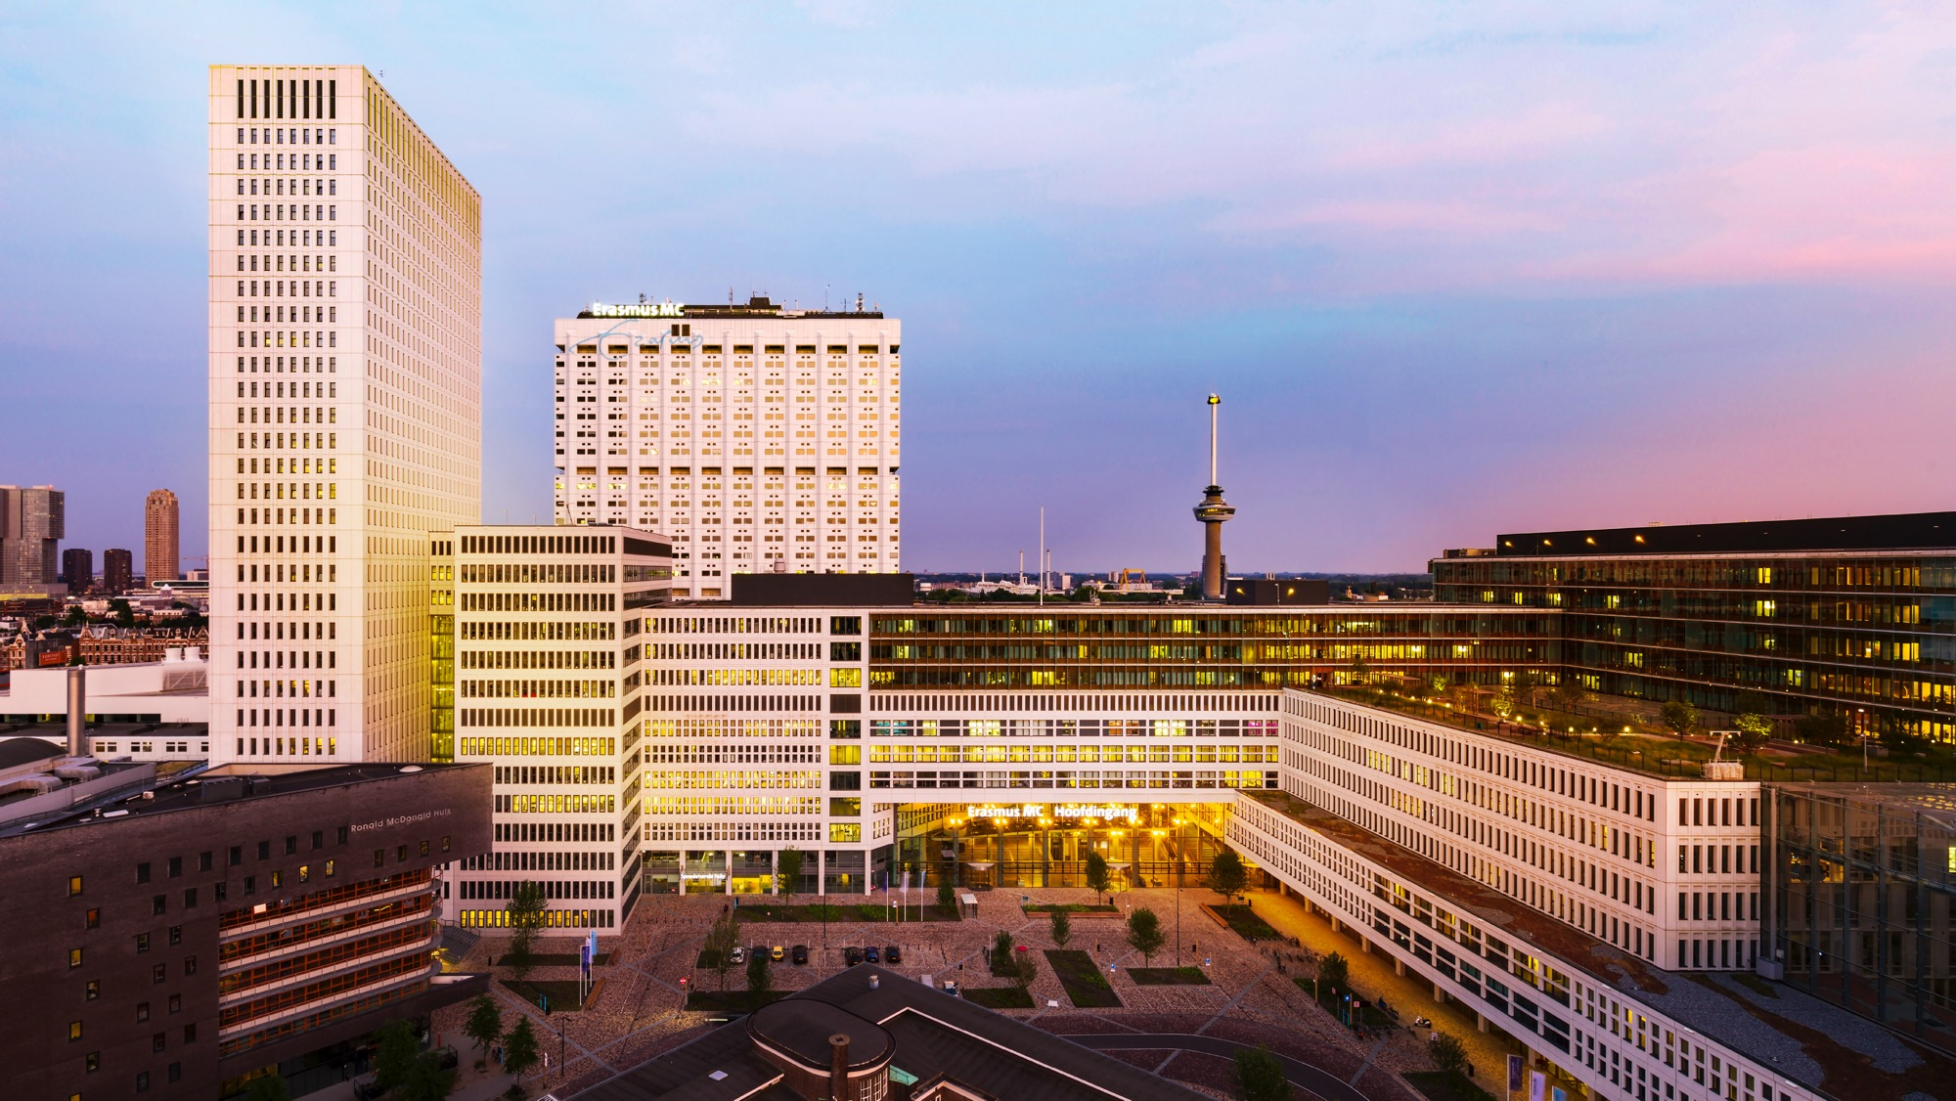
Histiocytoses at the cellular level
Astrid van Halteren
a.vanhalteren@erasmusmc.nl
Notes:
Disclosure: I am not a MD

Slide 2
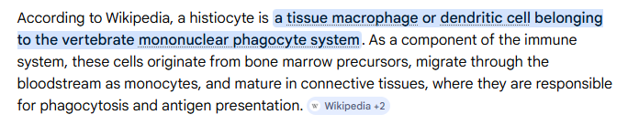
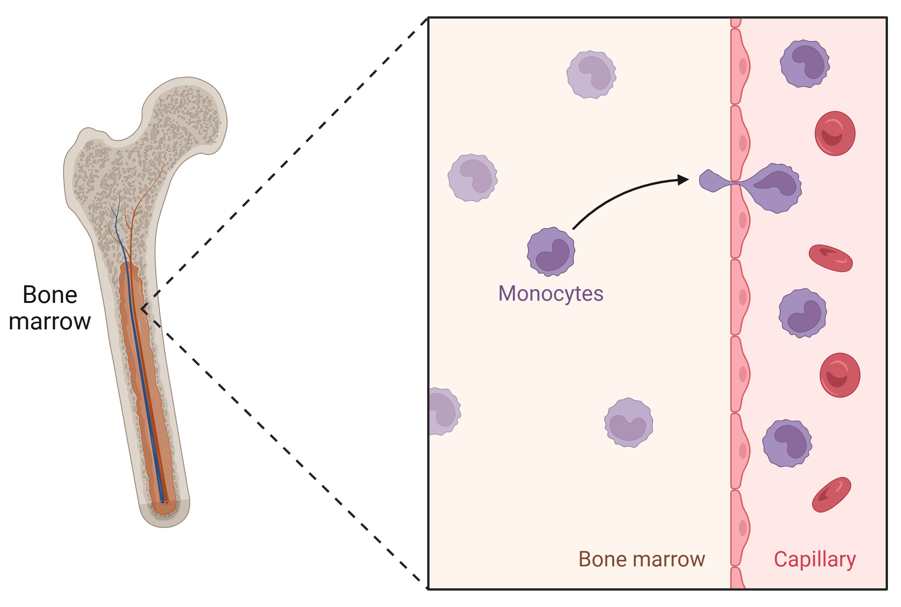
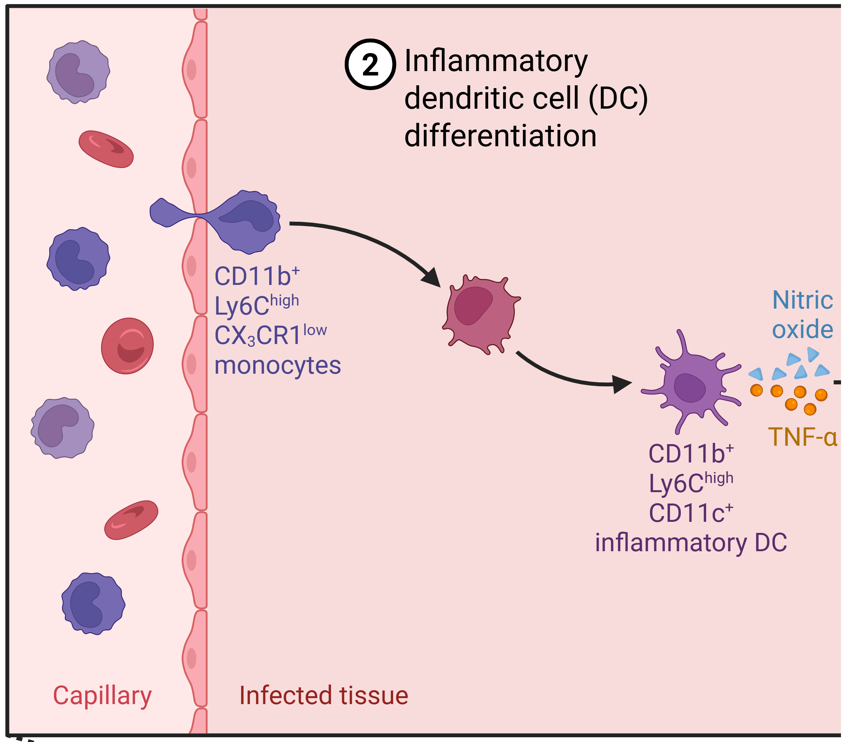
steady state
tissue inflammation

Slide 3
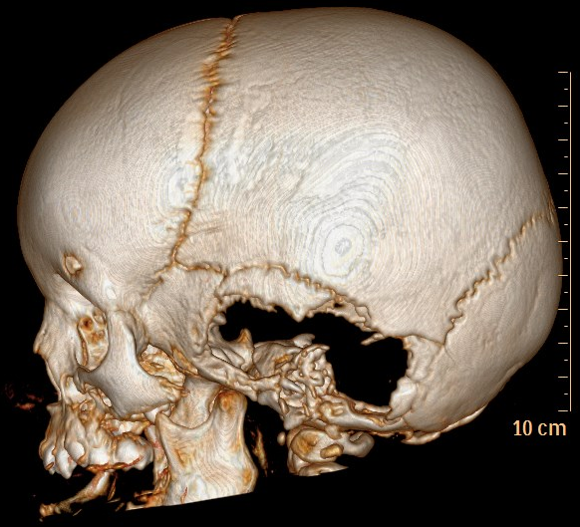
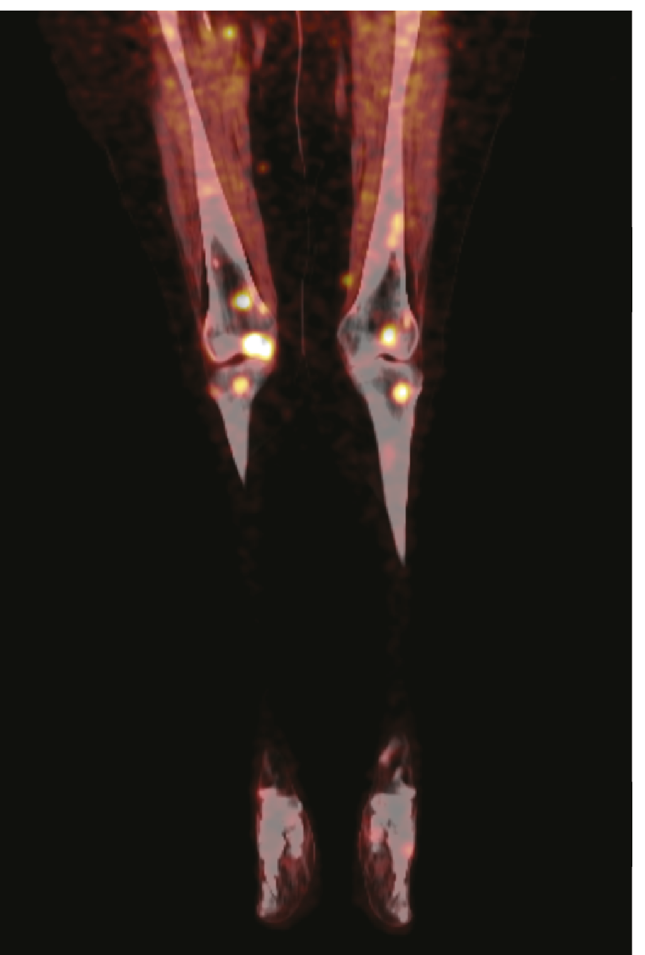
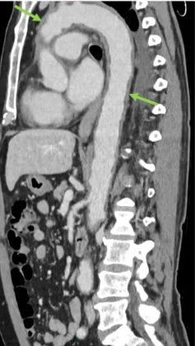
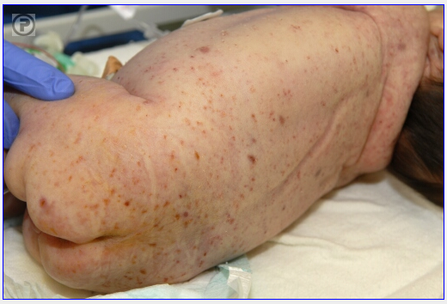
Histiocytoses: accumulation(s) of cells with monocyte, macrophage
and/or dendritic cell features in one or more tissues

Slide 4
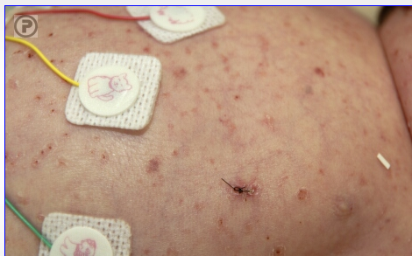
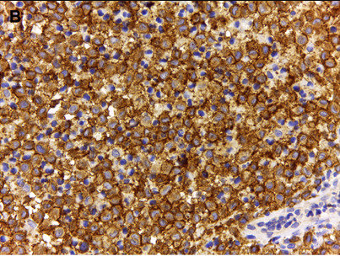
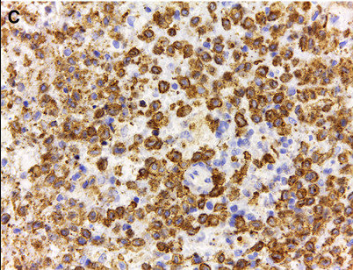
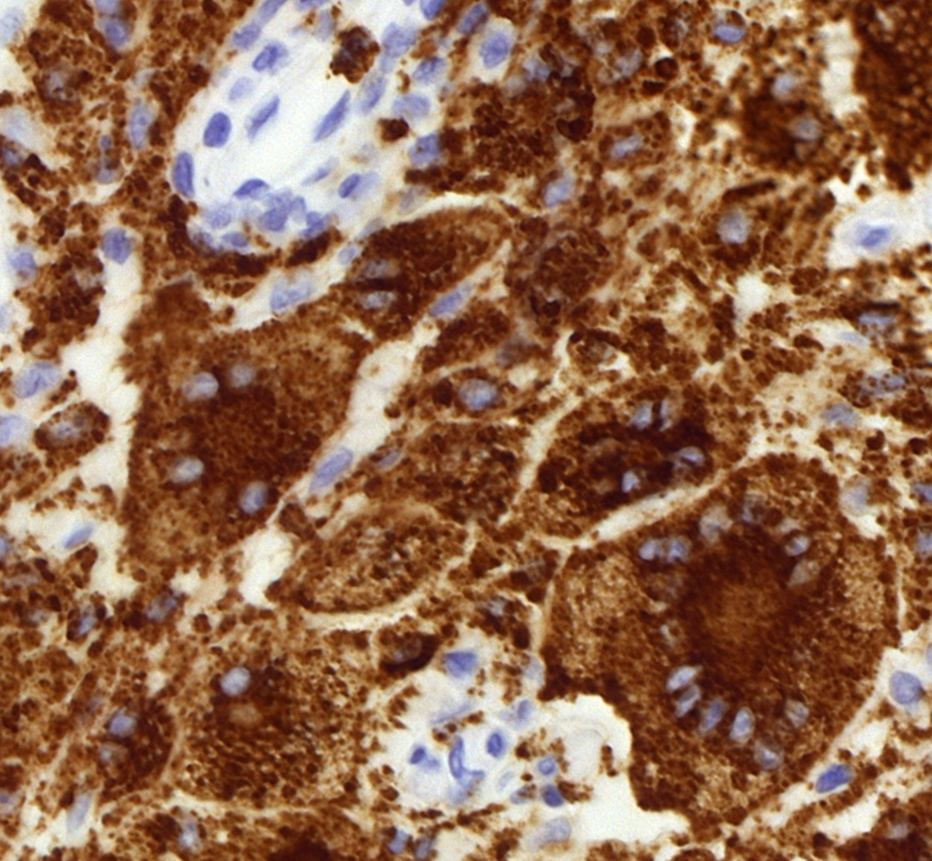
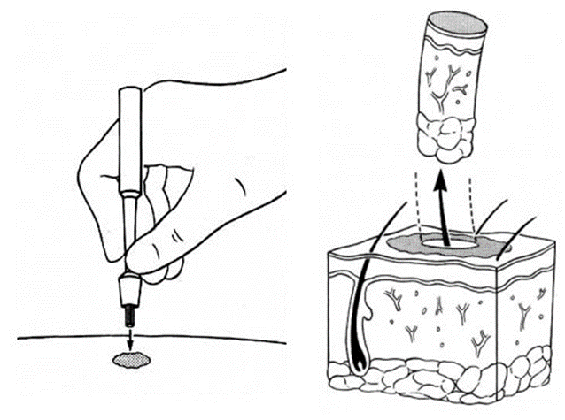
Histiocytosis diagnosis via histological evaluation of biopsies
CD1a
CD207
LC
CD68
Mac
Notes:
Top: LCH; bottom: non-Langerhans cell histiocytoses => uitleggen dat het de histiocyten zijn die aankleuren

Slide 5
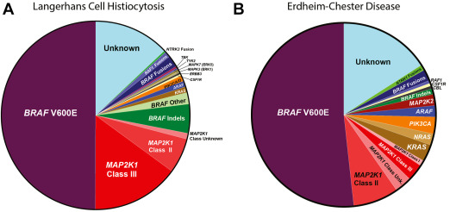
Pathognomonic cells in histiocytosis lesions express small errors in their genome leading to altered biological behavior
VE1
B.H. Durham Hematology/Oncology Clinics North America 2025

Slide 6
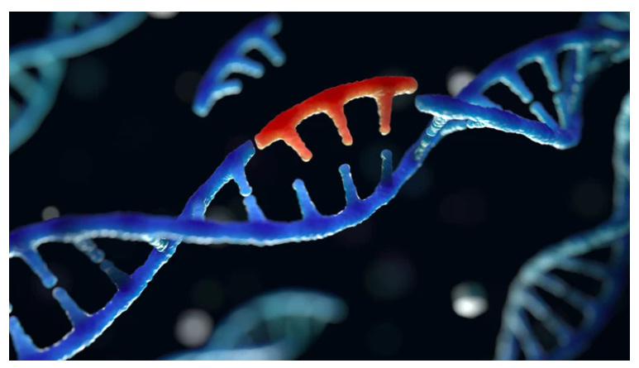

Tracing mutated cells in patients requires sensitive technology
probe MUT
probe WT
Credit: Getty

Slide 7
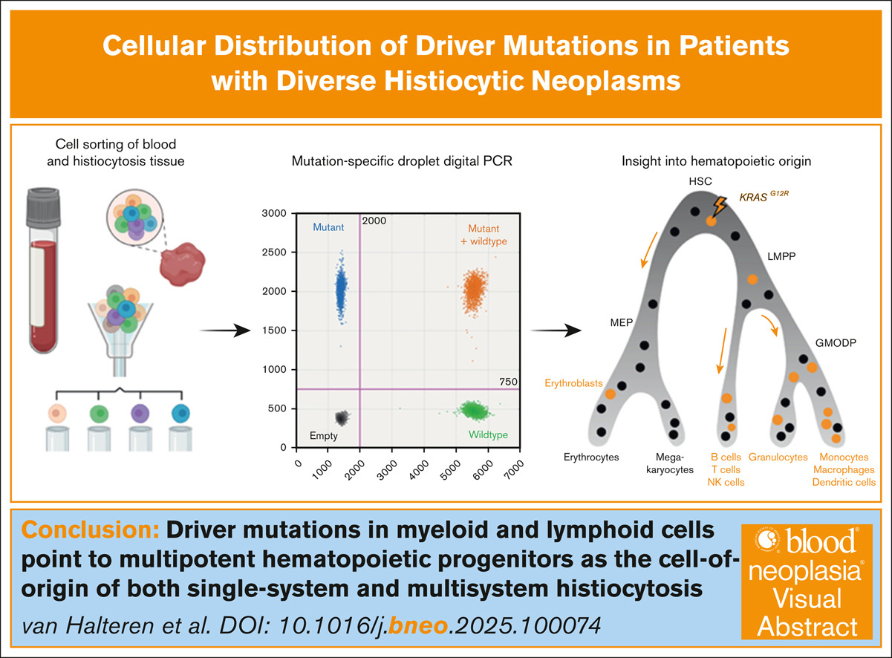
Tracing mutated cells in biopsies, blood and bone marrow
DNA
Notes:
Bekendste voorbeeld nipt test ofwel non-invasive parental testing waarbij specifiek gezocht wordt naar afwijkende chromosomaal DNA afkomstig van de foetus

Slide 8
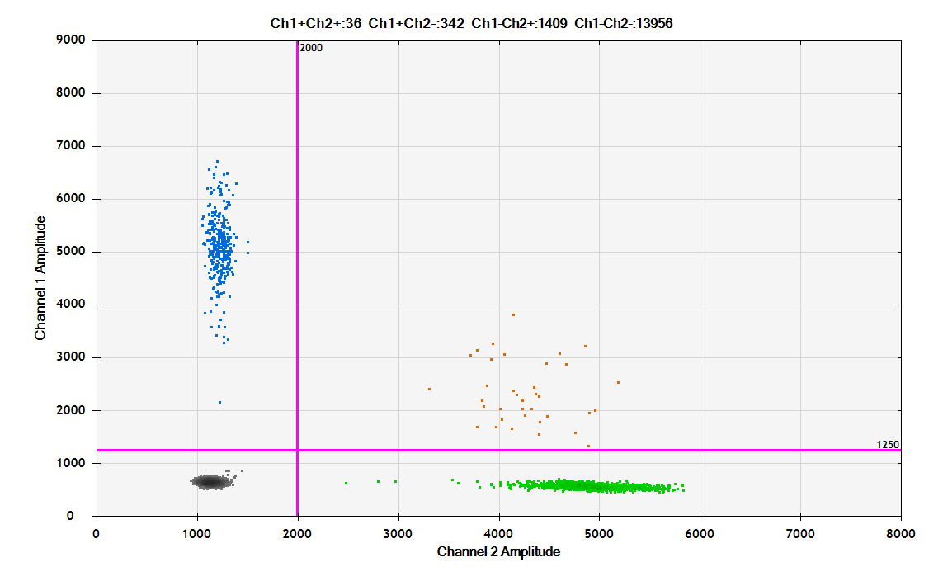
Can we find mutated monocytes in the patients’ blood and tissues?
histiocytes 40.4%

Slide 9
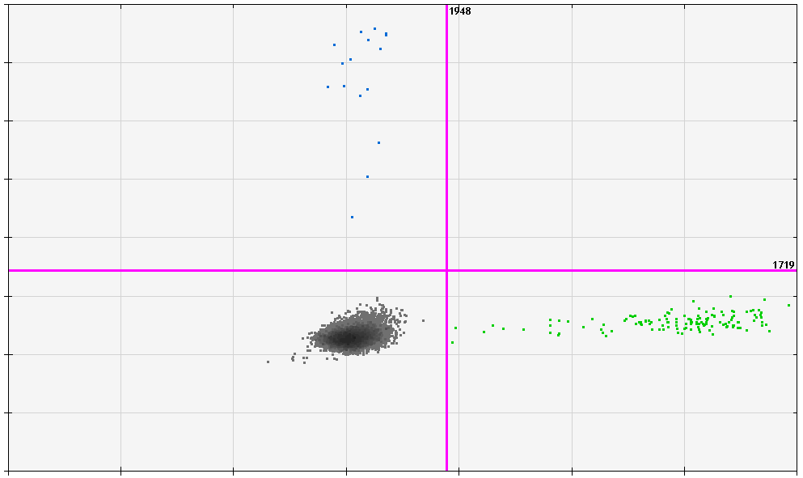
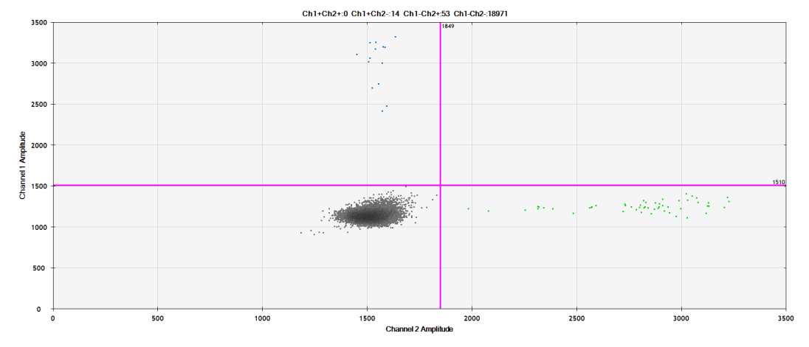
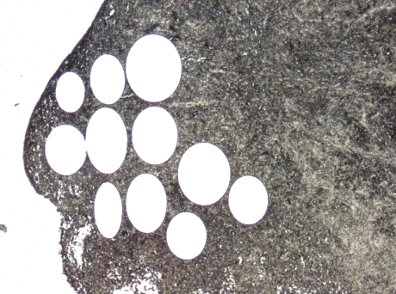
LCH lesions contain phenotypically diverse BRAF^{V600E+} myeloid cells
CD68
Mac
BRAF^{MUT}
MGC
A.G.S. van Halteren et al Blood 2020
BRAF^{WT}

Slide 10
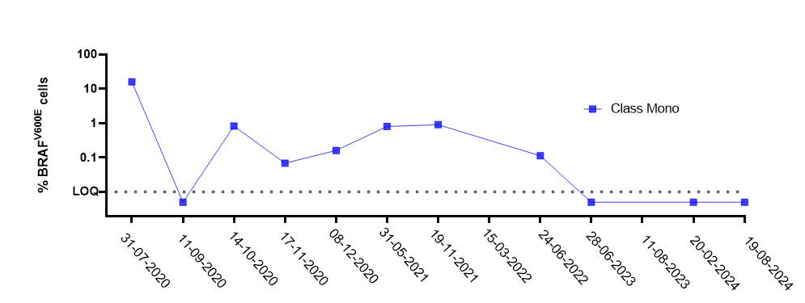
Can we find mutated monocytes in the patients’ blood?
infant with MS-RO⁺ LCH

Slide 11

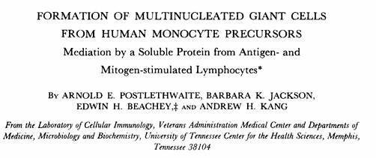
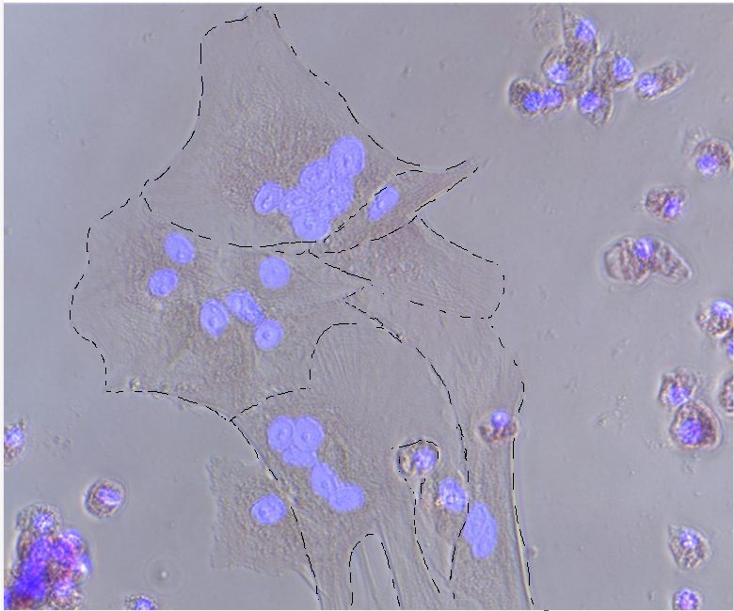
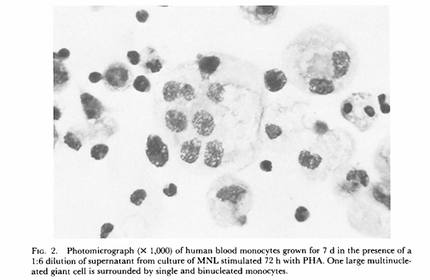
in vitro generated osteoclasts
DAPI
A.E. Postlethwaite et al. J. Exp Med 1982
M. van der Gaag et al. work in progress

Slide 12
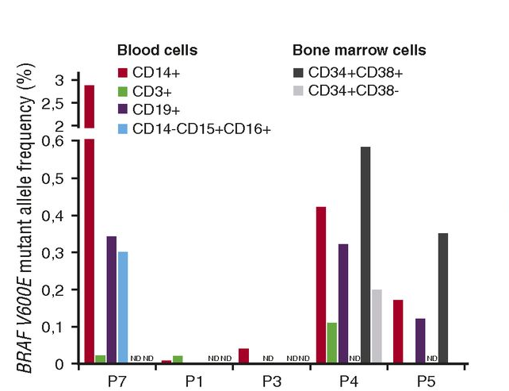
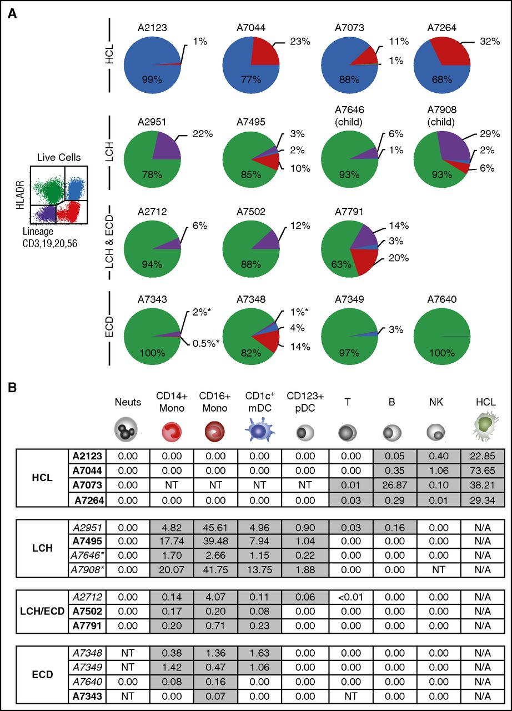
MSKCC and Newcastle data on mutation frequency in sorted populations
P. Milne et al. Blood 2017
B.H. Durham et al. Blood 2017

Slide 13
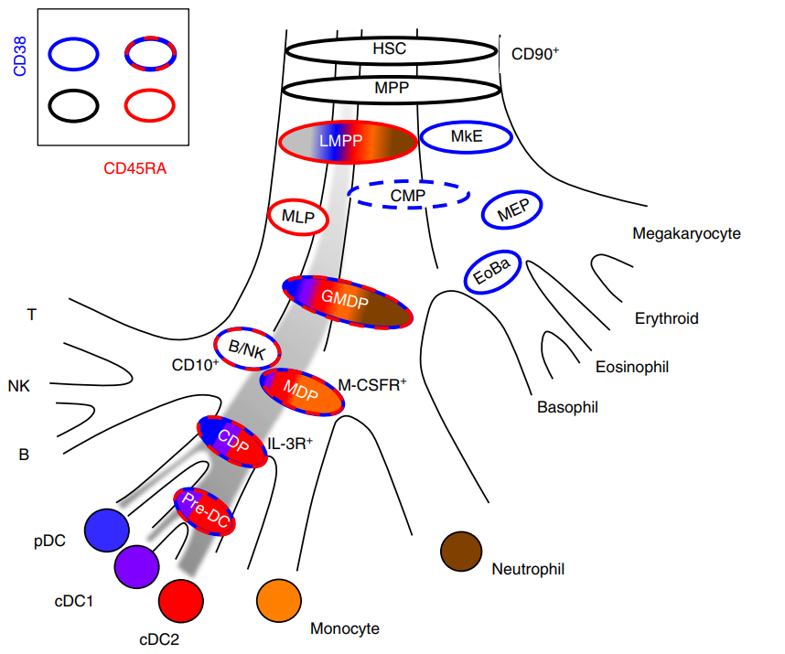
M. Collin et al Immunology 2018

Slide 14
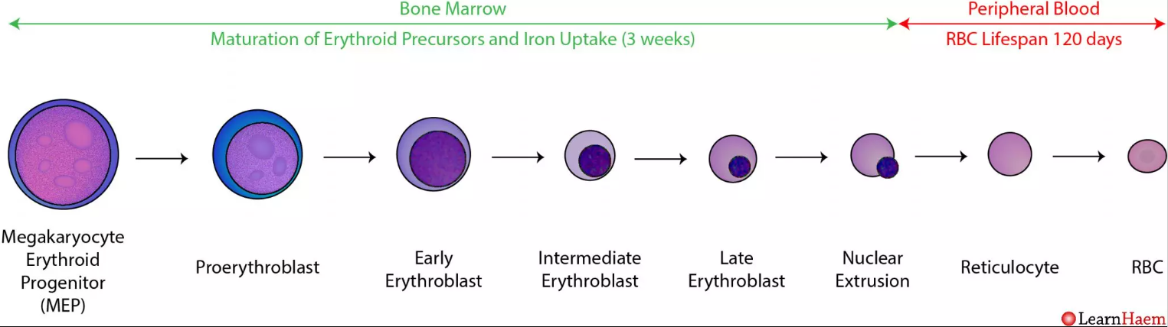
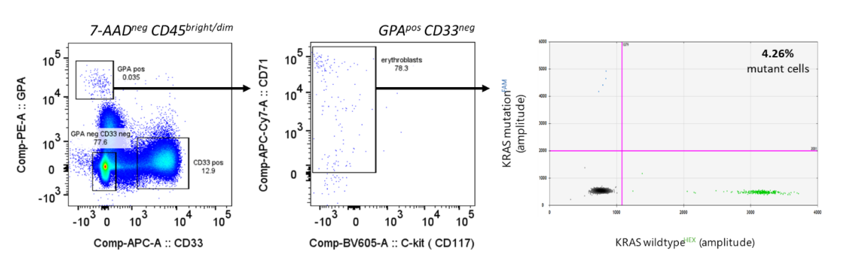
Driver mutations are found in nucleated erythroblasts
A.G.S. van Halteren et al. Blood Neo 2025

Slide 15
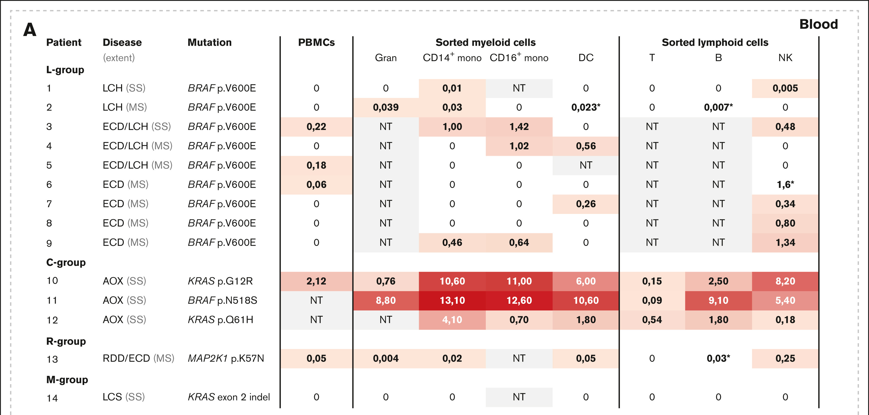
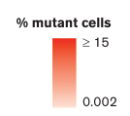
Overview of percentages of mutated cells in the blood (Rotterdam data)
A.G.S. van Halteren et al. Blood Neoplasia 2025

Slide 16
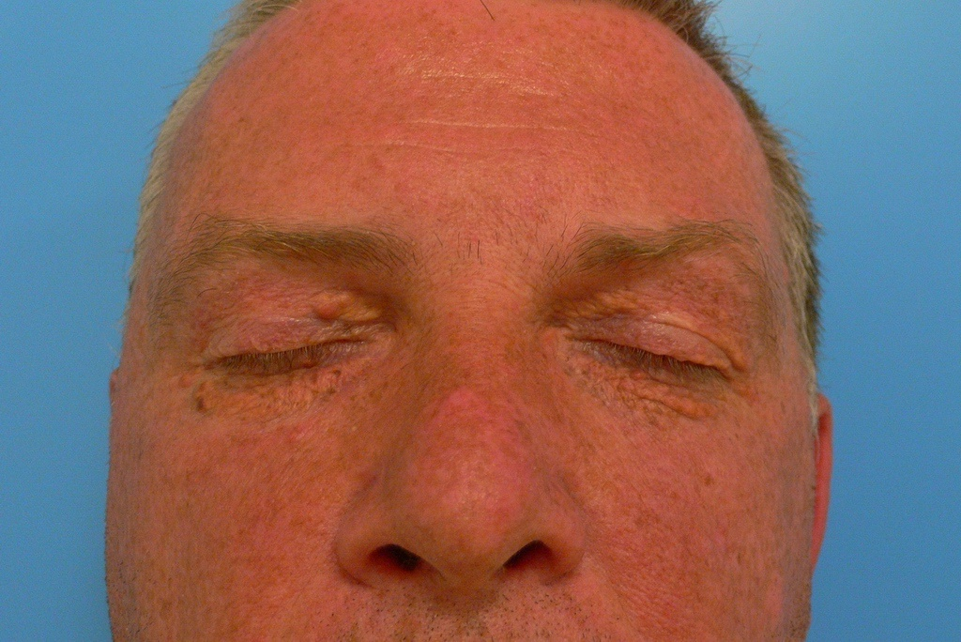
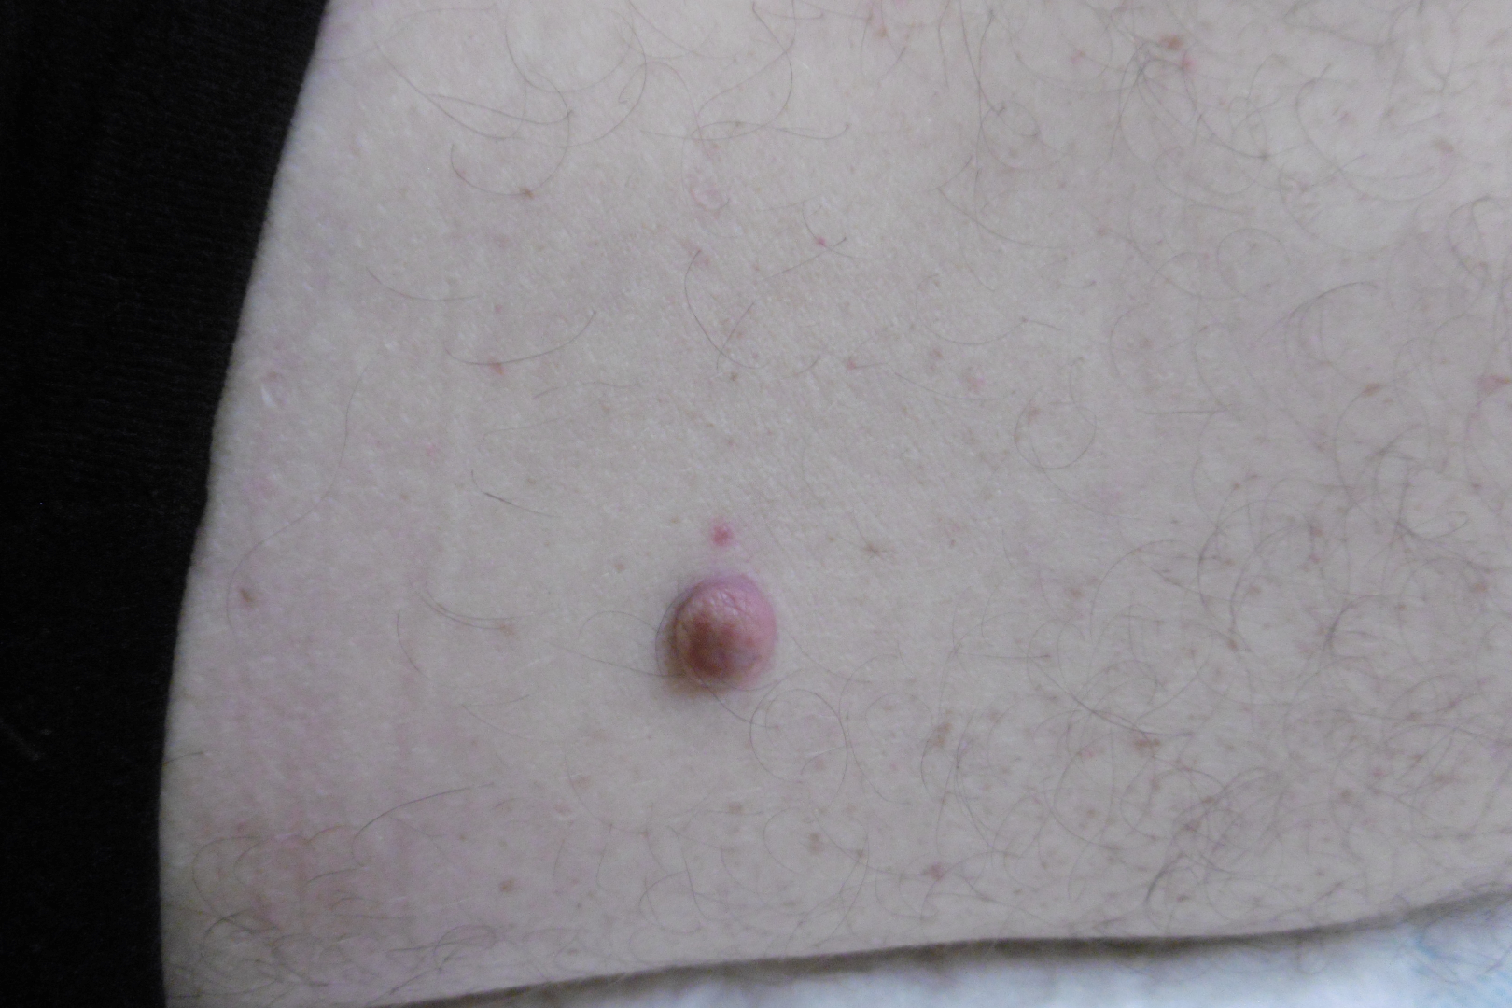
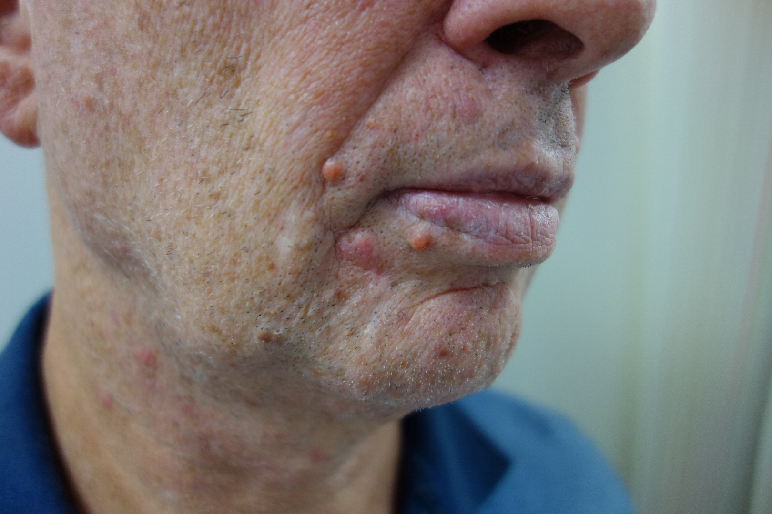
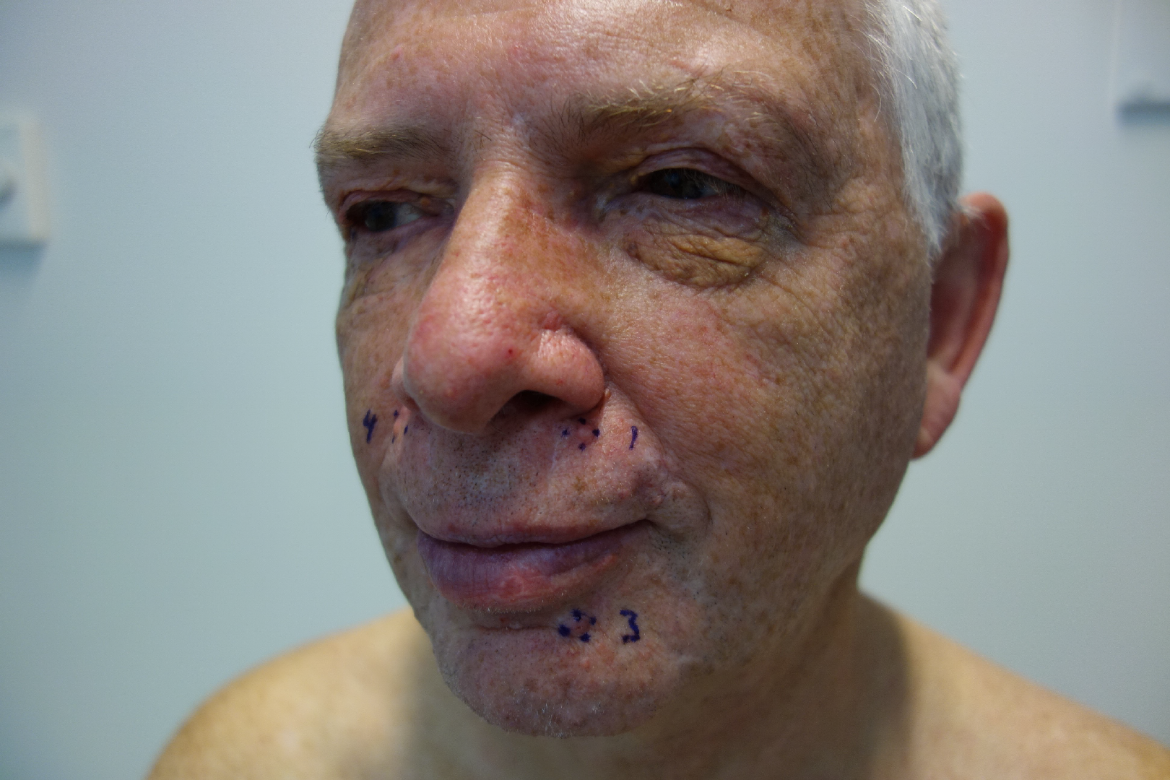
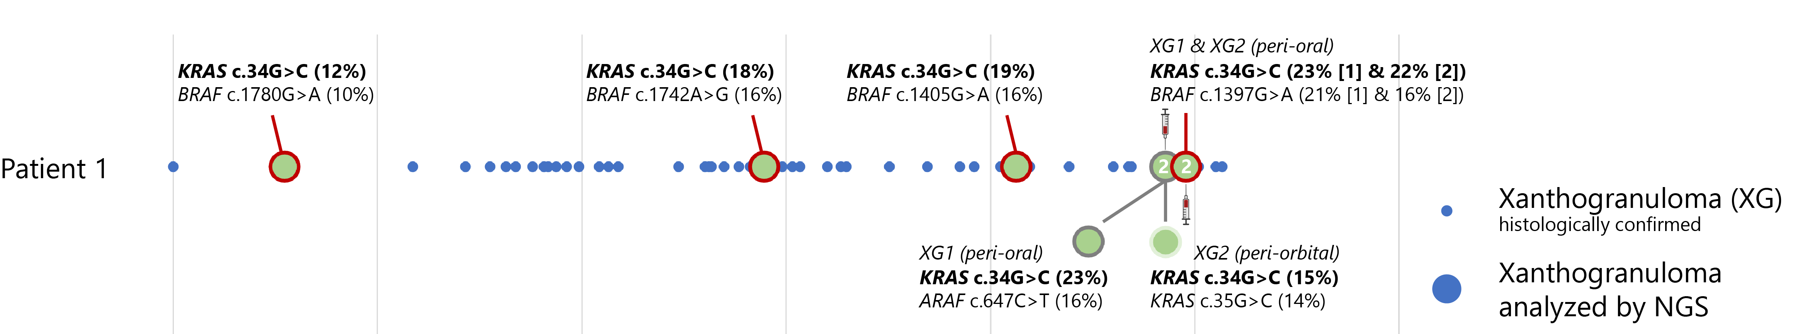
Long-lived driver mutation positive hematopoietic stem cells in AOX case?
2007
2016
2019
2022
1996
2022

Slide 17
M. Collin et al Immunology 2018

Slide 18
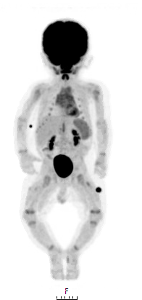
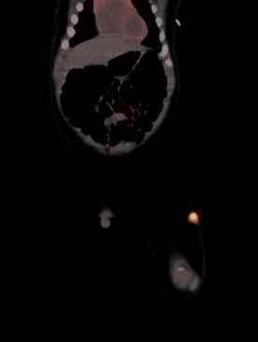
Do more downstream progenitor cells play a role in histiocytosis?

Slide 19
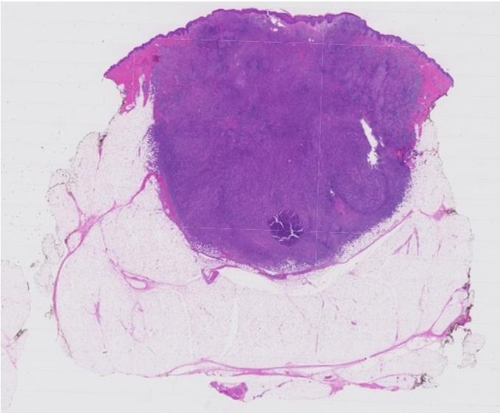
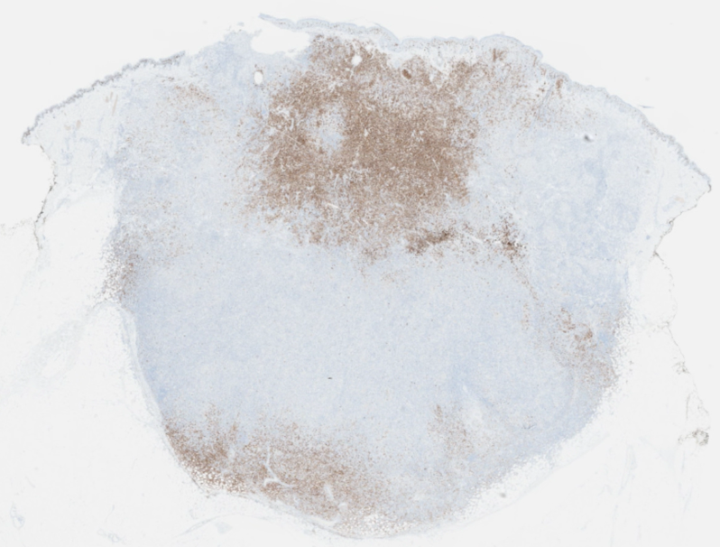
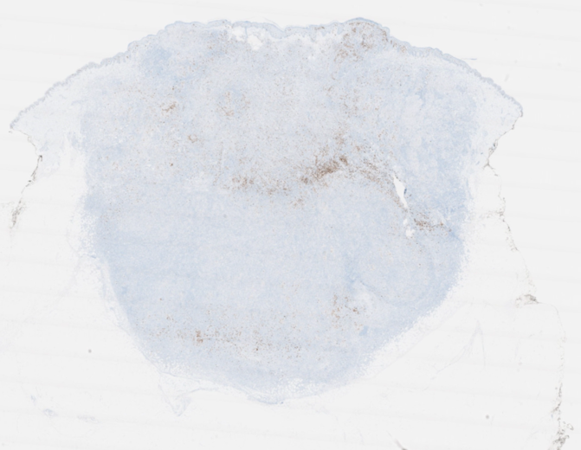
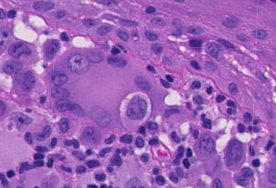
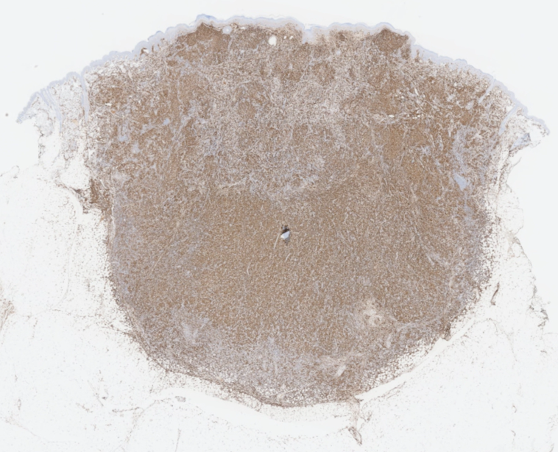
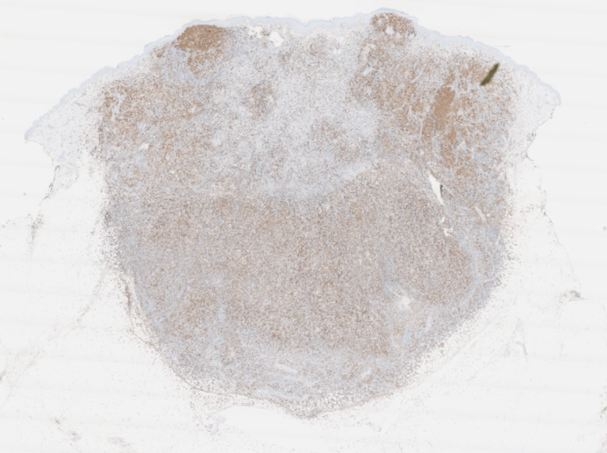
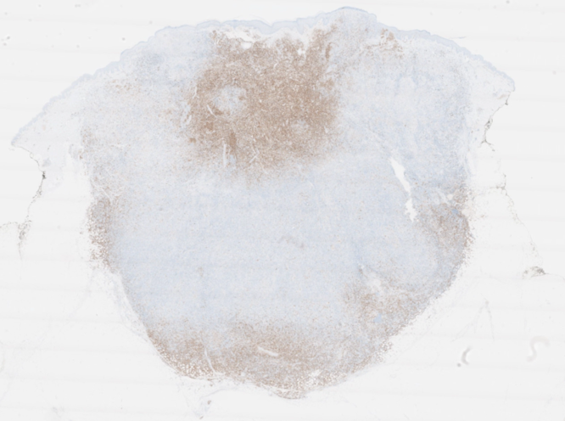
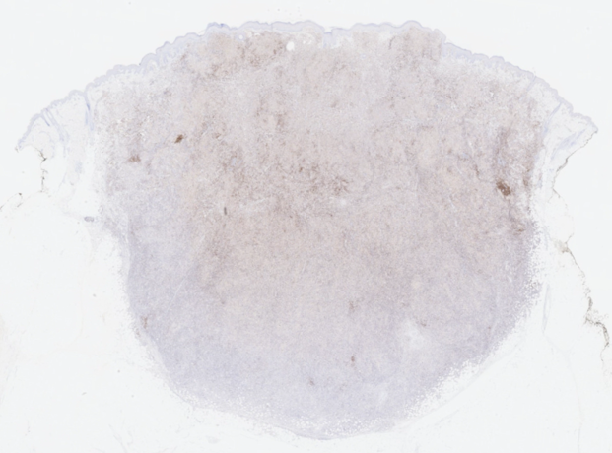
CD1a
CD207
CD14
CD163
CD56
CD19

Slide 20
M. Collin et al Immunology 2018

Slide 21
Summary
Histiocytic disorders are the result of hematopoietic stem / progenitor cells (HSPC)
acquiring one or more somatic mutations;
This ‘cell-of-origin’ can survive for decades while continuously producing offspring cells;
Mutated histiocyte precursor cells do not necessarily reside in the bone marrow only;
Tissue inflammation/destruction is caused by mutated histiocytes generated from
immediate precursor cells like monocytes;
Pathologic role of mutated lymphoid cells has not yet been clarified;

Slide 22
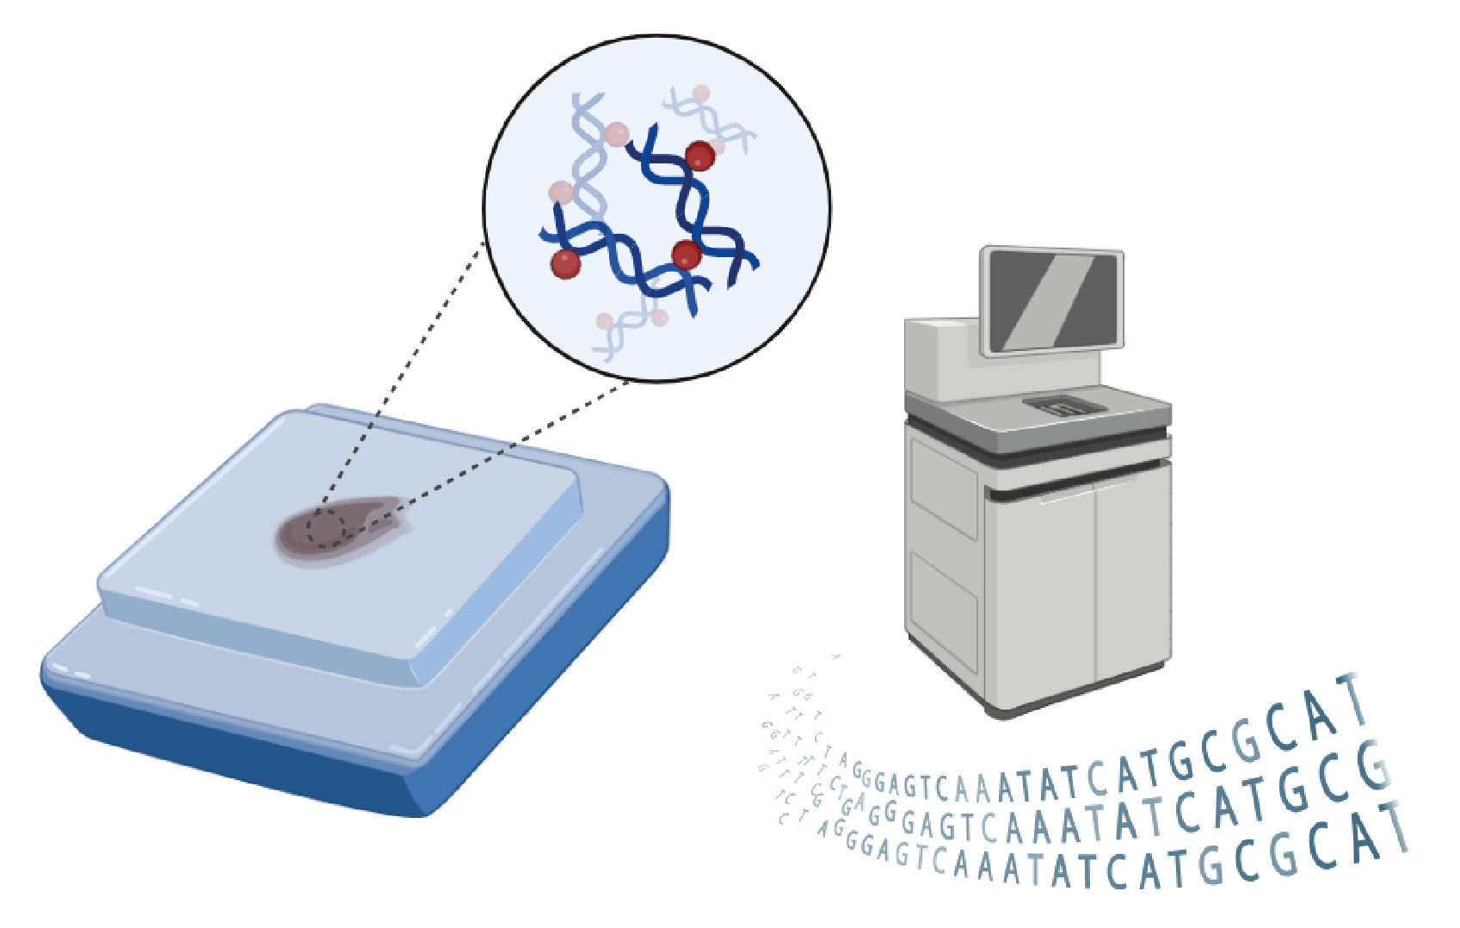
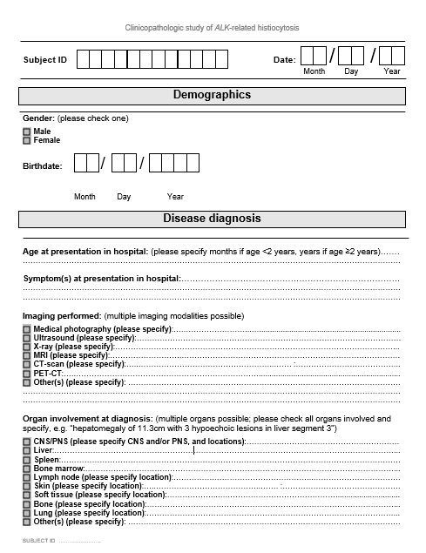




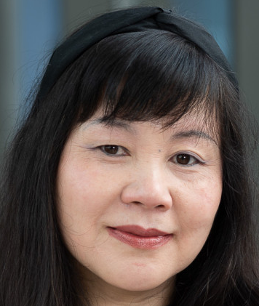



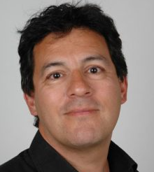







Acknowledgements

