Slide 1
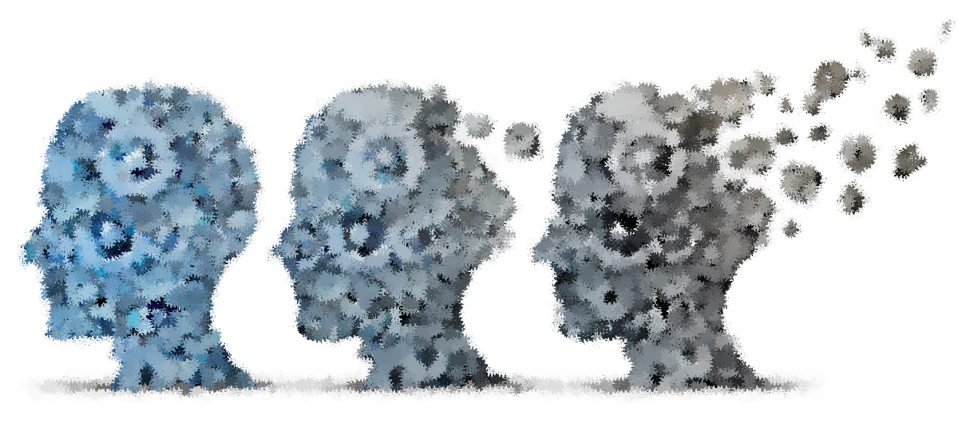
Diversity and Degeneration in Neurohistiocytic Disease
Nicole Coufal, M.D. Ph.D.
Associate Professor
Pediatric Critical Care
Department of Pediatrics & Neuroscience
University of California, San Diego
Sanford Consortium for Regenerative Medicine
Rady Children’s Hospital
Erdheim Chester Disease
Global Alliance
Annual Conference
May 1, 2026

Slide 2
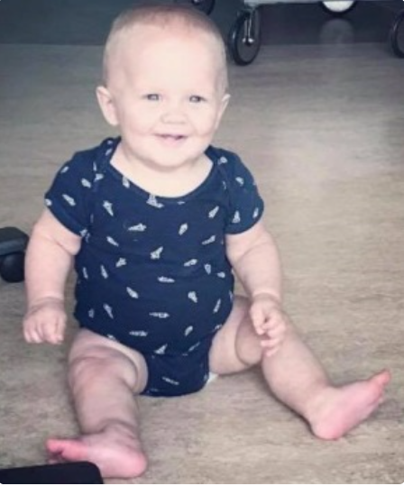
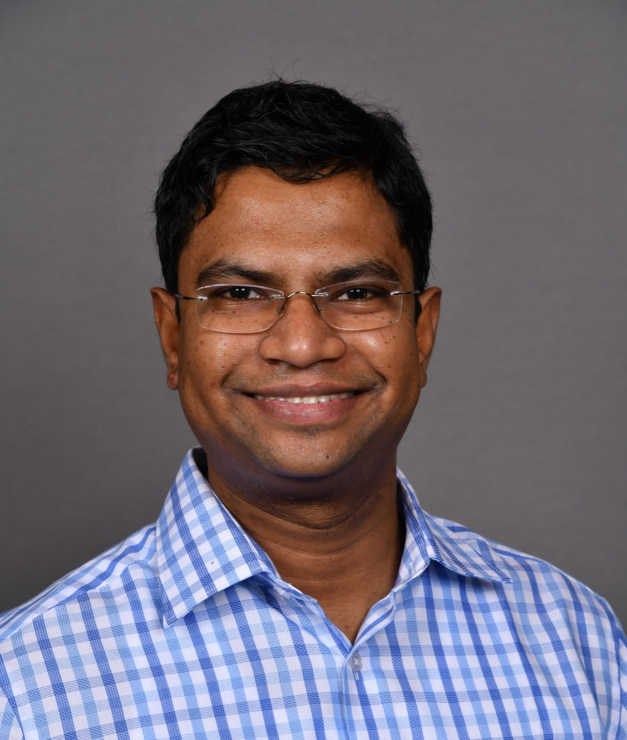
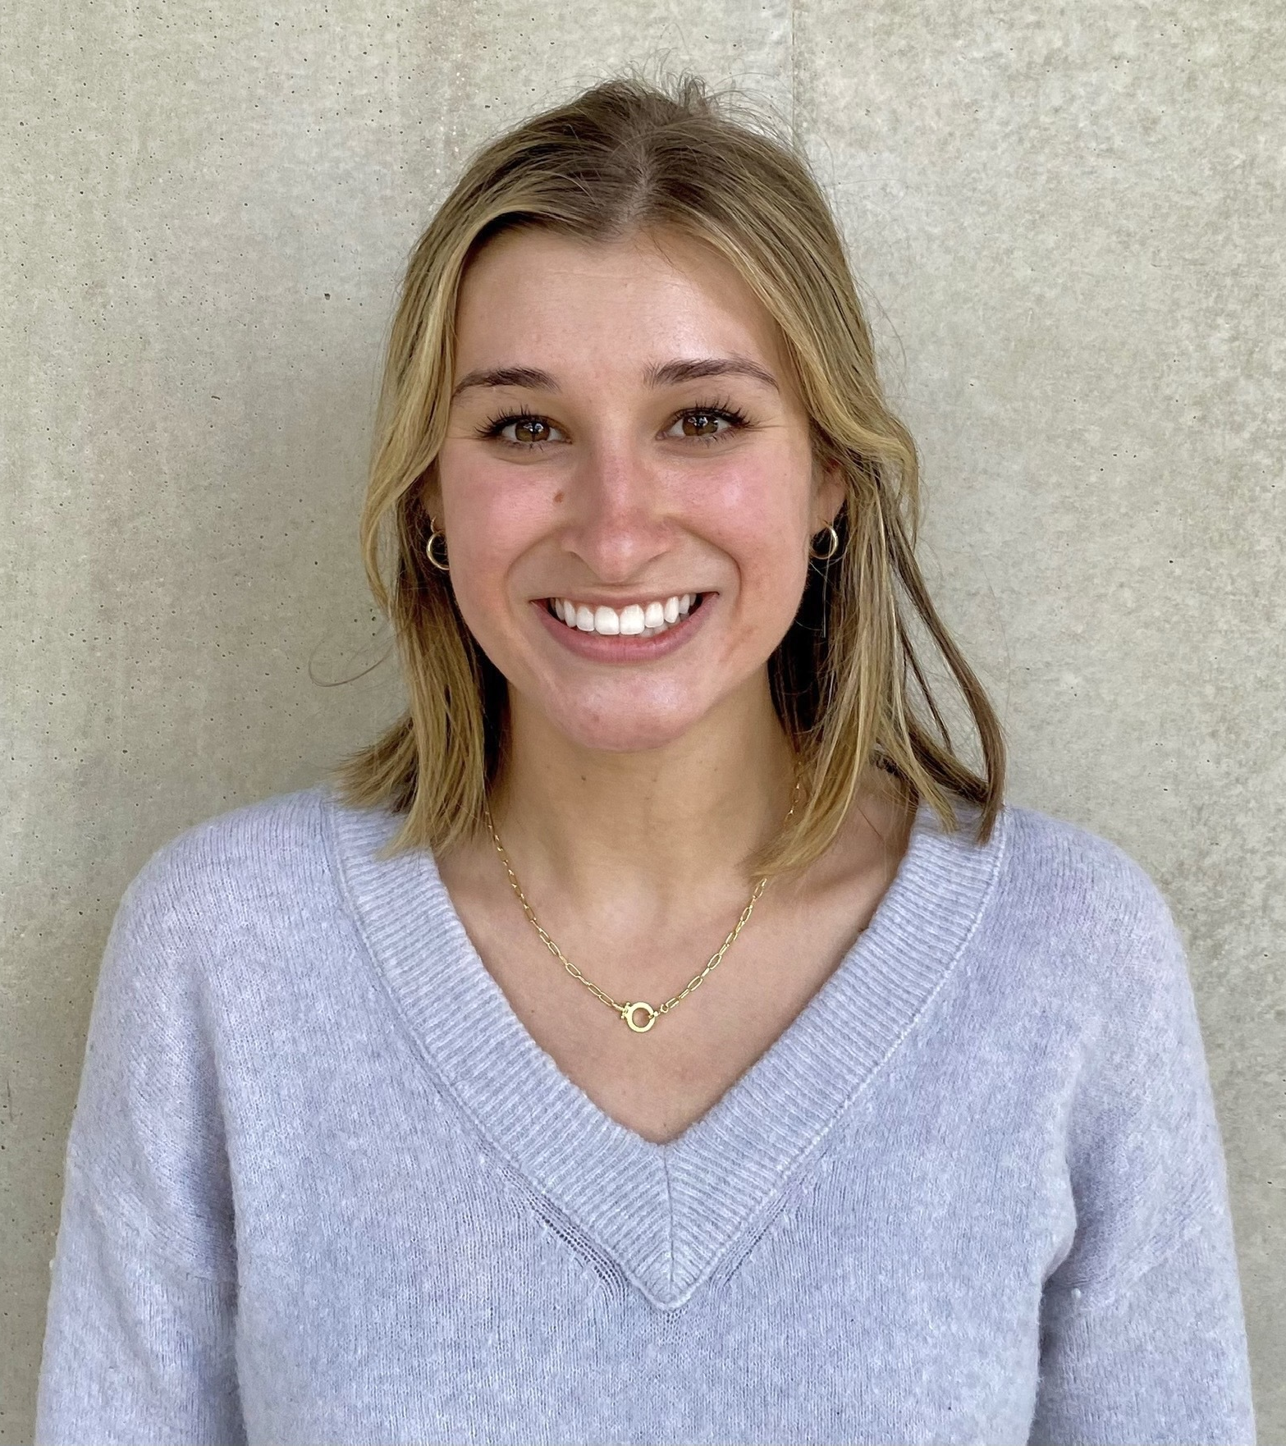
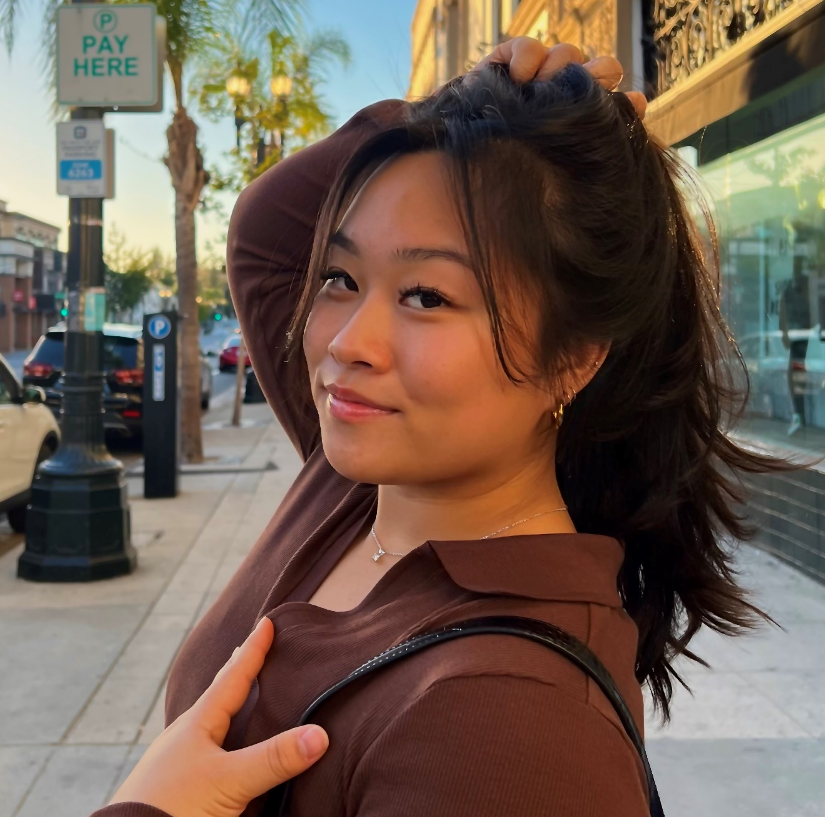
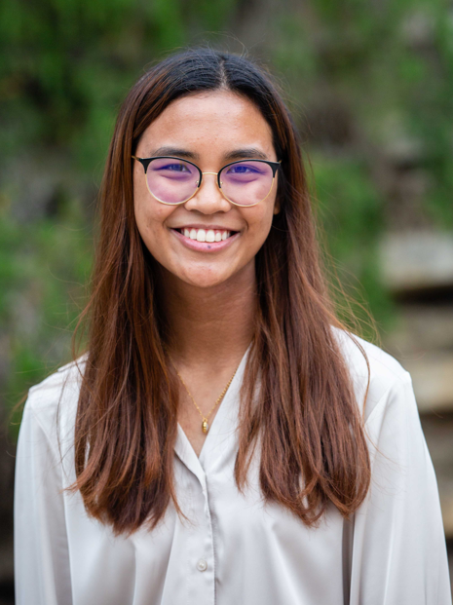
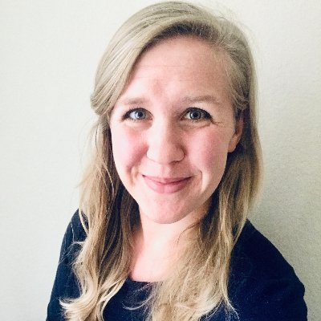
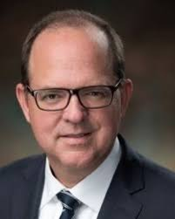
Disclosures
None related to work presented today
Consulting for Aspen Neurosciences
Patients
& Families
It takes a village…
Shivakumar
Rajamanickam, PhD
Samantha
Trescott
Samantha
Mak, MS
Amanda
Wilpitz
Anna
Warden, PhD
Carl Allen, MD

Slide 3
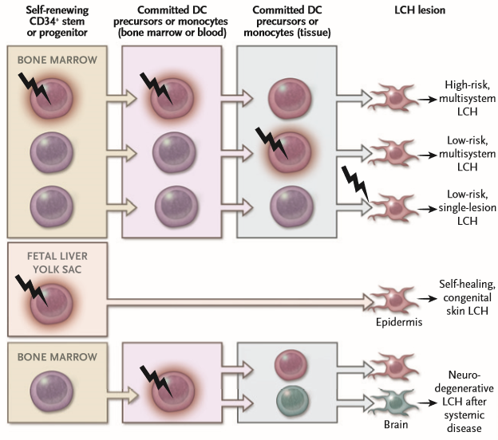
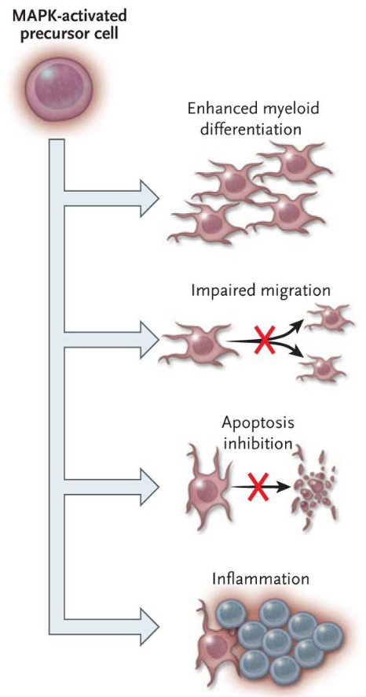
Pathophysiology of Histiocytic Disorders
Allen et al, NEJM 2018

Slide 4
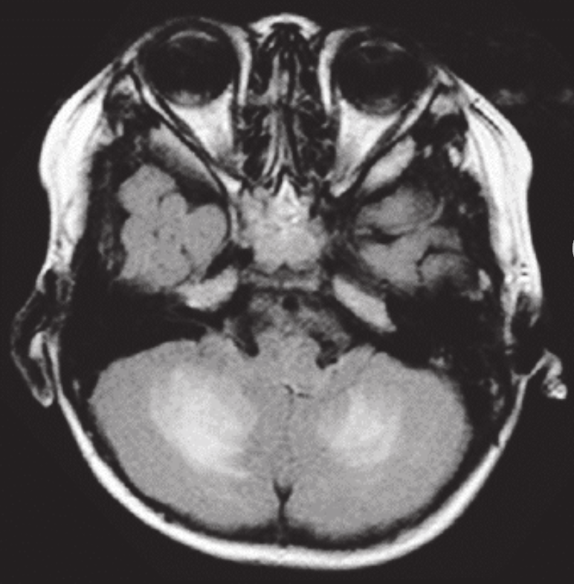
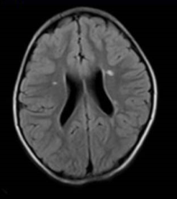
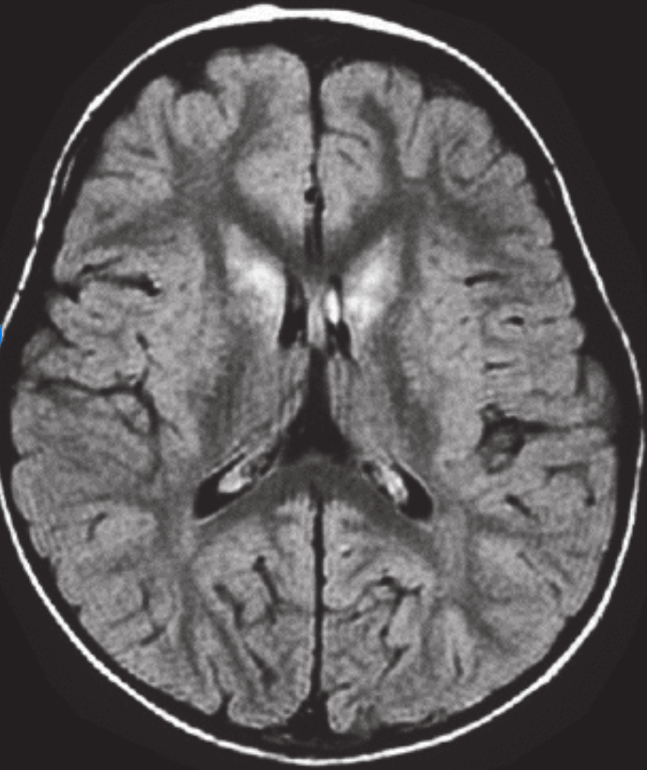
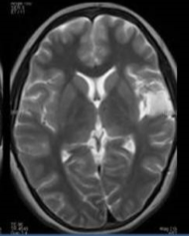
Prevalence of neurodegeneration in histiocytic disorders is substantial
Estimates vary widely 20-76% depending on the study
Diverse presentation types
Intention tremor, cerebellar ataxia, dysarthria, congitive deficits, psychomotor retardation, headaches, and psychosis – sequelae are severe
In ECD is an independent predictor of mortality
Often treatment refractory/progressive
Imashuku et al, Hematology & Oncology 2011
Notes:
3 main presentation types
Despite adequate treatment some LCH patients will go on to have ‘late’ neurodegeneration
Increased incidence with multisystem LCH
LCH neurodegeneration is more common the younger the age at dx – onset teens to 40’s
Symptoms: ataxia, memory and learning difficulties, dysarthria, behavioral difficulties.
No treatment

Slide 5
Unanswered questions
What drives histiocytic neurodegeneration in subsets of patients?
Why are brain lesions highly variable?
How does this heterogeneity impact treatment response or resistance?
Limitations of current models
Brains biopsies are rare, and other lesional samples are highly heterogenous, limited sample for study
Innate immunity in mice differs substantively from humans
Treatment evaluation is hampered by lack of human / humanized models and multiple mouse histiocytosis models without neurodegeneration
…..Need for a human model
Notes:
is that driven by the disease mutation or immune response or genetics or…?

Slide 6
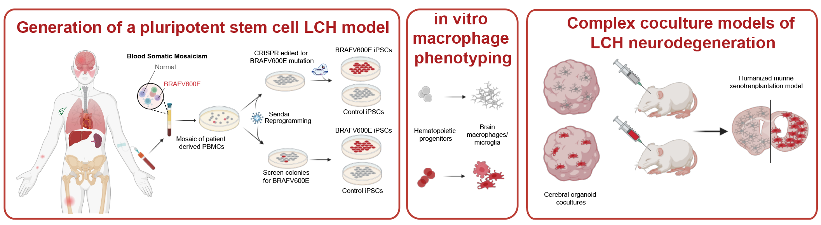
Overview
Rajamanickam et al Blood 2026
Notes:
Talk about BRAFV600E

Slide 7
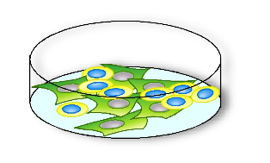
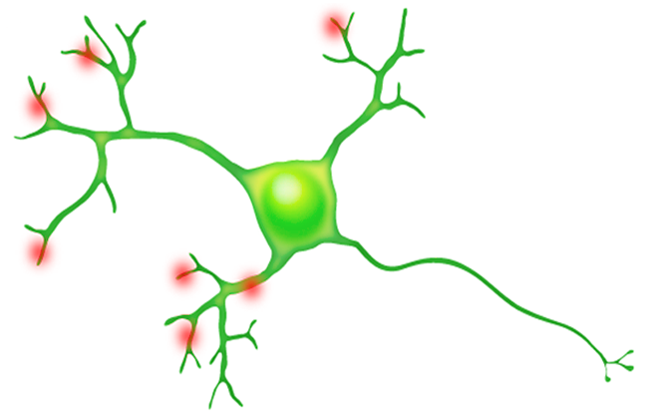
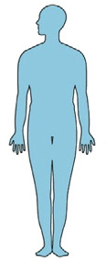



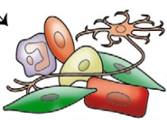




Induced pluripotent stem cell (iPSC) modeling of human disease
Disease modeling
Molecular mechanism of the disease
Reprogramming
Differentiation
Induced pluripotent stem cells
Somatic cell
(unipotent)
Specialized differentiated cells
Drug screening & discovery
Patient
New drugs
Cell therapy?
Toxicity testing
Human clinical trials in a tube

Slide 8
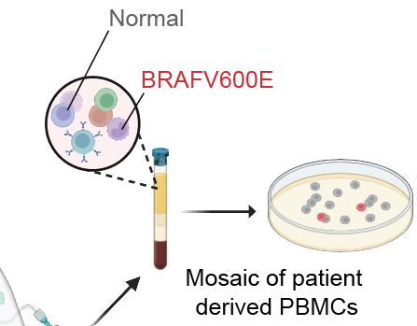
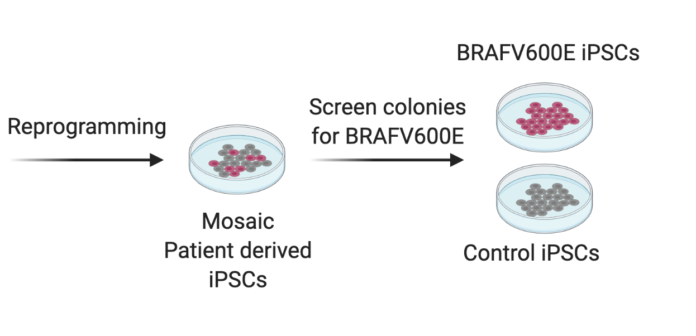
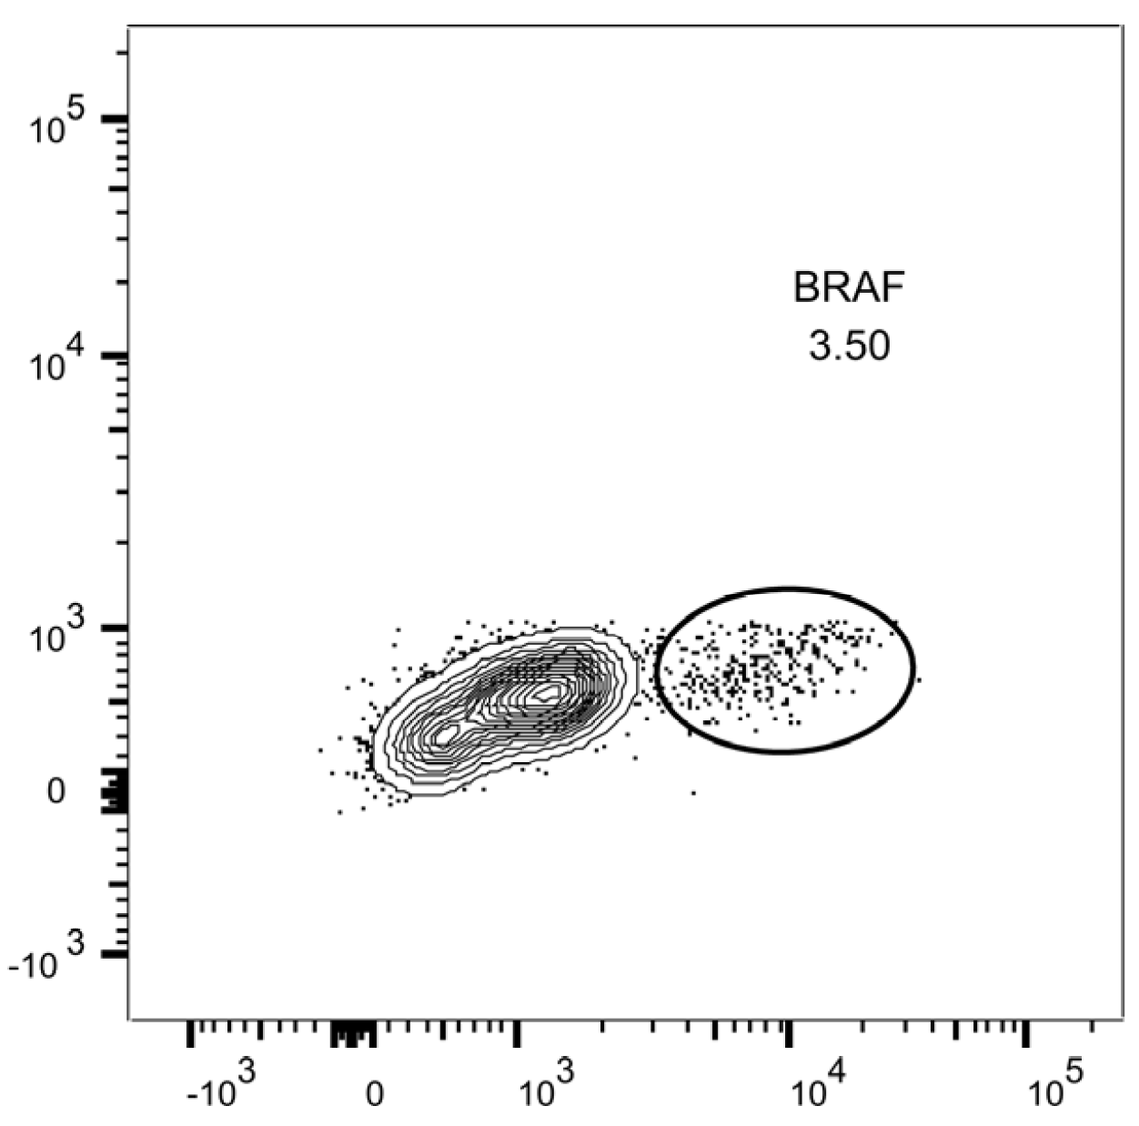
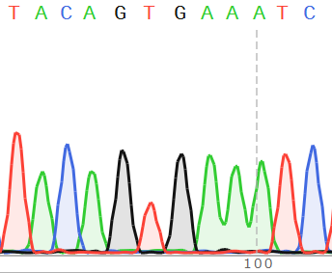
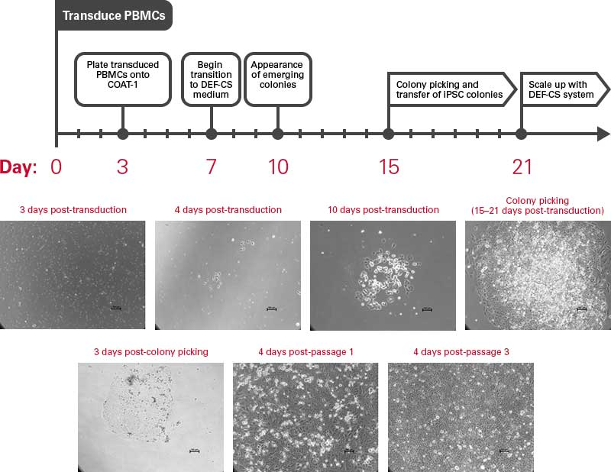
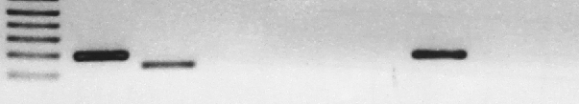
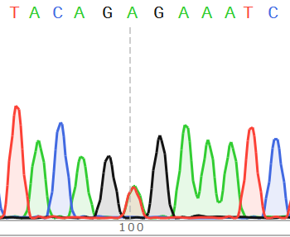
Generating isogenic iPSCs from histiocytosis patients
Live/Dead
BRAF V600E
BRAF
V600E
BRAF
V600E
LCH Patient Control
Rajamanickam et al Blood 2026

Slide 9
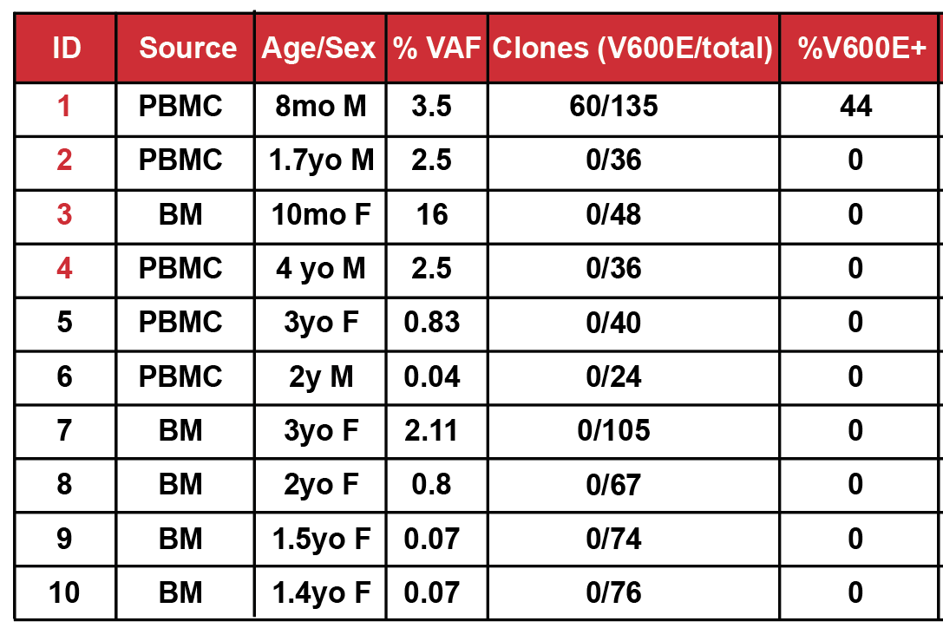
Early returns are not always predictive of future success
Rajamanickam et al Blood 2026
Additional samples courtesy of Carl Allen

Slide 10
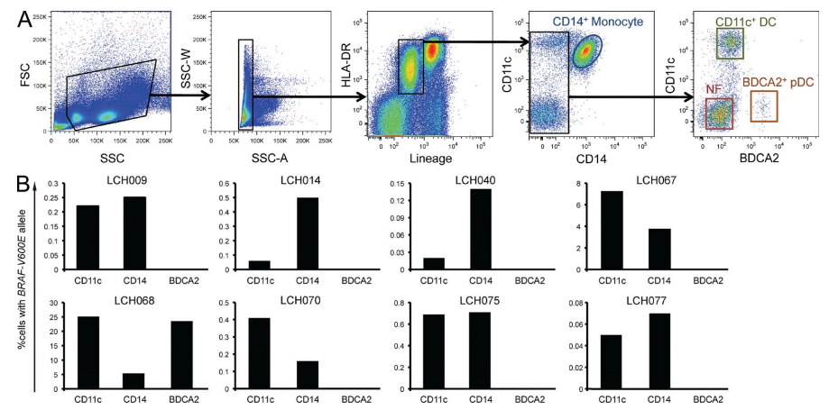
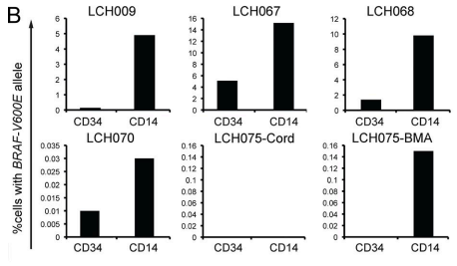
BRAFV600E cell carrying heterogeneity is a potential culprit
Allen et al, NEJM 2018
Notes:
First panel is peripheral cells and second is bone marrow heterogeneity

Slide 11
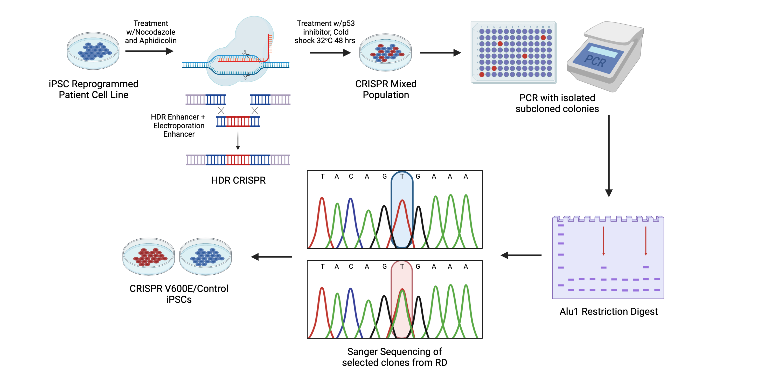
Alternative strategy: CRISPR/Cas9 with homology directed repair to introduce BRAFV600E into patient-derived lines
Rajamanickam et al Blood 2026

Slide 12
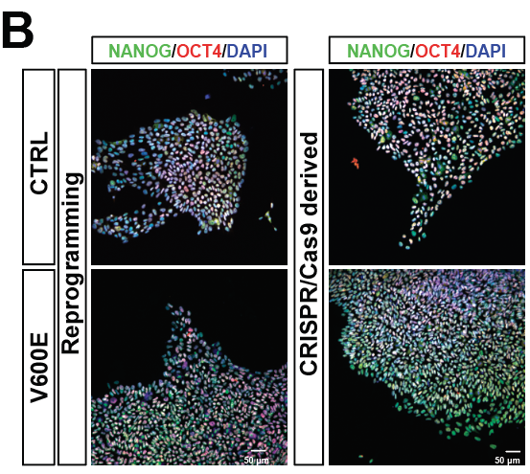
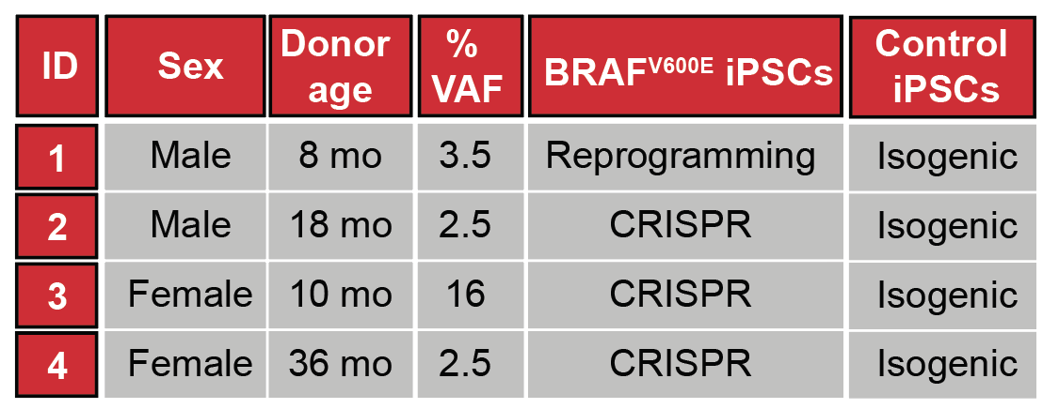
A patient derived LCH iPSC cohort
Rajamanickam et al Blood 2026

Slide 13
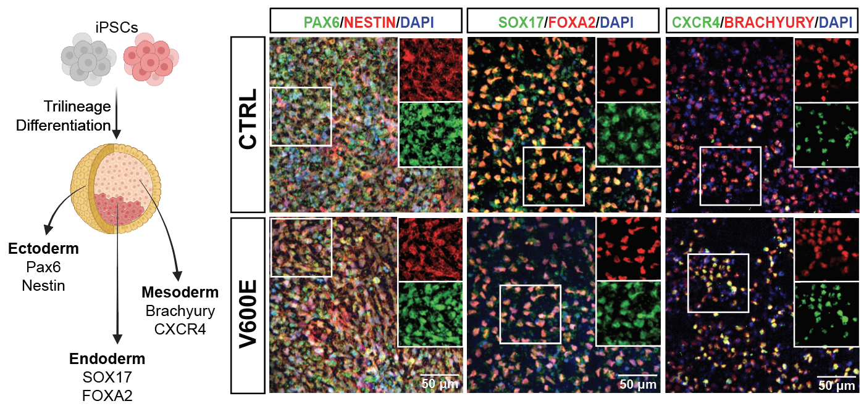
Pluripotent differentiation potential
Rajamanickam et al Blood 2026

Slide 14
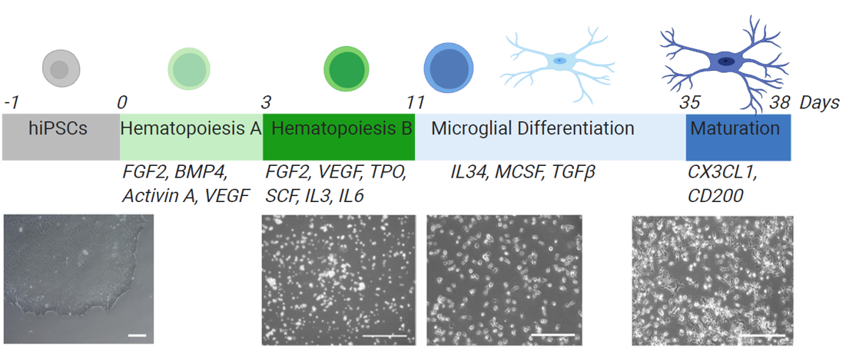
Human brain myeloid modeling
Derived from McQuade et al Mol Neurodegen 2018

Slide 15
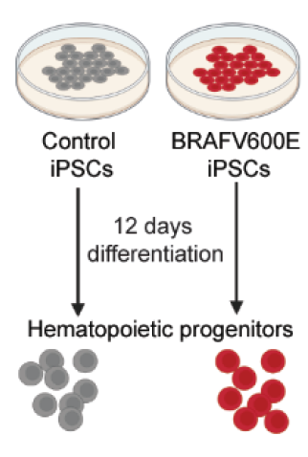
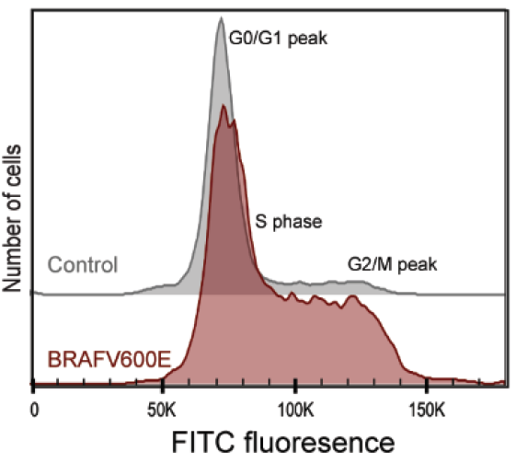
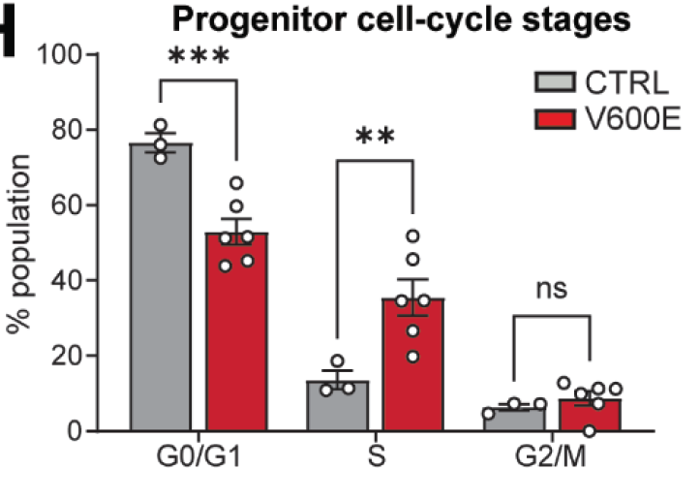
BRAFV600E hematopoietic progenitors are hyperproliferative
Rajamanickam et al Blood 2026
Notes:
In keeping with a tumor like

Slide 16
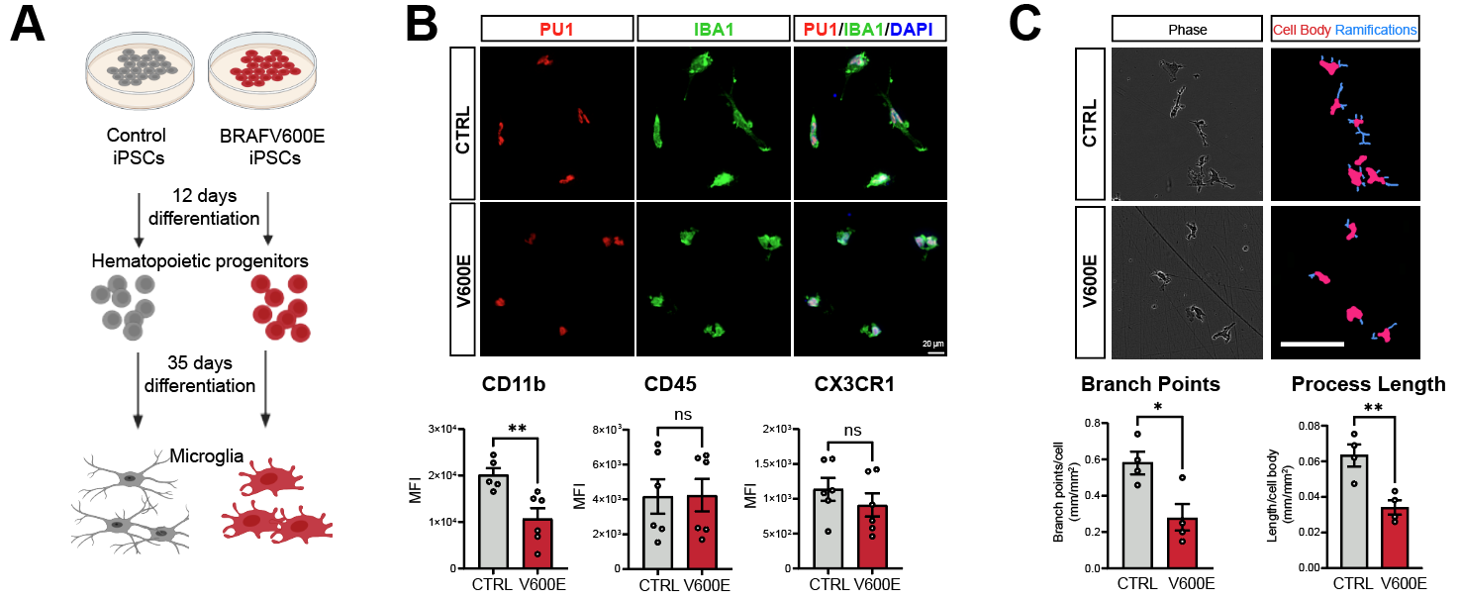
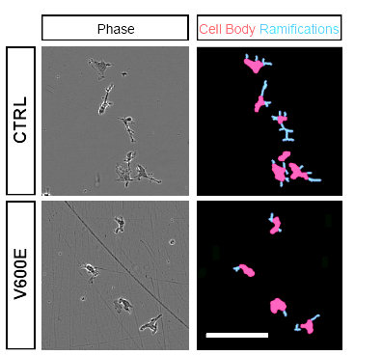
BRAF^{V600E} microglia have an ameboid activated morphology
Rajamanickam et al Blood 2026

Slide 17
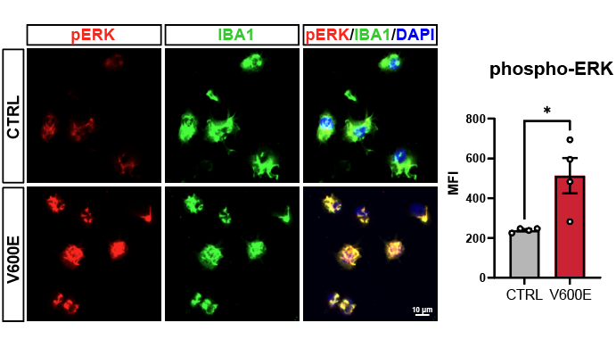
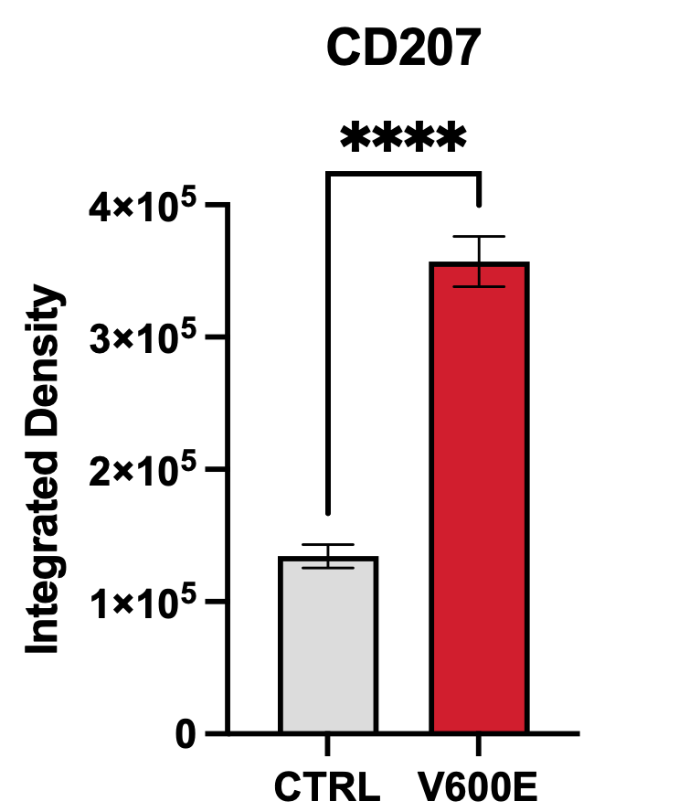
LCH microglia/macrophage exhibit disease specific phenotypes
CD207
CD207 IBA1 DAPI
Control
V600E
Rajamanickam et al Blood 2026

Slide 18
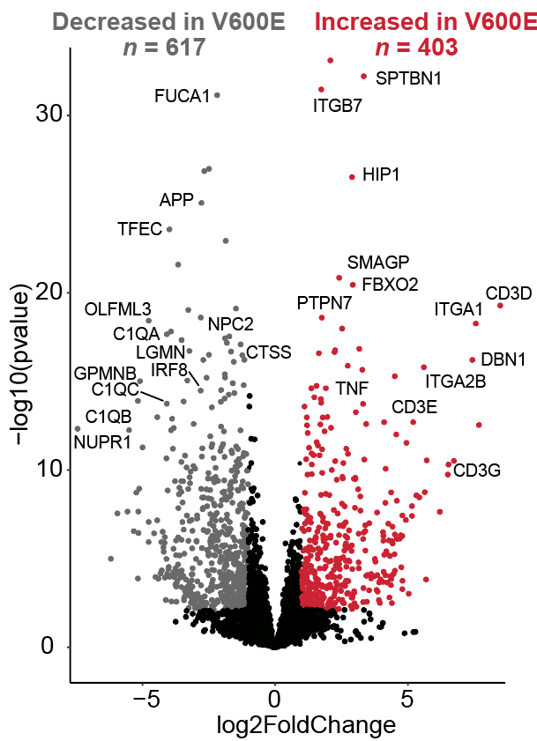
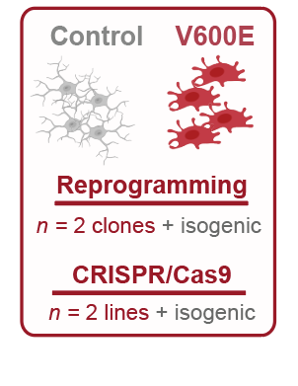
Broad transcriptomic changes in BRAF^{V600E} brain macrophages
Rajamanickam et al Blood 2026

Slide 19
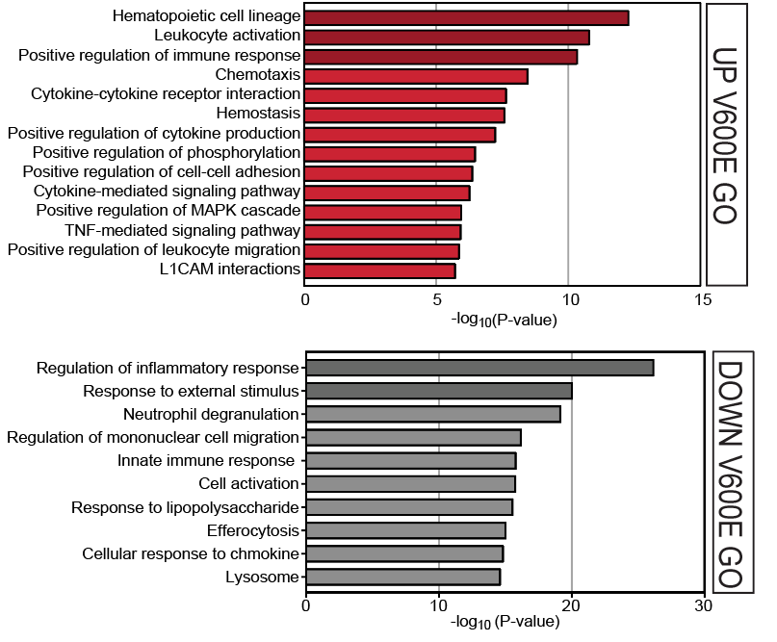
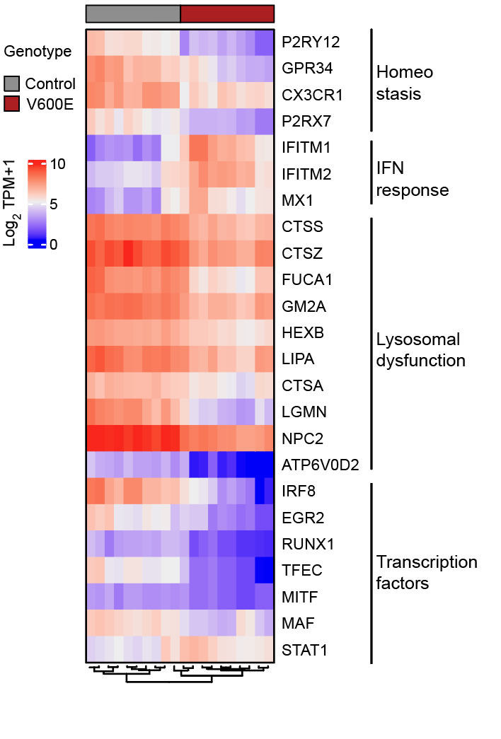
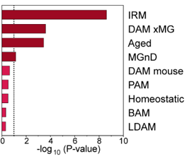
A hyperinflammatory dysregulated MAPK phenotype in BRAF^{V600E} brain macrophages
Rajamanickam et al Blood 2026

Slide 20
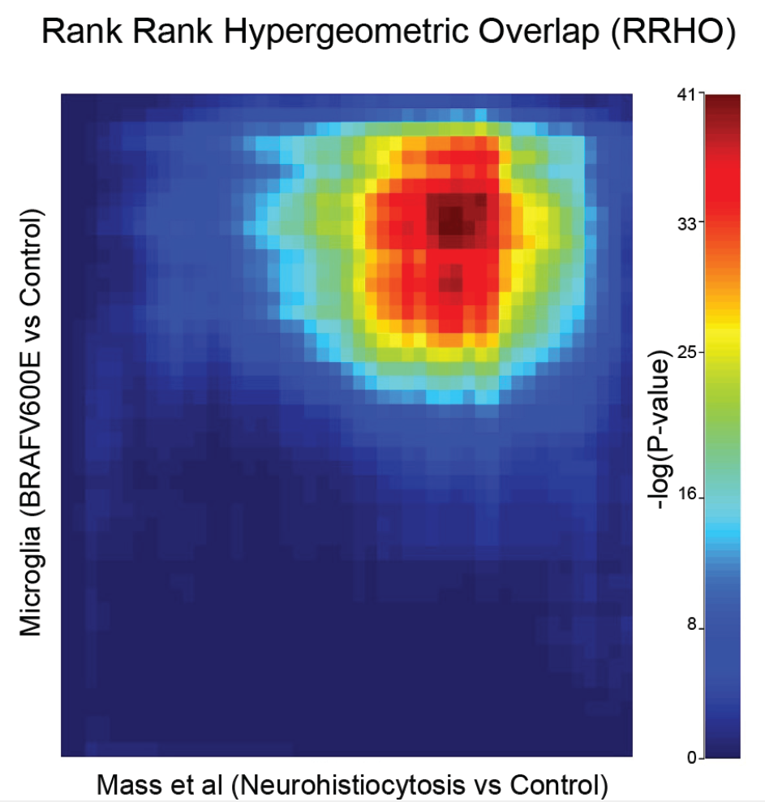
Substantive overlap with human histiocyte brain transcriptomics
Rajamanickam et al Blood 2026

Slide 21
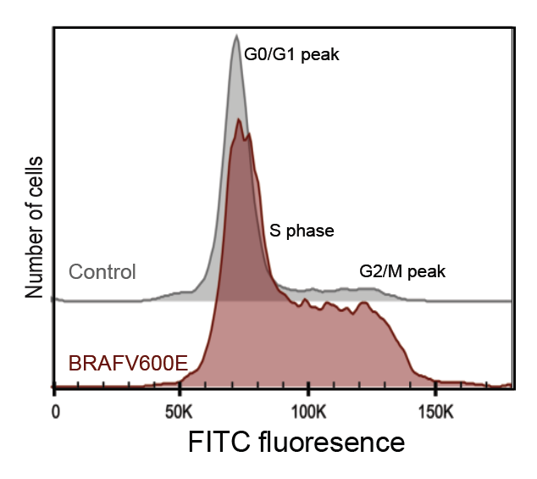
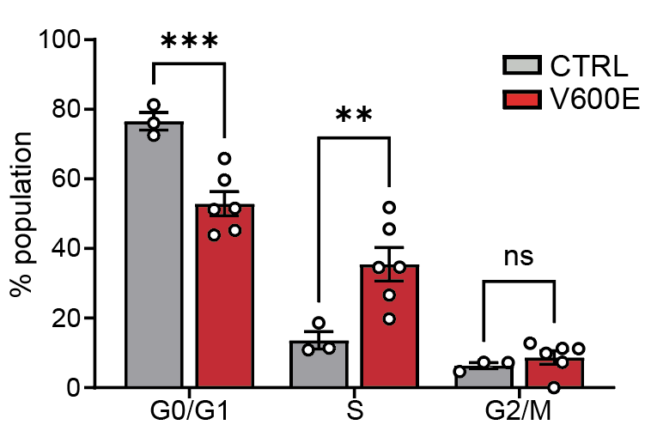
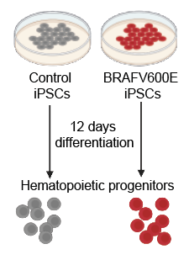


Proliferative hematopoietic progenitors coupled with apoptosis resistance in differentiated macrophages
Rajamanickam et al Blood 2026

Slide 22

Functional deficits in BRAF^{V600E} macrophages
Rajamanickam et al Blood 2026

Slide 23


Recapitulation of emerging human histiocyte biomarkers
Rajamanickam et al Blood 2026
McLain et al Cancer 2018
Notes:
Metalloproteases including EMMPRIN is upstream of MMPs. OPN is a substrate for metalloproteases and regulates their activity.
TNF upregulates ICAM-1 and is an adhesion molecule. Resistin induces TNF.

Slide 24



Microglia are extraordinarily dependent on their environment for their cell type identity
Gosselin et al Science 2017

Slide 25







Xenotransplantation more closely resembles postnatal microglia
Han et al, Immunity 2023
Notes:
TROM: Transcriptome Overlap Measure compares transcriptomes within or between species

Slide 26


Cerebral organoids with BRAF^{V600E} or control macrophages as a model of neurodegeneration
Rajamanickam et al Blood 2026

Slide 27
Cocultures of cerebral organoids with BRAF^{V600E} or control macrophage/microglia as a model of neurodegeneration
Rajamanickam et al Blood 2026

Slide 28
Organoids show loss of oligodendrocytes and proliferation of astrocytes and microglia
Rajamanickam et al Blood 2026

Slide 29


Evidence of astrogliosis and neuronal death in BRAF^{V600E} cerebral organoids
Rajamanickam et al Blood 2026

Slide 30



In vivo modeling of human BRAF^{V600E} brain macrophages
iPSC microglia
Primary
microglia
Primary microglia in vitro
xMGs
Hasselmann et al Neuron, 2019
Hasselmann et al Neuron, 2019
Hasselmann et al Neuron, 2019

Slide 31


Microgliosis with BRAF^{V600E} clones
Rajamanickam et al Blood 2026

Slide 32



Elevation of the inflammatory lysosomal marker CD68
\
Rajamanickam et al Blood 2026
Grois et al Brain 2005
Notes:
TROM: Transcriptome Overlap Measure compares transcriptomes within or between species

Slide 33





Elevated antigen presentation and CD163 similar to primary human neurohistiocytosis
Rajamanickam et al Blood 2026
McLain et al Cancer 2018

Slide 34





Surprising heterogeneity among brain histiocytosis myeloid cells
V600E
CTRL

Slide 35


Brain lesions are unique in LCH-ND
Unlike peripheral lesions they are mostly CD1a and CD207 negative
Rare patches of CD1a/CD207
Diffuse infiltrate lesions negative for all markers
CNS biopsy
McClain et al. Cancer 2018

Slide 36



Focal accumulations/granuloma-like lesions
MHC class 1
Grois et al Brain 2005
Powel et al CCR 2017
Rajamanickam et al Blood 2026
Prosch et al AJNR 2007
McLain et al Cancer 2018

Slide 37
BRAFV600E myeloid cells have intrinsic vessel infiltration
Vessel infiltration
Hu-nuclei+ cells / vessel area

Slide 38


BRAF^{V600E} macrophages are proliferative, infiltrative and destructive
Rajamanickam et al Blood 2026

Slide 39


BRAF^{V600E} macrophages are proliferative, infiltrative and destructive
Rajamanickam et al Blood 2026

Slide 40



Neuronal loss especially in large projection neurons
Rajamanickam et al Blood 2026
Prosch et al AJNR 2007

Slide 41




Cerebellar infiltration and accumulation resulting in Purkinje cell loss
100μM
Rajamanickam et al Blood 2026
Grois et al Brain 2005
Martin-Duverneuil et al European Radiology 2006

Slide 42




BRAFV600E myeloid cells cause BBB disruption
Thalamic microbleed
Prussian blue

Slide 43






Motor impairments in human histiocytosis engrafted mice
Rotarod
Limb clasping
Gait analysis
Rajamanickam et al Blood 2026

Slide 44

Summary
Rajamanickam et al Blood 2026

Slide 45


What does the future hold? Preclinical translation
Treatment sensitivity especially within proliferative progenitors and fully differentiate myeloid cells
Single or combination treatment approaches
In vivo drug sensitivity and addressing risk of recurrence
Identify niche specific features that define pathology and influence treatment response
Treatment
sensitivity

Slide 46










Acknowledgements
Coufal Lab
Shiva Rajamanickam
Samantha Mak
Amanda Wilpitz
Anna Warden
Celina Nguyen
Cristina Mora
Jing Wang
Carla Pernaci
Bing Xia
Annalisa Maggio
Katie Mostoller
Zahara Keuelen
Funding
Rajamanickam et al
Blood 2026
UC San Diego
Christopher Glass
Hilda Ding, MD
Past Members
Samantha Trescott
Sydney Gilette
Avalon Johnson
Emily Hansen
Roy Kim
Zahara Keulen
Jiayang Xiao
Yin Wu
Collaborators
Carl Allen, Baylor
Children
& families!
www.coufallab.com

Slide 47

Questions?

