Slide 1








Impact of additional genetic variants in the course of Erdheim-Chester disease: a multicentric longitudinal study of 445 French patients
Félicien Triboulet, Matthias Papo, Fleur Cohen-Aubart, Francesco Pegoraro, Jérôme Razanamahery, Ahmed Idbaih, Damien Roos-Weil, Zofia Hélias-Rodzewicz, Stéphane Barete, Karim Maloum, François Delhommeau, Irena Ungureanu, Jean-François Émile, Zahir Amoura, Pierre Hirsch, Julien Haroche

Slide 2
Disclosures
None

Slide 3
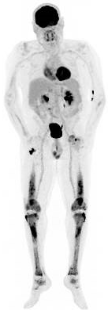
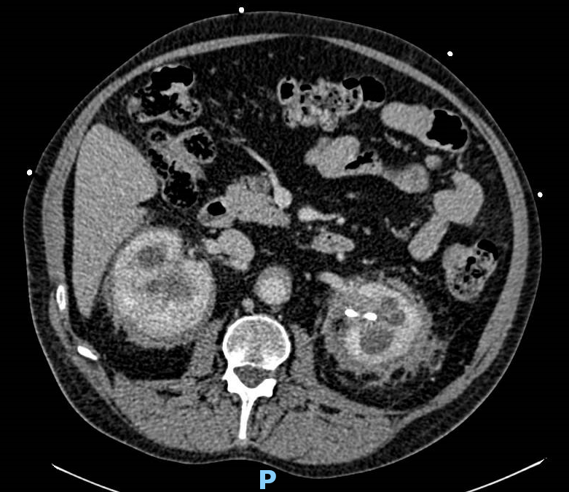
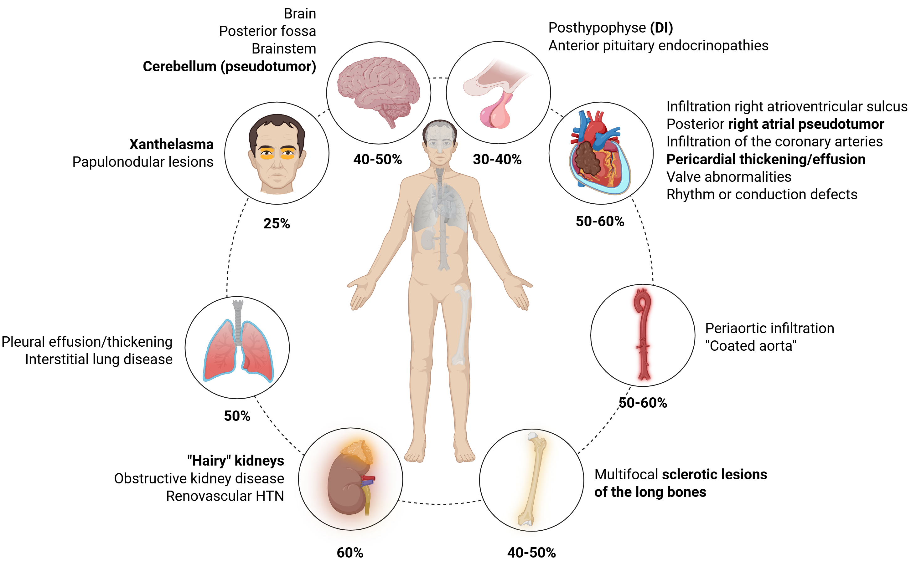
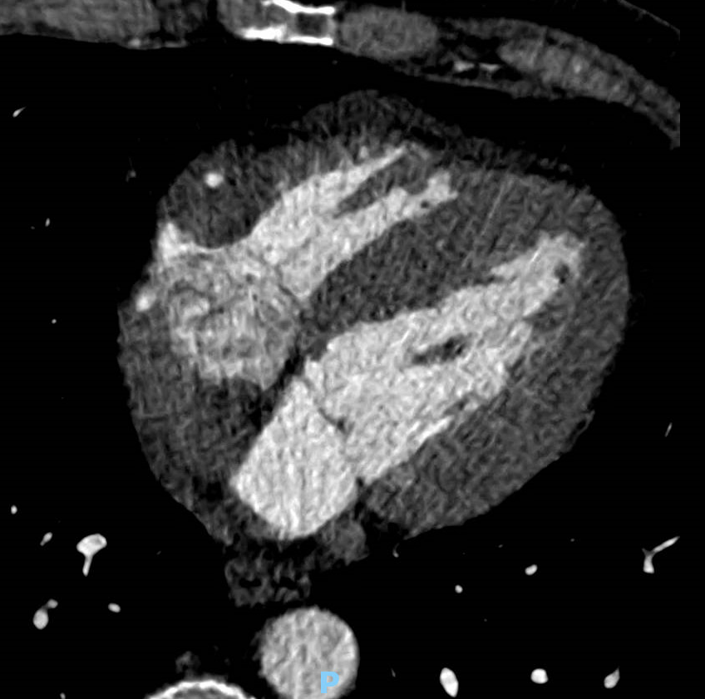
Introduction
Erdheim-Chester disease (ECD)
Rare clonal hematopoietic neoplasm
Infiltration of tissues by foamy histiocytes
MAP kinases signaling pathway activation
Revolution of targeted therapies (BRAFi, MEKi)¹⁻³
¹Haroche J, Cohen-Aubart F, Emile JF and al. J Clin Oncol. 2015 Feb 10;33(5):411-8
²Hao X, Feng R, Bi Y and al. J Neurosurg Pediatr. 2019 Jan 1;23(1):48-53
³Goyal G, Heaney ML, Collin M and al. Blood. 2020 May 28;135(22):1929-1945

Slide 4
Introduction
Clonal hematopoiesis (CH)
Subpopulation of bone marrow cells with acquired mutation(s)
Several categories of CH: ARCH, CHIP, ICUS, CCUS¹
Implication in more and more conditions
Increased burden of myeloid neoplasms in ECD²
Data about CH exist³⁻⁵, but its consequences are not well known
Objectives
Description of additional genetic variants
Association with ECD characteristics
Evolution of genetic variants VAF under main treatments of ECD
¹Steensma DP, Bejar R, Jaiswal S and al. Blood. 2015 Jul 2;126(1):9-16
²Papo M, Diamond EL, Cohen-Aubart F and al. Blood. 2017 Aug 24;130(8):1007-1013
³Cohen-Aubart F, Roos-Weil D, Armand M and al. Blood. 2021 Jan 28;137(4):485-492
⁴Goyal G. Blood. 2021 Jan 28;137(4):434-436
⁵Prabhakaran N, Jour G, Balar A and al. Acta Haematol. 2023;146(3):245-251
Notes:
Genes implicated in a broad array of cellular functions, including transcription factors, chromatin modifiers, DNA repair, ribonucleoprotein binding proteins, spliceosome components, signal transduction, and regulators of cellular metabolism

Slide 5
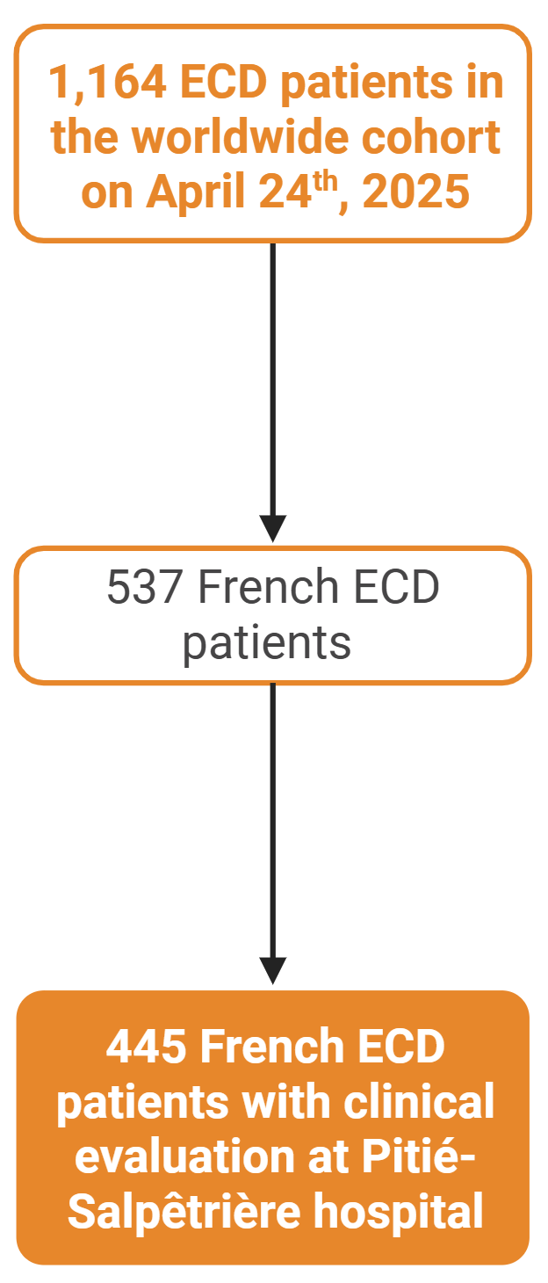
Methods
Retrospective longitudinal study
Study population
445 patients (from 537 French ECD patients)
From February 2001 to April 2025
Data collection
Sociodemographic characteristics (age, sex, CV burden)
ECD medical history (organ involvement, therapeutics)
Hematological malignancies, solid neoplasms
Bone marrow aspiration: 65 myeloid genes panel (NGS)
Mortality and survival analysis

Slide 6
Results – Characteristics of the population (1)
Age and sex
Male sex: 72.1% (N=321)
Mean age at first ECD manifestation: 55.6 ± 14.7 years
Mean age at ECD diagnosis (pathology): 58.8 ± 13.9 years
High frequency of cardiovascular risk factors
Former or current smoking: 44.2% (N=180/407)
Diabetes mellitus: 27.8% (N=120/431)
Obesity: 18.8% (N=81/431)
Dyslipidemia: 34.7% (N=150/432)
Hypertension: 54.7% (N=238/435)
Coronary artery disease: 27% (N= 117/433)

Slide 7
Results – Characteristics of the population (2)
ECD clinicoradiological manifestations
 | N=445
Inaugural symptoms Bone pain Diabetes insipidus CNS symptoms Xanthelasma Cardiac symptoms General signs | 87 (19.6) 63 (14.2) 39 (8.8) 31 (7) 24 (5.4) 19 (4.3)
Long bone hypermetabolism | 365 (82)
“Hairy kidneys” | 305 (68.5)
Large vessel infiltration | 264 (59.3)
Face and orbits infiltration | 193 (43.4)
Heart Right atrium pseudotumor/IVS infiltration | 177 (39.8) 117 (66.1)
CNS Neurodegenerative form | 156 (35.1) 82 (52.6)
 | N=445
Lungs Interstitial lung disease Nodules, cysts | 159 (35.7) 147 (33) 13 (2.9)
Skin | 144 (32.4)
Pituitary gland (anterior or posterior) | 134 (30.1)
Digestive tract | 67 (15.1)
Lymph nodes | 54 (12.1)
Testis | 24/321 (7.5)
Other (liver, etc.) | 32 (7.2)
Number of sites involved | 4.7 (2.0)
Associated LCH | 65 (14.6)
Associated DRDD | 16 (3.6)
CNS: Central nervous system
LCH: Langerhans cell histiocytosis
DRDD: Destombes-Rosai-Dorfman disease

Slide 8
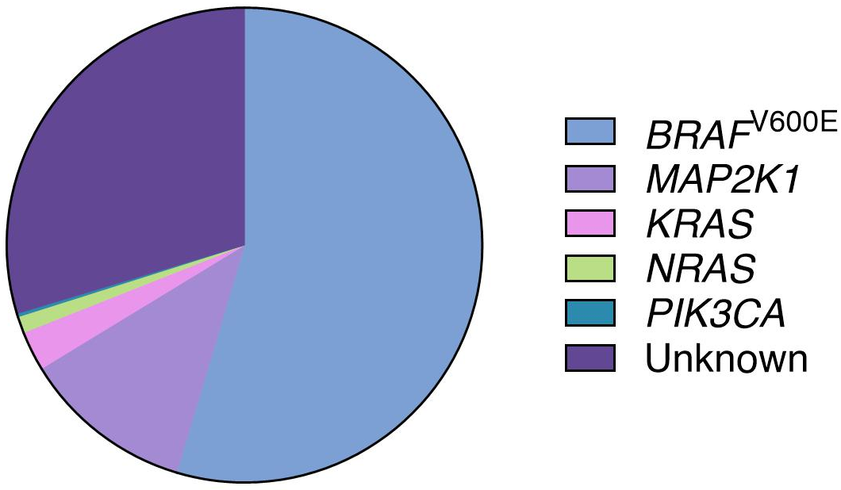
Results – Characteristics of the population (3)
Driving mutations
Treatments
No treatment: 10.3% (N=46)
Interferon alpha : 51.7% (N=230)
MEKi: 30.8% (N=445)
BRAFi: 27.6% (N=123)
Anakinra: 11.2% (N=50)
Chemotherapy: 10.3% (N=46)
MEKi+BRAFi: 5.4% (N=24)
Corticosteroids: 5.2% (N=23)
Infliximab: 4.8% (N=21)
Other: 4.8% (N=9)
Anti-IL6R: N=3
Anti-CD20: N=2
JAKi: N=1
mTOR: N=1
Sunitinib: N=1
29.7%
(2.7%)
54.6%
(1.1%)
(0.2%)
11.7%

Slide 9
Results – Characteristics of the population (4)
History of solid neoplasms or hematologic malignancies (HM)
 | N=445
Solid neoplasms (before or after Dx) Skin Basocellular cancer Melanoma Epidermoid cancer Prostate Breast Bladder Thyroid Kidney Colon Pancreas Lung Liver CNS Other | 87 (19.6) 26 (29.9) 11 (12.6) 11 (12.6) 4 (4.6) 26 (29.9) 13 (14.9) 8 (9.2) 6 (6.9) 6 (6.9) 4 (4.6) 3 (3.4) 1 (1.1) 1 (1.1) 1 (1.1) 6 (6.9)
 | N=445
Hematologic malignancies (HM) MGUS Myelodysplastic syndromes CMML Myeloproliferative syndromes ET MF CML PV Uncharacterized Lymphomas NHL HL ITP Acute leukemia MM CLL Other (POEMS, HES) | 95 (21.3) 23 (24.2) 23 (24.2) 21 (22.1) 20 (21.1) 10 (10.5) 5 (5.3) 2 (2.1) 1 (1.1) 2 (2.1) 4 (4.2) 3 (3.2) 1 (1.1) 5 (5.3) 5 (5.3) 4 (4.2) 3 (3.2) 2 (2.2)
MGUS: monoclonal gammapathy of unknown significance
CMML: chronic myelomonocytic leukemia
ET: essential thrombocytopenia
MF: myelofibrosis
CML: chronic myeloid leukemia
PV: polycythemia vera
NHL: Non Hogkin lymphoma
HL: Hogkin lymphoma
ITP: Immune thrombocytopenic purpura
MM: multiple myeloma
CLL: chronic lymphoid leukemia

Slide 10
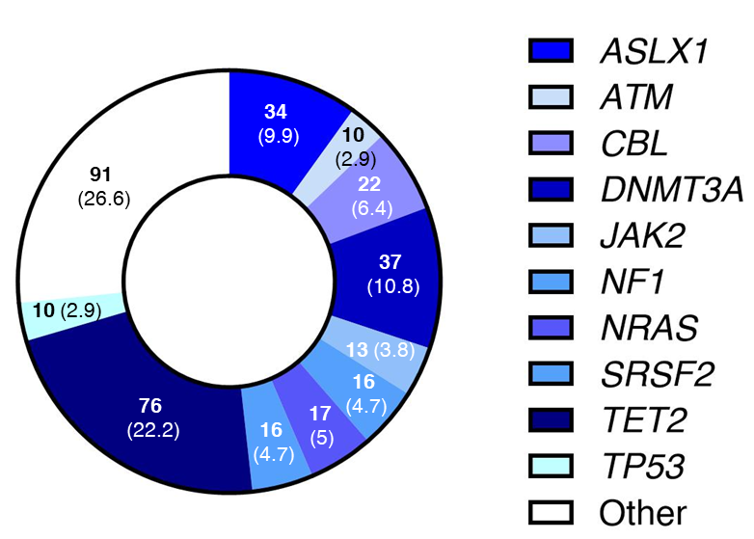
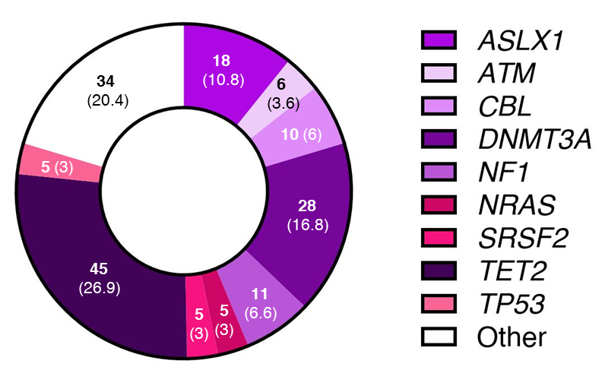
Results – Description of clonal hematopoiesis (CH)
286 available baseline myelograms (37.8% of patients)
58.9% (N=168) of patients with CH, 61 patients (36.3%) with HM
Mean number of variants: 2.3 ± 1.7
Age at CH identification
69.5 ± 9.2 years for patients with HM
63.9 ± 10.5 years for patients without HM
p=0.0005
342 genetic variants for all the 168 patients
167 genetic variants for the 107 patients without HM

Slide 11
Results – Description of clonal hematopoiesis (CH)
Comparison of patients with and without CH
Univariate analysis
Later onset of ECD (58.2 vs. 49.4 years; p<0.0001)
Higher proportion of current/former smoking (48.6 vs. 41.6%; p=0.0278)
Increased coronary artery disease (30.8 vs. 16.3%; p=0.0159)
More facial/orbit involvement (48.6 vs. 33.6%; p=0.0278, OR: 1.87 [CI95% 1.09-3.27])
Slight over risk of prostate cancer (9.4 vs. 2.7%, p=0.0477, OR: 3.68 [CI95% 1.03-12.7])
No association to driving mutations
Higher proportion of HM (MPN or other) when CH is identified (p<0.0001)
Multivariate analysis
Later onset of ECD (HR: 1.06 [CI95% 1.03-1.10])
IFN is associated with lower CH (HR: 0.60, CI 95%: 0.37-0.95)

Slide 12
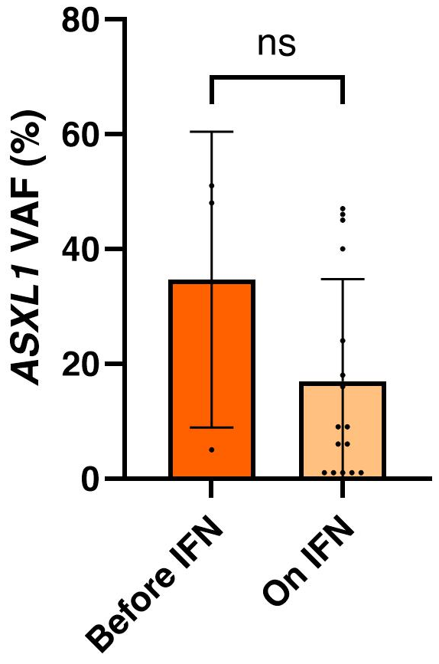
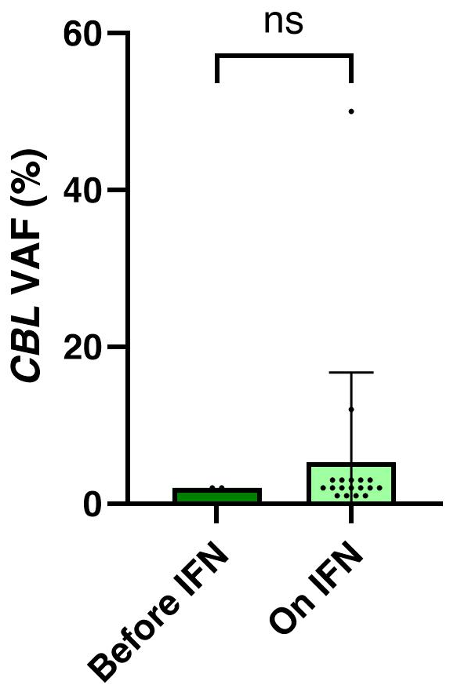
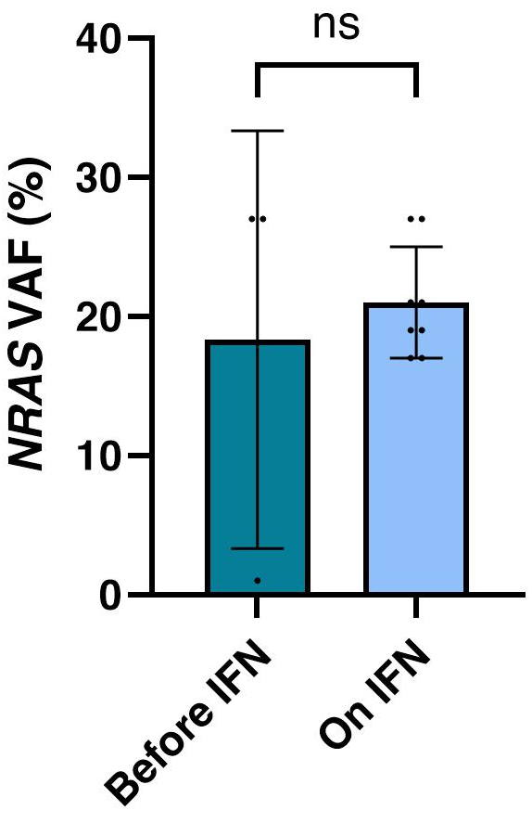
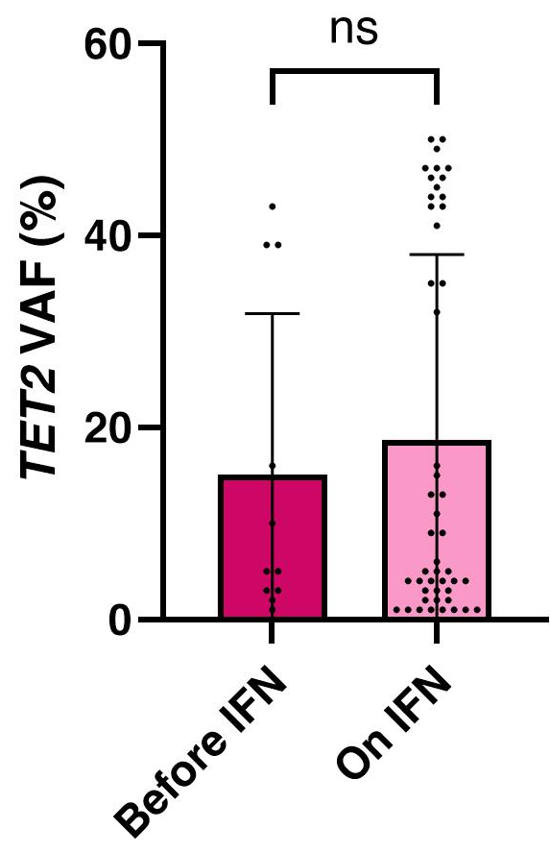
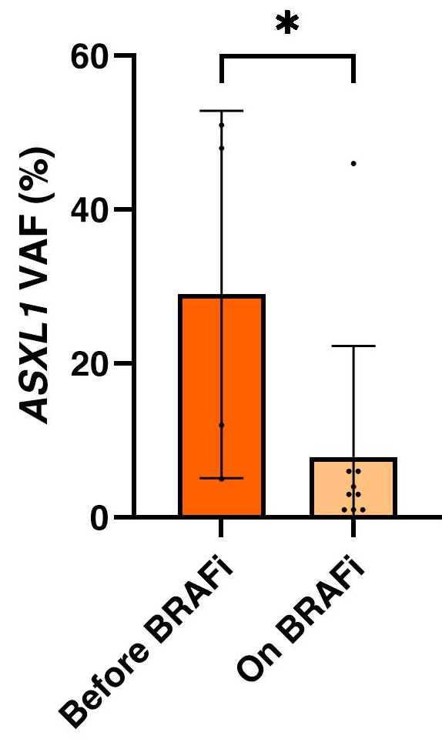
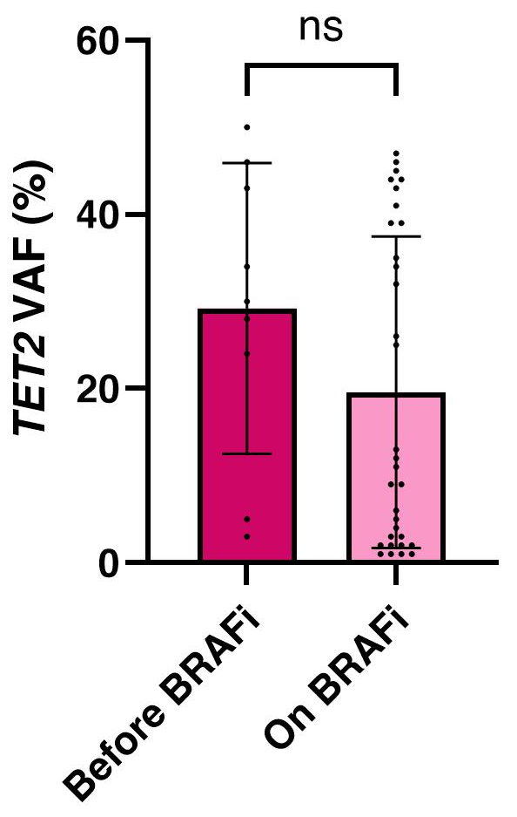
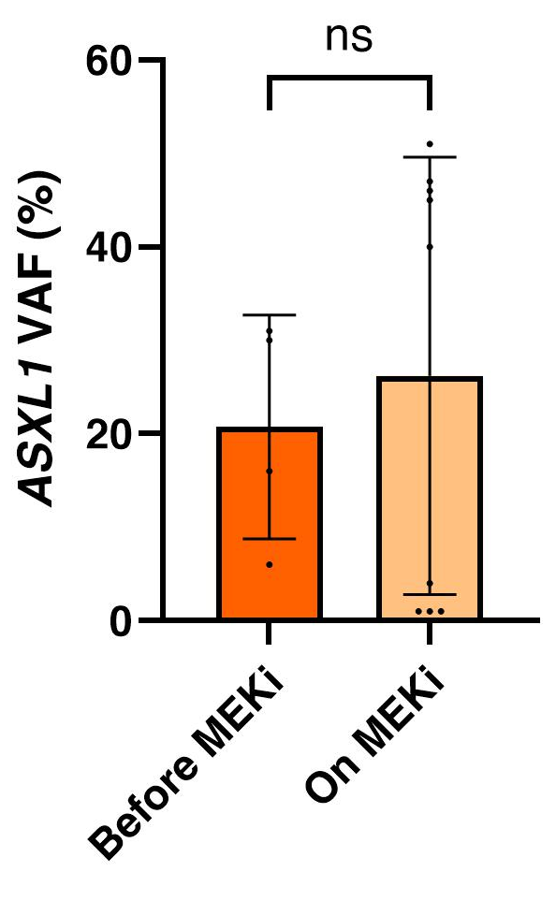
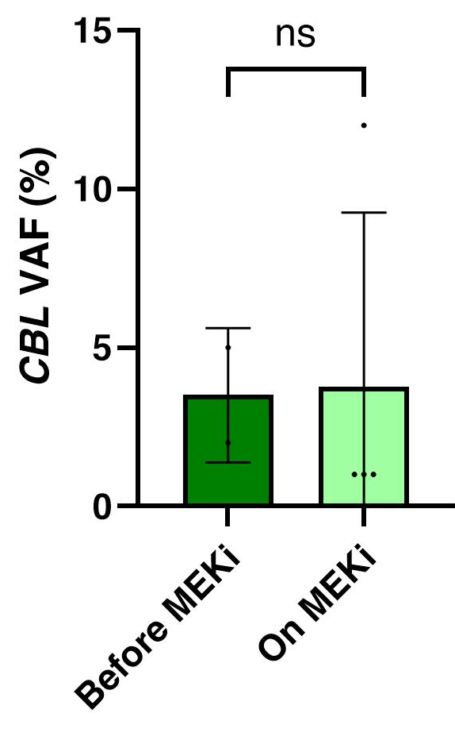
Results – Evolution of VAF under treatment
Patients without HM and CH
IFN
BRAFi
Not enough patients
MEKi
Not enough patients

Slide 13
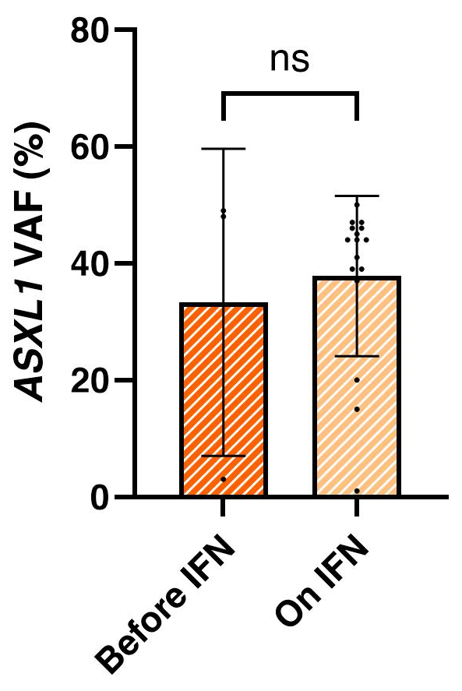
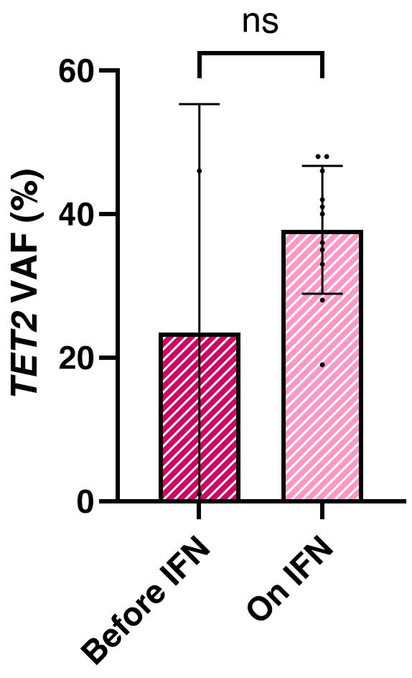
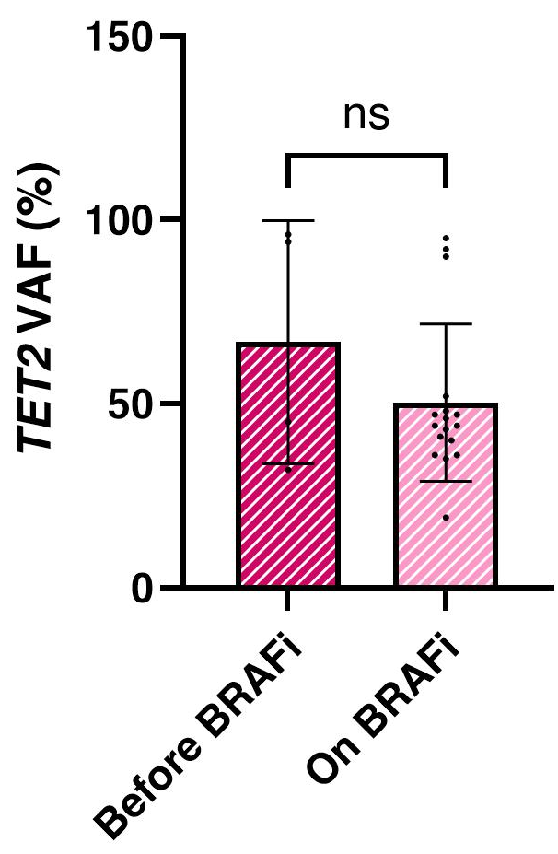
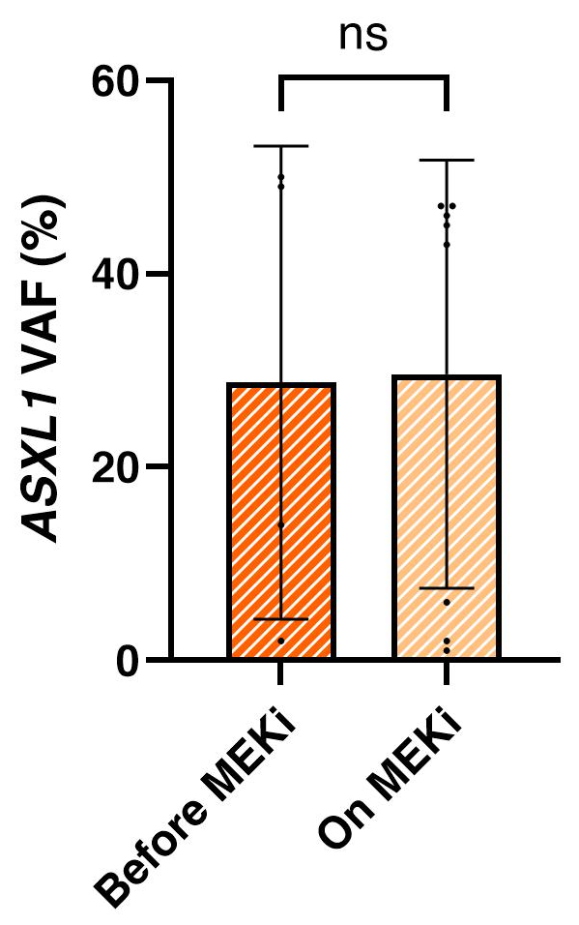
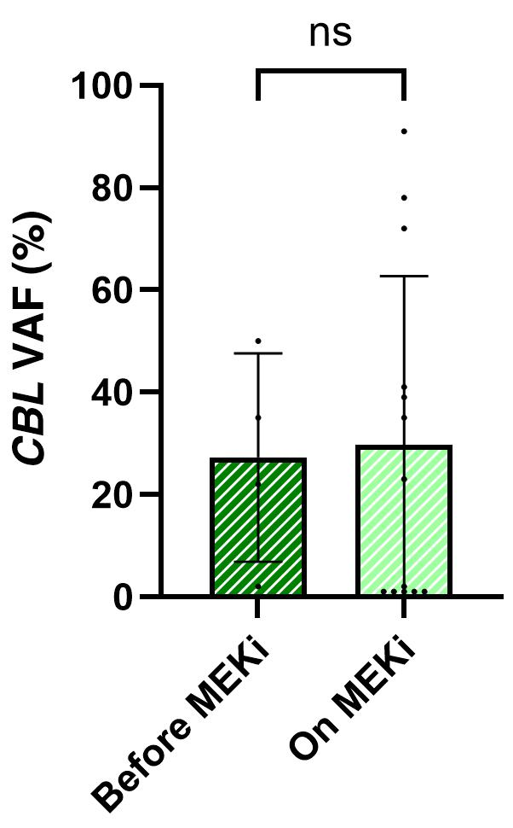
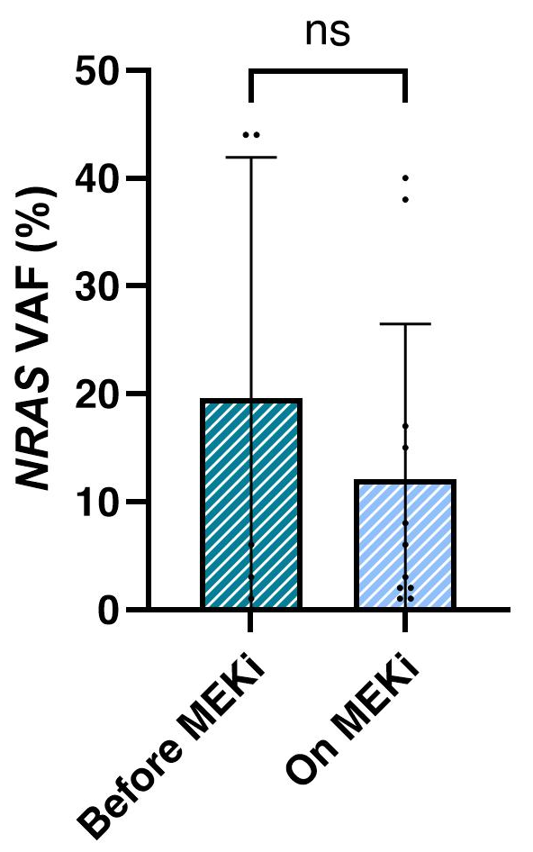
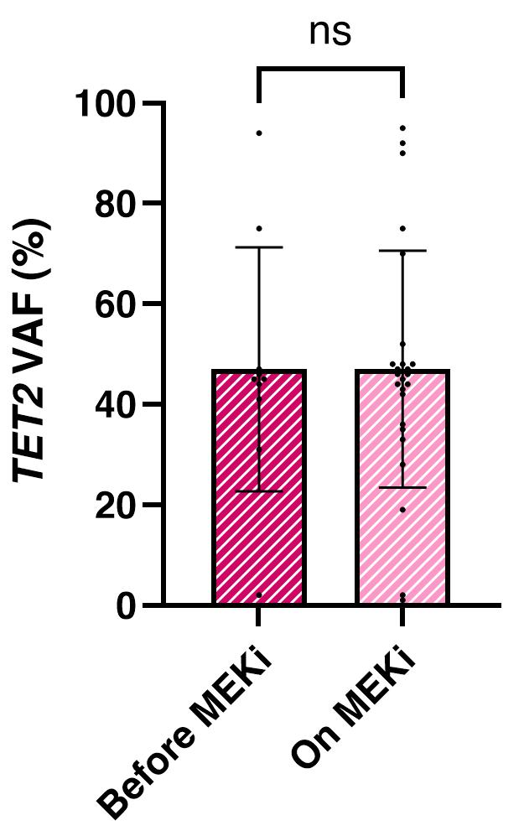
Results – Evolution of VAF under treatment
Patients with HM and CH
IFN
Not enough patients
BRAFi
Not enough patients
MEKi

Slide 14
Results – CH in biopsy samples
Comparison of VAF in bone marrow (BM) and tissue for 28 patients
12 patients with HM & 11 patients without HM (5 unknown)
111 variants in bone marrow & 65 variants in tissue
Same variants in BM and tissue: N=57
CH in BM only: N=46
CH in tissue only: N=8
Lower VAF in tissue (except for CBL)
Notes:
Mortality risk factors in univariate analysis
Later onset of symptoms (61.2 vs. 52.6 years, p<0.0001)
Later diagnosis (64.4 vs. 55.7 years, p<0.0001)
Hypertension (62.8 vs. 42.4%; p=0.0039, OR: 1.80 [CI 95% 1.20-2.69])
Coronary artery disease (37.8 vs. 20.1%; p<0.0001, OR: 2.42 [CI 95% 1.56-3.59])

Slide 15
Results – Mortality & survival analysis
Overall mortality rate: 35.1 % (N=156/445)
Mean follow-up period: 76.9 ± 64 months (1-412 months)
Death occurring 61.1 ± 57.7 months after ECD diagnosis
50.6% (N=79/156) of death related to ECD
Mortality risk factors in multivariate analysis
“Advanced” age at onset of symptoms (HR: 1.07, CI 95%: 1.04-1.09)
CNS involvement (HR: 2.33, CI 95%: 1.31-4.05)
ILD/pleural involvement (HR: 1.94, CI 95%: 1.21-3.09)
Presence of CH (HR: 2.15, CI 95%: 1.14-4.33)
Presence of BRAF^{V600E} variant (HR: 3.43, CI 95%: 1.74-6.95)
Notes:
Mortality risk factors in univariate analysis
Later onset of symptoms (61.2 vs. 52.6 years, p<0.0001)
Later diagnosis (64.4 vs. 55.7 years, p<0.0001)
Hypertension (62.8 vs. 42.4%; p=0.0039, OR: 1.80 [CI 95% 1.20-2.69])
Coronary artery disease (37.8 vs. 20.1%; p<0.0001, OR: 2.42 [CI 95% 1.56-3.59])

Slide 16
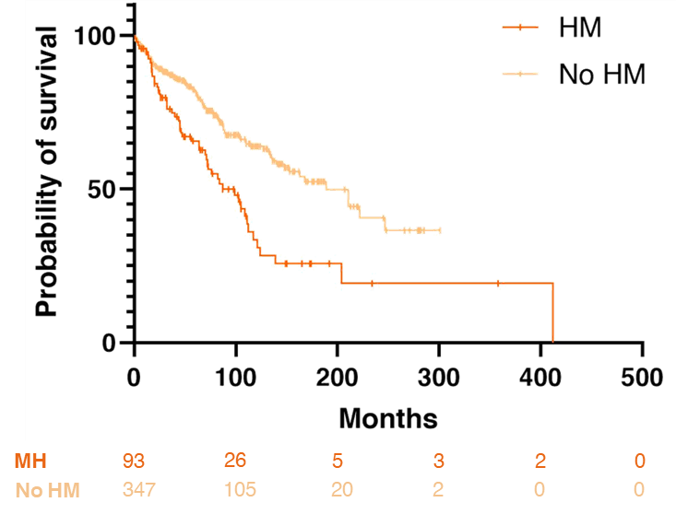
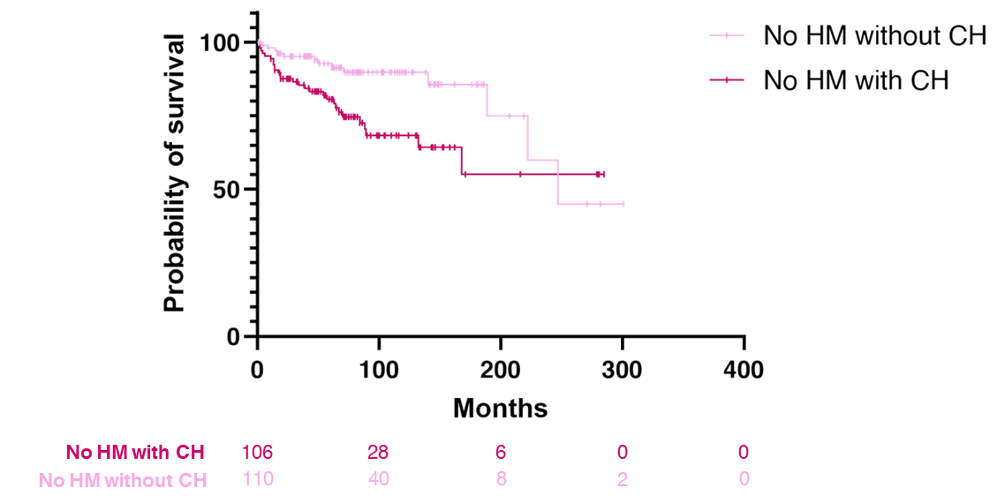
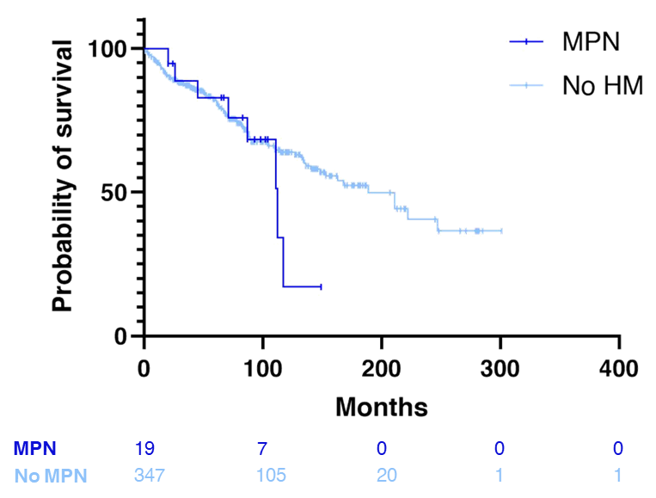
Results – Mortality & survival analysis
Survival analysis
p<0.0001
p=0.0057
(HR: 2.45, CI95% 1.33-4.52)
p=0.3570

Slide 17
Discussion
A prognostic impact for CH in ECD
CH associated with cardiovascular burden¹
CH as an independent mortality risk factor
CH as a first hit before BRAF^{V600E} or MAP2K1 variant²
Higher risk of HM: how to follow patients? Which ones?
No clear influence of (targeted) therapies of VAF
Lack of power (many missing data)…
… except from IFN (reduction of mortality, reduction of CH)
Contribution to fibrosis and inflammation ⇨ organ damage
BRAFi and oncogenic risk
Later onset ⇨ CH ⇨ mortality ?
¹Jaiswal S, Natarajan P, Silver AJ and al. N Engl J Med. 2017;377(2):111-121
²Durham BH, Roos-Weil D, Baillou C and al. Blood. 2017 Jul 13;130(2):176-80

Slide 18

Discussion
Strengths
High number of patients (>30% of the worldwide cohort)
Long-term follow-up
Translational research
High sensitivity to detect VAF
Limits
Wide period of recruitment (different therapeutics)
Bone marrow aspiration not available for all patients, invasiveness
Lack of CH in the follow-up period, influence of treatments
No distinction between cancers under treatment and prior ones

Slide 19
Conclusion
CH is frequent in ECD patients (even without underlying HM)
Late onset of ECD is an independent risk factor of CH
CH has a prognostic value
Cardiovascular risk factors
Higher risk for HM to emerge
Increased mortality in patients without MH
CH: independent mortality risk factor (all cohort analysis)
No clear influence of treatments on CH but…
…tendency for VAF reduction with BRAFi in patients without MH
… IFN may “protect” from CH in patient without MH

Slide 20
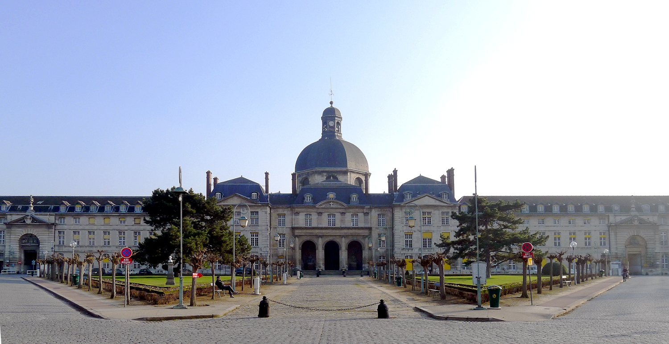

Thanks to the medical team, nurses and patients ☺
Thank you for your attention!
felicien.triboulet@aphp.fr

