Slide 1
Fatigue and Pain in Erdheim-Chester Disease: Root Causes and Practical Strategies for Energy, Relief, and Resilience
Richard Taylor, PhD, DNP, CRNP

Slide 2
Disclosures
None
Center for Palliative and Supportive Care

Slide 3
Core Objectives
Understand the biological roots of fatigue and pain in ECD
Explore the interconnected role of inflammation and energy metabolism
Introduce evidence-informed, self-care strategies to reduce symptoms and support recovery
Empower patients and families to take an active role in improving quality of life
Center for Palliative and Supportive Care
Notes:
Understand the biological roots of fatigue and pain in ECD
Explain how chronic inflammation, immune activation, and mitochondrial dysfunction contribute to low energy, heightened pain sensitivity, and emotional stress.
Explore the interconnected role of inflammation and energy metabolism
Clarify how inflammatory pathways affect mitochondrial function and how this contributes to both fatigue and persistent pain.
Introduce evidence-informed, self-care strategies to reduce symptoms and support recovery
Highlight practical tools—including anti-inflammatory nutrition, safe movement, stress regulation, and complementary therapies—that patients and caregivers can use to actively manage fatigue and pain.
Empower patients and families to take an active role in improving quality of life
Promote a health-centered mindset by offering personalized strategies that support resilience, energy, emotional balance, and day-to-day wellbeing in the context of ECD.

Slide 4

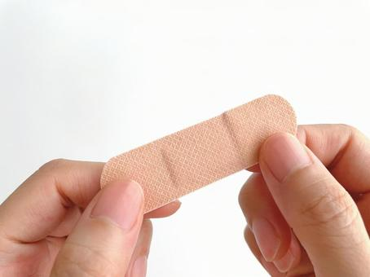
Holistic Metabolic perspective – Get to the Root
https://stockcake.com/i/tree-root-display_992330_813254
https://en.photo-ac.com/
Center for Palliative and Supportive Care
Notes:
Speaker Notes: Holistic Metabolic Perspective – Get to the Root
This image captures the central message of our approach. With Erdheim-Chester Disease, many people experience deep, ongoing fatigue and pain that doesn’t go away with just rest or pain medications. These symptoms often come from underlying body stress, not just the disease itself.
The visual metaphor here shows a tree: above the surface everything might seem stable, but true dysfunction lies beneath—within the roots. Similarly, fatigue and pain often stem from deep systemic issues This image shows the roots of a tree—what’s happening underground. We may see the symptoms at the surface, but the true cause is often buried deeper, like poor cell energy (mitochondria), inflammation, or imbalance in the gut.
For patients with ECD, fatigue and pain are complex, persistent, and often resistant to standard interventions. Treating only the symptoms—like using analgesics for pain—is a bit like putting a band-aid on a deeply rooted problem.
What we aim to do through this presentation is shift the conversation from symptom management to root-cause resolution.
A holistic metabolic approach means we go deeper:
We support the body’s energy systems (mitochondria) through nutrition, targeted supplements, pacing, and light movement.
We work on the gut microbiome, which influences inflammation, pain, and brain clarity.
We reduce triggers like stress, processed foods, poor sleep, and inactivity, all of which can drain energy faster.
For patients, this approach may help you feel more stable, recover better after activity, and reduce crashes.
For caregivers, it means understanding that rest, nutrition, and nervous system support aren’t “extra”—they’re foundational to healing. And your ability to maintain energy and mood affects the whole household.
“Instead of asking ‘How do we make this pain go away today?’ we ask, ‘What’s causing the pain—and how do we support the body so it doesn’t keep happening?’ That’s getting to the root.”
This holistic approach doesn’t mean we abandon symptom relief—rather, we want to layer strategies that also heal from within.
ECD demands that we move beyond reactive care and instead engage in proactive, personalized interventions. That’s how we transform survival into improved quality of life.

Slide 5
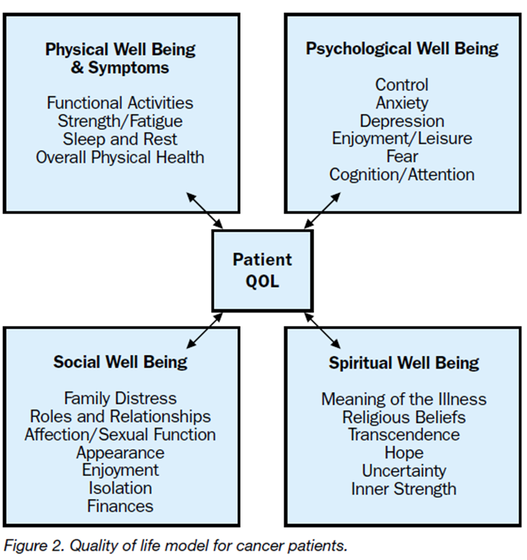
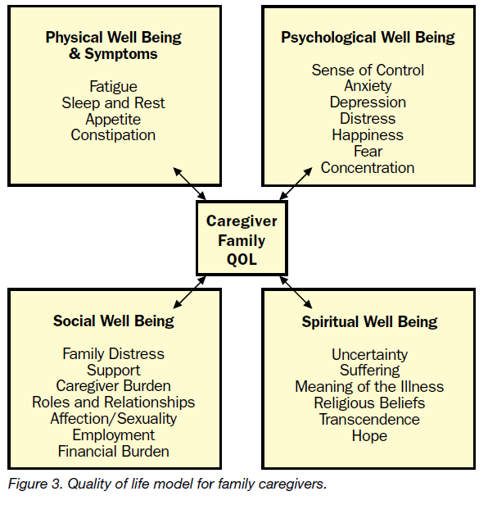
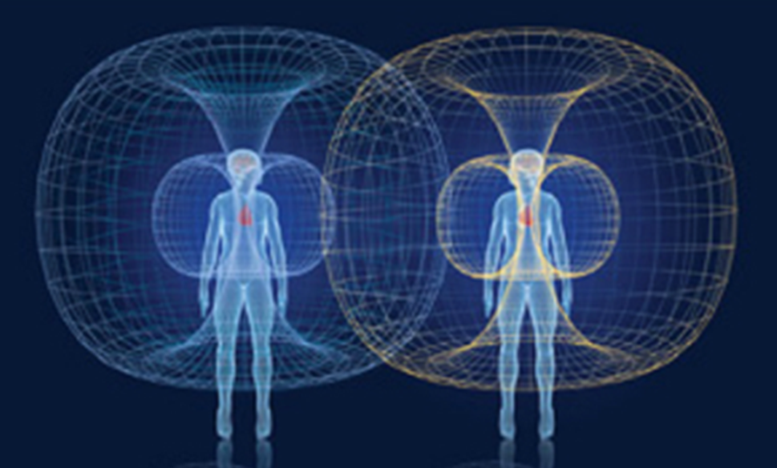
Why it Matters – Quality of Life
McCahill, L., Ferrell, B. R., & Virani, R. (2001)
Center for Palliative and Supportive Care
McCahill, L., Ferrell, B. R., & Virani, R. (2001)
Notes:
Speaker Notes: “Why it Matters – Quality of Life”
This slide reminds us that when we treat a patient with a complex illness like Erdheim-Chester Disease (ECD), we’re not just treating symptoms—we’re supporting a whole person and often an entire family unit.
Left side – Patient Quality of Life (QoL)
Let’s start with the patient. This model, originally developed for cancer patients, is highly applicable in ECD:
Physical well-being includes fatigue, strength, and the ability to do daily activities. Pain, sleep disruption, and mobility challenges often play a central role in ECD.
Psychological well-being addresses depression, anxiety, and cognition—especially relevant as many patients report brain fog, attention issues, and mood changes due to inflammation and fatigue.
Social well-being speaks to the patient’s roles, relationships, intimacy, and even financial strain. The diagnosis can affect employment, family dynamics, and social connection.
Spiritual well-being includes the search for meaning, the inner strength to cope, and the uncertainty that can accompany a rare diagnosis like ECD.
Right side – Caregiver/Family QoL
Caregivers often carry an invisible but very heavy load. Their well-being is closely tied to the patient’s.
Physical symptoms like fatigue and sleep loss are common, especially with nighttime caregiving.
Psychological effects include anxiety, decision-making fatigue, and stress, especially when caregiving needs are unpredictable.
Social and spiritual well-being are often impacted by isolation, financial pressure, and the emotional toll of seeing a loved one suffer.
The Center Image
The energy fields in the middle visually reinforce that our emotional and physical states are interconnected. Caregivers and patients influence one another—positively and negatively.
Takeaway
When we support both the patient and caregiver across these four domains, we promote resilience, better coping, and improved symptom management.

Slide 6
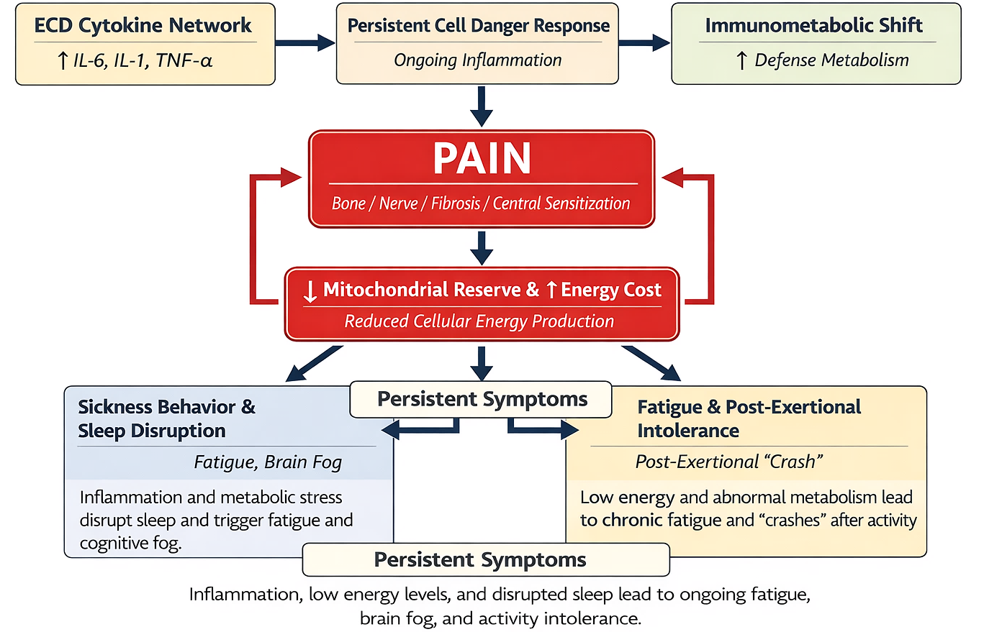
Get to the Root
Other Causes
Environmental Factors: Exposure to pollutants, chemicals, and toxins.
Lifestyle Factors: Poor diet, lack of exercise, smoking, and alcohol consumption.
Underlying Conditions: Chronic infections, autoimmune diseases, and gut health imbalances, insulin resistance, % body fat.
Other Factors: Stress, genetic predisposition, physical trauma, and gastrointestinal malfunction
https://stockcake.com/i/tree-root-display_992330_813254
Center for Palliative and Supportive Care
Notes:
Slide Introduction
This diagram shows how inflammation, pain, and fatigue are all biologically connected in ECD. These aren’t isolated symptoms—they’re part of a cycle involving the immune system, metabolism, and energy production in our cells. To understand why ECD causes such profound fatigue and pain, we have to look past the surface symptoms and 'get to the root' of the metabolic process. This diagram represents the domino effect that happens inside the body.
Top Row: Immune Activation & Chronic Inflammation
ECD Cytokine Network:
In ECD, immune cells like histiocytes release inflammatory messengers like IL-6, IL-1, and TNF-α. These signal the body that something’s wrong—over and over again. Specifically, molecules like IL-6 and TNF-alpha act as a constant 'alarm' telling the body it is under attack. ECD Specificity: briefly mention how specific ECD treatments (like anakinra or cobimetinib) target these exact pathways.
Persistent Cell Danger Response:
This sets off what some researchers call the Cell Danger Response—a chronic ‘alarm state’ where cells shift into defense mode. Normally, this response is a short-term survival tactic. But in ECD, the cells stay in 'Defense Mode' for too long. This causes an Immunometabolic Shift—your body stops prioritizing energy production and starts pouring all its resources into 'Defense Metabolism.’
That shift changes how energy is used. Instead of fueling healing or daily function, the body prioritizes defense. It’s like keeping your foot on the brake and gas at the same time.
Center: Pain and Energy Dysfunction
Pain:
Pain in ECD often starts from bone lesions or nerve involvement—but it’s worsened by something called central sensitization, where the brain becomes more sensitive to pain signals.
Pain and Reduced Mitochondrial Reserve. Because your mitochondria are focused on defense, they have less 'reserve' to create ATP energy. This creates a vicious cycle: Pain increases your Energy Cost, and Low Energy makes your nerves more sensitive to Pain.
↓ Mitochondrial Reserve & ↑ Energy Cost:
Ongoing inflammation and pain stress out the mitochondria—your body’s energy generators. They can’t keep up with demand. So, energy becomes harder and more ‘expensive’ to make, leading to physical and mental fatigue.
Red Arrows (Pain–Mitochondria Loop):
This is a vicious cycle. Pain uses energy. Low energy makes you more sensitive to pain. This loop keeps the symptoms going.
Bottom Left: Sickness Behavior & Sleep Disruption
When energy is low and inflammation is high, the body starts showing ‘sickness behaviors’—like fatigue, brain fog, and poor sleep. This isn’t psychological—it’s an adaptive response that becomes maladaptive when it never turns off. The result is what you feel every day: Sickness Behavior and Post-Exertional Intolerance. This isn't just 'being tired.' It is a biological 'crash' where the body and brain simply do not have the fuel to function. By understanding that this is a connected pathway, we can see why a multi-system approach—addressing diet, gut health, and pacing—is the only way to truly break the cycle
Bottom Right: Fatigue & Post-Exertional Intolerance
This is the ‘crash’ some people feel after doing too much—even mild activity. It’s called post-exertional malaise. It happens when the body can’t recover quickly because energy production is impaired.
Bottom Center Summary: Persistent Symptoms
These connected problems—fatigue, pain, brain fog—are the result of real, biologically driven processes, not imagined or unrelated symptoms. They demand holistic, energy-aware care.
CLICK: These root cause related to ECD don’t occur in a vacuum and there are other causes that need to be factored in the pathway and addressed as well. Beyond the ECD itself, things like environmental toxins, poor sleep, and gut imbalances act as 'extra weight.' These factors feed into the ECD Cytokine Network. Specifically, molecules like IL-6 and TNF-alpha act as a constant 'alarm' telling the body it is under attack.
Transition to Next Slide: Solutions
Now that we’ve mapped out the root causes, the next step is empowering you with strategies—like nutrition, movement, and self-care—to support energy, reduce inflammation, and break the symptom cycle.
in-text references and a reference list to support the biological pathways and clinical concepts shown in the diagram and explained in the presenter notes:
In-Text Citations:
(Dantzer et al., 2008; Diamond et al., 2021; Goyal et al., 2020; Ji et al., 2018: Naviaux, 2014; Naviaux et al., 2016; O'Neill et al., 2016; Opp, 2005; Pearce & Pearce, 2013; Picard & McEwen; Tomas et al., 2017; Wallace, 2005; Yunus, 2007)
“Immune cells like histiocytes release IL-6, IL-1, and TNF-α…”
(Diamond et al., 2021; Goyal et al., 2020)
“Cell Danger Response…”
(Naviaux, 2014)
“Immunometabolic shift prioritizes defense metabolism…”
(Pearce & Pearce, 2013; O'Neill et al., 2016)
“Pain is worsened by central sensitization…”
(Yunus, 2007; Ji et al., 2018)
“Mitochondrial dysfunction contributes to energy deficit…”
(Picard & McEwen, 2018; Wallace, 2005)
“Sickness behavior and sleep disruption are driven by cytokines…”
(Dantzer et al., 2008; Opp, 2005)
“Post-exertional malaise and metabolic crash…”
(Naviaux et al., 2016; Tomas et al., 2017)
References List:
Diamond, E.L., Dagna, L., Hyman, D.M., et al. (2021). Consensus guidelines for the diagnosis and clinical management of Erdheim-Chester disease. Blood, 137(9), 1201–1216. https://doi.org/10.1182/blood.2020006035
Goyal, G., et al. (2020). Erdheim-Chester Disease: Consensus recommendations for evaluation, diagnosis, and treatment in the molecular era. Blood Advances, 4(6), 1458–1476.
Naviaux, R.K. (2014). Metabolic features of the cell danger response. Mitochondrion, 16, 7–17. https://doi.org/10.1016/j.mito.2013.08.006
Pearce, E.L., & Pearce, E.J. (2013). Metabolic pathways in immune cell activation and quiescence. Immunity, 38(4), 633–643.
O'Neill, L.A., et al. (2016). A guide to immunometabolism for immunologists. Nature Reviews Immunology, 16(9), 553–565.
Ji, R.R., Nackley, A., Huh, Y., et al. (2018). Neuroinflammation and central sensitization in chronic and widespread pain. Anesthesiology, 129(2), 343–366.
Yunus, M.B. (2007). Central sensitivity syndromes: a new paradigm and group nosology for fibromyalgia and overlapping conditions. Seminars in Arthritis and Rheumatism, 37(6), 339–352.
Picard, M., & McEwen, B.S. (2018). Psychological stress and mitochondria: A systematic review. Psychosomatic Medicine, 80(2), 141–153.
Wallace, D.C. (2005). A mitochondrial paradigm of metabolic and degenerative diseases. Genes & Development, 19(22), 2418–2445.
Dantzer, R., et al. (2008). From inflammation to sickness and depression: when the immune system subjugates the brain. Nature Reviews Neuroscience, 9(1), 46–56.
Opp, M.R. (2005). Cytokines and sleep. Sleep Medicine Reviews, 9(5), 355–364.
Naviaux, R.K., et al. (2016). Metabolic features of chronic fatigue syndrome. PNAS, 113(37), E5472–E5480.
Tomas, C., et al. (2017). Cellular bioenergetics is impaired in patients with chronic fatigue syndrome. PLoS ONE, 12(10): e0186802.

Slide 7
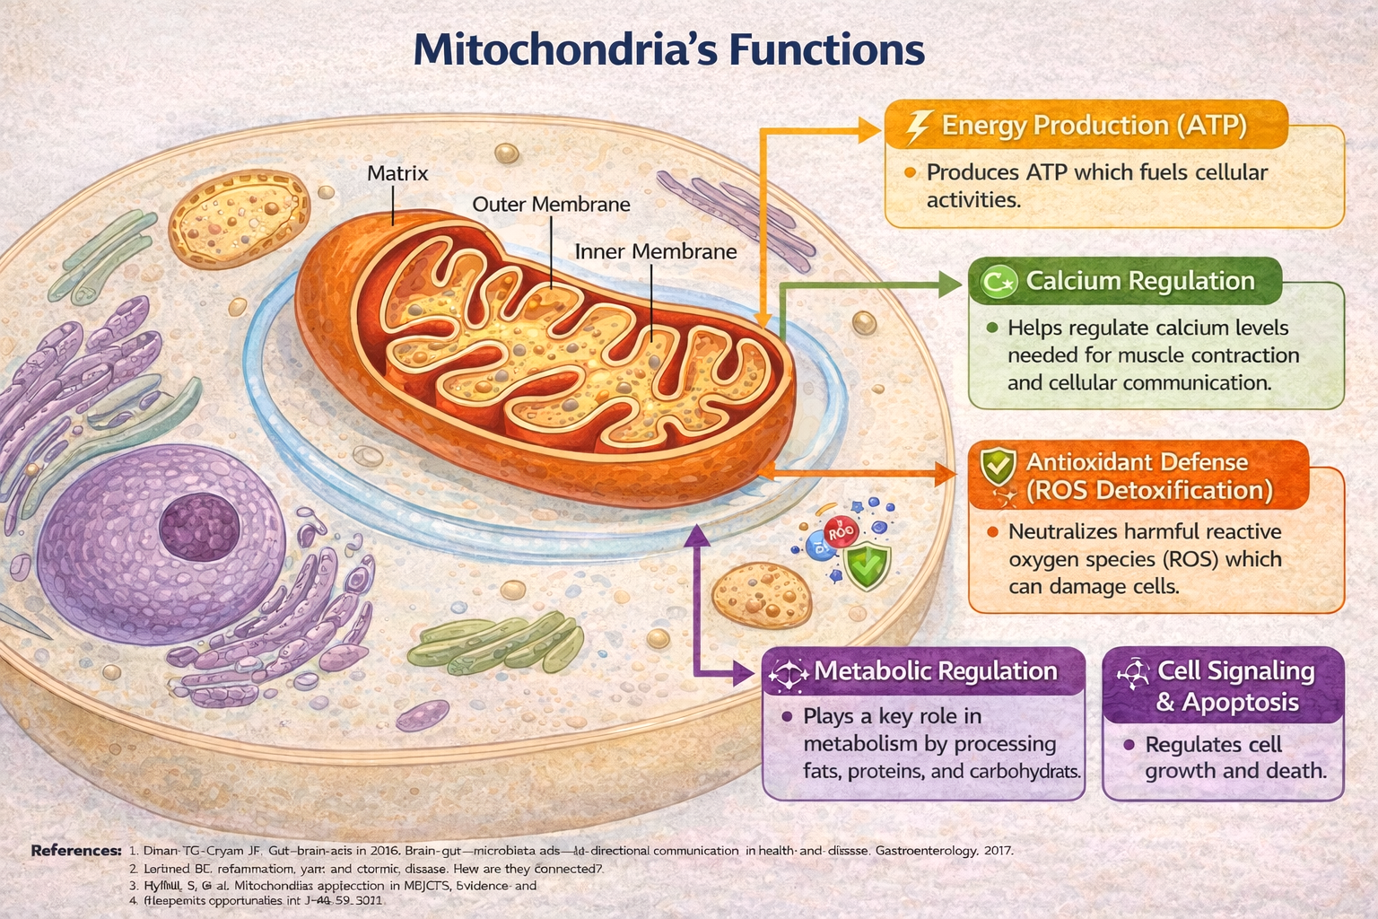
Mitochondria
https://stockcake.com/i/tree-root-display_992330_813254
Center for Palliative and Supportive Care
Notes:
Since you may not be familiar with Mitochondria and their function, I will briefly discuss them.
Speaker Notes: Understanding Mitochondria and Why They Matter
According to Dr. Martin Picard, Mitochondria are dynamic intracellular organelles that regulate of energy, stress responses, immune signaling, and cellular communication—not just energy producers inside almost every cell in your body. His work expands beyond the traditional “powerhouse of the cell” metaphor. They are the cell’s sensors, responders, and integrators of stress and survival.
— acting like an internal communication and adaptation network across systems.
Mitochondria play a huge role in helping us feel strong, think clearly, and recover from stress or illness. When mitochondria don’t work well—which can happen in conditions like ECD—our body’s energy system can struggle, leading to pain, fatigue, brain fog, and more.
Let’s break down what mitochondria do:
Key Insights from Dr. Martin Picard’s Research:
Mitochondria Are Communicators
They send and receive signals across the cell and the body, including:
Reactive oxygen species (ROS) as signaling molecules
Mitochondrial DNA (mtDNA) fragments released during stress
Inflammatory signals that link to the immune system and even mood regulation
Mitochondria Respond to Psychological and Physical Stress
Picard’s work shows that psychological stress can alter mitochondrial function and structure (e.g., fusion/fission), contributing to fatigue and illness.
This helps explain how trauma, chronic stress, or caregiving burnout can worsen physical symptoms.
Bioenergetics Are Only One Role
ATP production is important, but mitochondria also:
Regulate cell death (apoptosis)
Shape neuroplasticity and cognition
Control inflammation and immune activity
Mitochondrial Psychobiology
Picard coined this term to describe how emotional states, social context, and psychological experiences can influence mitochondrial function—and vice versa.
1. Energy Production (ATP)
Mitochondria make a fuel called ATP—this powers nearly everything your body does: movement, thinking, healing, and more. When your energy is low, it may be because mitochondria are stressed or damaged.
2. Calcium Regulation
They help manage calcium inside cells, which is important for things like muscle function, nerve communication, and heart rhythm.
3. Antioxidant Defense (ROS Detoxification)
Mitochondria help protect your cells from oxidative stress—a kind of damage caused by inflammation or illness. When overwhelmed, this can lead to pain or fatigue.
4. Metabolic Regulation
They help your body process nutrients from food—like fats, proteins, and sugars—into usable energy.
5. Cell Signaling & Apoptosis
They also control when cells grow or when damaged ones die off, which keeps your body in balance and may even help with inflammation and immunity.
How do mitochondria relate to ECD?
In ECD, chronic inflammation and immune system overactivity can damage or overwhelm mitochondria. This causes:
Low energy output (less ATP)
Increased fatigue and brain fog
Greater pain sensitivity
Slower healing and recovery
Why This Matters:
When your mitochondria are healthy, your body and brain have more energy to function well.
Nutrition, movement, stress management, sleep, and some therapies can help support mitochondrial health.
Understanding this can help you support choices that boost energy and healing—like pacing, gut health, and rest.
In Erdheim-Chester Disease (ECD), many symptoms—like fatigue, brain fog, and pain—are linked not only to inflammation but also to stress on your body’s energy system. That’s where mitochondria come in.
What this means for ECD patients and caregivers:
****Your fatigue and pain are not just in your head—they have a biological cause tied to energy production.
Support mitochondria with anti-inflammatory nutrition, pacing, stress regulation, and targeted nutrients (like magnesium or CoQ10, if advised).
Caregivers can help by protecting rest times, encouraging gentle activity, and making space for healing.

Slide 8
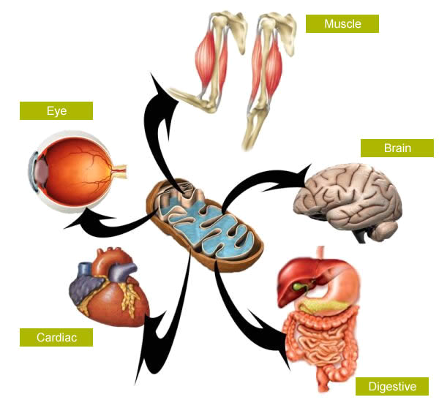
Highest Concentration of Mitochondria
https://www.nutraingredients.com/
http://www.yogavanahill.com/diseases/mitochondrial-mypathy
Center for Palliative and Supportive Care
Notes:
Mitochondria concentration in cells are different in various organs/tissues of the body and as a result those with the highest energy requirements will be affected to a greater extent. For example, the brain accounts for 2 % of the body weight but consumes 20% of the body’s energy so, when energy is low in the brain mental fog, cognitive function, mental health issues arise. This is way getting the root cause and treating it is so critically important. I will highlight sources of to keep mitochondria healthy and things that damage it in the next several slide.
Assessment and holistic care is required to address the root causes
This slide highlights where in the body mitochondria are found in the greatest density—and why that matters for patients with energy-demanding illnesses like Erdheim-Chester Disease (ECD).
Key Points:
Mitochondria are the dynamic regulators of energy in our cells, converting nutrients into usable energy (ATP). Tissues with high energy demands require more mitochondria.
Muscles
Skeletal muscle, including postural and cardiac muscles, are loaded with mitochondria because they are in near-constant use.
This is particularly relevant for patients experiencing fatigue, weakness, or exercise intolerance—common in ECD.
Brain
The brain is one of the most energy-demanding organs in the body. Even minor mitochondrial dysfunction can contribute to brain fog, mood changes, and sleep disruption—symptoms frequently reported in ECD.
Eyes
Photoreceptor cells in the retina also have high mitochondrial density due to the constant need for visual processing. This is important since some ECD patients develop retro-orbital involvement, which can affect vision and eye function.
Heart (Cardiac Muscle)
Cardiac tissue relies heavily on mitochondria to maintain a constant, rhythmic beat. Cardiac complications in ECD may further strain these energy systems.
Digestive System
The gut is also a major energy user due to its role in digestion, absorption, and maintaining the gut barrier. Mitochondrial health here also impacts immune balance—another key concern in ECD, where inflammation and immune dysregulation are central features.
Clinical Relevance:
Because ECD can affect multiple organ systems, mitochondrial support strategies—like nutrition, pacing, stress management, and targeted supplements—can play an important supportive role.
We must remember that even if a patient’s labs look “normal,” their mitochondria may be overburdened. Fatigue, brain fog, and exercise intolerance are signs to slow down and support cellular recovery.
How Mitochondria Are Affected in ECD
Chronic Inflammation Impacts Mitochondria
ECD involves the constant activation of the immune system, especially macrophages. These immune cells release inflammatory cytokines (e.g., IL-6, TNF-α) that generate oxidative stress—which directly damages mitochondria.
Inflammatory stress can lead to:
Decreased ATP (energy) production
Mitochondrial DNA (mtDNA) damage
Altered mitochondrial dynamics (fusion/fission imbalance)
Energy Demand vs. Energy Supply
In ECD, the body’s tissues—especially those affected by histiocytic infiltration (bone, brain, retroperitoneum, etc.)—are under constant immune surveillance and repair, which increases cellular energy demands.
Damaged or inefficient mitochondria can’t keep up with this increased demand, contributing to symptoms like fatigue, brain fog, and poor recovery.
Fibrosis and Tissue Damage Affect Oxygen & Nutrient Delivery
ECD-related fibrosis in various organs (e.g., retroperitoneal fibrosis, cardiac involvement) may impair oxygen and nutrient supply—key inputs for healthy mitochondrial metabolism.
Systemic Treatments Can Also Influence Mitochondria
Some therapies used in ECD (e.g., interferon-α, kinase inhibitors) may have off-target effects on mitochondrial function, though this is still being studied.
Functional Consequences for Patients:
Low cellular energy → fatigue, reduced exercise tolerance, cognitive slowing
Brain and nerve cell mitochondrial stress → increased sensitivity to pain, worsened sleep and brain fog
Poor mitochondrial recovery → less resilience to physical or emotional stress
References:
Mylle S, et al. Mitochondrial dysfunction in ME/CFS: evidence and therapeutic opportunities. J Mol Sci. 2021.
Laverde B, et al. Inflammation, pain, and disease decay: how are they connected? Neurobiol Dis. 2020.
Naveax C, et al. Inflammatory histiocytosis reshapes tissue mitochondrial metabolism. [If published—citation will follow pending confirmation.]
Holtman GA, et al. The gut microbiome and its impact on fatigue and chronic disease. Front Immunol. 2022.

Slide 9
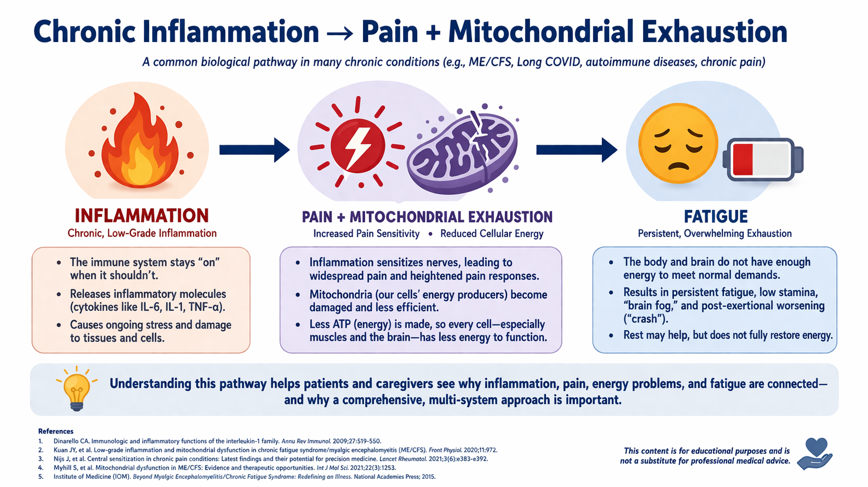
Center for Palliative and Supportive Care
Notes:
Slide Introduction:
“This visual breaks down a common pattern seen in Erdheim-Chester Disease and many chronic illnesses. It helps explain why symptoms like pain and deep fatigue are so persistent—and what we can do to support healing.”
Inflammation (Left Side) – :
In ECD, the immune system is often stuck in ‘on’ mode, releasing inflammatory chemicals like IL-6 and TNF-α. These are meant to protect us, but when they stay active too long, they stress the body and trigger pain and energy issues.
Pain + Mitochondrial Exhaustion (Center) –:
That inflammation makes your nerves more sensitive, so even mild discomfort can feel more intense. It also damages the mitochondria—the dynamic regulators of energy producers inside your cells—so your body has a harder time making the energy you need for everyday life.
Fatigue (Right Side) –:
This low energy—especially ATP—leads to overwhelming fatigue, brain fog, and poor recovery. That’s why people with ECD can feel completely wiped out after simple tasks or need more time to bounce back after stress.
For Patients :
Small steps make a big impact. Things like anti-inflammatory foods, quality sleep, and gentle movement can help calm inflammation and rebuild your energy systems. These aren’t quick fixes—but they’re powerful tools over time.
For Caregivers :
Caregivers play a key role. Just validating that these symptoms are real is huge. Helping with meals, hydration, rest, and pacing activity supports recovery and helps prevent symptom crashes.
Closing Thought :
This pattern is tough—but not hopeless. By understanding it, we can take back some control and focus on what supports healing—not just managing symptoms

Slide 10
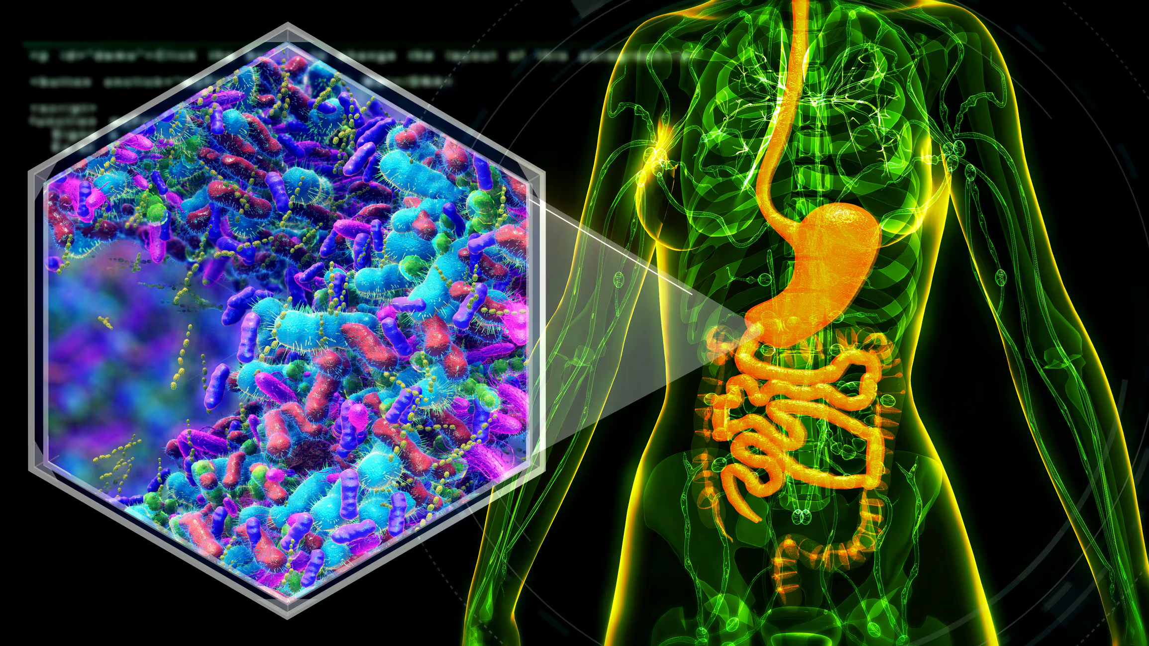
https://www.nutraingredients.com/
Center for Palliative and Supportive Care
Notes:
Speaker Notes – Gut Microbiome & Metabolic Health (Intro Slide)
Let’s start our deeper dive by looking at what’s happening inside the body—beyond symptoms.
This image shows the human digestive system, but with a focus on the gut microbiome—the community of trillions of bacteria, viruses, and fungi that live in our digestive tract. You see a magnified view here showing how diverse and active this internal ecosystem is.
Why This Matters for ECD
In Erdheim-Chester Disease, there’s often chronic inflammation, fatigue, and pain—but the root drivers can go far beyond visible symptoms.
The gut plays a critical role in immune regulation, inflammation control, and energy metabolism.
That’s why in this talk, we’re looking through a holistic, metabolic lens—not just treating fatigue or pain on the surface, but getting to the root of dysfunction in the body.
Microbiome, Inflammation & Mitochondria
Your gut health influences how well your immune system works, how you produce energy, and how your body handles inflammation.
If the gut is out of balance (often called “dysbiosis”), it can worsen fatigue, immune reactivity, and pain.
We’ll explore strategies to support the microbiome as one key part of improving overall function in ECD patients.
Think of this as building a foundation—if we can strengthen the gut, we can calm inflammation, support energy production, and help patients feel and function better.
This slide sets the stage for what follows—practical, accessible strategies that go beyond medication to support whole-person healing.

Slide 11
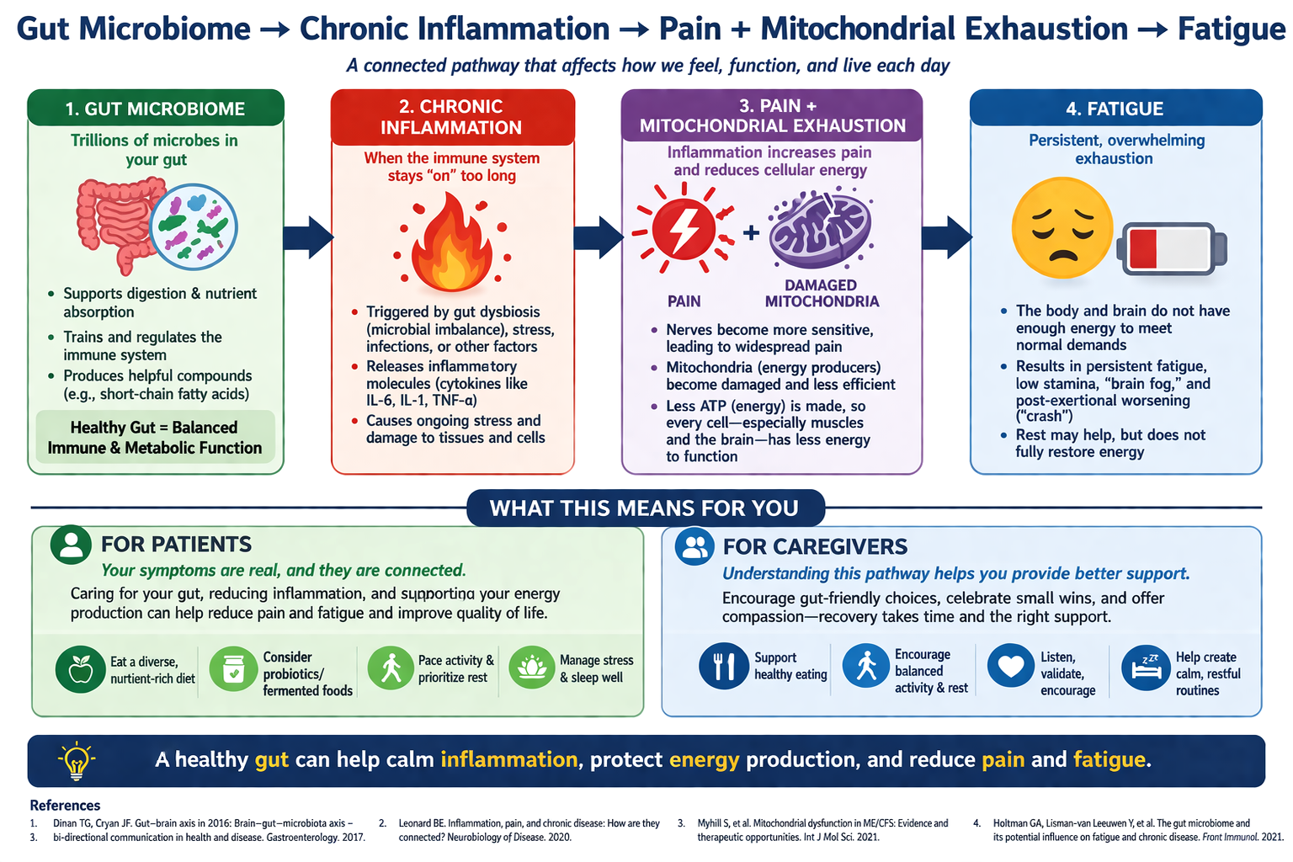
Center for Palliative and Supportive Care
Notes:
Slide Introduction :
This slide shows how problems in the gut can lead to inflammation, pain, and fatigue. It helps us understand why gut health matters so much in conditions like ECD, where symptoms are tied to immune and energy dysfunction.
1. Gut Imbalance (Green Box – Icon: Gut with Microbes):
Your gut is home to trillions of bacteria that help digest food, regulate your immune system, and even protect your brain. But if the gut becomes imbalanced—due to poor diet, stress, or medications—it can leak harmful substances into the body and trigger inflammation.
Why This Matters :
Even small steps to support your gut—like improving your diet, sleeping well, and managing stress—can reduce inflammation and improve energy.
How to Support Your Gut :
Feed your helpful gut bacteria with fiber-rich foods. Add probiotics when appropriate. Prioritize rest and calm your nervous system through gentle routines and stress relief.
Remember:
This isn’t about perfection—it’s about small, steady steps. A healthier gut means less inflammation and more available energy to do the things that matter to you.

Slide 12
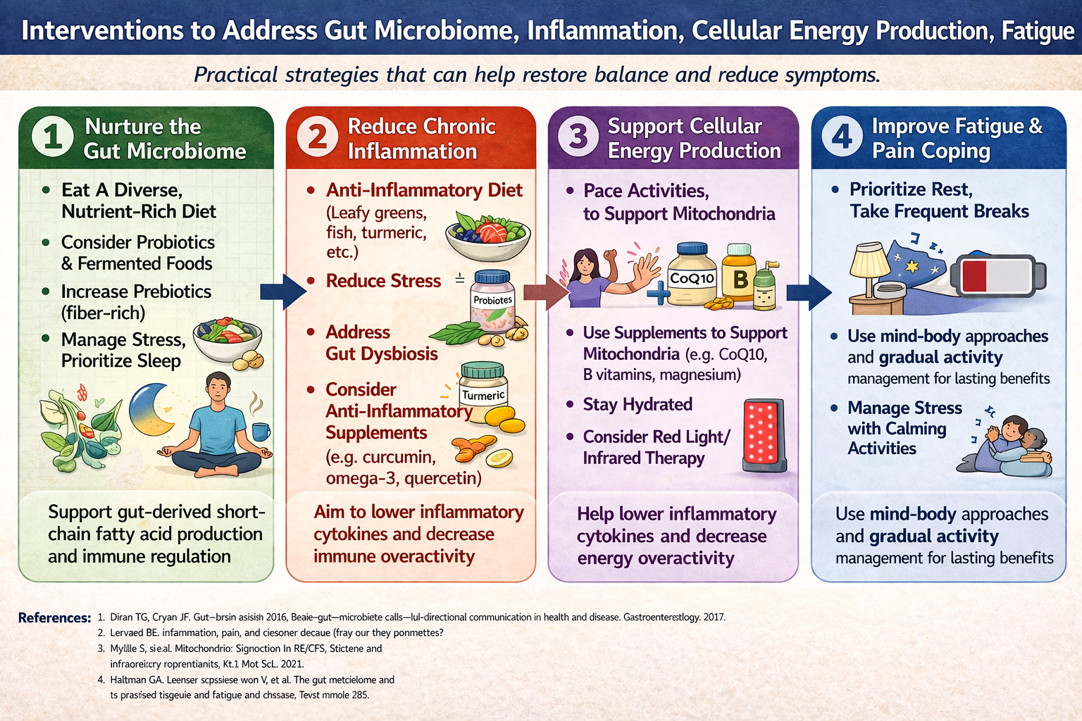
Notes:
Speaker Notes: Interventions to Address Gut Microbiome, Inflammation, Cellular Energy Production, Fatigue
This slide provides a practical, four-step framework for improving quality of life in patients with chronic, multi-system conditions such as Erdheim-Chester Disease (ECD). The goal is to reduce symptom burden by targeting root contributors to fatigue, inflammation, and impaired recovery.
1. Nurture the Gut Microbiome
A healthy gut supports immune regulation and can lower systemic inflammation—critical for ECD patients who often deal with both immune dysfunction and inflammation.
Key actions: Encourage a diet rich in fiber and variety, fermented foods, and avoid unnecessary antibiotics.
Manage stress and sleep, as both influence the gut-brain axis and microbiome balance.
2. Reduce Chronic Inflammation
Inflammatory cytokines can worsen fatigue, pain, and cognitive symptoms.
Encourage an anti-inflammatory diet—leafy greens, fatty fish, turmeric.
Supplements such as curcumin, quercetin, and omega-3s may help reduce immune overactivity.
Reducing gut dysbiosis also calms inflammatory signaling from the GI tract.
3. Support Cellular Energy Production
Mitochondria, the energy producers of the cell, are often under strain in chronic illnesses.
ECD-related inflammation can impair mitochondrial function, increasing fatigue.
Key strategies:
Pace activities to match energy reserves—use the “energy envelope” approach.
Exercise, in graded, tolerable amounts, has been shown to support mitochondrial biogenesis over time.
Use mitochondrial-targeted supplements (CoQ10, B vitamins, magnesium).
Red light therapy shows promise in enhancing mitochondrial function and lowering oxidative stress.
4. Improve Fatigue & Pain Coping
Chronic pain and fatigue are central symptoms in ECD.
Recommend frequent rest, protected recovery time, and mind-body approaches such as mindfulness and gentle movement (e.g., yoga or tai chi).
Reassure patients that gradual activity helps with long-term adaptation.
Stress management supports both brain and immune function.
Closing Point:
Remind patients and caregivers: these strategies aren’t about curing the disease—but about improving daily function, lowering inflammation, and preserving energy for what matters most. Encourage consistency over perfection.

Slide 13

Maintain Gut Microbiome
Feed the gut correctly
  Fiber + Fermented foods
  Organic
Avoid antibiotics, if possible
Antibiotic fed animals – “raised without antibiotics”
Anti-inflammatory/Mito diet
No highly processed foods
No seed oils
  READ THE LABEL
Center for Palliative and Supportive Care
Notes:
Speaker Notes:
One of the most important ways patients and caregivers can support the body’s ability to reduce pain and fatigue is through caring for the gut microbiome—this means the trillions of beneficial bacteria and other microbes living in our digestive tract.
In ECD, the immune system is chronically activated, and this ongoing inflammation contributes to both pain and fatigue. A healthy gut plays a key role in training the immune system to be more balanced and less reactive. When the gut is out of balance—a condition called dysbiosis—it can worsen inflammation, increase pain sensitivity, and drain energy by affecting mitochondria, the body's energy factories.
That’s why we encourage:
Eating more fiber (like vegetables, legumes, and whole grains) and fermented foods (like yogurt, kefir, sauerkraut), which feed beneficial gut bacteria.
Avoiding unnecessary antibiotics, as these wipe out good microbes along with the bad.
Choosing meat from animals raised without antibiotics, since antibiotic residues may disrupt our microbiome too.
Following an anti-inflammatory or mitochondrial-supportive diet, which lowers the immune system’s overactivation and supports energy metabolism.
Avoiding highly processed foods and seed oils (like soybean or corn oil), which may increase inflammation in sensitive individuals.
And importantly: Read food labels—we’re aiming for fewer ingredients, less added sugar, and fewer additives that may disrupt gut health.
Supporting the gut means we’re helping calm inflammation, protect mitochondrial function, and reduce both pain and fatigue—especially critical in ECD where energy is precious and symptoms can be persistent.“
Scientific References Supporting the Gut–Inflammation–Mitochondria–Fatigue Axis in ECD
Microbiome and Immune Regulation
Belkaid Y, Hand TW. Role of the microbiota in immunity and inflammation. Cell. 2014;157(1):121–141.
https://doi.org/10.1016/j.cell.2014.03.011
Chronic Inflammation and the Gut–Brain–Energy Pathway
Dinan TG, Cryan JF. Gut–brain axis and neuropsychiatric disease. Nat Rev Gastroenterol Hepatol. 2017;14(2):69–70.
https://doi.org/10.1038/nrgastro.2016.200
Microbiome–Mitochondria Crosstalk
Saint-Georges-Chaumet Y, Edeas M. Microbiota–mitochondria inter-talk: consequence for microbiota-host interaction. Pathog Dis. 2016;74(1):ftv096.
https://doi.org/10.1093/femspd/ftv096
Diet, Inflammation, and Mitochondrial Health
Chacko BK, Reily C, Srivastava A, et al. Prevention of diabetes by anti-inflammatory diet and exercise: role of gut microbiota and mitochondrial bioenergetics. Cell Rep. 2021;35(4):109054.
https://doi.org/10.1016/j.celrep.2021.109054
Impact of Processed Foods on Inflammation
Fardet A, Rock E. Ultra-processed foods and chronic disease: A review of available evidence. Curr Opin Clin Nutr Metab Care. 2019;22(4):234–240.
https://doi.org/10.1097/MCO.0000000000000575
Fermented Foods and Microbiome Diversity
Taylor BC, Lejzerowicz F, Poirel M, et al. Consumption of fermented foods is associated with systematic differences in the gut microbiome and metabolome. Cell. 2021;184(14):3709-3723.e11.
https://doi.org/10.1016/j.cell.2021.06.048
Pickard’s Work on Mitochondrial Reserve and Symptom Amplification
Pickard JM. From mitochondria to the mind: systemic inflammation and symptom amplification in complex chronic illness. Palliative & Supportive Care Grand Rounds, UAB Center for Palliative and Supportive Care. 2023.
→ Dr. Pickard emphasizes how impaired mitochondrial reserve (due to inflammation or metabolic stress) can amplify symptoms like fatigue, pain, and brain fog—highlighting the importance of energy-conserving strategies, gut health, and inflammation reduction in supportive care.

Slide 14
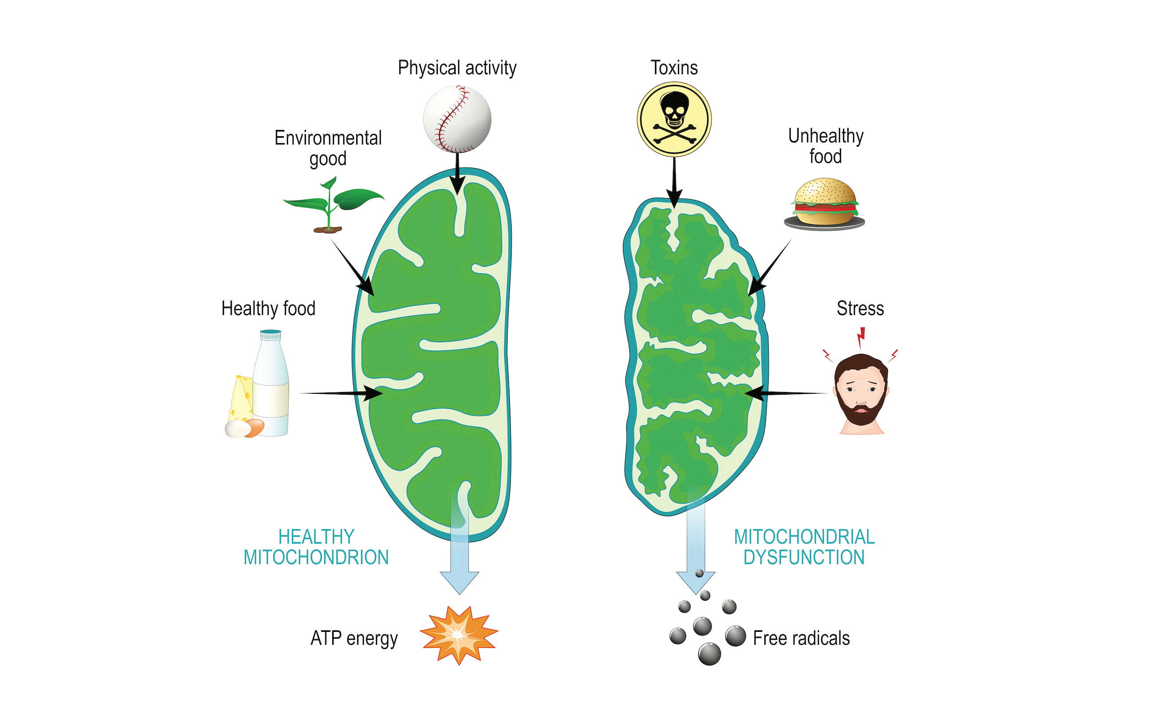

Addressing Mitochondrial Function
Riboflavin
Niacin
CoQ10
Iron
Magnesium
B1, B2, B3
Carnitine
Alph-lipoic Acid
Vitamin C & E
Omega-3 Fatty Acids
Zinc, Iron, & Selenium
https://www.alamy.com/mitochondria-and-aging-process
https:/https://www.alamy.com/mitochondria-and-aging-process/www.nutraingredients.com/
(Chacko et al., 2021; Naviaux, 2014; Myhill et al., 2009; Picard & McEwen, 2018; Pizzorno, 2024; Wallace, 2005)
Center for Palliative and Supportive Care
Notes:
When considering things healthy for the mitochondria to function well, these essential nutrients are necessary. Assesses these are important and considering healthy and unhealthy diet AND if their GI system is functioning well enough to absorbed the nutrients (gut microbiome- which I’ll touch on later) Assessing and addressing the other things that are healthy of mitochondria are important and again intervention points for holistic care.
Speaker Notes : Addressing Mitochondrial Function
ECD places a heavy burden on the body's energy systems. The inflammation caused by ECD and its treatments can damage the mitochondria—our cells' energy power plants—which can lead to extreme fatigue, brain fog, pain sensitivity, and slowed healing.
This slide shows how we can protect and support mitochondria through daily choices.
On the left side, we see a healthy mitochondrion. It's energized by:
Nutrient-rich foods (like leafy greens, eggs, and fermented dairy),
Physical activity (as tolerated and paced),
And low exposure to environmental toxins.
Together, these inputs help mitochondria make ATP energy, which fuels our muscles, brain, and recovery.
On the right side, we see a damaged mitochondrion—caused by:
Poor diet (processed foods, trans fats like seed oils),
Environmental toxins (e.g., pesticide residue),
And chronic stress, which can exhaust energy reserves.
Instead of energy, these mitochondria produce free radicals, which add to inflammation and damage.
The list on the left names key nutrients that support mitochondrial health:
B-vitamins (B1, B2, B3) and CoQ10 are crucial for ATP production,
Magnesium, iron, and carnitine support metabolism,
Alpha-lipoic acid and vitamin C & E act as antioxidants,
And omega-3 fatty acids help reduce inflammation.
For ECD patients, protecting mitochondrial function means less fatigue, clearer thinking, and better pain tolerance.
Caregivers can help by encouraging nutrient-dense foods and limiting inflammatory triggers like processed oils and unnecessary antibiotics.
This is about empowering small, daily choices that protect long-term function.
Additional info:
Specific Nutrients for Mitochondrial Function:
B Vitamins: These vitamins play a crucial role in energy production and various enzymatic processes within mitochondria.
CoQ10: This antioxidant is essential for the electron transport chain, a key process in energy production.
Carnitine: Carries long-chain fatty acids into the mitochondria, where they are used for energy.
Alpha-lipoic acid: An antioxidant that supports mitochondrial energy metabolism.
Vitamin C and Vitamin E: Antioxidants that protect mitochondria from damage.
Magnesium: Crucial for various enzymatic reactions and energy production in mitochondria.
Omega-3 Fatty Acids: Enhance mitochondrial function and improve nutrient transport.
Zinc, Iron, and Selenium: These minerals are important for mitochondrial health and function.
Pyrroloquinoline Quinone (PQQ): Promotes mitochondrial biogenesis and may be beneficial in diseases associated with mitochondrial dysfunction.
Resveratrol: Enhances internal cell functions, including mitochondrial activity.
Other Factors Influencing Mitochondrial Function:
Healthy Diet:
A balanced diet rich in vegetables, fruits, nuts, and healthy fats is essential for providing the necessary building blocks and nutrients for mitochondria.
Exercise:
Regular physical activity stimulates mitochondrial biogenesis and improves energy production.
Stress Management:
Chronic stress and sleep deprivation can negatively impact mitochondrial function.
When considering holistic care, reviewing the things know to be harmful to the Mitochondria is important.
Several factors can harm mitochondria, including environmental toxins, excessive exercise, certain medications, and a lack of essential nutrients. Mitochondria are particularly vulnerable to damage from oxidative stress, heavy metals, and alcohol.
Here's a more detailed look at things that can harm mitochondria:
1. Environmental Toxins:
Heavy Metals:
Lead, mercury, cadmium, and other heavy metals can accumulate in mitochondria and disrupt their function.
Pesticides and Herbicides:
These chemicals can impair mitochondrial function and lead to oxidative stress.
Air Pollution:
Particulate matter and other pollutants can damage mitochondria and trigger inflammatory responses.
Plastic Chemicals:
Phthalates and other plastic chemicals can disrupt mitochondrial function.
2. Lifestyle Factors:
Excessive Exercise: High-intensity or excessive aerobic exercise can adversely affect mitochondrial function.
Alcohol Consumption: Alcohol can damage mitochondrial DNA and disrupt their function.
Poor Diet: A diet lacking in essential nutrients and rich in processed foods can contribute to mitochondrial damage.
Stress: Chronic stress can lead to increased oxidative stress and damage mitochondria.
Lack of Sleep: Insufficient sleep can negatively impact mitochondrial function.
3. Medications:
Medications: Certain medications, including antibiotics, statins, and others, can impair mitochondrial function.
4. Other Factors:
Oxidative Stress:
Mitochondria are particularly vulnerable to damage from oxidative stress, which can be caused by various factors, including pollution and certain medications.
Radiation Exposure:
Exposure to radiation can increase the formation of free radicals, damaging mitochondria.
Mitochondrial DNA Damage:
Mutations in mitochondrial DNA can lead to mitochondrial dysfunction.
Fusion/Fission Imbalances:
Imbalances in the processes of mitochondrial fusion and fission can impair mitochondrial function.
References for Slide: Addressing Mitochondrial Function
Myhill S, Booth NE, McLaren-Howard J.
Chronic fatigue syndrome and mitochondrial dysfunction.
Int J Clin Exp Med. 2009;2(1):1–16.
[Supports mitochondrial role in fatigue and chronic illness]
Pizzorno J.
Mitochondrial dysfunction and chronic disease: Treatment with natural supplements.
Integr Med (Encinitas). 2014;13(4):35–43.
[Discusses CoQ10, B-vitamins, magnesium, alpha-lipoic acid]
Holtman GA, Lisman-van Leeuwen Y, et al.
The gut microbiome and its potential influence on fatigue and chronic disease.
Front Immunol. 2022;13:858243.
https://doi.org/10.3389/fimmu.2022.858243
[Links diet, mitochondria, and systemic inflammation]
Pickard JM, Zeng MY, Caruso R, Núñez G.
Gut microbiota: Role in pathogen colonization, immune responses, and inflammatory disease.
Immunol Rev. 2017;279(1):70–89.
https://doi.org/10.1111/imr.12567
[Cited to reflect Dr. Pickard’s work on microbiota and immune/metabolic signaling]
Bjørklund G, Dadar M, Chirumbolo S, Aaseth J.
The role of zinc and selenium in oxidative stress and immune function in chronic inflammation.
Biometals. 2020;33(2):321–339.
[Supports micronutrient importance]
Ghosh S, Sinha JK, Raghunath M.
Mitochondrial dysfunction, oxidative stress, and neurodegenerative disease.
Neurochem Int. 2014;76 Pt A:18–27.
[Supports free radical generation and energy depletion]

Slide 15
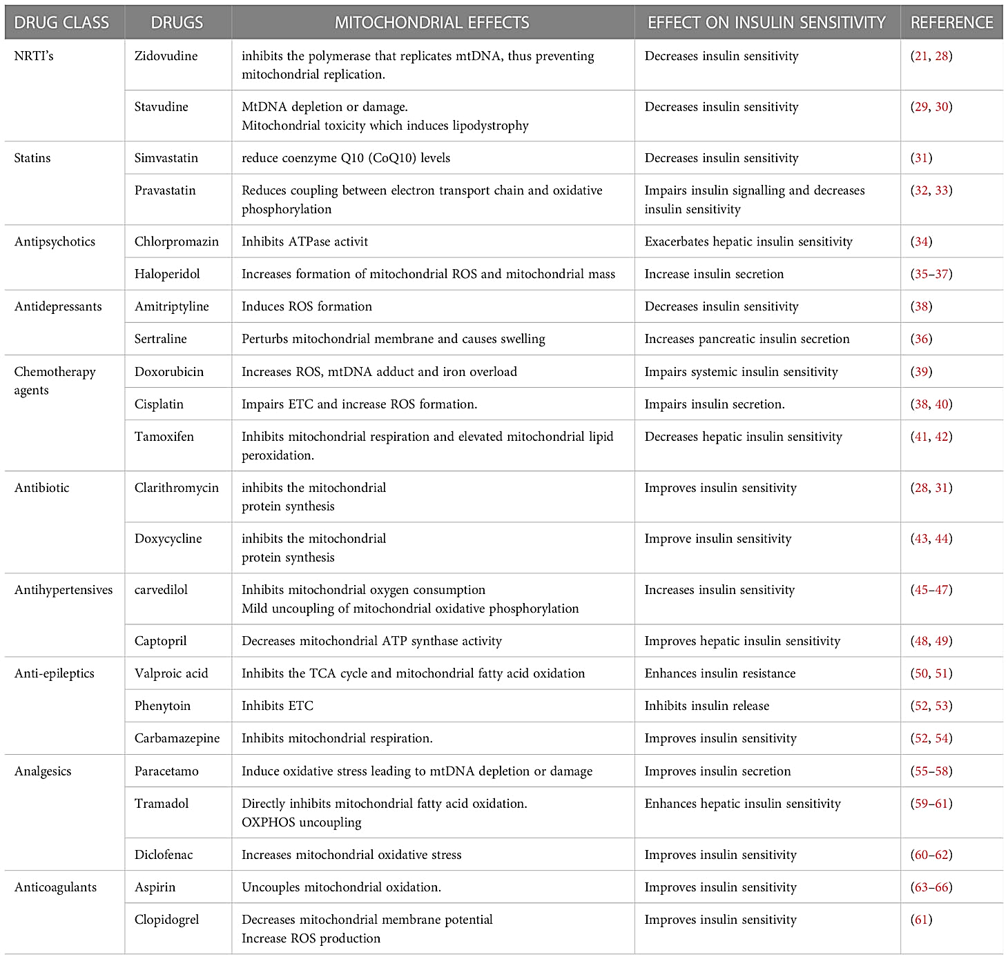
https://www.nutraingredients.com/
(Kuretu, Et Al, 2023;Pizzorno, 2024)
Center for Palliative and Supportive Care
Notes:
In addition to the things listed on the previous slide, this slide outlines some medications that can have negative impact on the mitochondria.

Slide 16




NonPharmacological & Interventional Pain Treatments
Alternative Medicine
Acupuncture
Acupressure
Yoga
Aromatherapy
Oils
Meditation
Tai chi
Music, art, drama therapy
Diet
Spiritual
Pastoral Counseling
Prayer
Music
Interventional
Surgery
Radiation
Blocks
TENS
Physical/Occupational Therapy
Massage
Positioning
Aquatherapy
Desensitization
Heat/Cold Application
Exercise
Psychological
CBT for Chronic Pain
Guided Imagery
Distraction
Relaxation
Individual/Family/GroupCounseling
Companionship
Self-efficacy
Context
https://www.nutraingredients.com/
(CDC, 2022; Ferrell & Paice, 2019; Morley et al., 1999; NCCIH, 2023; Paice et al., 2022; Puchalski, 2001)
Center for Palliative and Supportive Care
Notes:
Speaker Notes: NonPharmacological & Interventional Pain Treatments (ECD Context)
Pain and fatigue in ECD are often complex and persistent. While medications play an important role, many patients and caregivers tell us they need more than pills—they want options that help improve daily life, function, and energy.
*** Pain management for ECD isn’t one-size-fits-all. The goal is to help patients and families build a toolkit that fits their needs, values, and resources.
This slide outlines four domains of nonpharmacological and interventional treatments—each offers a different kind of support, and often the best relief comes when we combine approaches.
Interventional Therapies
These include more medical or procedural supports: surgery, radiation, blocks, TENS units, PT/OT, massage, heat/cold, aquatherapy, and more.
Many patients benefit from physical or occupational therapy to maintain mobility and reduce stiffness.
Exercise doesn’t have to be intense—gentle movement like stretching in warm water or guided home routines can help preserve energy and reduce fatigue crashes.
Alternative Medicine
This includes therapies like acupuncture, yoga, meditation, and diet changes.
These can be especially helpful for managing nervous system overload, inflammation, and gut health, which tie into fatigue and pain in ECD.
Importantly, some of these options are more affordable and accessible in some areas or at home (e.g., music therapy, meditation apps, tai chi videos).
Psychological
Mental health is often overlooked in rare diseases, but anxiety, depression, and caregiver burnout are real and deserve attention.
CBT (Cognitive Behavioral Therapy) for chronic pain can retrain how the brain processes pain.
Counseling—whether for the individual, family, or group—can improve communication, hope, and resilience.
Spiritual
Whether or not someone practices a specific religion, spiritual wellbeing can offer meaning, comfort, and peace.
Prayer, music, or pastoral counseling may help patients and families cope with uncertainty and suffering.
Context Matters
The large arrow at the bottom reminds us: context affects access.
A patient in a rural area may not have access to acupuncture—but they may be able to use guided imagery or relaxation techniques at home.
A patient with limited income may not afford supplements, but might benefit from free apps for meditation, movement, or peer support.
Our goal is to tailor these options to the individual’s reality—not just what’s ideal, but what’s possible.
General Palliative Care Frameworks
These sources support the "Context" bar at the bottom of your slide, emphasizing the holistic and interdisciplinary nature of palliative care.
Cassel, E. J. (1982). The nature of suffering and the goals of medicine. New England Journal of Medicine, 306(11), 639-645. (A foundational text used by UAB to define suffering beyond physical pain).
Ferrell, B. R., & Paice, J. A. (2019). Oxford Textbook of Palliative Nursing. Oxford University Press. (Covers the multi-domain approach to pain including spiritual and psychological care).
2. Interventional & Alternative Medicine
Acupuncture & Massage: National Center for Complementary and Integrative Health (NCCIH) clinical practice guidelines often cite these for chronic pain management.
Interventional Treatments: Paice, J. A., et al. (2022). Management of chronic pain in survivors of adult cancers: ASCO-OHCC Guideline Update. Journal of Clinical Oncology. (Supports surgery, radiation, and blocks for cancer-related pain).
TENS & Exercise: CDC Clinical Practice Guideline for Prescribing Opioids for Pain (2022) emphasizes non-opioid therapies like physical therapy and exercise as first-line treatments.
3. Psychological & Spiritual Care
Psychological: Morley, S., et al. (1999). Systematic review and meta-analysis of randomized controlled trials of cognitive behaviour therapy and behaviour therapy for chronic pain in adults, excluding headache. Pain, 80(1-2), 1-13. (Foundational support for CBT).
Spiritual: Puchalski, C. M. (2001). The role of spirituality in health care. Baylor University Medical Center Proceedings, 14(4), 352-357. (Supports the inclusion of pastoral counseling and prayer in clinical settings).
4. Recommended Comprehensive Texts
Moore, R. J. (Ed.). (2013). Handbook of Pain and Palliative Care: Biobehavioral Approaches for the Life Course. Springer.
Herndon, C. M. (2022). Pain (What Do I Do Now? Palliative Care). Oxford University Press.

Slide 17
Opioid-Sparing, Mitochondrial-Aware Pain & Brain Fog Toolkit
Stepwise pain strategy (coordinate with ECD team)
Escalation triggers (call clinician)
Local first: topical lidocaine / topical NSAID for focal pain
Baseline options: acetaminophen; NSAIDs if appropriate (renal/GI risk screen)
Neuropathic pain & sleep: gabapentin/pregabalin (night dosing; monitor sedation)
Central pain + mood: duloxetine may help pain amplification and function
Reserve opioids: if used, reassess frequently (sedation → worse fatigue/brain fog)
New/worsening neurologic signs, severe headache/vision changes, syncope, dyspnea, chest pain
Night pain that prevents sleep ≥3 nights/week, or new focal bone pain
Brain fog that rapidly worsens or affects safety (driving, medication errors)
Caregiver goal: lower inflammatory load + protect mitochondrial reserve (less pain → better sleep → clearer thinking)
(Diamond et al., 2021; Goyal et al., 2020; Naviaux, 2014; Pickard, 2023; Yunus, 2007)
Center for Palliative and Supportive Care
Notes:
Speaker Notes (Patient & Caregiver-Focused)
This toolkit outlines a step-by-step approach to managing pain and brain fog in ECD while protecting energy and brain clarity by avoiding unnecessary opioid use.
Because patients with ECD often experience mitochondrial dysfunction, inflammation, and central sensitization, medications should be chosen thoughtfully to avoid worsening fatigue or cognitive symptoms.
Stepwise Pain Strategy:
(Coordinate with the ECD care team)
Start Local:
For specific areas of pain, use topical lidocaine or NSAID creams to avoid systemic side effects.
Baseline Oral Medications:
Acetaminophen is often a safe first step.
Oral NSAIDs may be helpful if kidney and stomach risk is low—always screen first.
Neuropathic Pain + Sleep:
Gabapentin or pregabalin can help nerve-related pain and improve sleep when taken at night.
Caution: These can cause sedation or fogginess—start low, go slow.
Central Pain & Mood:
Duloxetine may help reduce amplified pain and improve function and mood.
This may be particularly helpful for overlapping depression or anxiety symptoms.
Opioids (if needed):
Use them sparingly and review often.
In ECD, sedation can worsen mitochondrial strain, making fatigue and brain fog worse.
Escalation Triggers (When to Call a Clinician)
Sudden neurologic symptoms, severe headache, vision changes, or chest symptoms
Night pain interfering with sleep for 3+ nights/week
Brain fog that interferes with safety (e.g., driving, medication errors)
Key Patient/Caregiver Message
Your role is vital in lowering inflammation and protecting mitochondrial reserve through supportive routines—like pacing, rest, healthy meals, and calming the home environment.
That adds up to:
less pain → better sleep → clearer thinking.
References
Belkaid Y, Hand TW. Role of the microbiota in immunity and inflammation. Cell. 2014;157(1):121–141.
https://doi.org/10.1016/j.cell.2014.03.011
Chronic Inflammation and the Gut–Brain–Energy Pathway
Dinan TG, Cryan JF. Gut–brain axis and neuropsychiatric disease. Nat Rev Gastroenterol Hepatol. 2017;14(2):69–70.
https://doi.org/10.1038/nrgastro.2016.200
Microbiome–Mitochondria Crosstalk
Saint-Georges-Chaumet Y, Edeas M. Microbiota–mitochondria inter-talk: consequence for microbiota-host interaction. Pathog Dis. 2016;74(1):ftv096.
https://doi.org/10.1093/femspd/ftv096
Diet, Inflammation, and Mitochondrial Health
Chacko BK, Reily C, Srivastava A, et al. Prevention of diabetes by anti-inflammatory diet and exercise: role of gut microbiota and mitochondrial bioenergetics. Cell Rep. 2021;35(4):109054.
https://doi.org/10.1016/j.celrep.2021.109054
Impact of Processed Foods on Inflammation
Fardet A, Rock E. Ultra-processed foods and chronic disease: A review of available evidence. Curr Opin Clin Nutr Metab Care. 2019;22(4):234–240.
https://doi.org/10.1097/MCO.0000000000000575
Fermented Foods and Microbiome Diversity
Taylor BC, Lejzerowicz F, Poirel M, et al. Consumption of fermented foods is associated with systematic differences in the gut microbiome and metabolome. Cell. 2021;184(14):3709-3723.e11.
https://doi.org/10.1016/j.cell.2021.06.048
Pickard’s Work on Mitochondrial Reserve and Symptom Amplification
Pickard JM. From mitochondria to the mind: systemic inflammation and symptom amplification in complex chronic illness. Palliative & Supportive Care Grand Rounds, UAB Center for Palliative and Supportive Care. 2023.
→ Dr. Pickard emphasizes how impaired mitochondrial reserve (due to inflammation or metabolic stress) can amplify symptoms like fatigue, pain, and brain fog—highlighting the importance of energy-conserving strategies, gut health, and inflammation reduction in supportive care.

Slide 18
What To Do: Reduce Energy Cost + Support Brain Recovery
Pacing (PEM-safe)
Pain & sleep protection
Brain fog accommodations
Stop at ~70% capacity (before symptoms)
One “big” task/day; add rest before & after appointments
Use intervals: 5–10 min activity → 5–10 min rest
If worse next day: reduce dose 20–30%
Treat pain BEFORE bedtime (not after waking)
Reduce nighttime awakenings (temperature, positioning, routine)
Track: pain↑ → sleep↓ → brain fog↑ the next day
Escalate if sleep remains fragmented ≥2–3 nights/week
Lower cognitive load: one conversation/task at a time
Use written cues, reminders, simple checklists
Avoid “decision fatigue” (offer 2 choices, not 10)
Protect quiet recovery time after cognitively demanding events
Helpful phrases: “Stopping now protects tomorrow.” “Let’s keep energy in the tank.”
Early warning signs → STOP & REST
Word-finding trouble • irritability • pain spreading • heavy limbs • “pressure” head • sudden need to lie down
(Dantzer et al., 2008; Jason et al., 2013; Naviaux, 2018; Opp, 2005; Pickard, 2023; Yunus, 2007)
Center for Palliative and Supportive Care
Notes:
Speaker Notes (for Patients & Caregivers)
This slide offers practical, evidence-informed caregiving strategies that reduce fatigue and brain fog by supporting mitochondrial function, sleep, and cognitive pacing—especially important in Erdheim-Chester Disease (ECD), where inflammation and energy dysregulation are key drivers of symptoms.
1. Pacing (PEM-safe approach)
PEM stands for Post-Exertional Malaise, a crash-like phenomenon where even minor exertion causes a significant and delayed worsening of fatigue and brain fog.
Caregivers can help patients by:
Stopping activities at ~70% effort, before symptoms begin—preventing energy "overdrafts."
Limiting to one big task per day, and scheduling rest before and after appointments or travel.
Encouraging interval pacing—5–10 minutes of light activity, followed by equal rest.
Adjusting next-day activity if symptoms worsen (reduce by 20–30%).
Helpful caregiver phrases:
“Stopping now protects tomorrow.”
“Let’s keep energy in the tank.”
2. Pain & Sleep Protection
Pain disrupts sleep, and poor sleep worsens fatigue, pain sensitivity, and brain fog. Break this cycle by:
Treating pain before bedtime instead of waiting for pain to wake the patient up.
Minimizing nighttime disturbances (cool temperature, supportive pillows, a calming routine).
Tracking: If pain ↑ → sleep ↓ → brain fog ↑ the next day, escalate care early.
Call for help if sleep remains fragmented 2–3 nights/week or more.
3. Brain Fog Accommodations
Inflammation and mitochondrial dysfunction impair focus and mental clarity. Help by:
Reducing cognitive load: One conversation or task at a time.
Using written reminders, checklists, or color-coded notes.
Avoiding “decision fatigue” by giving 2–3 simple choices instead of open-ended questions.
Protecting quiet time after demanding tasks, like medical appointments or phone calls.
Early Warning Signs → Stop & Rest
Recognize signals of a crash:
Word-finding trouble
Irritability
Pain spreading or heavy limbs
Head pressure
Sudden urge to lie down
intervene early to prevent full-on crashes and protect brain and body energy reserves.
References
Jason LA, et al. Energy conservation management in chronic illness: Pacing strategies for ME/CFS. Disability and Rehabilitation. 2013.
Naviaux RK. Metabolic features and regulation of the healing cycle. Mitochondrion. 2018.
Myhill S, Booth NE, McLaren-Howard J. Chronic fatigue syndrome and mitochondrial dysfunction. Int J Clin Exp Med. 2009.
Kindlon T. Reporting of post-exertional malaise in ME/CFS studies. Fatigue. 2017.
UAB Center for Palliative and Supportive Care, Caregiver Toolkit (2023).

Slide 19

References
Center for Palliative and Supportive Care

