Slide 1

Targeted Therapies: The Good, the Bad, and the Unaffordable
Daniel Sokolowski, PharmD

Slide 2
Disclosure
I have nothing to disclose.

Slide 3


Treatment Risks vs. Benefit
The Good
Quality of Life
Disease Response
The Bad
Quality of Life
Cost
Side Effects
Notes:
When medications are studied, researchers are looking at how the medication affects the disease and the patients. Attempting to balance disease response with adverse effects and how that relates to QOL.
Since histiocytosis effects multiple areas of the body the treatment can have side effects in multiple areas as well.
Trying to balance the good and bad of a medication requires individual plans.
Targeted therapies are a way to reduce “off target” adverse effects.

Slide 4
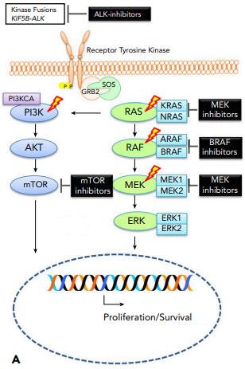
Targeted Therapies
BRAF-inhibitors and MEK-inhibitors are the most used
targeted therapies for ECD.
These two classes are used in combination in other disease states and can be used alone or together in ECD.
ECD is very sensitive to single agent treatment and risks of combination therapy may outweigh potential benefits.
CNS disease may require higher doses of single agents or combination therapy.
MEK-inhibitors may be used to treat patients without proof
of MAPK pathway mutations.
ECD: Erdheim-Chester Disease; CNS: Central Nervous System; Blood (2020) 135 (22): 1929–1945.
Notes:
Approximately, 50% of patients have BRAF V600E mutation
Other common mutations are from the MAPK-ERK and PI3K-AKT pathways
CNS disease may require higher doses to overcome the blood brain barrier and combination therapies may be used to increase disease response.

Slide 5
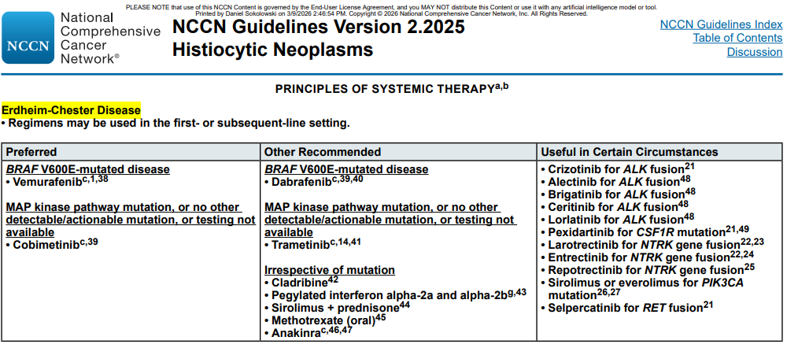
Treatment for Erdheim-Chester Disease
Most patients require treatment at diagnosis.
  For patients without symptoms or disease involvement in critical sites, we may watch and wait.
Treatment options have changed over the years due to molecular assessment for alterations/mutations, which has allowed for the development of targeted therapies.
Blood (2020) 135 (22): 1929–1945.; NCCN Guidelines: Histiocytic Neoplasms
Notes:
Most patients will require treatment at presentation because they already have symptoms from the disease.
The use and availability of molecular testing to identify mutations has changed the treatment for histiocytosis. This led to the use of targeted therapies which are now being recommended first line when selecting treatments.

Slide 6

Common Medications
Notes:
Most common two classes of medications are BRAF and MEK.

Slide 7
Cotellic (cobimetinib)
Doses range from 20 to 60 mg daily for 21 days of a 28-day cycle
Warnings
Cardiomyopathy, rhabdomyolysis, bleeding, new primary cancer, ocular toxicity
Before treatment: ECHO, ophthalmology consult and dermatology consult
Will routinely need monitoring and follow up with ophthalmology and cardiology assessment with ECHO
Taken with or without food
MEK Inhibitor
Ophthalmology follow up 2-3 weeks after initiation; then every 3 to 4 months during first year of treatment, then routinely
Avoid grapefruit
Side effects
Decreased blood counts, high blood pressure, skin reactions (sun sensitivity, acneiform rash), diarrhea, nausea, decreased electrolytes, and liver function changes
Rare: Decreased ejection fraction, visual impairment, skin cancer, and decreased kidney function
Cotellic Package Insert; Blood (2020) 135 (22): 1929–1945
Notes:
Normal dosing in ECD would start at 40 mg (2 tablets) daily for 21 days on and 7 days off but the dose can be modified by increasing or decreasing the number of tablets or changing the days the medication is taken. (eg 14 days on and 7 days off, or 21 days on 3 days off)
All MEK inhibitors can cause cardiac function decreases and can cause reversible vision impairment. So, we recommend initially being assessed by cardiology and ophthalmology.
These drugs do cause blood counts to decrease and may cause other adverse effects

Slide 8
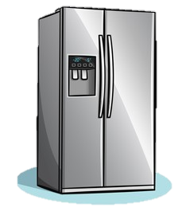
Mekinist (trametinib)
Doses range from 0.5 to 2 mg daily
Warnings
Ocular toxicity, new primary cancers, lung toxicity, major bleeding, cardiac toxicity, dermatologic toxicity
Before treatment: ECHO, ophthalmology consult, and dermatology consult
Will routinely need monitoring and follow up with ophthalmology and cardiology assessment with ECHO
Taken on empty stomach (1 hour before or 2 hours after a meal)
MEK Inhibitor
Ophthalmology follow up 2-3 weeks after initiation; then every 3 to 4 months during first year of treatment, then routinely
Side effects
Decreased blood counts, high blood pressure, swelling, skin reactions (acneiform rash, redness/rash, etc),
abdominal pain, and diarrhea
Store in the refrigerator
Rare: Decreased ejection fraction, visual impairment, skin cancer, mouth sores, and liver function changes
Mekinist Package Insert; Blood (2020) 135 (22): 1929–1945
Notes:
Usually starting at 1 mg (take two 0.5 mg tablets) daily.
Must be stored in the refigerator

Slide 9
Zelboraf (vemurafenib)
Dose 240 to 960 mg twice daily
Warnings
New primary cancers, changes in electrical activity of the heart, decreased kidney function, decreased liver function, eye toxicity, dermatologic toxicity, pancreatitis
Before treatment: dermatology consult and electrocardiogram
Will routinely need monitoring and follow up
Taken with or without food
BRAF Inhibitor
Side effects
Decreased blood counts, high blood pressure, muscle/joint pain, hair loss, fatigue, skin reactions (sunburn, rash, thickening, etc.), nausea, diarrhea, decreased appetite, swelling, neuropathy, headache, and fever
Avoid grapefruit
Rare: Decreased ejection fraction, QT prolongation, visual impairment, skin cancer, mouth sores, radiation recall, kidney and liver function changes
ECD: Erdheim-Chester Disease; Zelboraf Package Insert; JAMA Oncol 2018 Mar 1;4(3):384-388; Blood (2020) 135 (22): 1929–1945
Notes:
Usual starting dose of 480 mg (2 tablets) twice daily

Slide 10
Tafinlar (dabrafenib)
Doses range from 75 to 150 mg twice daily
Warnings
Skin cancer, ocular toxicity, changes in electrical activity of the heart
Before treatment: dermatology consult and electrocardiogram
Will routinely need monitoring and follow up
Take on an empty stomach (1 hour before or 2 hours after eating)
Avoid in patients with G6PD deficiency
Side Effects
Decreased blood counts, high blood pressure, fever, fatigue, high blood sugar, hair loss, skin reactions (thickening, rash, etc.), constipation, joint pain, headache, liver function changes
Avoid grapefruit
Rare: Decreased ejection fraction, QT prolongation, visual impairment, and skin cancers
BRAF Inhibitor
Tafinlar Package Insert; Blood (2020) 135 (22): 1929–1945 ; NCCN Guidelines
Notes:
Usual starting dose of 75 mg twice daily (Capsules are 50 or 75 mg)
Less skin reactions with Tafinlar than Zelboraf

Slide 11
Medications Useful in Certain Circumstances
Targets
ALK Fusion
Alectinib
Brigatinib
CSF1R Mutation
Pexidartinib
NTRK gene fusion
PIK3CA mutation
RET fusion
Ceritinib
Crizotinib
Larotrectinib
Entrectinib
Sirolimus
Everolimus
Selpercatinib
Repotrectinib
Lorlatinib
Medications Used Regardless of Mutation Status
Cladribine
Methotrexate
Peginterferon alpha-2a
Sirolimus
Anakinra
Other Medications may be used based on disease presentation, prior adverse events, etc.
NCCN Guidelines

Slide 12
Side Effect Management
Notes:
Generally, side effects are managed the same regardless of which medication is causing them.
Report side effects to your healthcare team if they are new, worsening or limiting daily life.

Slide 13
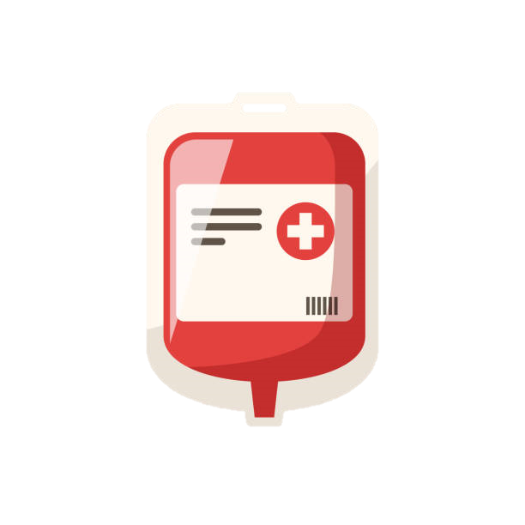
Side Effect: Low Blood Counts
Low white blood cells: increased risk of infection
Low hemoglobin: increased fatigue
Low platelets: increased risk of bleeding
Monitored regularly on lab work
Notes:
Perform good hand hygiene, where a mask in crowds, and discuss precautions with your physician

Slide 14
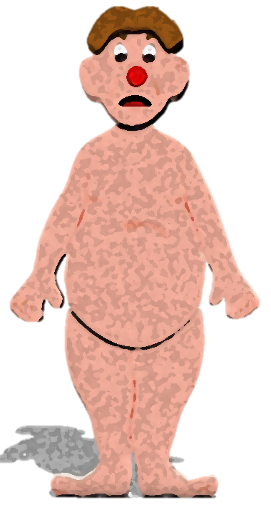
Side Effects: Dermatology
Rash treatment
  Topical creams and/or antihistamines
Dry or Irritated Skin
  Use fragrance-free creams- Apply after each shower and as needed several times a day
Increased sensitivity to sun
  Wear UV protection- clothing, sunscreen (SPF 30+) and other protective measures when in sunlight
Acneiform rash
(MEK-inhibitors)
  Over the counter products like benzoyl peroxide
  Prophylaxis or treat with antibiotics
Check your skin regularly for changes
  Asymmetry, Border irregularity, Color changes, Diameter/size, and Evolving/changes
Follow up with dermatology consistently
  If you cannot make your appointment, be sure to reschedule
Notes:
3- Even indirect sunlight, even in the car

Slide 15

Side Effects: Gastrointestinal Issues
Includes diarrhea, abdominal pain, nausea, vomiting, loss of appetite and constipation
Drink 8 to 10 glasses of water per day
You do not have to eat three large meals each day – Graze!
Bland food diet- bananas, rice, apples, bread, boiled potatoes, chicken, crackers, oatmeal
Diarrhea- Imodium (loperamide) over the counter
Multiple nausea and vomiting prescription options
Constipation- stool softeners or laxatives over the counter

Slide 16

Side Effects: Joint and/or Muscle Pain
Keep a log of your pain, including location and duration
Stay as active as possible but plan more rest breaks
Corticosteroids, various OTC meds may be a treatment option for limiting joint pain
Notes:
Hot pads can be used on sore/stiff muscles.
Cold packs for painful or swollen joints or muscles.

Slide 17
Side effects: Fatigue and Liver Function
ZzZz
No good fix for fatigue.
Schedule rests or down time.
Light exercise first thing in the morning and after any naps.
Liver function will be monitored on your lab work.
Call the team if you notice yellowing of the skin or eyes, or urine darkens.

Slide 18
Additional Treatment Considerations

Slide 19
FDI: Food Drug Interactions
Some treatments are not to be taken with grapefruit or juice containing grapefruit.
Some medications cause nausea. Eat a small meal/snack when you take the medication.
ECD: Erdheim-Chester Disease
Notes:
Grapefruit can increase the amount of medication your body absorbs which puts you at risk for side effects and toxicities.

Slide 20
Treatment Considerations: Insurance Approval
Often with targeted therapies, insurance requires special paperwork to be filed for coverage.
The initial step of this process is called a prior authorization.
Cotellic and Zelboraf are approved for ECD, so insurance companies are likely to approve use.
Other medications may require one or two appeals before an insurance will approve and cover the medication.
There is more data being published every year to submit for coverage of these medications.

Slide 21
Unaffordable Medications
Insurance copays vary based on plan types
Patients with unaffordable copays or coverage denial from insurance
Copay cards for some work with commercial insurance
Providers can engage social work or case management to assist with some medications
A grant may be available, but options are limited for histiocytosis
Cost is a negative for many targeted therapies
Prescription Assistance Program (PAP) from the manufacturer
Option for Medicare and Medicaid patients
However, some manufacturers will not approve PAP for off-label use of medication

Slide 22
Questions?

