Slide 1




Clonal hematopoiesis predicts response to Interferon-α in Erdheim-Chester disease
Jerome Razanamahery¹, Francesco Pegoraro², Dana Bossert³, Matthias Papo⁴, F.Triboulet⁴, Jean-Francois Emile⁵, Francesco Poeta², Bernard Bonnotte¹, Louis Terriou⁶, Tanguy Le Scornet⁷, Noemie Gensous⁷, Etienne Rivière⁷, Ludwig Serge Aho⁸, Adrien Guilloteau⁹, Marc Maynadie⁹, Zahir Amoura⁴, Fleur Cohen-Aubart⁴, Augusto Vaglio², Eli Diamond³ and Julien Haroche⁴
ECD global Alliance 2026 meeting
Birmingham, Alabama

Slide 2
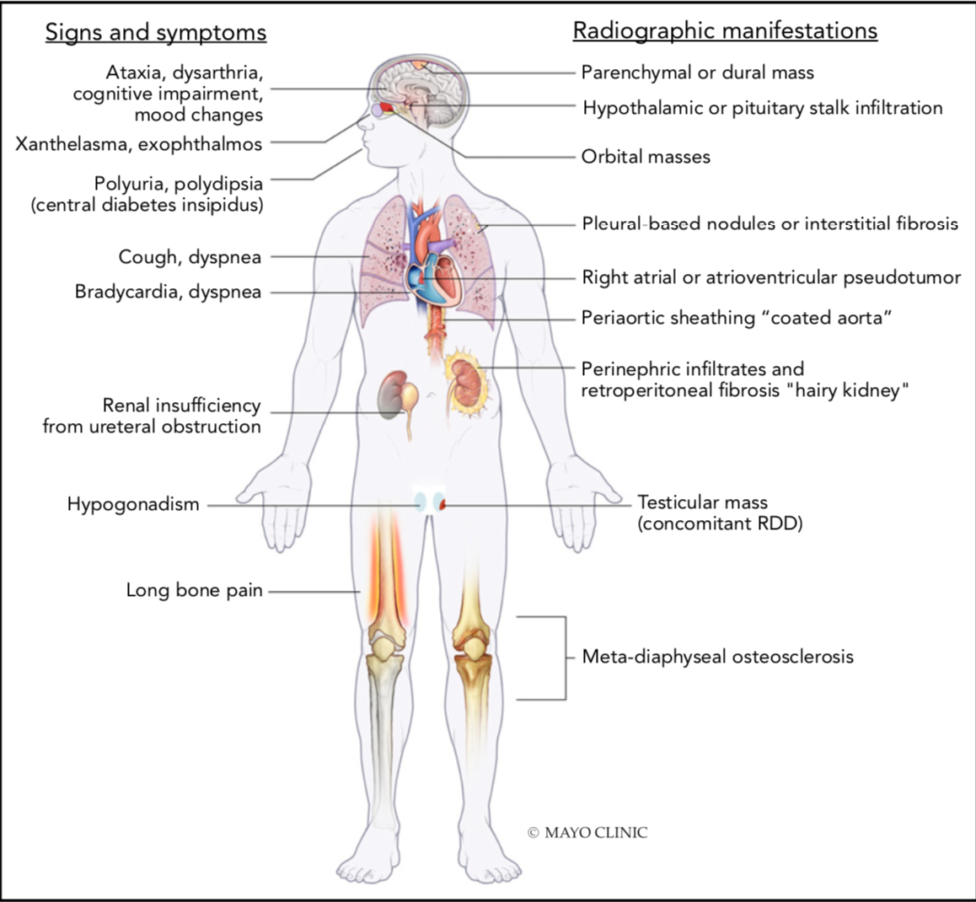
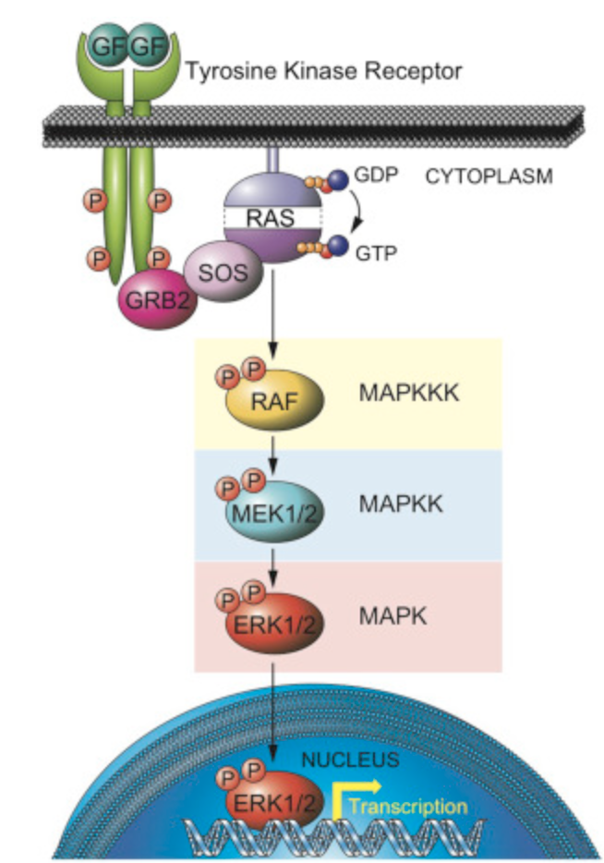
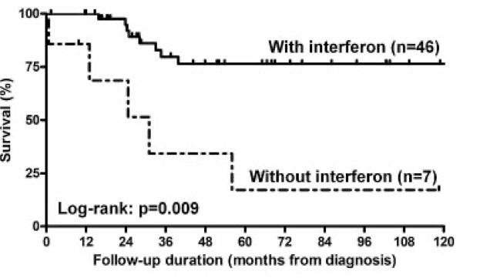
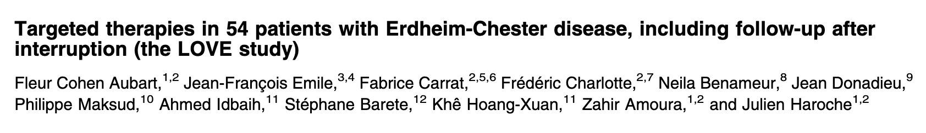
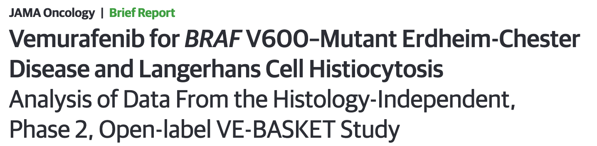
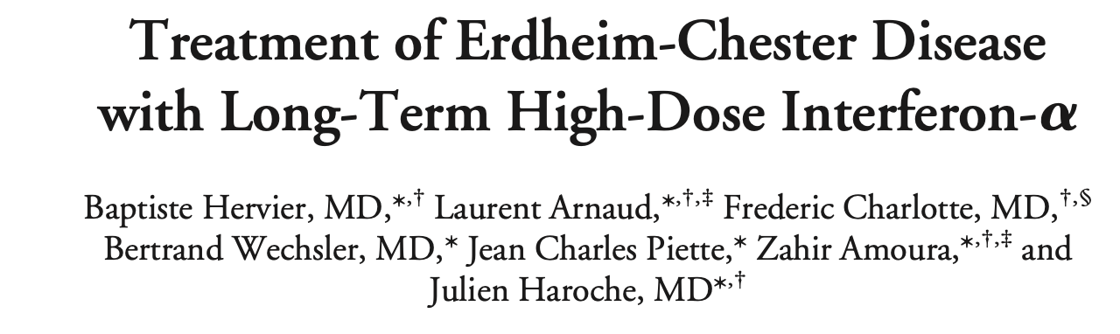

Background
Erdheim Chester is a rare clonal histiocytosis
Systemic involvement
Frequent BRAF^{V600E} mutation
Kinase inhibitors (BRAF_{i} or MEK_{i}) are efficacious
Interferon-alpha (IFN-α) is effective in ECD patients¹
and patients with myeloid neoplasms (MPN).
Evaluate the efficacy of IFN-α and identify the predictors of response in large cohort of:
ECD (n=300)
MPN (n=77)

Slide 3
Result in ECD cohort (n=300)
Median age 57, Men 87%, BRAF^{V600E:} 67%
Overall response (CR, PR, and SD) : 83% (249/300) with mostly SD (n=222)
Characteristics | Interferon Responder (n=249) | Interferon Non-Responders (n=51) | P – value
Age at ECD diagnosis median IQR | 59 [48-67] | 54 [42-61] | 0.0189*
Sex (women) n (%) | 28 (11%) | 10 (19%) | 0.0262*
Age at first ECD manifestation | 56 [44-64] | 51 [37-59] | 0.0231*
Clinical characteristic
Lone bone osteosclerosis | 208 (83.5%) | 46 (90.2%) | 0.2890
Long bone lytic lesions | 19 (7.6%) | 5 (9.8%) | 0.7774
Central nervous system | 69 (27.7%) | 21 (41.2%) | 0.0655
Neurodegenerative lesions | 29 (11.6%) | 14 (27.5%) | 0.0054**
ENT lesions | 110 (44.2%) | 15 (29.4%) | 0.0613
Heart lesions | 103 (41.4%) | 16 (31.4%) | 0.1187
Right atrium lesion | 76 (30.5%) | 8 (15.7%) | 0.0391*
Large vessels | 150 (60.2%) | 28 (54.9%) | 0.5324
Lung interstitial/pleura | 67 (26.9%) | 12 (23.5%) | 0.7280
Lung nodule/cyst | 5 (2.0%) | 0 (0.0%) | 0.5928
Peri-renal and adrenal | 162 (65.1%) | 32 (62.7%) | 0.8724
skin | 75 (30.1%) | 16 (31.4%) | 0.8682
Hypothalamic lesions | 71 (28.5%) | 22 (43.1%) | 0.0472*
Mixed LCH | 26 (10.4%) | 6 (11.8%) | 0.8037
Mixed RDD | 10 (4.0%) | 1 (2.0%) | 0.6970
testis | 13 (5.2%) | 0 (0.0%) | 0.2260
Lymph node | 19 (7.6%) | 9 (17.6%) | 0.0342*
Digestive lesions | 20 (8.0%) | 9 (17.6%) | 0.0412*
Number of involved site | 4 [3-6] | 4 [3-6] | 0.6429
Widespread disease | 168 (67.5%) | 33 (64.7%) | 0.7446
Elevated CRP at diagnosis | 177 (71%) | 24 (47%) | 0.1551
Characteristics | Interferon Responder (n=249) | Interferon Non-Responders (n=51) | P – value
BRAF mutation | 165 (66.3%) | 36 (70.6%) | 0.7021
MAP2 K1 mutation | 22 (8.8%) | 1 (2.0%) | 0.1433
Other mutation | 13 (5.2%) | 0 (0.0%) | 0.4995
Myeloid neoplasm | 40 (16.1%) | 6 (11.8%) | 0.5269
Solid cancer | 39 (15.7%) | 5 (9.8%) | 0.3844
Bone marrow mutation when NGS performed ( SMP and CH) | 77 (30.9%) | 9 (17.6%) | 0.0171*
CH when NGS performed | 52/112 | 7/27 | 0,08
Number of bones mutation median [IQR] | 1 [1-2] | 1 [0-1] | 0.0045**

Slide 4
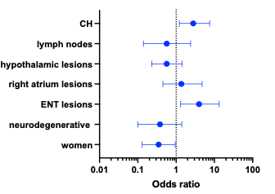
Result in ECD cohort (n=300)
Machine learning analysis
Random Forrest | Gradient boosting
0.22 | 0.25
0.02 | 0.005
0.13 | 0.094
0.04 | 0.02
0.095 | 0.08
0.023 | 0.05
0.139 | 0.20
 | Multivariable |  | Machine learning analyses
 | OR (95% CI) | p-value | Random Forrest | Gradient boosting
Female sex | 0.3589 (0.1339 – 0. 9562) | 0.0406 | 0.139 | 0.20
Neurodegenerative lesions | 0.3877 (0.1080 – 1. 431) | 0.1506 | 0.023 | 0.05
ENT lesions | 3.985 (1.391 – 13.39) | 0.0089 | 0.095 | 0.08
Right atrium lesions | 1.377 (0.4553 – 4. 774) | 0.5816 | 0.04 | 0.02
Hypothalamic lesions | 0.5785 (0.2327 – 1. 456) | 0.2415 | 0.13 | 0.094
Lymph nodes | 0.5729 (0.1477 –2.481) | 0.4391 | 0.02 | 0.005
Clonal hematopoiesis | 2.809 (1.122 – 7. 588) | 0.0270 | 0.22 | 0.25
Clonal hematopoiesis (OR: 2.8) +++ in machine learning
ENT lesions (OR: 3.9)
Women sex (OR: 0.35)

Slide 5
Result in ECD with first line INF-α (n=255)
Overall response (CR, PR, and SD) : 88% (225/255) with mostly SD (n=200)
Characteristics | Responders (n=225) | Non-responders (n=30) | P value
Age at ECD diagnosis median IQR | 59[49-68] | 54.5[44.7-61] | 0.0500*
Sex (women) n (%) | 9 (4.0%) | 6 (20.0%) | 0.2798
Age at first ECD manifestation | 56[43-664] | 51.5[39.75-56.25] | 0.1162
Clinical characteristic
Lone bone osteosclerosis | 185 (82.2%) | 28 (93.3%) | 0.1895
Long bone lytic lesions | 15 (6.7%) | 2 (6.7%) | >0,999
Central nervous system | 59 (26.2%) | 11 (36.7%) | 0.2776
Neurodegenerative lesions | 27 (12.0%) | 7 (23.3%) | 0.1478
ENT lesions | 93 (41.3%) | 10 (33.3%) | 0.4331
Heart lesions | 91 (40.4%) | 7 (23.3%) | 0.0741
Right atrium lesion | 69 (30.7%) | 6 (20.0%) | 0.3912
Large vessels | 136 (60.4%) | 16 (53.3%) | 0.4335
Lung interstitial/pleura | 57 (25.3%) | 5 (16.7%) | 0.3690
Lung nodule/cyst | 5 (2.2%) | 0 (0.0%) | 0.6376
Peri-renal and adrenal | 145 (64.4%) | 16 (53.3%) | 0.2292
skin | 68 (30.2%) | 11 (36.7%) | 0.5312
Hypothalamic lesions | 65 (30.2%) | 12 (40.0%) | 0.2905
Mixed LCH | 23 (10.2%) | 2 (6.7%) | 0.7502
Mixed RDD | 7 (3.1%) | 0 (0.0%) | 0.6138
testis | 12 (5.3%) | 0 (0.0%) | 0.3801
Lymph node | 16 (7.1%) | 6 (20.0%) | 0.0976
Digestive lesions | 19 (8.4%) | 4 (13.3%) | 0.4890
Number of involved site | 4[3-6] | 4[2.7-6.2] | 0.8993
Widespread disease | 150 (67.3%) | 17 (56.7%) | 0.3048
Elevated CRP at diagnosis | 185 (82.2%) | 11 (36.7%) | 0.0448*
BRAF mutation | 146 (64.9%) | 19 (63.3%) | 0.9584
MAP2 K1 mutation | 18 (8.0%) | 1 (3.3%) | 0.4992
Other mutation | 9 (4.0%) | 4 (13.3%) | 0.0870
Myeloid neoplasm | 42 (18.7%) | 2 (6.7%) | 0.1891
Solid cancer | 38 (16.9%) | 3 (10.0%) | 0.5897
CH when NGS performed | 73 (32.7%) | 5 (16.7%) | 0.1220
Number of bones mutation median [IQR] | 1[1-2] | 0[0-1] | 0.0013**

Slide 6
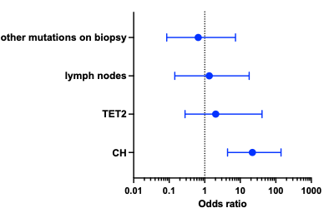
Result in ECD with first line INF-α (n=255)
Machine learning analysis
Random Forrest | Gradient Boosting
0.07 | 0.06
0.070 | 0.01
0.034 | 0.01
0.616 | 0.746
 | Multivariable |  | Machine learning
 | OR (95% CI) | p-value | Random Forrest | Gradient Boosting
Lymph nodes | 1.346[0.1440-17.78] | 0.8045 | 0.070 | 0.01
Clonal hematopoiesis | 21.90[4.390-140] | 0.0001*** | 0.616 | 0.746
TET2 | 2.036[0.2793-41.08] | 0.5118 | 0.034 | 0.01
Other mutations on biopsies (not BRAF or MAP2K1) | 0.6561[0.0855-7.342] | 0.7086 | 0.07 | 0.06
presence of CH (OR:21) +++ in machine learning

Slide 7
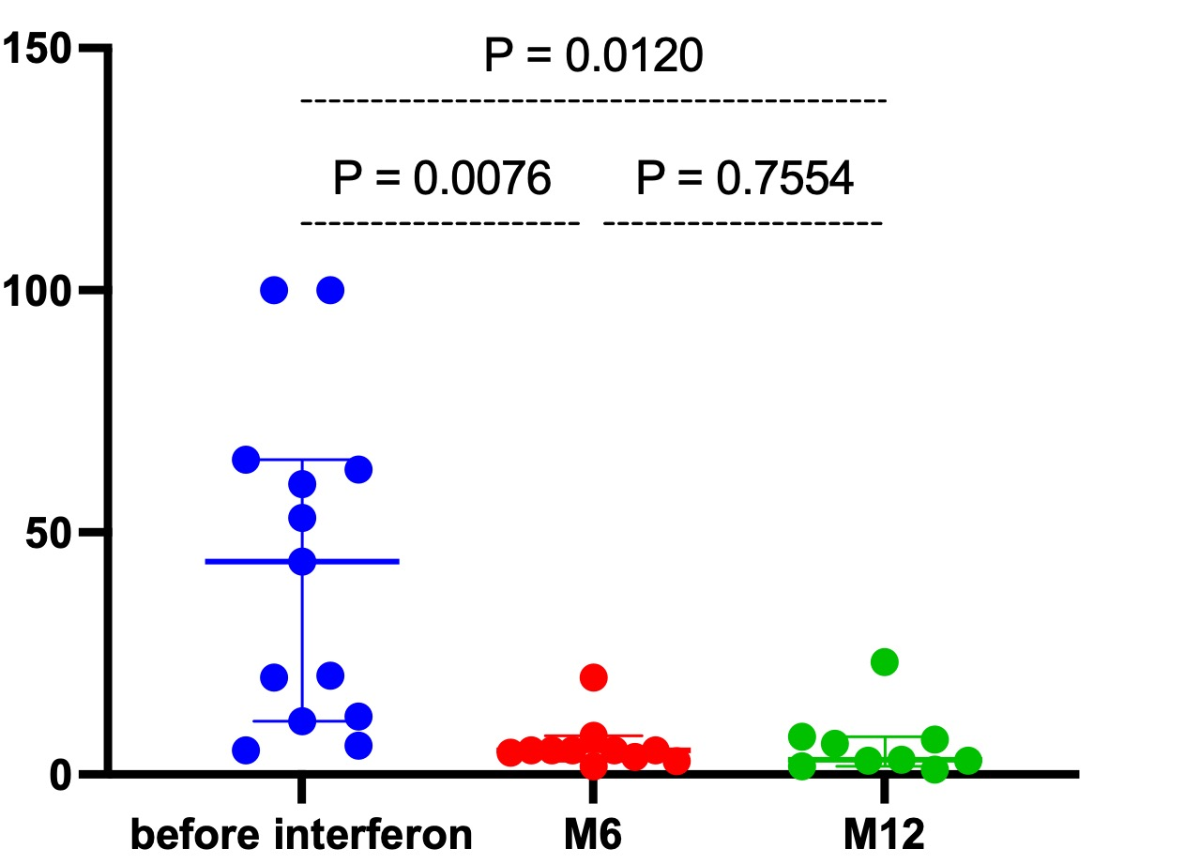
Response in patients with bone marrow mutations (n=85)
Patients with clonal hematopoiesis (n=59)
TET2 : n= 27
DNMT3A: n=15
ASXL1: n= 9
ORR: 88% and 93 % in first line recipient ( n=45)
Patients with hematological malignancy (n=26)
Mostly myeloid neoplasm (MDS: n=9, ET: n= 6, CMML: n= 5)
ORR: 88% and one patient with hemopathy worsening
Patients with identified bone marrow mutations ( CH and HM)
141 mutations identified range [1-4]
ORR: 89%
ORR: 96 % in patients with two mutations (n=27)
ORR: 87% in patients with three mutations (n=8)
ORR: 86 % on patients with one mutation (n=45)
ORR: 80% in patients with four mutations (n=5)

Slide 8
MPN(n=77) and pooled cohort (n=377)
MPN cohort (n=77)
CML: n=48
PV: n=11
ET: n=10
PMF: n=7
Systemic mastocytosis: n=1
  ORR: 79%
  First line treatment : OR:3.328
ECD and MPN cohort (n=377)
  ORR: 82%
  Predictors of response (after imputation model):
  CH: OR: 1.94
  First line treatment OR: 1.90

Slide 9
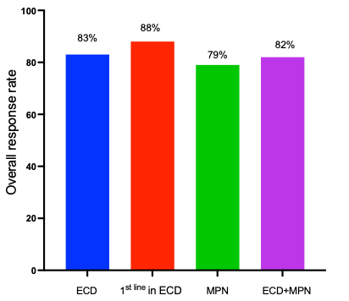
Overall response of IFN-α (>80%)
PR+CR+SD

Slide 10
Discussion
Large multicenter study evaluating interferon in ECD
High response rate
Factor associated with response with machine Learning
CH as a robust predictor of response
Absence of mechanistic experiments
Inclusion of SD patients into response rate
Absence of comparison with KI
Further directions:
Larger MPN cohort
Direct comparison with KI

Slide 11
Conclusion
IFN-α is effective in ECD and MPN (overall response rate>80%)
Clonal hematopoiesis independently predicts response in ECD
CH status could help to guide treatment decision

Slide 12
Acknowledgements
French histiocytosis network:
Julien Haroche
Fleur Cohen-Aubart
Matthias Papo
Felicien Triboulet
Jean-Francois Emile
Zahir Amoura
Firenze histiocytosis network:
Francesco Pegoraro
Augusto Vaglio
Francesco Poeta
Memorial Sloan Kettering Cancer Center:
Dana Bossert
Eli Diamond

