Slide 1





Distribution of MAP2K1 variants across peripheral blood cells in Erdheim-Chester Disease and other histiocytoses
ECDGA meeting, Birmingham, USA, 2026
Irena Ungureanu, MD
Pathology Department, Ambroise-Paré Hospital, Boulogne-Billancourt, France
Versailles Saint-Quentin-en-Yvelines University
Doctoral School of Paris-Saclay University, Paris, France

Slide 2
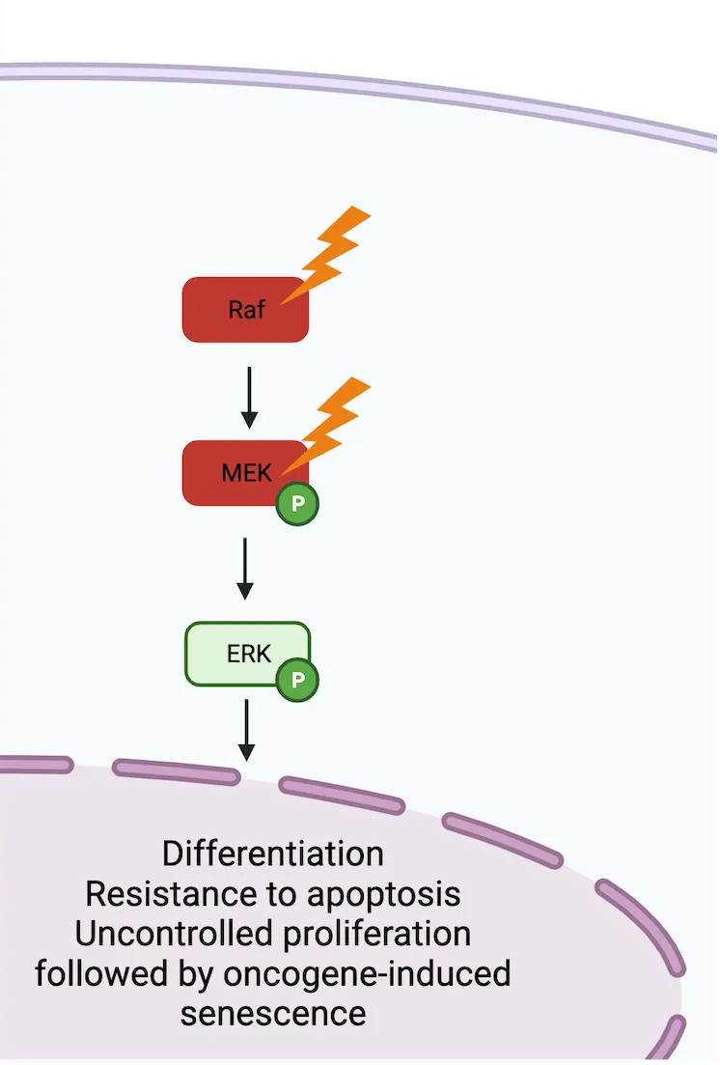
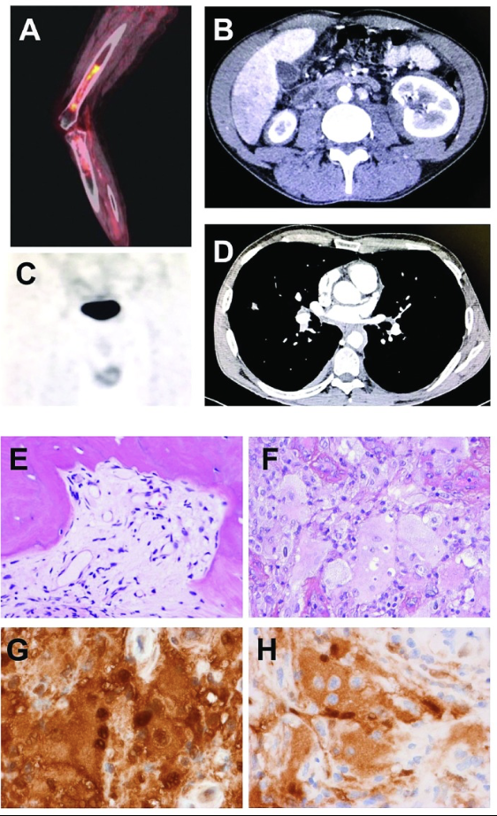
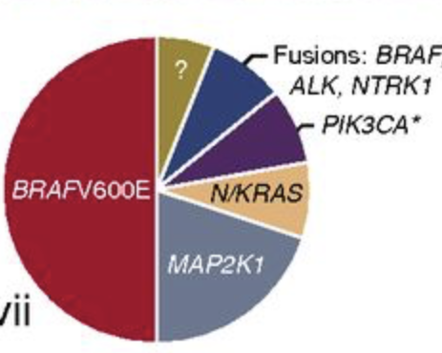
MAP2K1 mutations in histiocytoses
Histiocytoses - clonal proliferations with activation of MAPkinase pathway
MAP2K1 gene - second most frequently mutated in Erdheim-Chester disease and Langerhans-cell histiocytosis
The most frequent in Rosai-Dorfman disease
Phenotype overlaps with BRAFV600E
Typically lack associated neurodegeneration
BRAFV600E
MAP2K1
overlapping cases of ECD-RDD
Emile JF Blood 2016
Sconocchia Front. Immunol, 2023
Razanamahery et al. 2020 Hematologica
Notes:
RAS/RAF/MEK/ERK signaling pathway. Under homeostatic conditions the RAS/RAF/MEK/ERK is activated through the binding of extracellular ligands (i.e. hormones, growth factors, and cytokines) to receptor tyrosine kinases (RTKs) leading to dimerization and phosphorylation. In turn, this leads to the induction of the active form RAS-GTP, which leads to a downstream cascade that is characterized by the activation through phosphorylation of Raf, MEK, and ERK. Activated ERK can then trigger the transcription of numerous genes involved in the growth, proliferation, and survival of the cell. In the presence of activating mutations of Raf (i.e. BRAF^{V600E}) or MEK (MAP2K1 mutations), this pathway becomes constitutively active independent of the ligand-receptor interaction. Constitutive activation of the pathway can consequently lead to oncogenesis through induced cell differentiation, resistance to apoptosis, and oncogene-induced senescence.

Slide 3
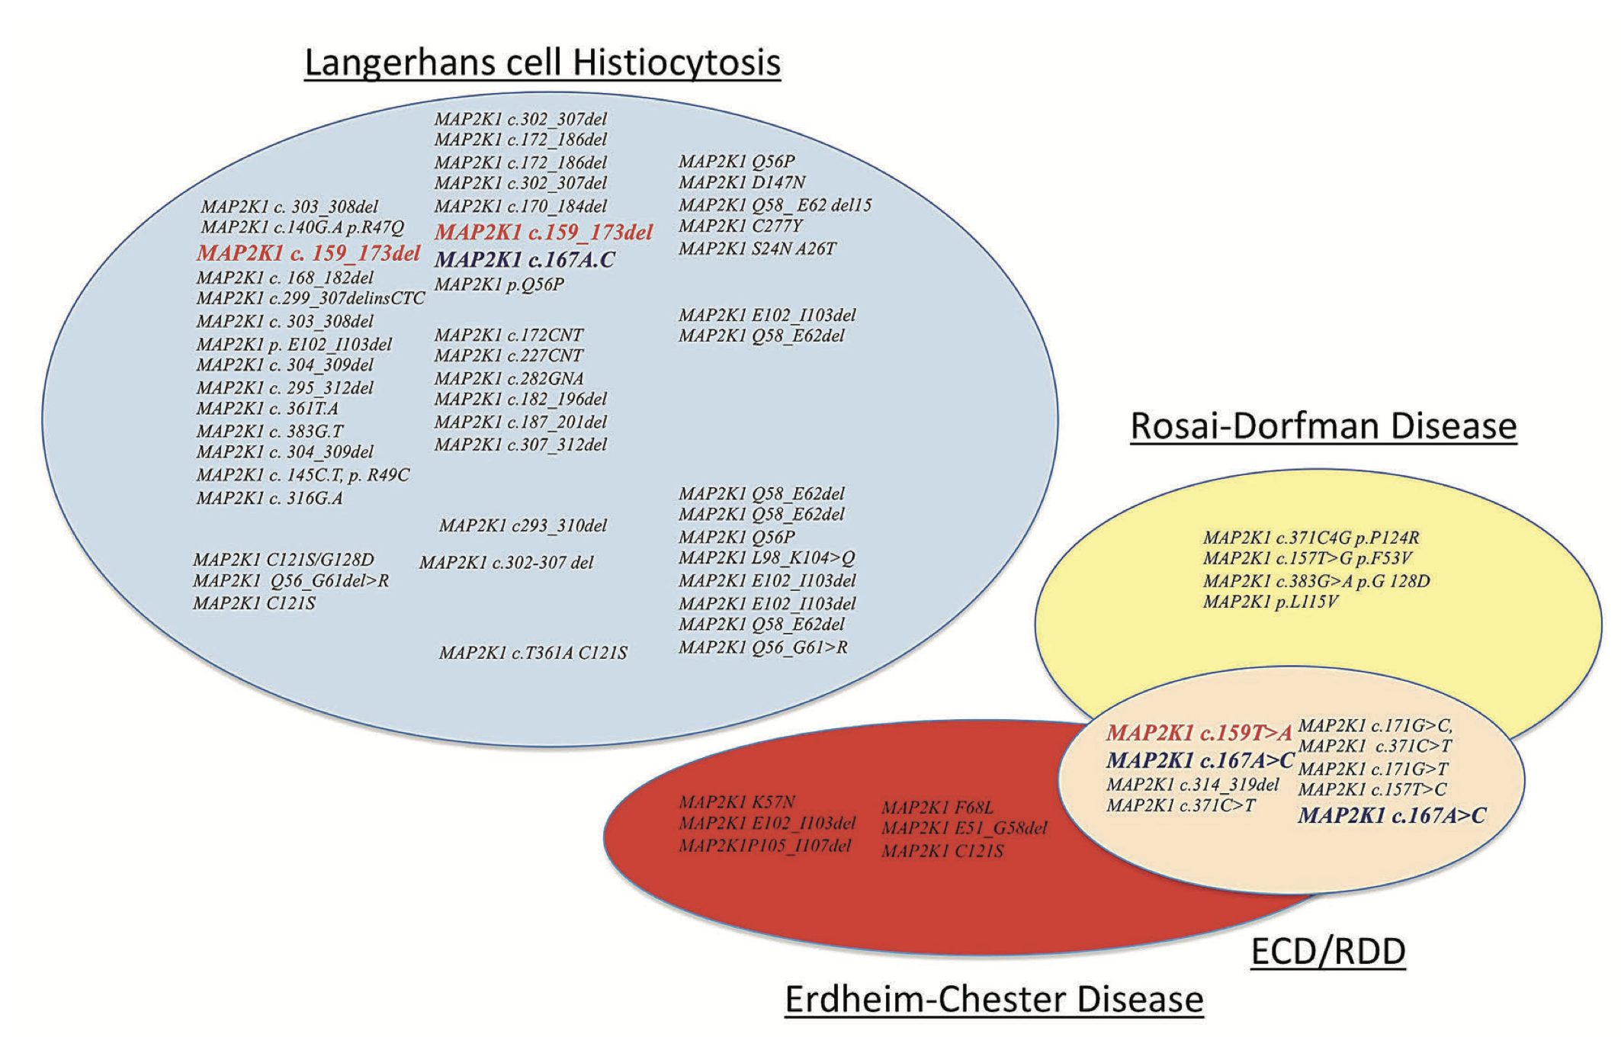
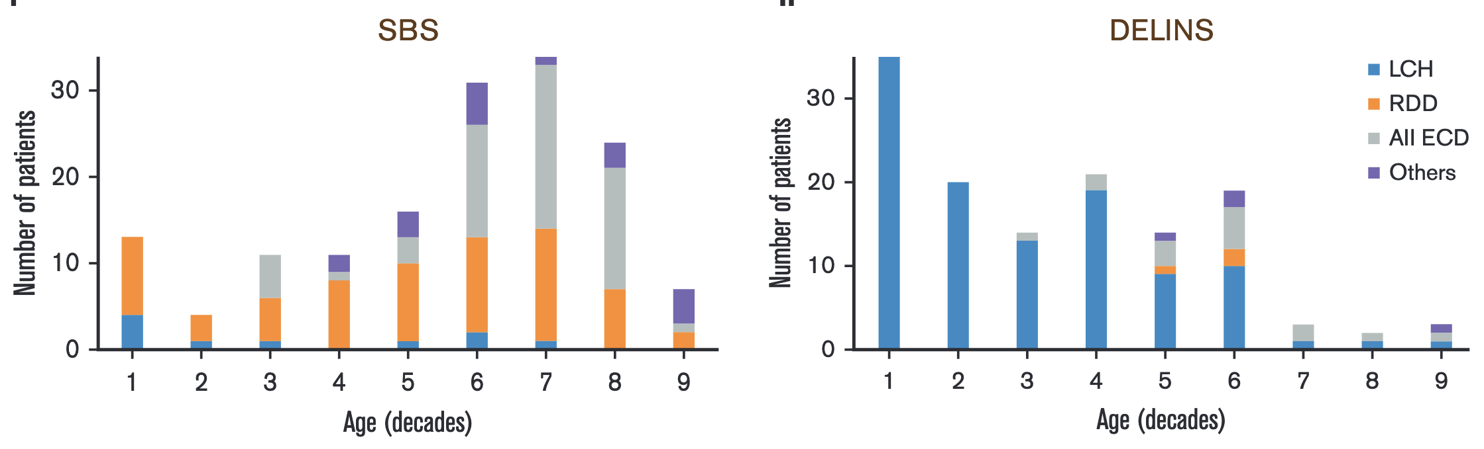
MAP2K1 mutations in histiocytoses
Any age, any localisation, any type of histiocytosis
MAP2K1 - over 60 variants found in histiocytoses
→ Single base substitutions associated with ECD & RDD
→ Delins associated with LCH
Emile JF et al. Blood Adv 2023
Razanamahery et al. 2020 Hematologica
Notes:
RAS/RAF/MEK/ERK signaling pathway. Under homeostatic conditions the RAS/RAF/MEK/ERK is activated through the binding of extracellular ligands (i.e. hormones, growth factors, and cytokines) to receptor tyrosine kinases (RTKs) leading to dimerization and phosphorylation. In turn, this leads to the induction of the active form RAS-GTP, which leads to a downstream cascade that is characterized by the activation through phosphorylation of Raf, MEK, and ERK. Activated ERK can then trigger the transcription of numerous genes involved in the growth, proliferation, and survival of the cell. In the presence of activating mutations of Raf (i.e. BRAF^{V600E}) or MEK (MAP2K1 mutations), this pathway becomes constitutively active independent of the ligand-receptor interaction. Constitutive activation of the pathway can consequently lead to oncogenesis through induced cell differentiation, resistance to apoptosis, and oncogene-induced senescence.

Slide 4
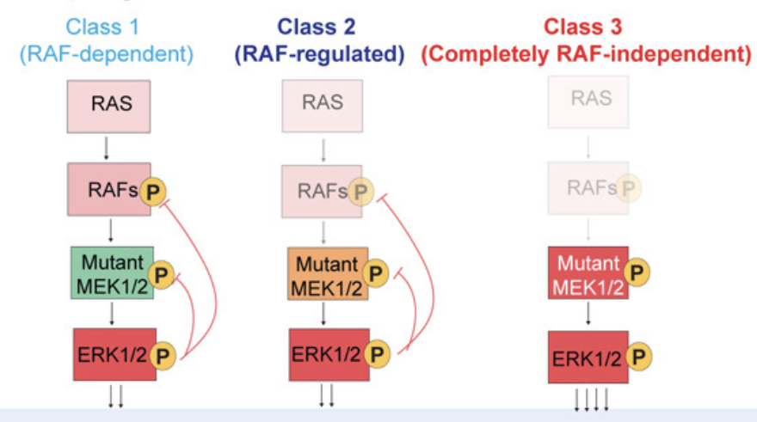
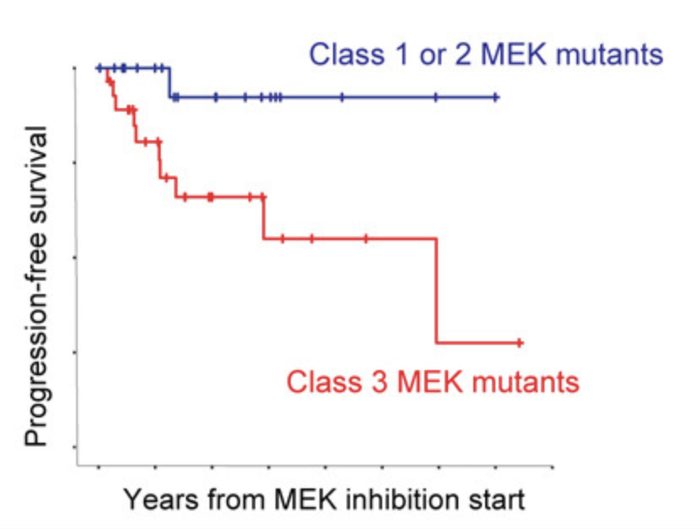
Functional classes of MAP2K1 mutations
3 classes first described by Gao et al. in 2018.
Class I – RAF-dependent
Low ERK output and weak transforming activity
Often co-exists with other ERK-activating mutations
Class II – Partially RAF- regulated
Class III – Completely RAF- independent
Constitutively active → high ERK output
Strong transforming potential
Unresponsive to current MEK inhibitors
Responsive to ERK inhibitors (Diamond Cancer Cell 2026)
All three classes are found in histiocytoses.
Diamond et al. Cancer Cell 2026
Notes:
Class I – RAF-dependent
Requires RAF activation
Low ERK output and weak transforming activity
Often co-exists with other ERK-activating mutations
Class II – Partially RAF-independent
Baseline activity without RAF
Further activated by RAF-mediated phosphorylation
Frequently (but not always) co-mutated with others
Class III – RAF- independent
Independent of RAF and phosphorylation
Constitutively active → high ERK output
Strong transforming potential
Unresponsive to current MEK inhibitors in vitro

Slide 5
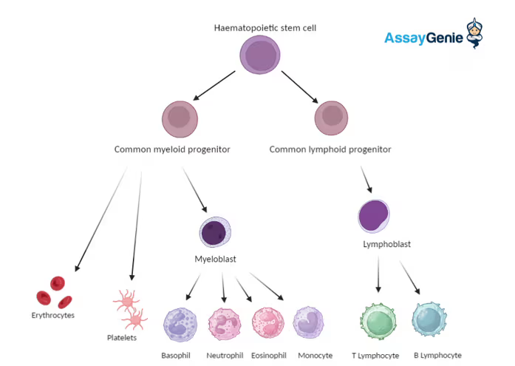
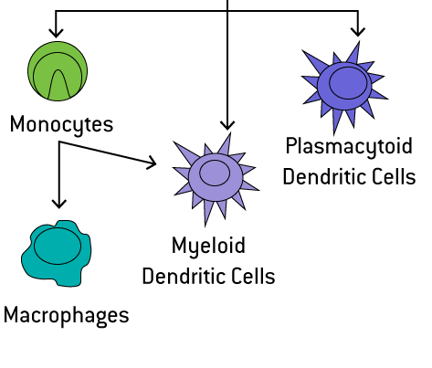
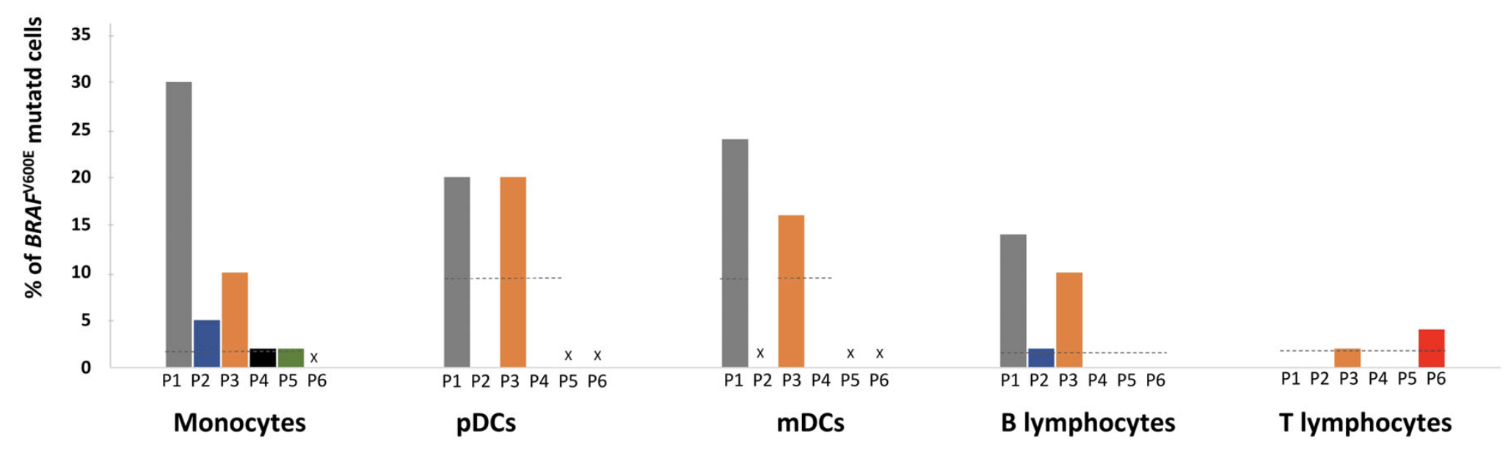
BRAF^{V600E} in hematopoietic progenitors and PBMCs
BRAF^{V600E} - detectable in circulating hematopoietic cells and bone marrow-based progenitors in adults with ECD and LCH (Durham et al. Blood 2017)
In LCH - BRAF^{V600E} mutation burden in PBMCs correlates with clinical risk (Milne et al. Blood adv 2020), switch to T lineage after long treatment with MEKi.
In Erdheim Chester Disease - BRAF^{V600E} detected in myeloid
and lymphoid cells
Hematopoietic stem cells
Common myeloid progenitor
Common lymphoid progenitor
T lymphocytes
B lymphocytes
tissue biopsies
BRAF^{V600E} in LCH patients (Poch et al. Bjh 2021)

Slide 6
Are MAP2K1 mutations detectable in peripheral blood in histiocytoses ?

Slide 7
Objectives of the study
To investigate the distribution of MAP2K1 mutations in circulating blood cell populations in patients with histiocytosis
To correlate the detection with treatment and disease activity
To improve understanding of disease ontogeny in histiocytoses with MAP2K1 mutation

Slide 8
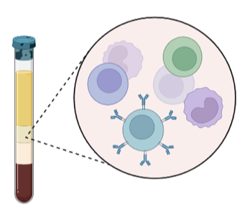
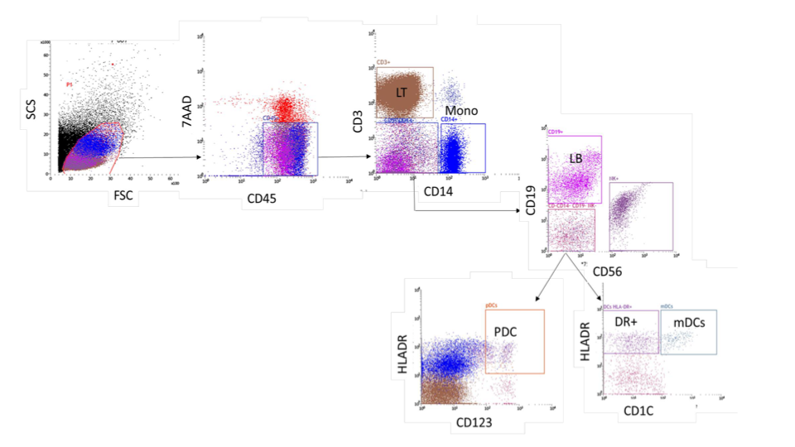
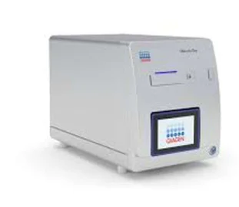
Methods
Study cohort (n = 34):
Patients with MAP2K1 mutation confirmed on the biopsy
Distribution of diseases:
19 Erdheim-Chester disease (pure/ mixed)
11 Langerhans cell histiocytosis
3 Rosai-Dorfman disease
1 L group histiocytosis
median age=58 yo.
Internal Medicine Department, Pitié - Salpêtrière Hospital, Paris
Pediatric Hemato-Oncology Department, Trousseau Hospital, Paris
FACS - sorted cell populations:
PBMC collection
plasma separation
Blood cell populations:
Monocytes CD14+
Myeloid dendritic cells CD1c+
Plasmacytoid dendritic cells CD123+
T lymphocytes CD3+
B lymphocytes CD19+
digital PCR testing for MAP2K1 variants

Slide 9
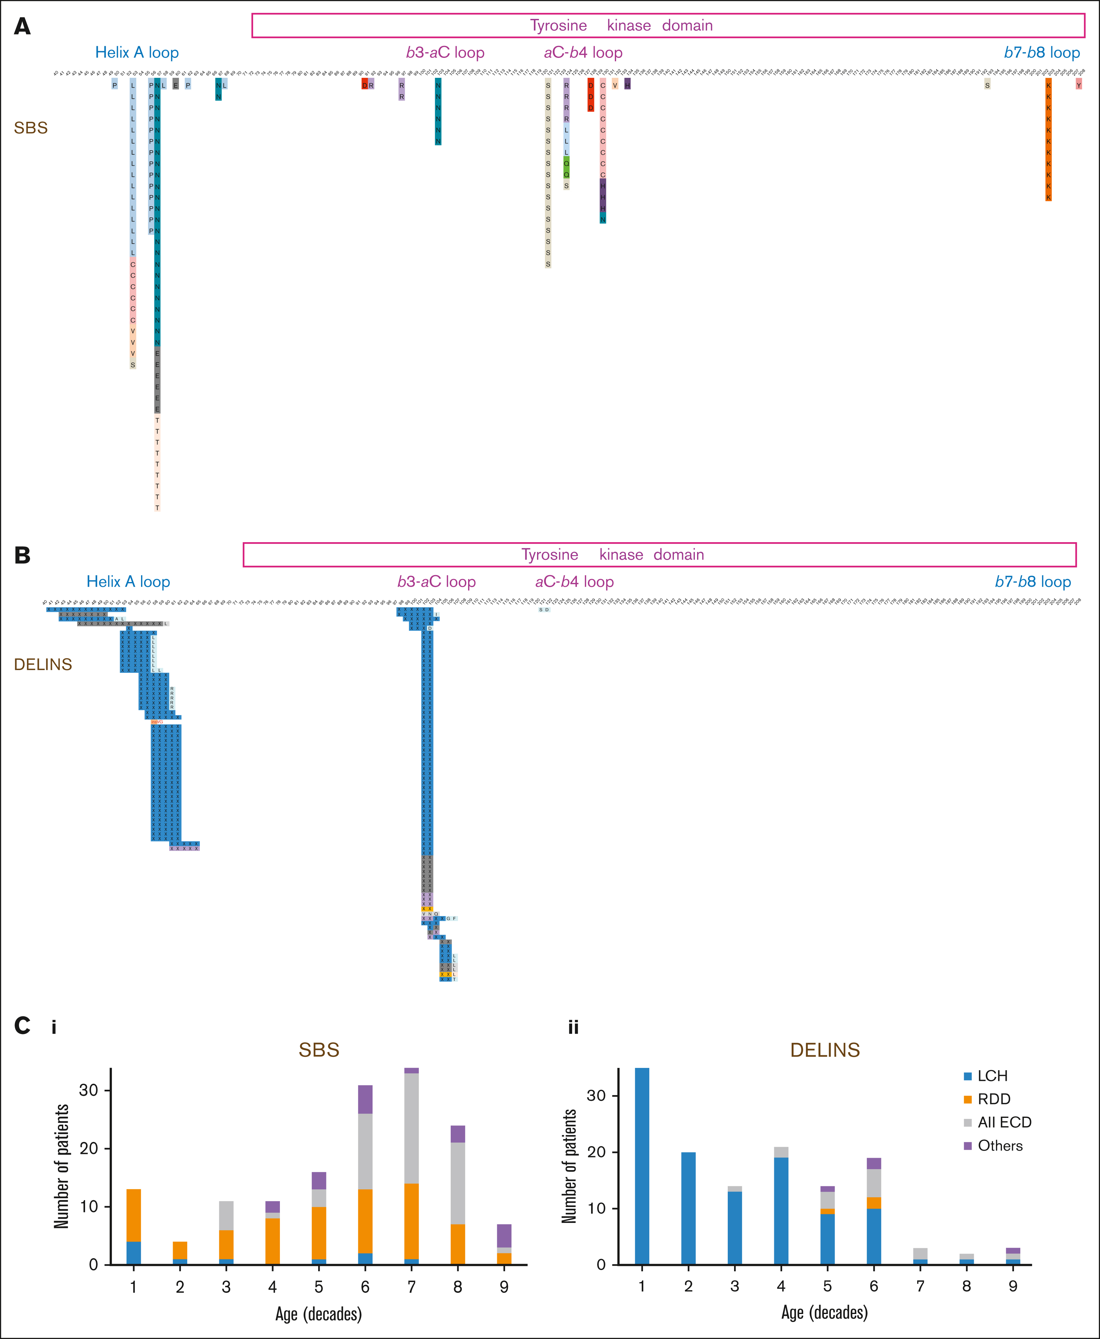
Detection of MAP2K1 variants by digital PCR
c.157T>C
c.308T>A
c.371C>G
c.167A>C
c.171G>C
c.371C>T
c.607G>A
c.171G>T
c.361T>A/ c.362G>C
Available probes in the Pathology Department of Ambroise-Paré Hospital:
Panel targeting 20 MAP2K1 variants
Covering ~ 80% of histiocytoses
High-sensitivity detection
Detection of very low VAFs - LOD ~ 0.01%
c.169A>G
c.170A>C
single base substitutions ~ Erdheim-Chester disease &
Rosai-Dorfman disease
c.120_158del
c.159_173del
c.165_179del
c.167_181del
c.302_307del
c.173_187del
c.172_186del
c.305_308delinsTGAA
c.314_318del
deletions-insertions ~ Langerhans-cell histiocytosis
Emile et al. Blood Adv. 2023

Slide 10
RESULTS
Detection of MAP2K1 in PBMCs by disease group and risk organ involvement
Disease Group | Positive (≥1 PBMC subset) | Negative
Erdheim-Chester disease (n=19) | 13 (68%) | 6 (32%)
Langerhans cell histiocytosis (n=10) | 1 (10%) | 10 (90%)
Rosai-Dorfman disease (n=3) | 0 | 3
L group (n=1) | 1 | 0
Total (n=34)
Detection across risk-organ involvement in ECD:
1
Total PBMC analysed = 48 (288 sorted samples)
MAP2K1 variants are detectable in PBMCs of most patients with ECD and rare or absent in LCH and RDD.
Detection in PBMCs was independent of risk organ involvement in ECD.
Notes:
LCH: MSRO+, MSRO- and SS.

Slide 11
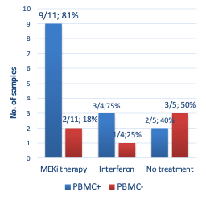
Detection of MAP2K1 variants according to treatment and disease activity
23 blood samples of Erdheim-Chester disease - correlated with disease activity.
MAP2K1 variants were detectable in PBMCs during clinical remission in at least one subset.
40 samples correlated with treatment
MAP2K1 variants are detectable in PBMCs despite MEK inhibitor or interferon treatment.

Slide 12
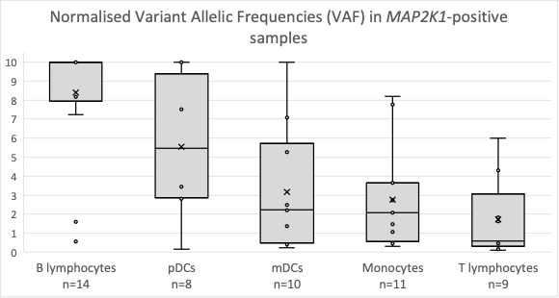
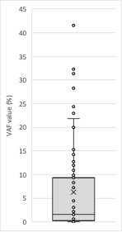
MAP2K1 detection in PBMC subsets and variant allelic frequencies
MAP2K1 mutations are detected in all populations.
B lymphocytes were the most frequently mutated population, followed by monocytes.
B lymphocytes showed the highest VAF values (range 0.2 - 41.5%).
VAFs : 0.1 - 41.5%
Median value = 1.6%

Slide 13
Detection of MAP2K1 variants by functional class
Patients included in the study:
Disease Group | Class 3 Variants* | Class 2 Variants* | not studied
Erdheim–Chester disease (ECD) | c.170A>C; c.303_308del | c.157T>C; c.167A>C; c.171G>C; c.361T>A; c.169A>G; c.171G>T
mixed ECD–RDD | c.303_308del | c.157T>C
mixed ECD–LCH | c.303_308del | —
Langerhans-cell histiocytosis | c.303_308del; c.167_181del; c.159_173del | c.173_187del | c.120_158del
Rosai-Dorfman disease |  | c.157T>C; c.371C>A; c.607G>A
L group | c.303_308del
PBMC detection is lower in class 3 compared to class 2 MAP2K1 (20% vs 50%, respectively).
classification according to Gao et al. 2018, Mizuno et al. 2023

Slide 14
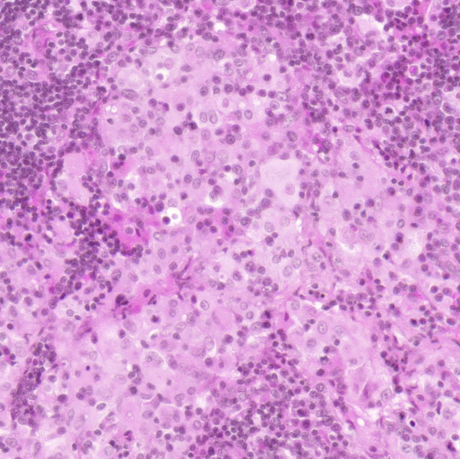
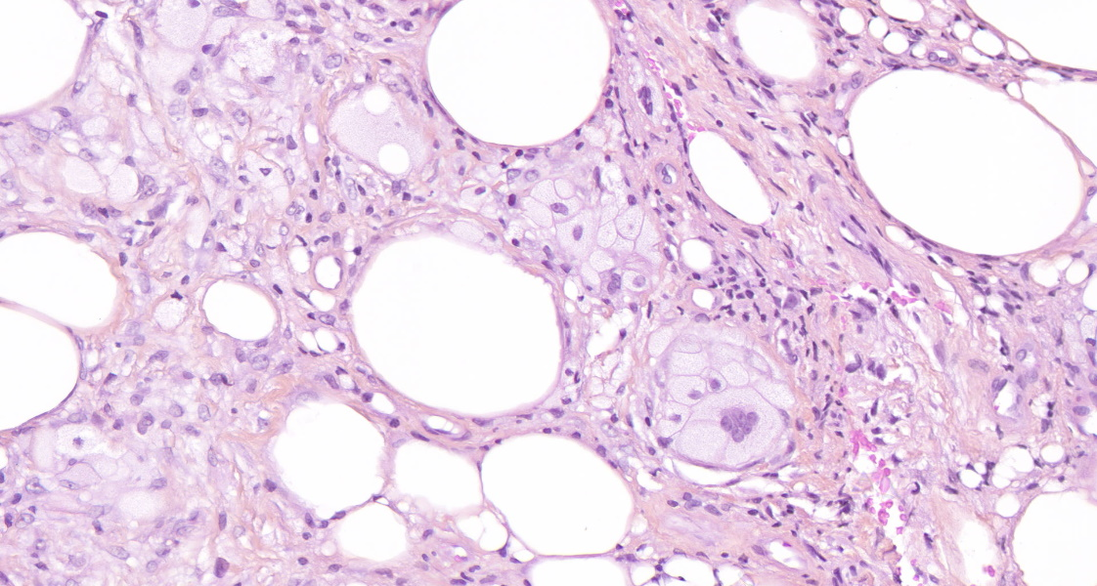
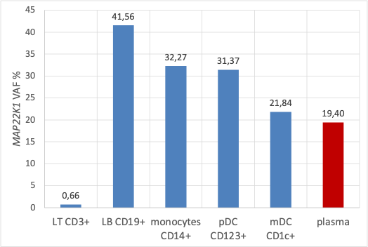
Example of a patient with mixed ECD-RDD and high VAFs of MAP2K1
Woman, 59 yo, mixed ECD-RDD
Skin, periaortic, pleural, lymph node, peri-renal and mesentery involvement
MAP2K1 c.157T>C, p.(Phe53Leu)
! Highest MAP2K1 VAFs in PBMCs and plasma
Lymph node: RDD histology
Skin biopsy: ECD histology
Blood sample - complete remission under Trametinib for 16 months
Pleural biopsy : VAF 22% (NGS)
VAF 19% (NGS)

Slide 15
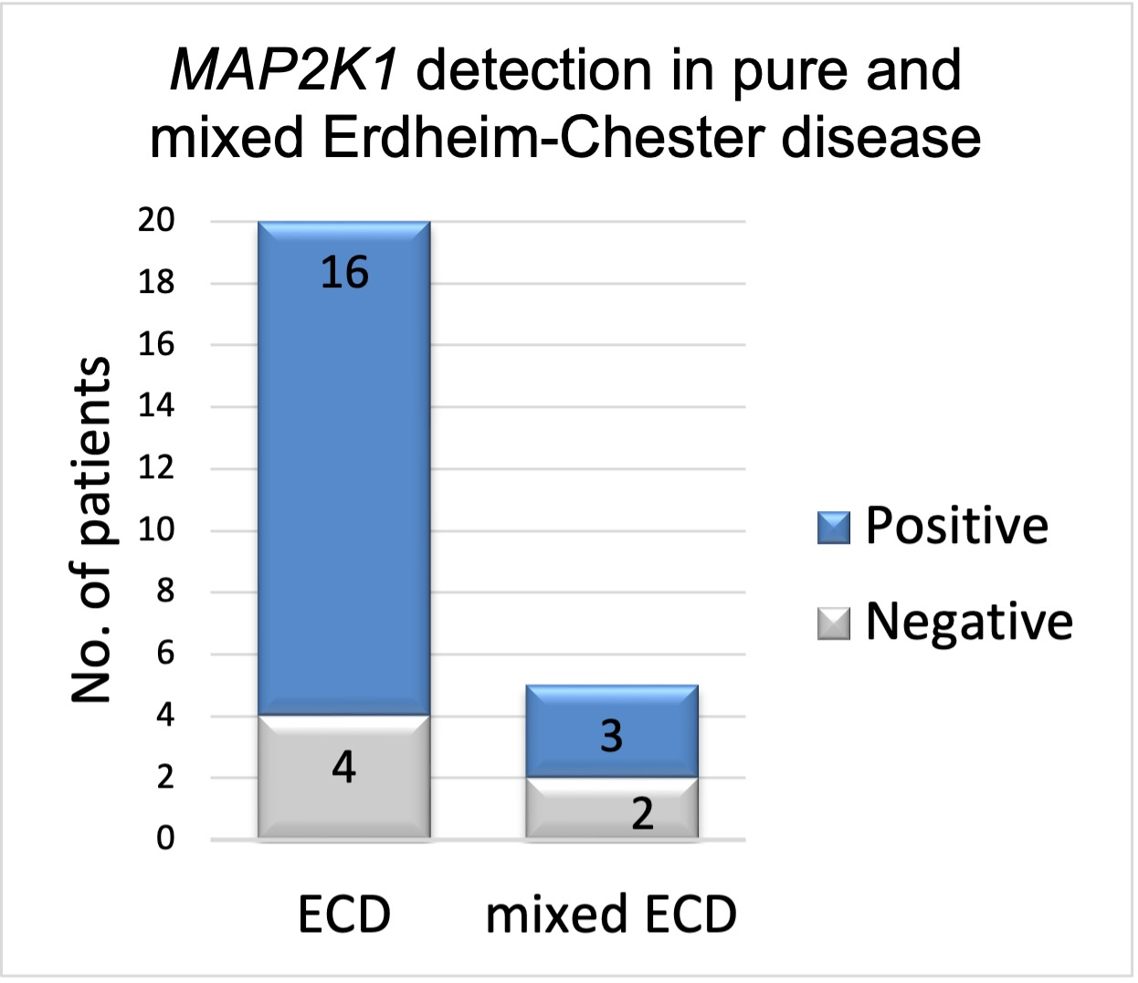
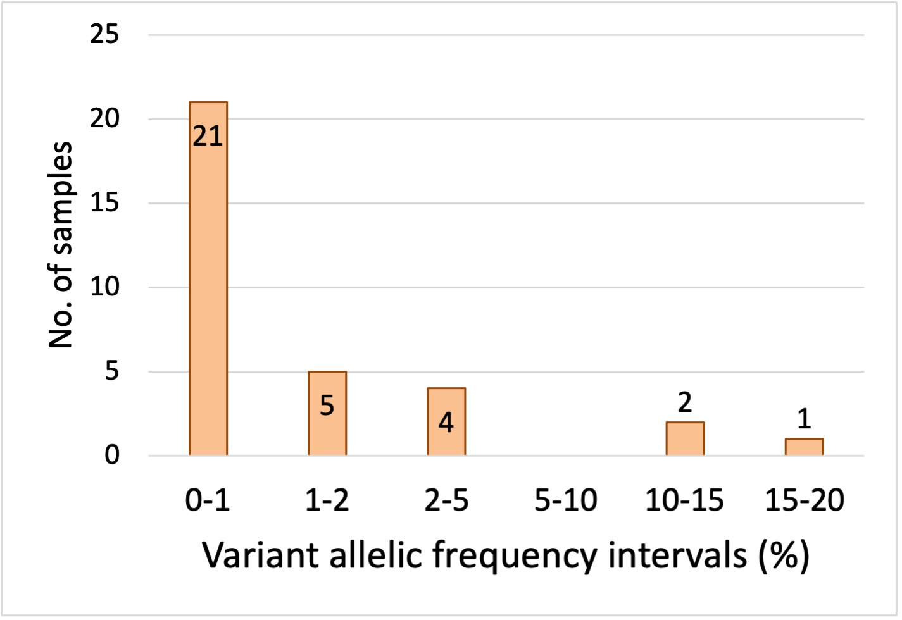
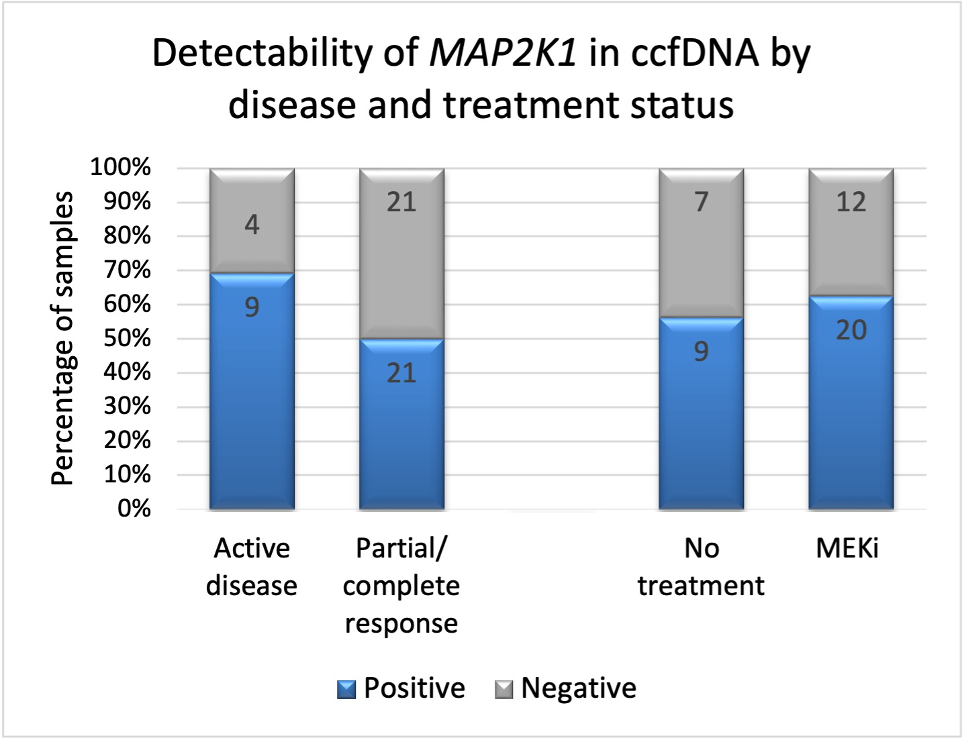
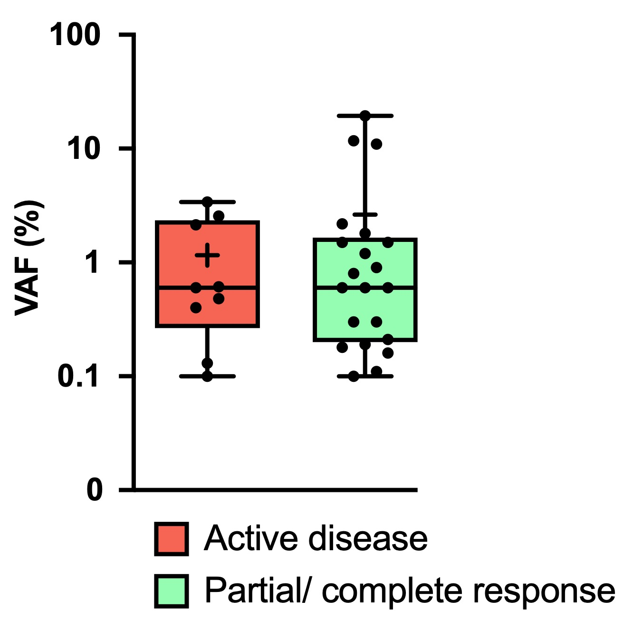
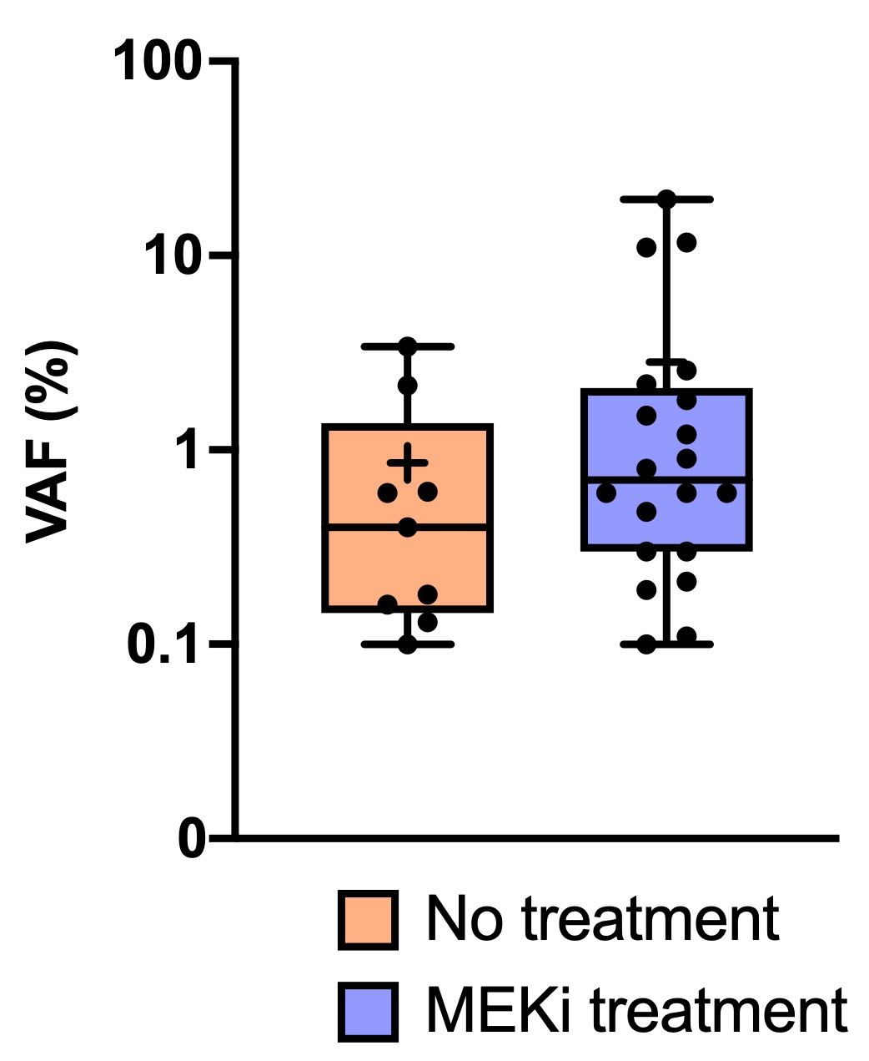
Detection of MAP2K1 in circulating cell-free DNA in Erdheim-Chester disease
25 patients tested
19/25 were positive at least once during disease course.
Detection in ccfDNA persisted despite MEK inhibitor treatment or remission periods, with no difference in VAF values.
VAFs between 0 and 20% (median - 0,12%).

Slide 16
CONCLUSION
MAP2K1 mutations in ECD are detected in both lymphoid and myeloid subsets of PBMCs - common origin from early multipotent hematopoietic precursors
MAP2K1 - mutated clones in PBMC and ccfDNA during remission / under targeted therapy
Highest VAFs were observed in B lymphocytes, without clonal expansion

Slide 17


Thank you !
Internal Medicine team
Julien Haroche
Matthias Papo
Fleur Cohen-Aubart
Pediatric Team
Jean Donadieu
Sebastien Héritier
Solenne Le Louet
Hematology
Camille Bigenwald
Marzieh Nashvi
Florian Houdu
Pathology Team
Jean-François Emile
Zofia-Hélias Rodzewicz
Malik da Silva
Technicians:
Rim Ben Jannet
Nathalie Terrones
Yassin El Koulali
Mariama Bakari
Thamila Satour

