Slide 1

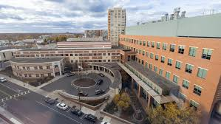
ARAF Mutations Drive Histiocytic Neoplasms In Vivo and Provide Insights Into Cellular Origins
Benjamin H. Durham, M.D.
Assistant Professor (Tenure-Track)
Department of Pediatrics
Division: Pediatric Hematology/Oncology Research
Department of Pathology and Laboratory Medicine
Division: Hematopathology/Molecular Pathology/Oncological Pathology
Robert Wood Johnson Medical School
Rutgers Cancer Institute
Rutgers, The State University of New Jersey
E-mail: bd559@cinj.rutgers.edu
11th International Erdheim-Chester Disease Medical Symposium
Birmingham, AL United States
Friday, May 1, 2026

Slide 2
Disclosures
Benjamin H. Durham, M.D. has no relevant financial conflicts of interest to disclose related to this presentation.

Slide 3
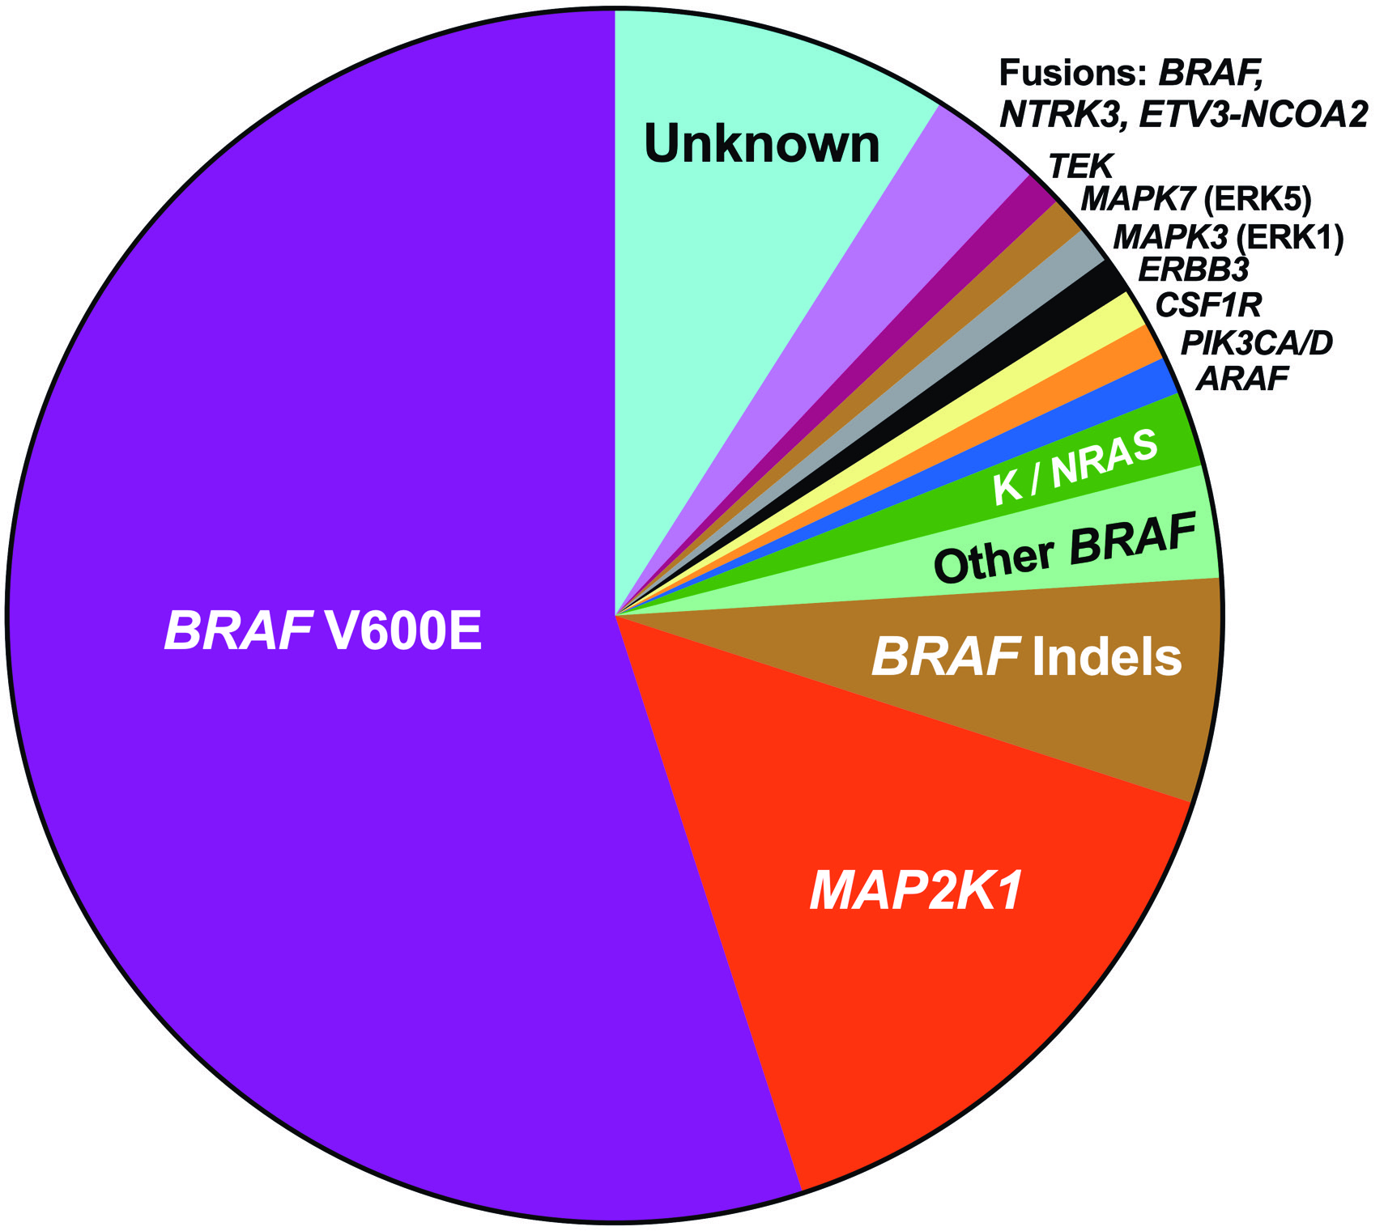
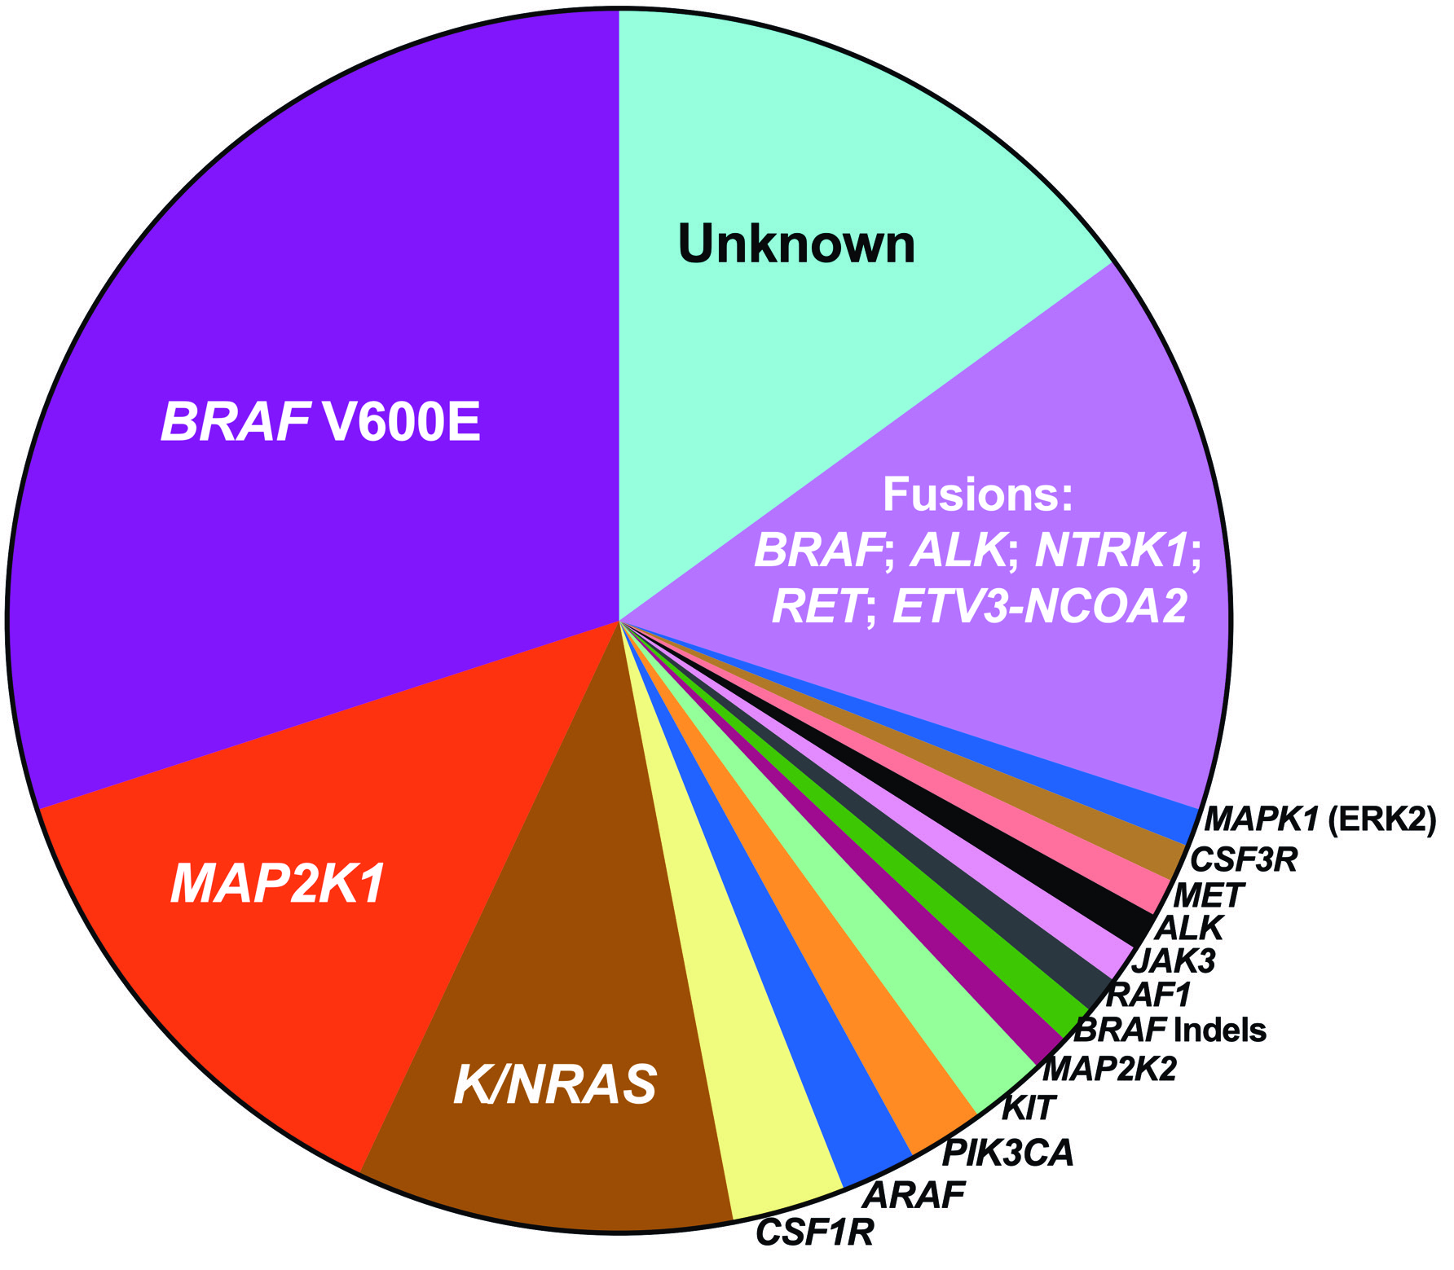

Kinase Alterations in the Histiocytoses as of 2026
Langerhans Cell HIstiocytosis
Non-Langerhans Cell HIstiocytoses
Durham, Lopez-Rodrigo, Picarsic, et al.
Nature Medicine 2019
Notes:
These pie charts show the rapid pace and evolution of the molecular discovery of diverse and potentially targetable driver kinase alterations in LCH and non-LCH histiocytoses (predominantly ECD of the “L” Group) over the past 10 years, which has solidified these disorders as clonal, myeloid neoplasms driven by MAP Kinase and PI3K-AKT signaling rather than non-neoplastic inflammatory disorders.

Slide 4
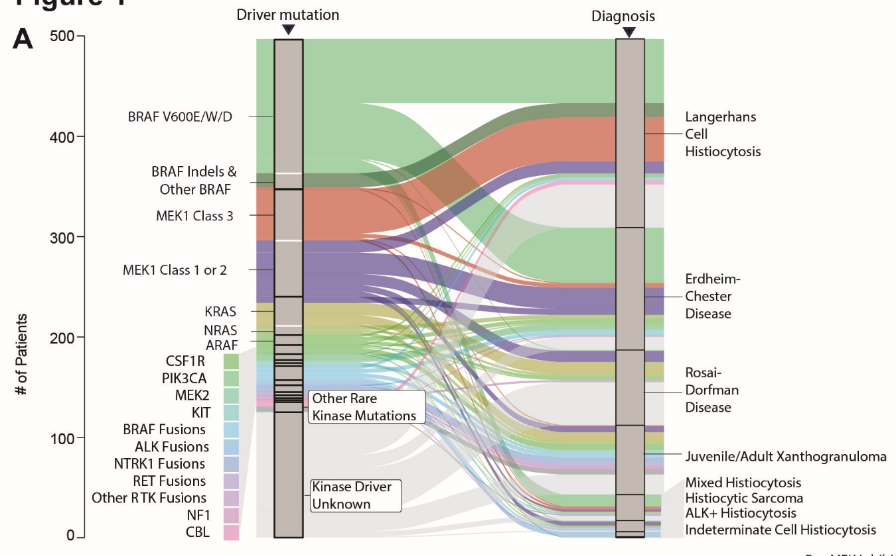
ARAF Mutations are Enriched in Histiocytic Neoplasms
N=500 patients
International collaborations and a prospective clinical registry of patients with histiocytic neoplasms (clinicaltrial.gov identifier NCT033292740.
Diamond, Emile, Fujino et al. Cancer Cell 2026.
Notes:
Aided by use of an international collaboration and a prospective clinical registry of patients with histiocytic neoplasms (clinicaltrial.gov identifier NCT03329274), this cohort included the largest group of patients treated with MEK1/2 inhibitors to date. Analyses of these patients revealed an enrichment of the MEK1^{E102_I103del} mutations in patients with progressive disease on cobimetinib.

Slide 5
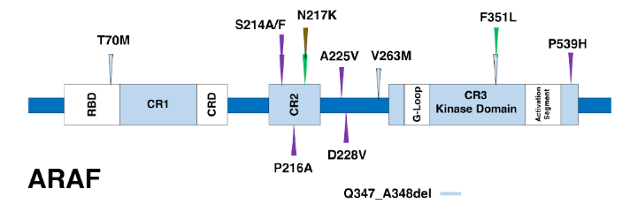
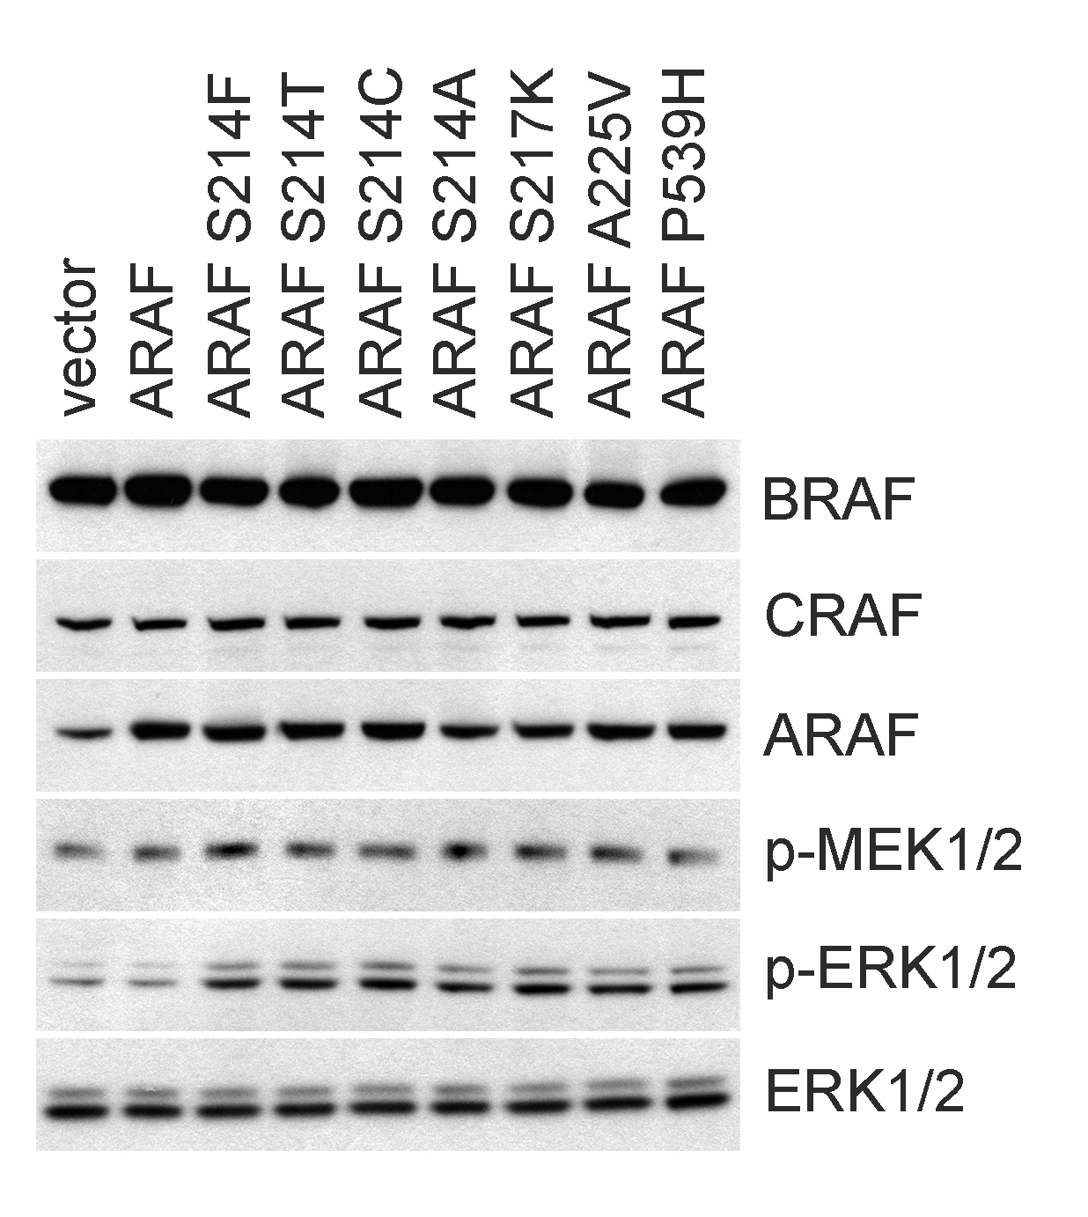
ARAF^{S214A} is Enriched, Activating, and Targetable in Histiocytic Neoplasms
ARAF^{S214A} –mutated ECD
Durham et al. Nat Med. 2019
Diamond, Durham, Haroche et al. Cancer Discovery 2016

Slide 6
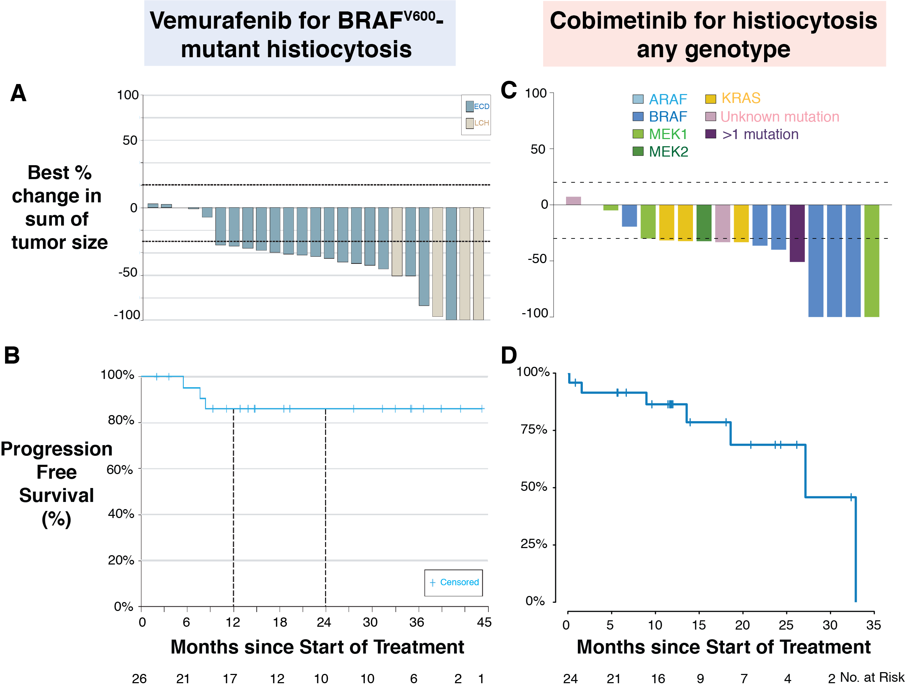
FDA-Approved Molecular Therapeutics for Histiocytic Neoplasms
Vemurafenib was FDA approved for the treatment of BRAF V600-mutated ECD in 2017.
FDA approved cobimetinib in the treatment of BRAF V600-wild type histiocytic neoplasms on 11/02/2022.
Hyman DM et al. N Engl J Med. 2015
Diamond et al. JAMA Oncol. 2018
Diamond, Durham et al. Nature 2019
Notes:
Although responses to cobimetinib amongst histiocytoses patients have been favorable, they have not recapitulated the consistently durable responses to BRAF inhibition. For example, in the phase II cobimetinib trial, ORR was 79% (by modified PERCIST criteria) and 53% (by RECIST criteria) while for vemurafenib, ORR was 100% and 61.5%, respectively. Additionally, clinical experience, as well as a modest but growing literature, reflects variable responsiveness and even instances of resistance to MEK1/2 inhibition²⁴⁻²⁶, the basis of which is currently unknown. Importantly, there are no FDA-approved therapies beyond vemurafenib or cobimetinib (for BRAF^{V600}-mutant or WT patients, respectively) if patients progress on one of these agents.

Slide 7
Research Questions
Can ARAF mutations drive histiocytosis development in vivo?
What disease phenotypes emerge when ARAF mutations are expressed at different stages of hematopoietic development (using Mx1-Cre and Cd11c-Cre promoters)?
What is the best therapeutic approach for ARAF^{S214A}-mutated histiocytoses?

Slide 8
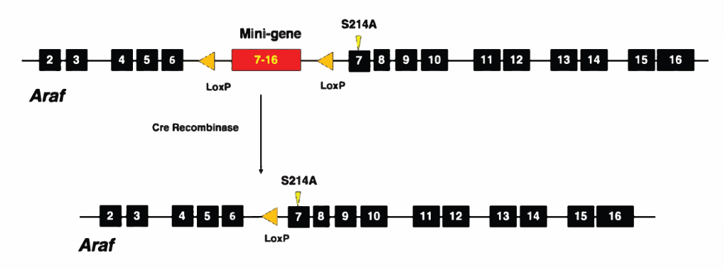
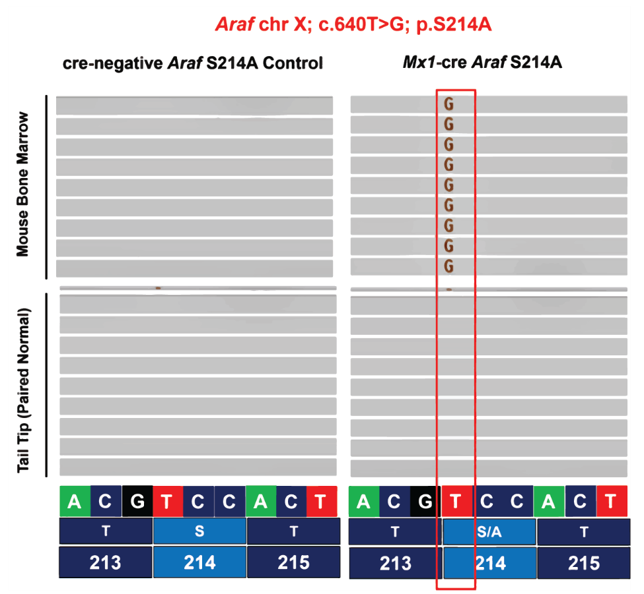
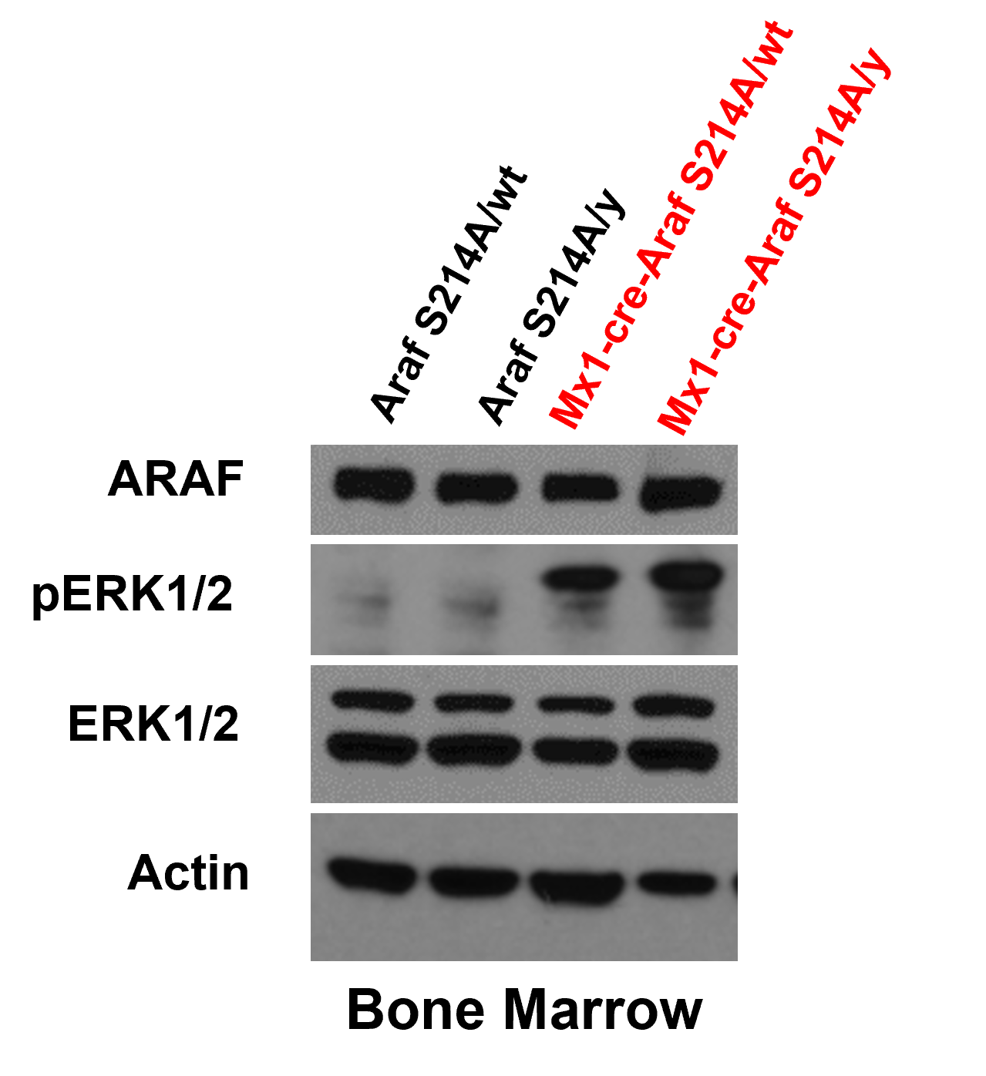
Araf exon7 p.S214A Present in Mx1-Cre Conditional Knock-in Mice by Next-Generation Sequencing

Slide 9
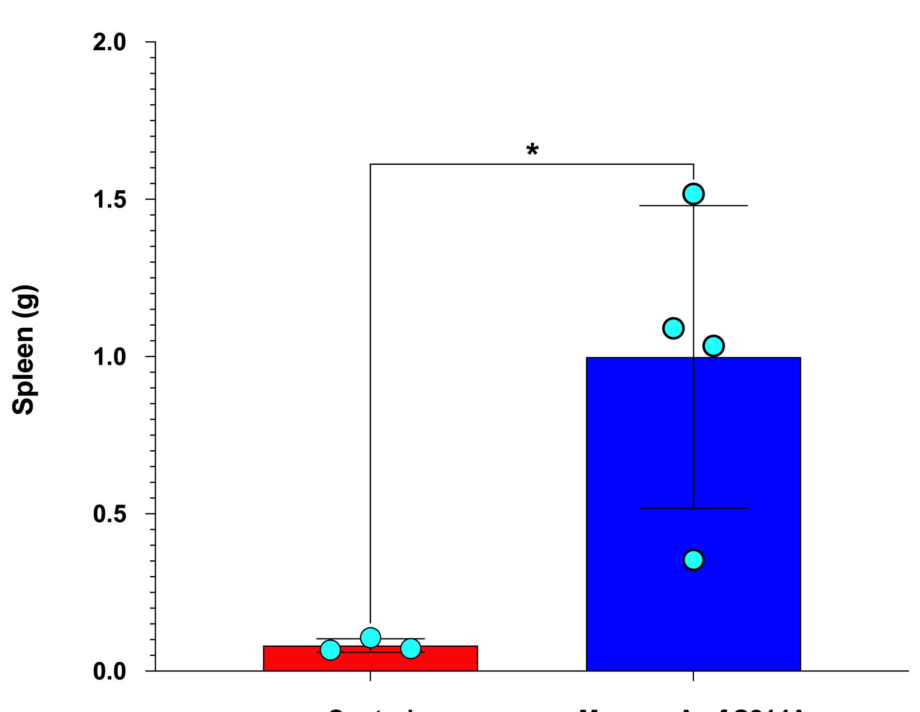

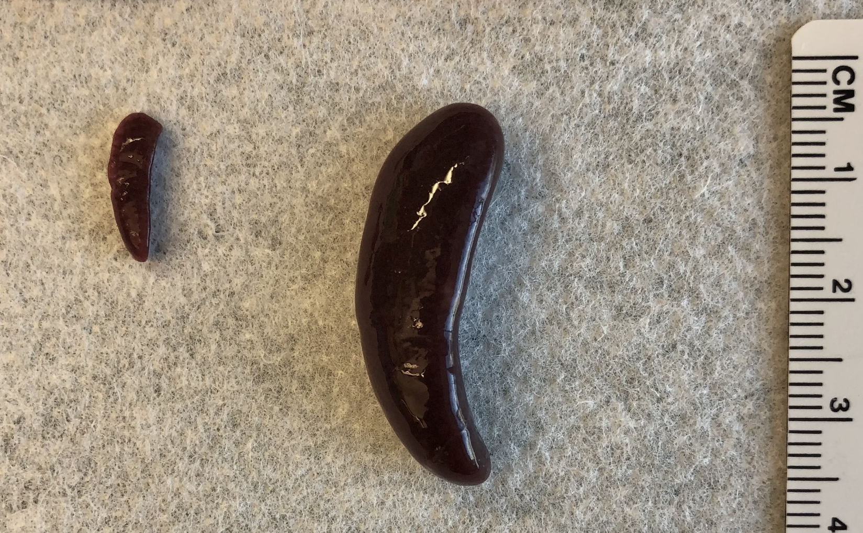
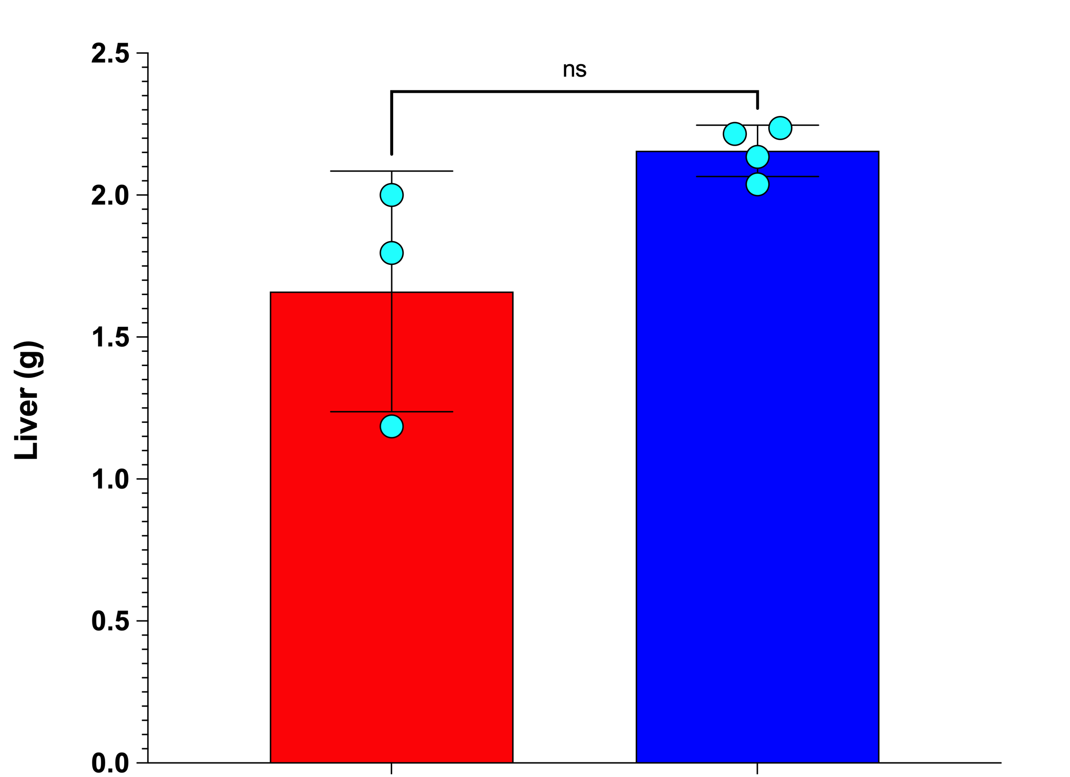
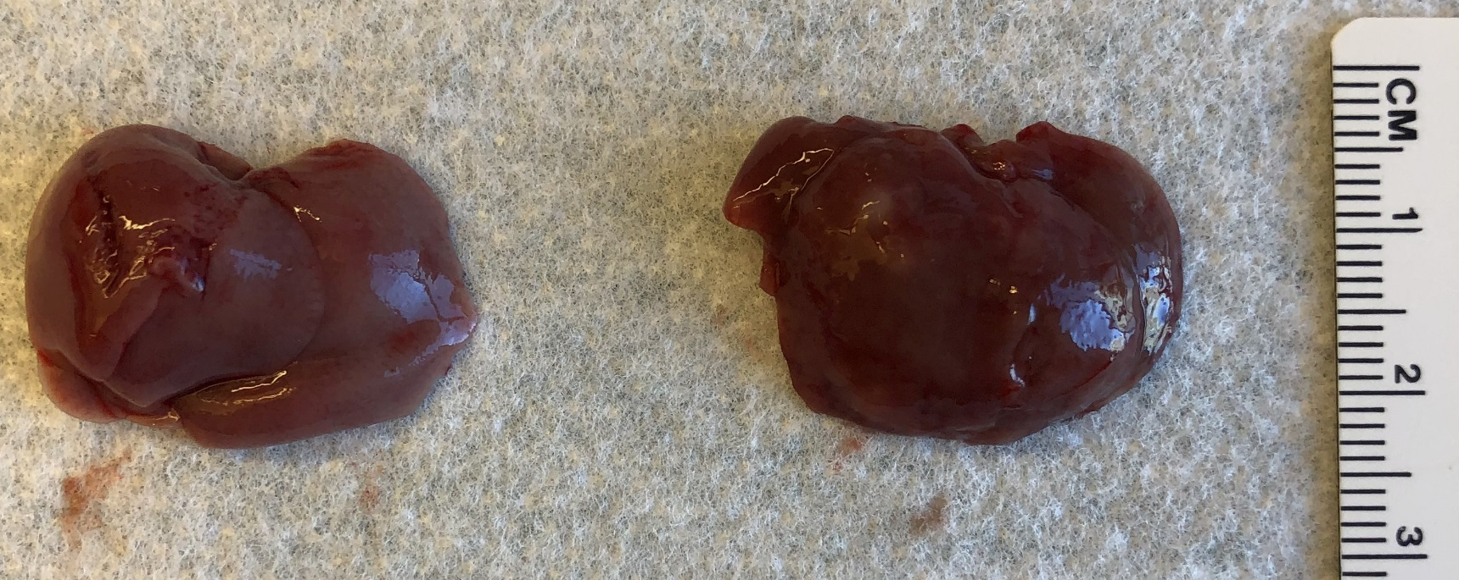
Mx1-Cre Araf S214A Survival Curves
Control
Mx1-Cre Araf^{S214A}
Control
Mx1-Cre
Araf^{S214A}
Control
Mx1-Cre Araf^{S214A}
Control
Mx1-Cre
Araf^{S214A}

Slide 10
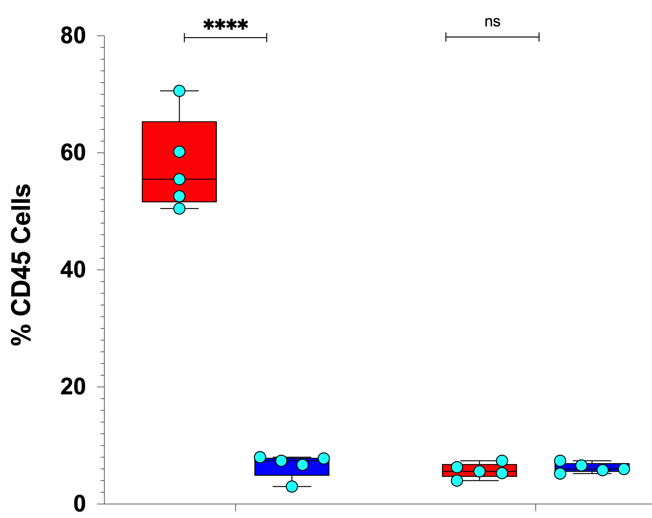
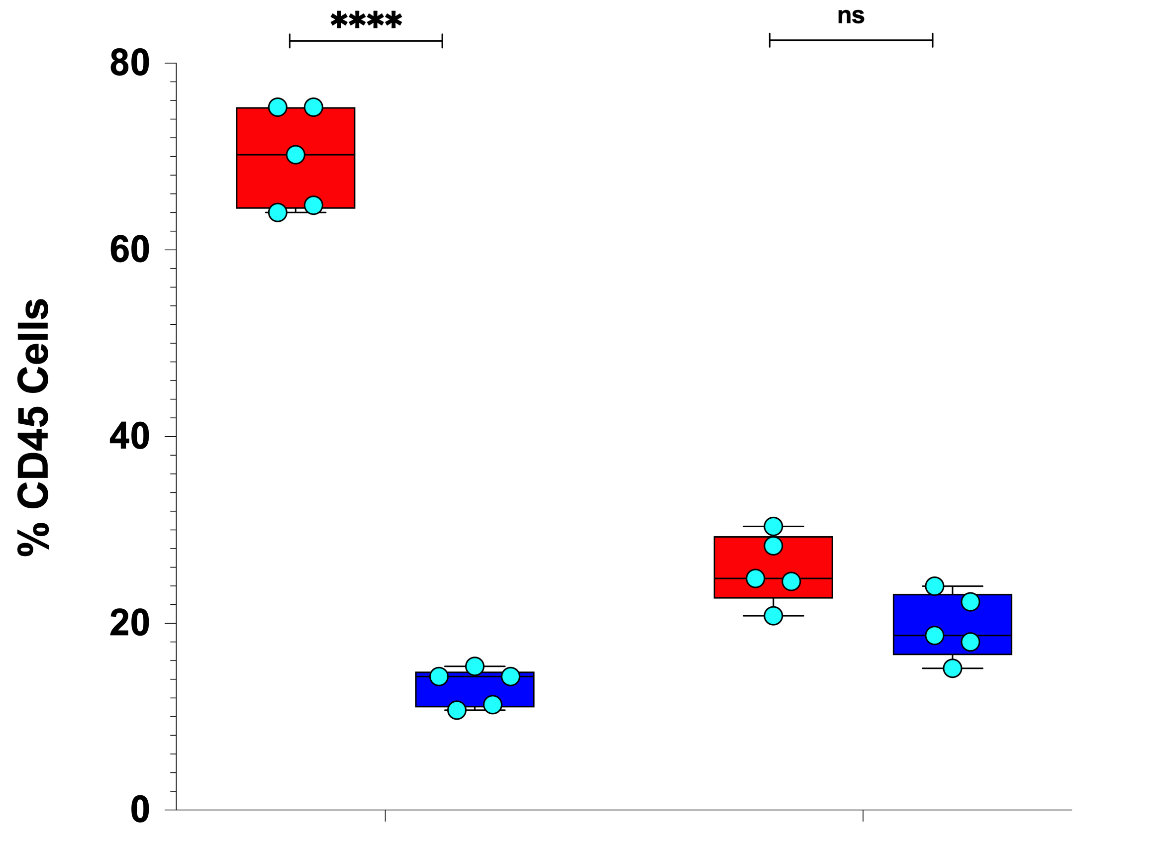
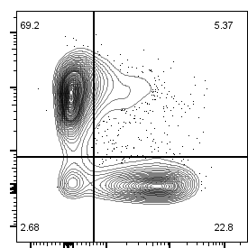
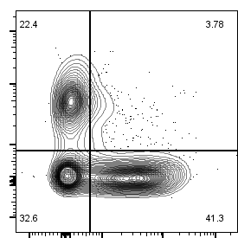
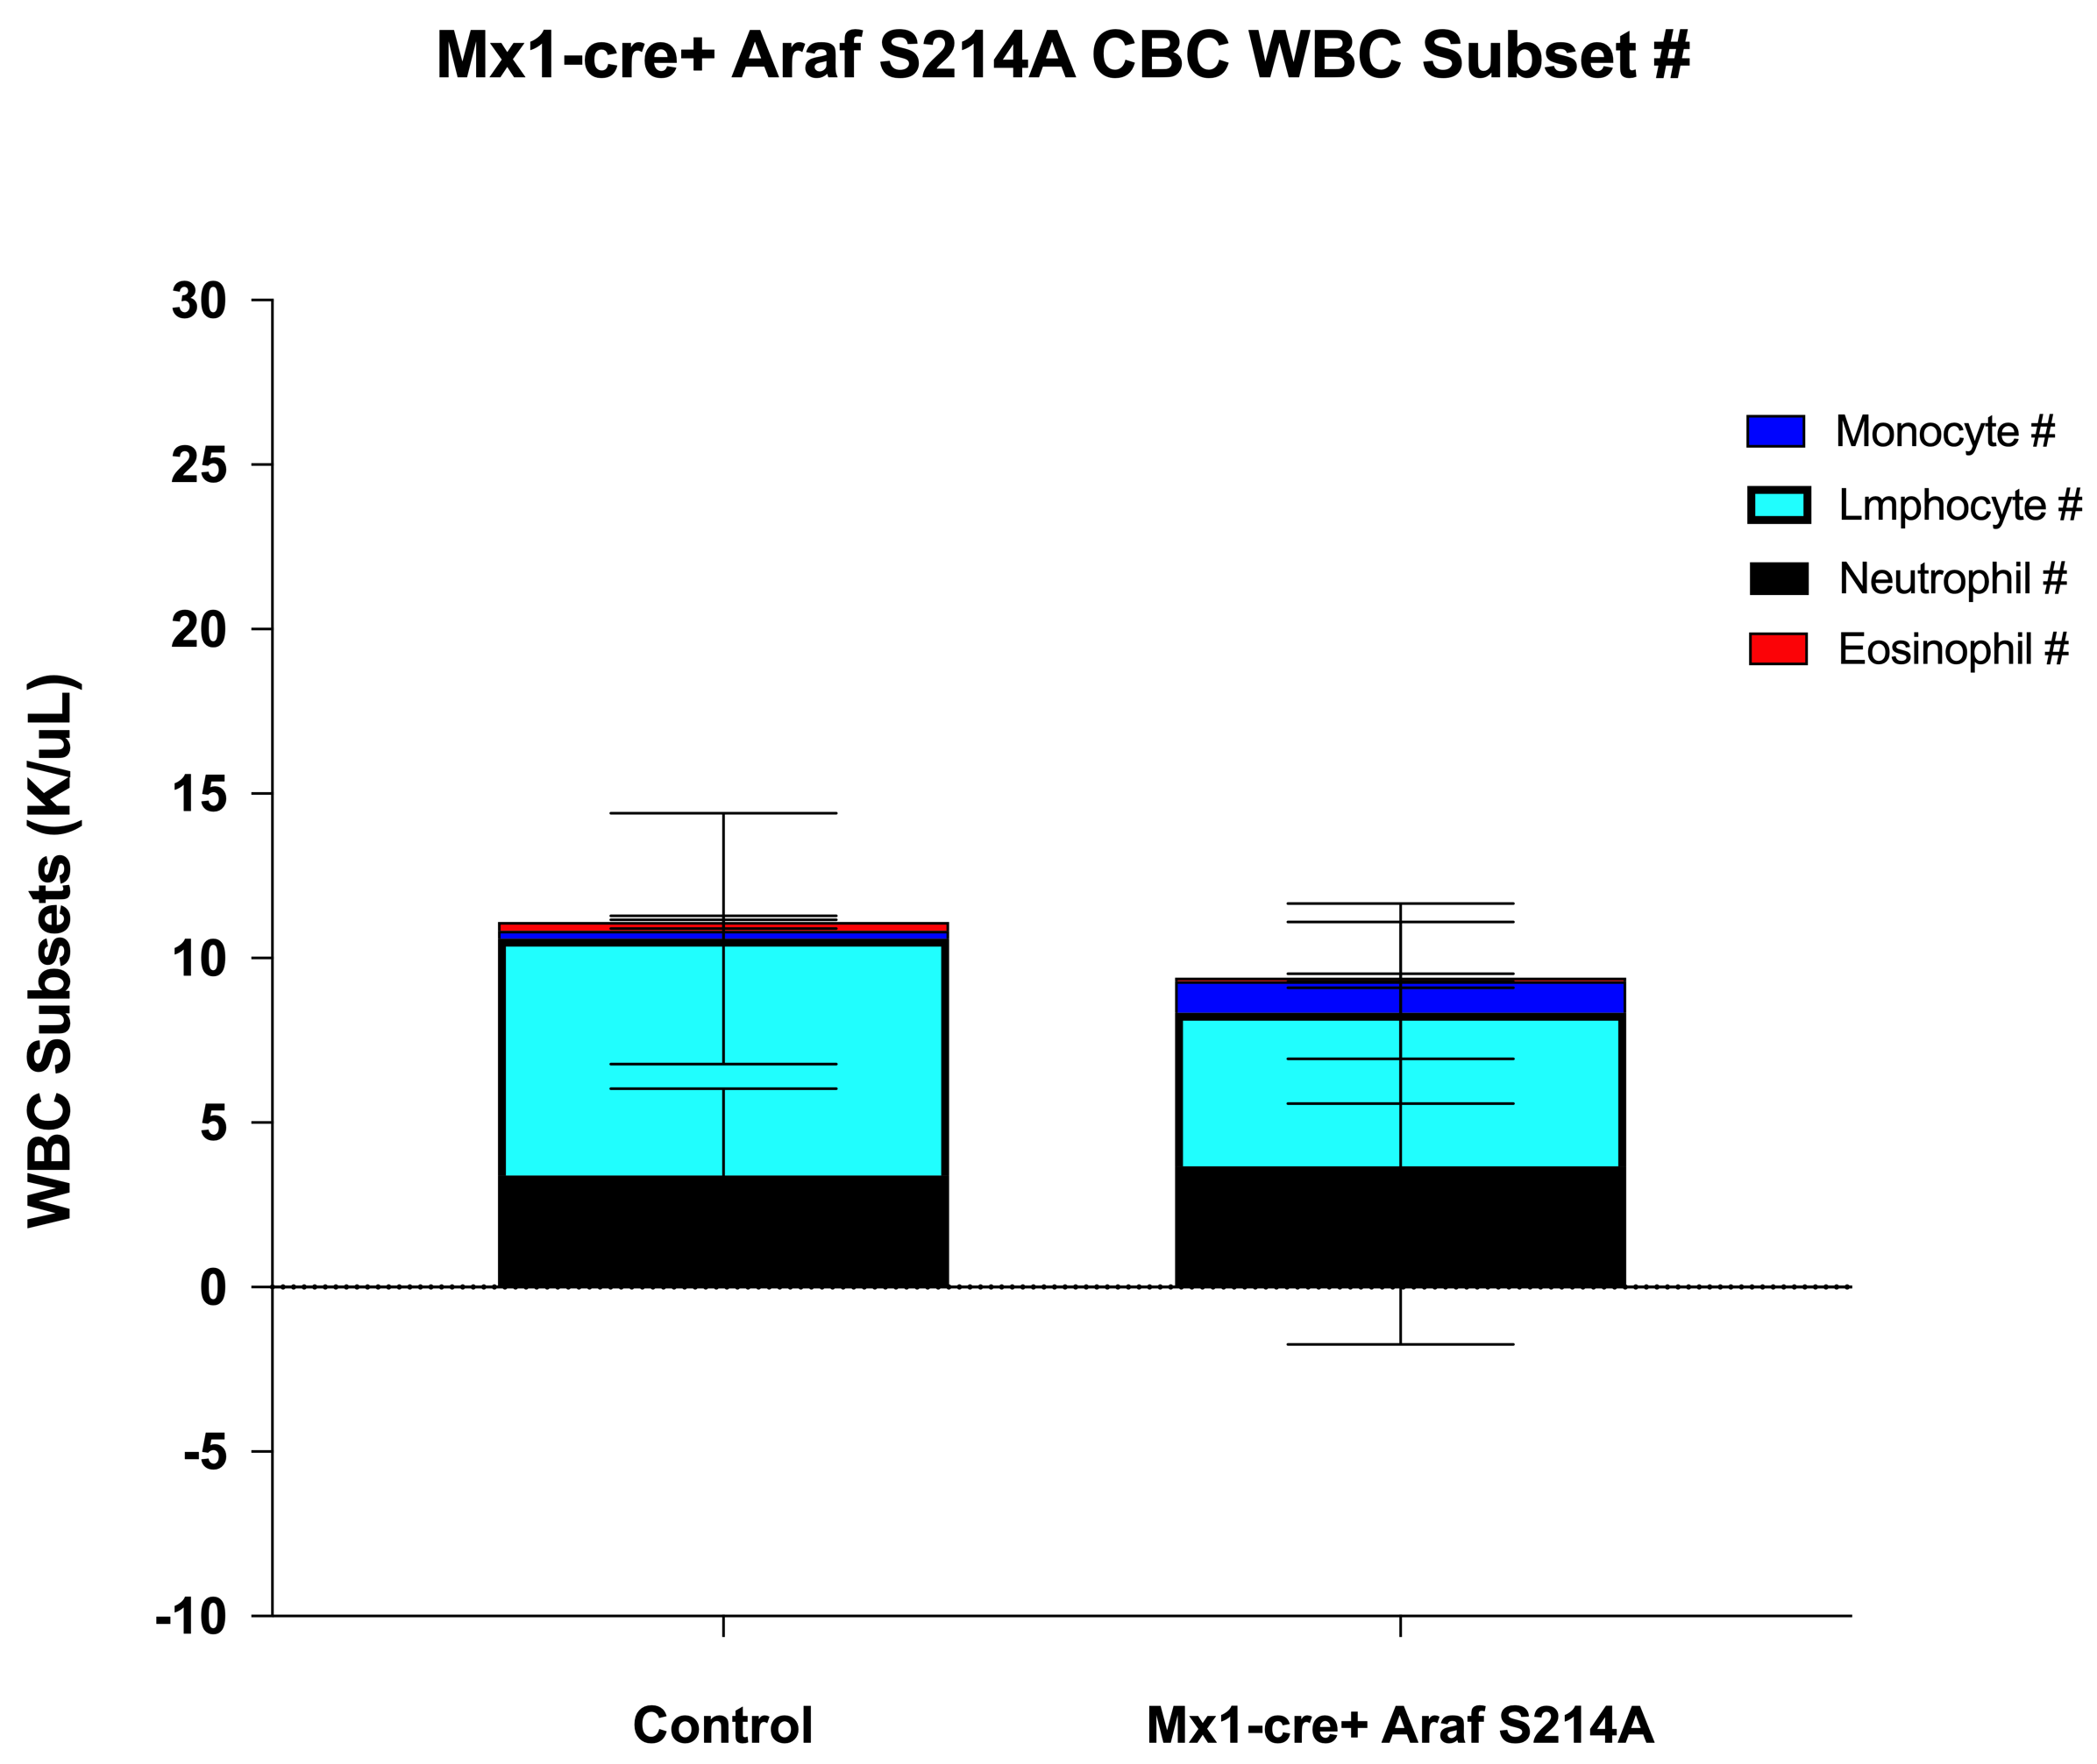
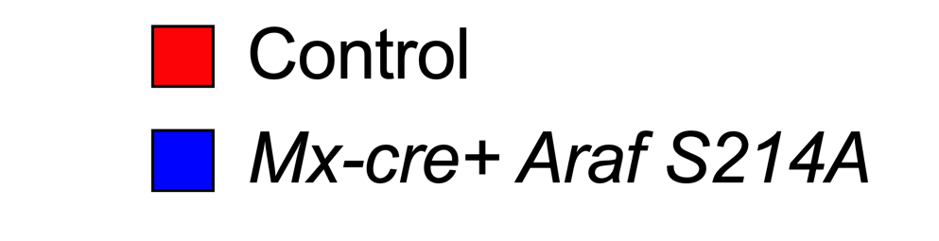
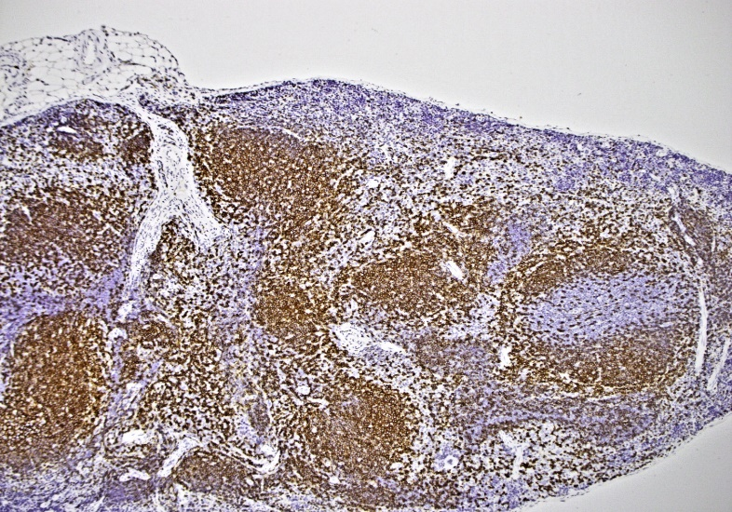
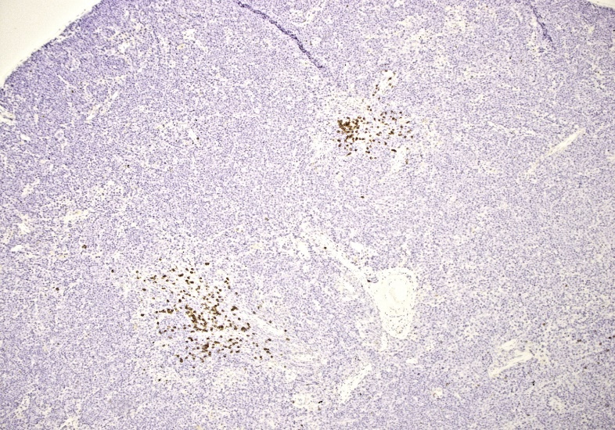
Suppression of B-Lymphopoiesis and Myelomonocytic Expansion in Araf^{S214A} Mice
Gated on DAPI⁻ CD45⁺ CD11b⁻
Bone Marrow
Spleen
Control
Mx1-Cre Araf^{S214A}
63%
11%
B220
CD3e
B-Cells
T-Cells
B-Cells
T-Cells
WBC Subsets
Control
Mx1-Cre Araf^{S214A}
Control
Mx1-Cre Araf^{S214A}
B220
B220

Slide 11
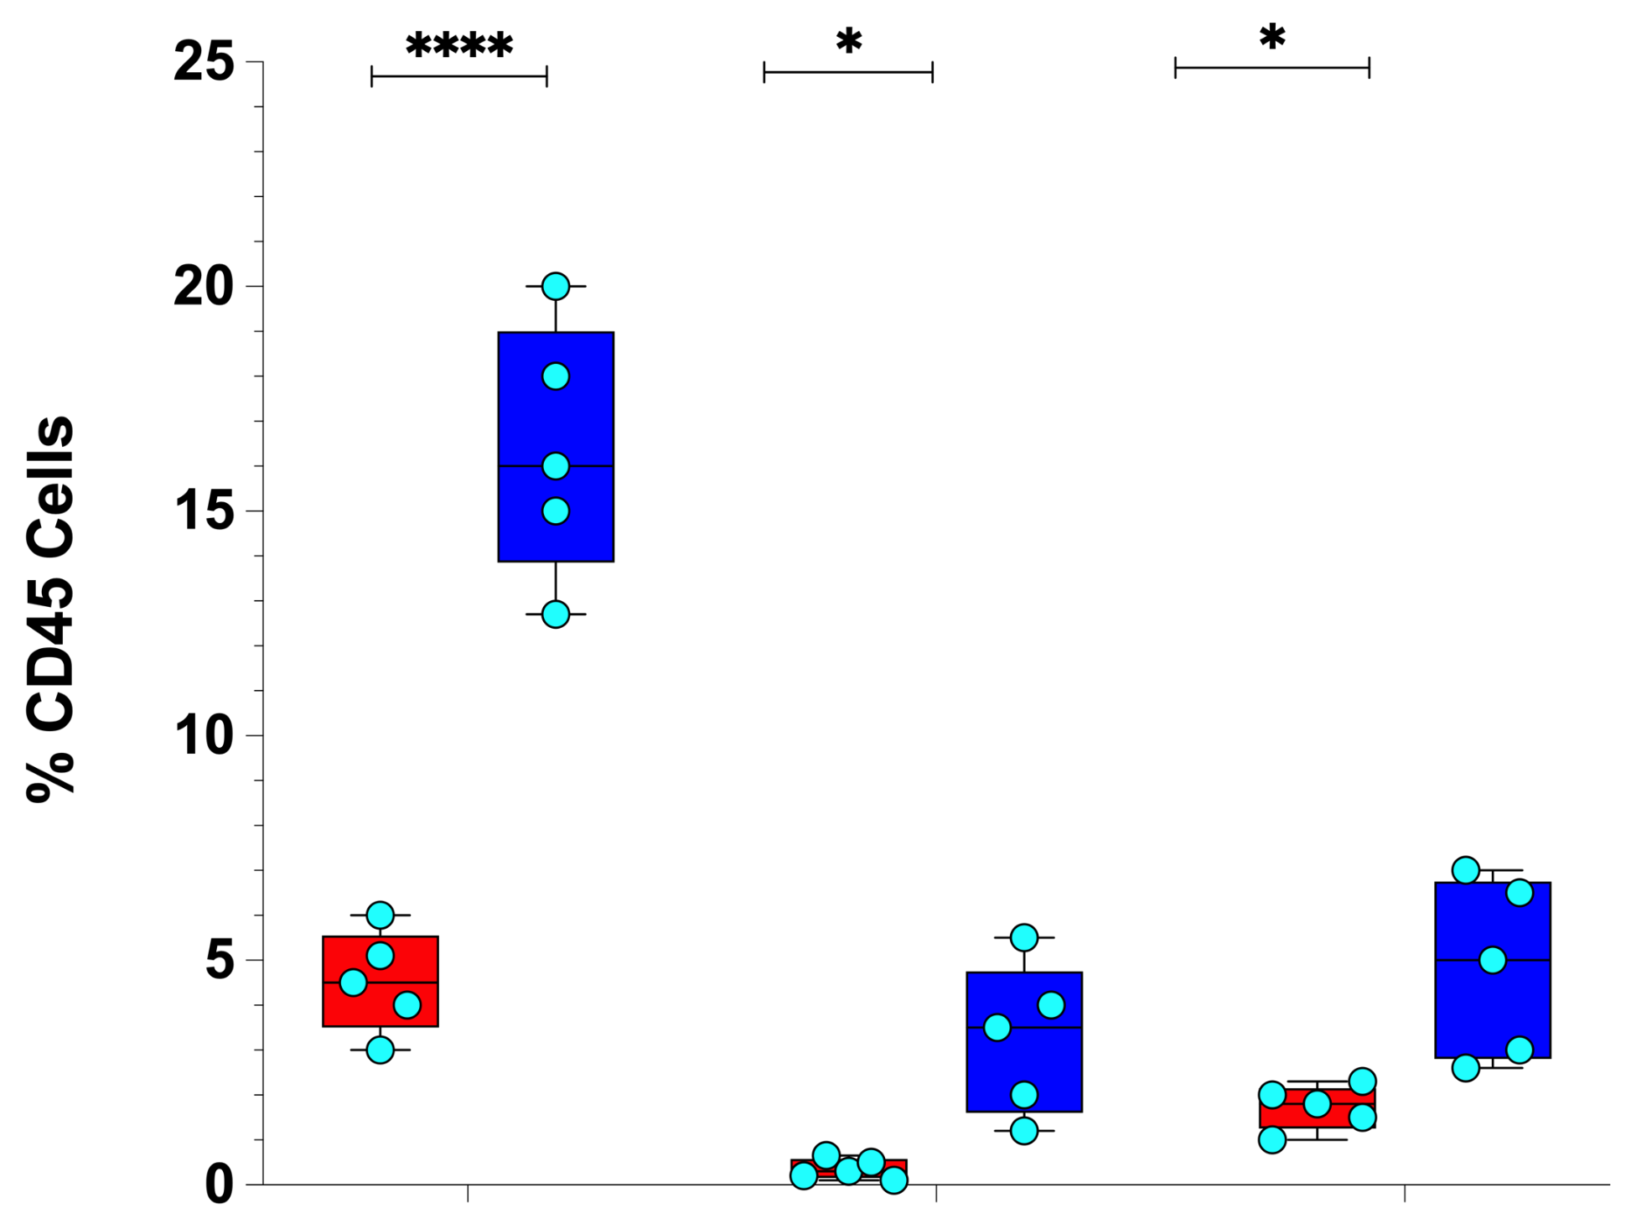
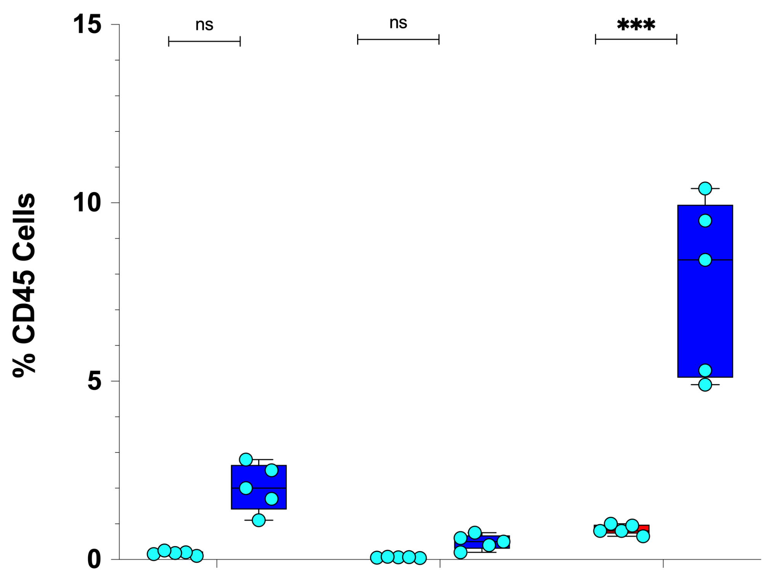
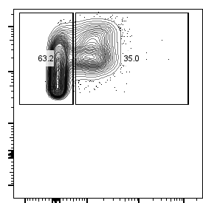
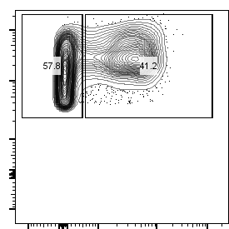
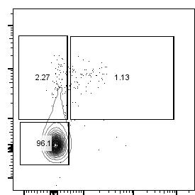
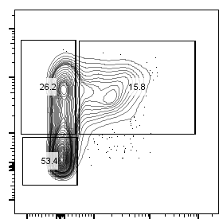
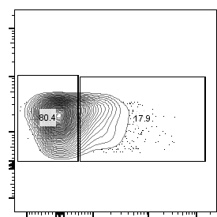
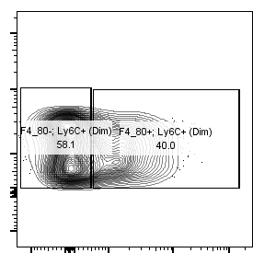
Expansion of Monocyte Subsets/Macrophages in Araf^{S214A} Mice
Bone Marrow
Spleen
DAPI⁻ CD45⁺ CD11b⁺ Ly6C⁺⁺ Ly6g⁻
Control
Mx1-Cre Araf^{S214A}
Classical
Monocytes
mLy6C
5%
13%
mCD115
Classical
Monocytes
Nonclassical
Monocytes
Macrophages
Classical
Monocytes
Nonclassical
Monocytes
Macrophages
DAPI⁻ CD45⁺ CD11b⁺ Ly6C^{+/-} Ly6g⁻
Control
Mx1-Cre Araf^{S214A}
Control
Mx1-Cre Araf^{S214A}
Nonclassical
Monocytes
Macrophages
mCX3CR1
mLy6C
0.1%
1%
2%
3%
mCD115
mF4/80

Slide 12
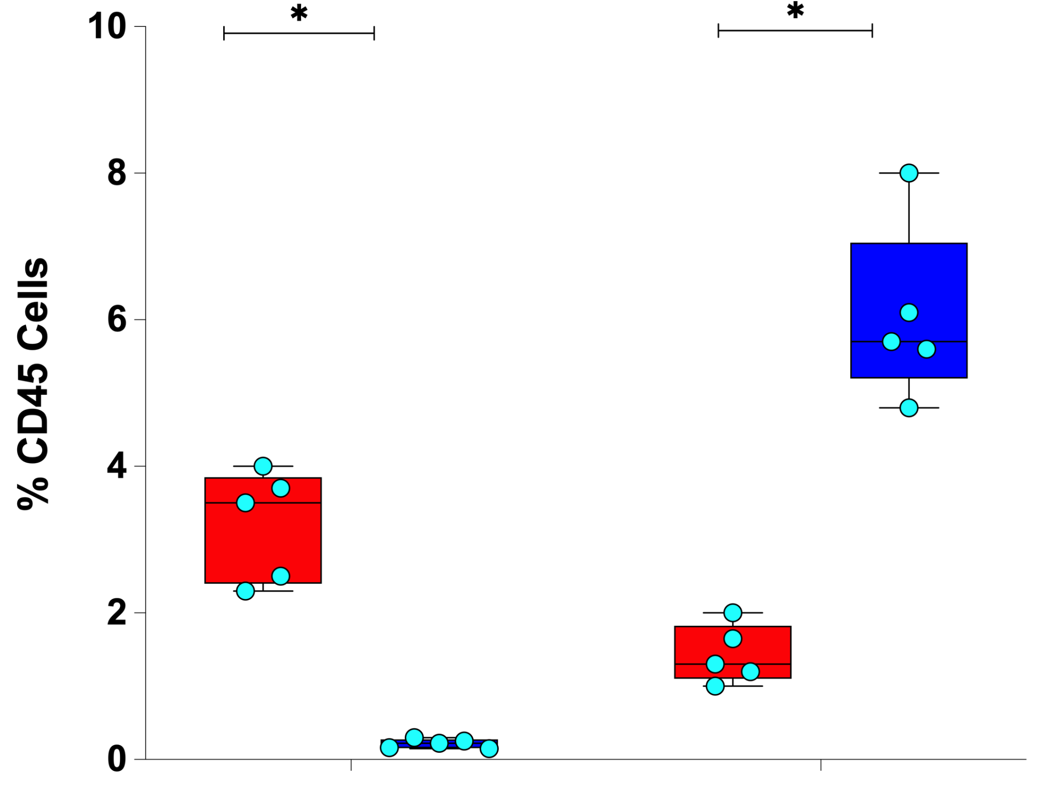
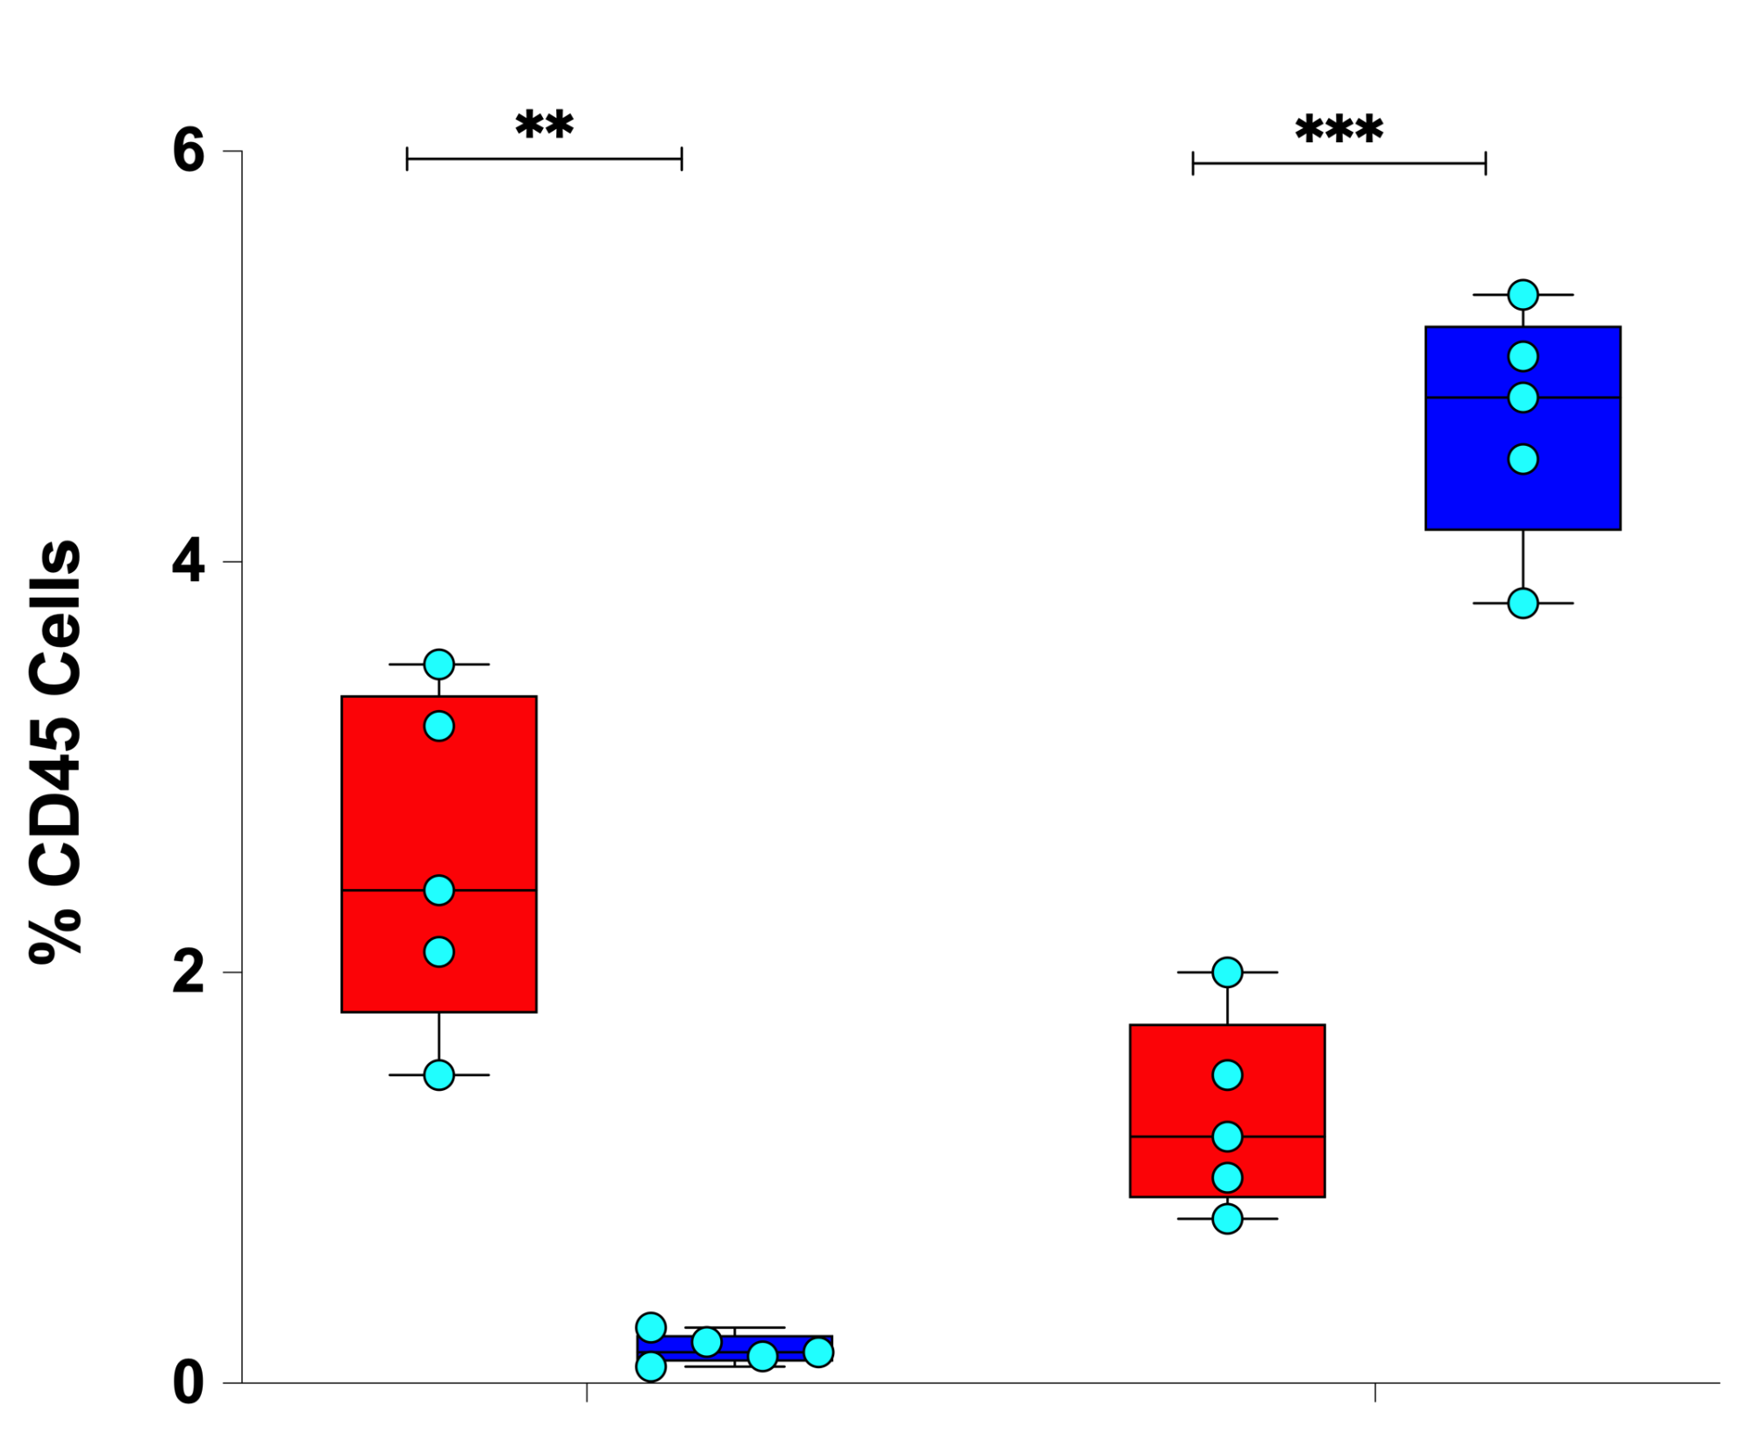
Expansion of CD11b⁺ Classical Dendritic Cells Type 2 (DC2) and Reduction of Classical Dendritic Cells Type 1 (DC1) in Araf^{S214A} Mice
Spleen
Bone Marrow
Classical DC1
(Cd24+)
Classical DC2
(Cd11b+)
Classical DC1
(Cd24+)
Classical DC2
(Cd11b+)

Slide 13
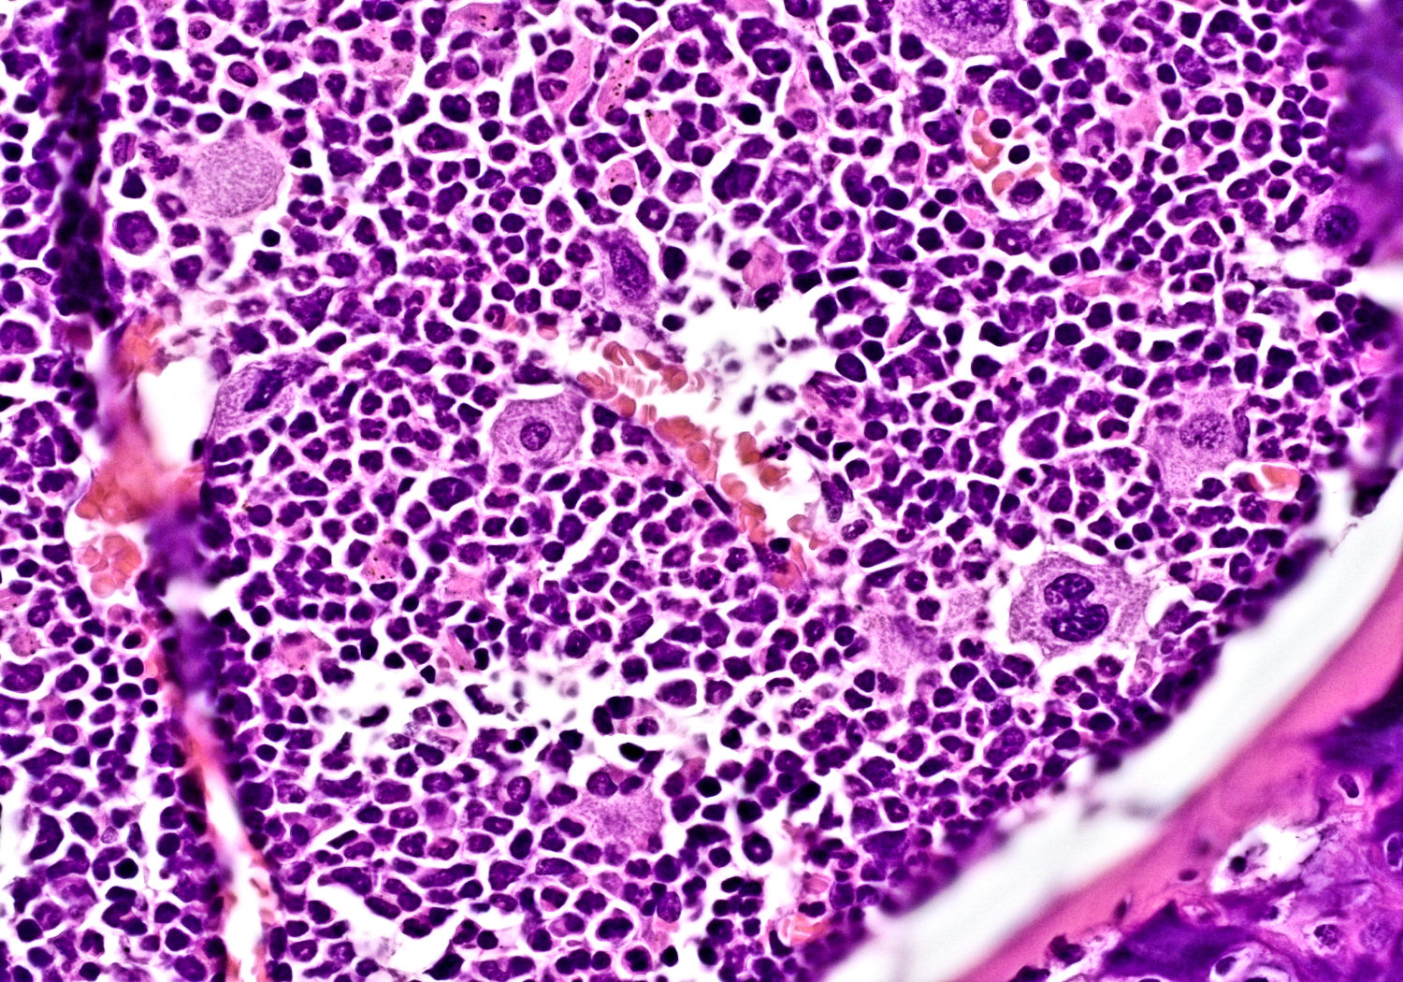
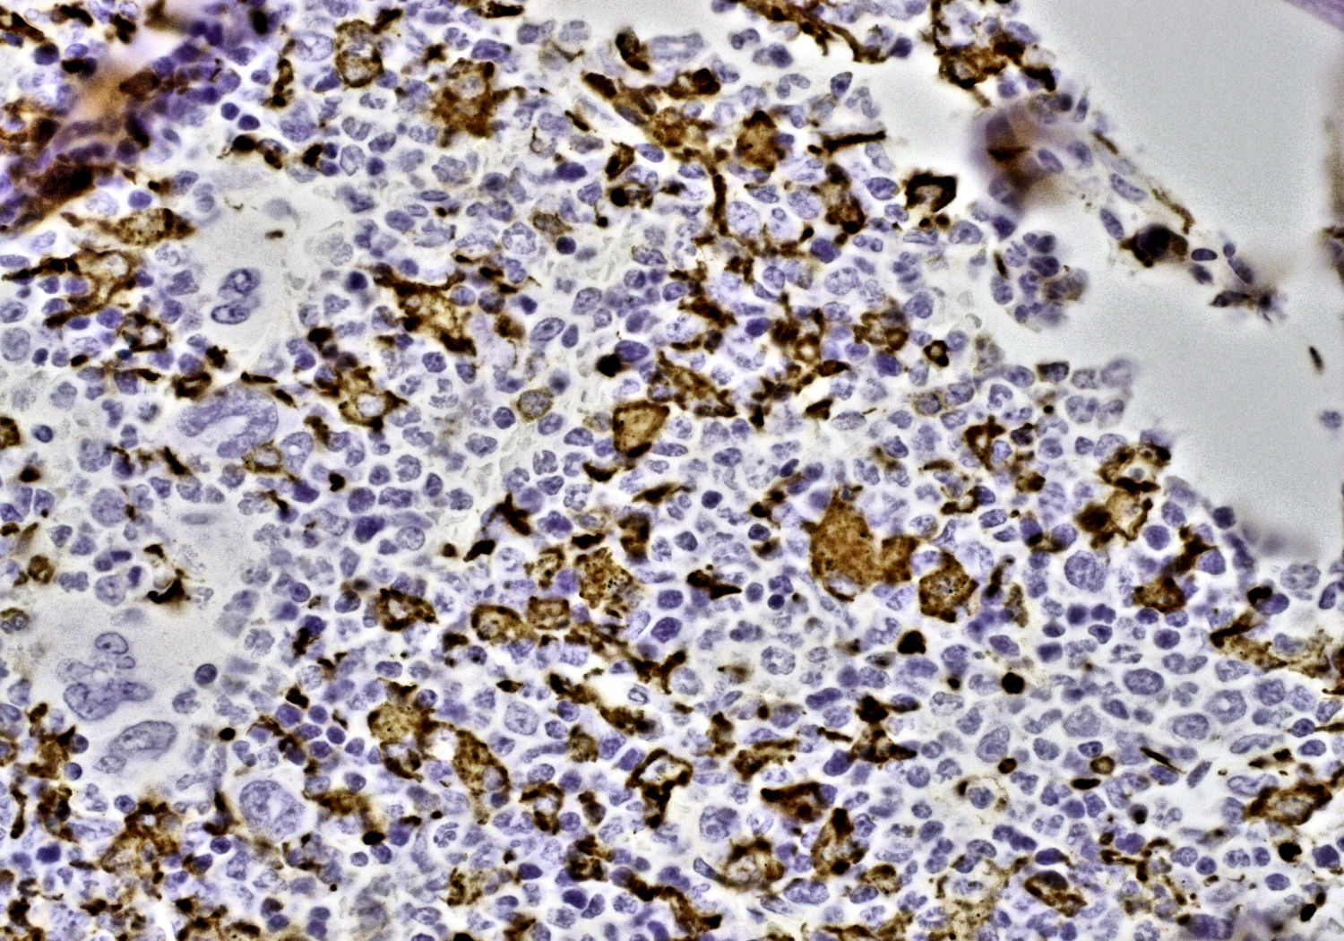
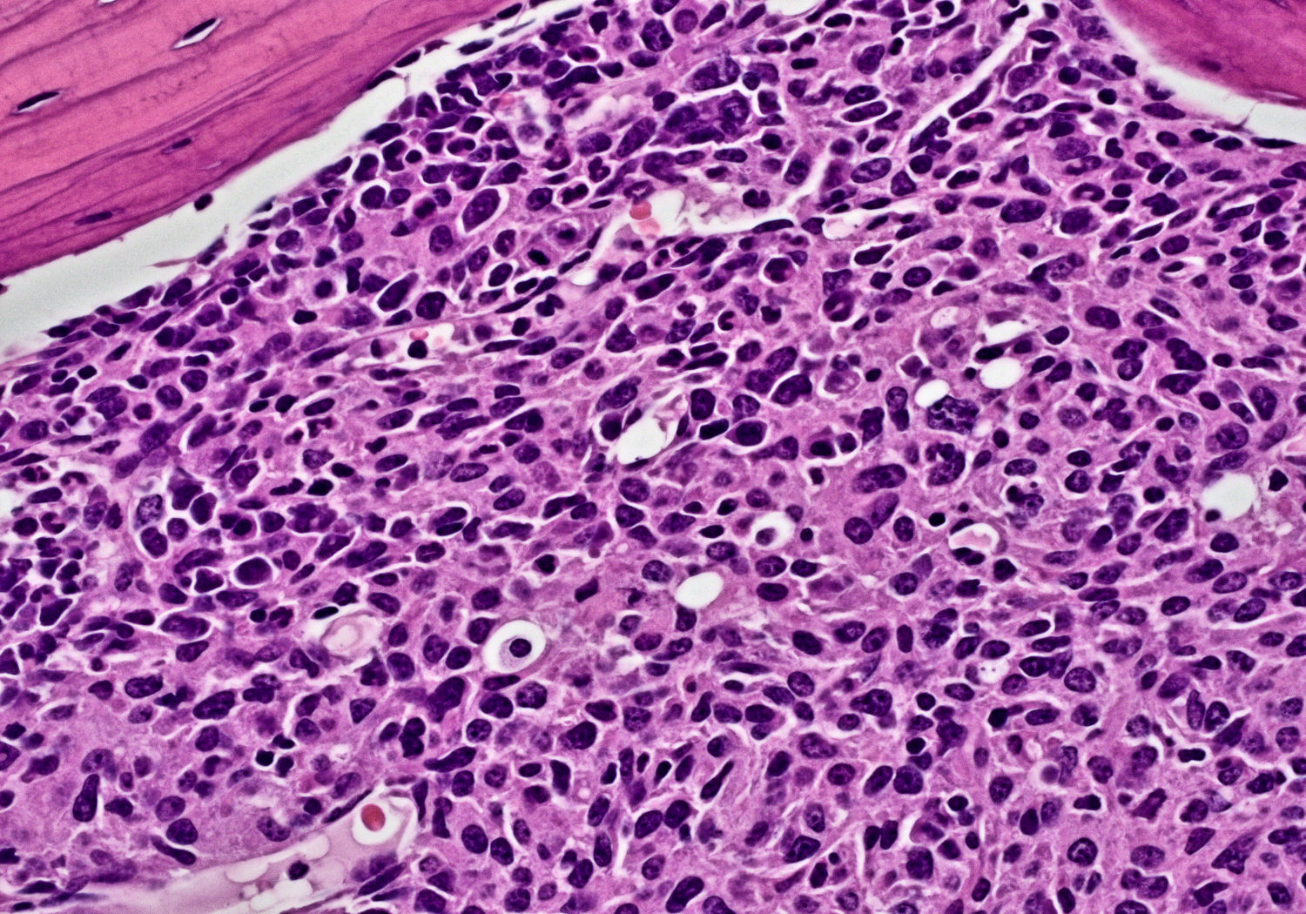
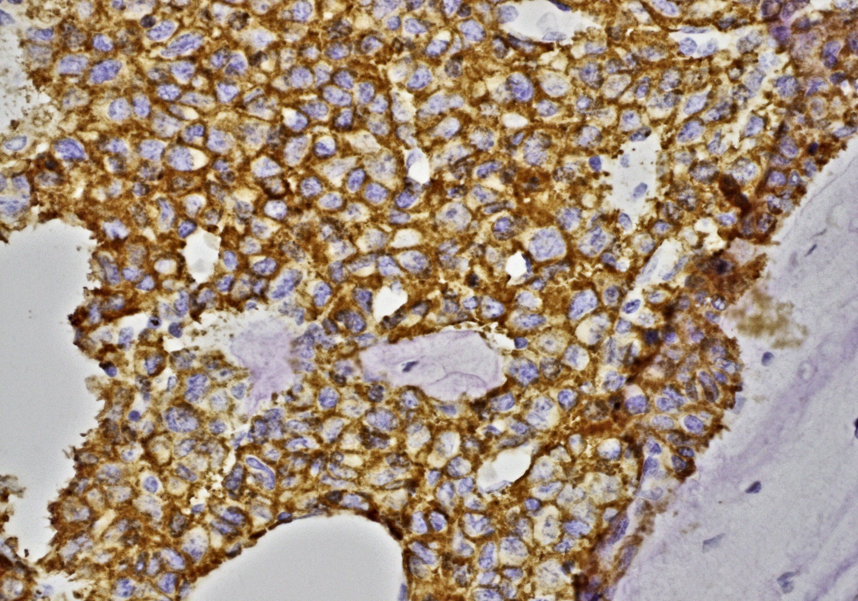
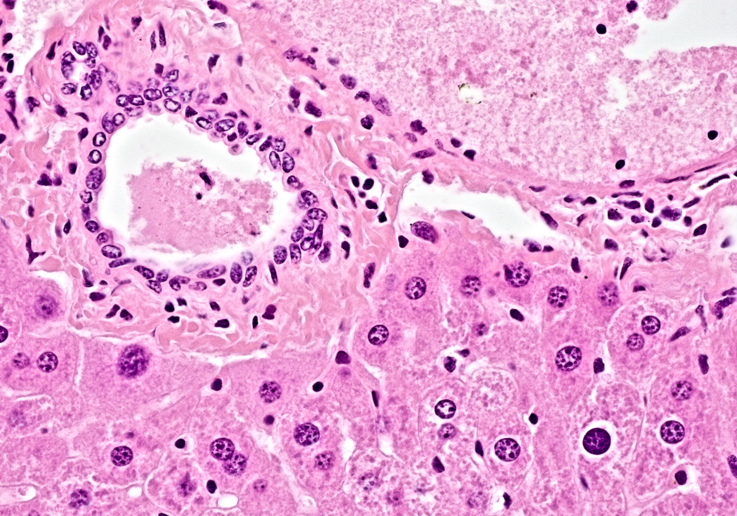
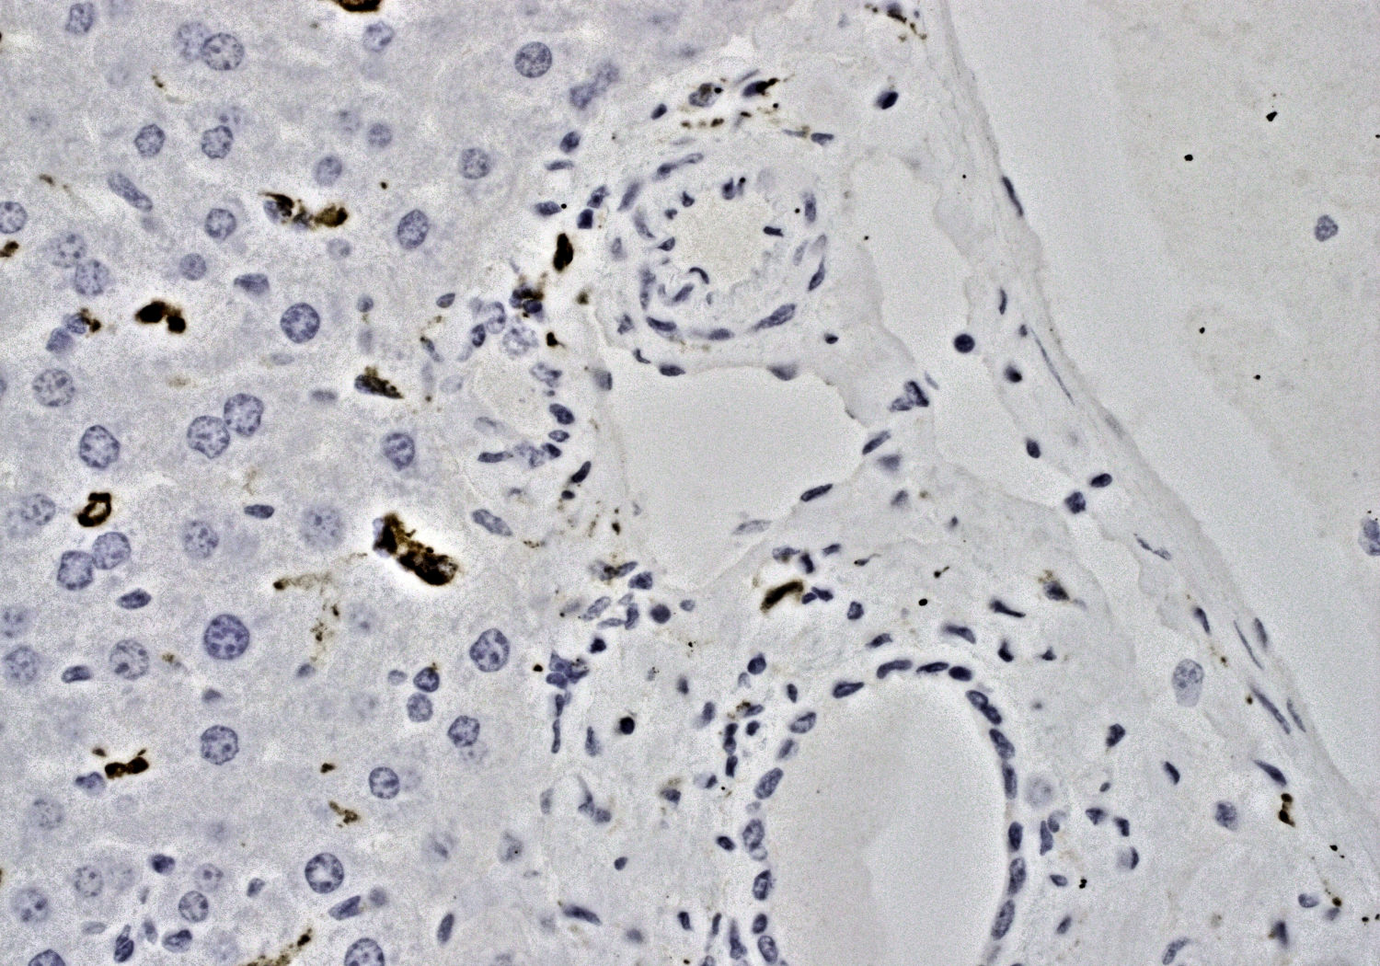
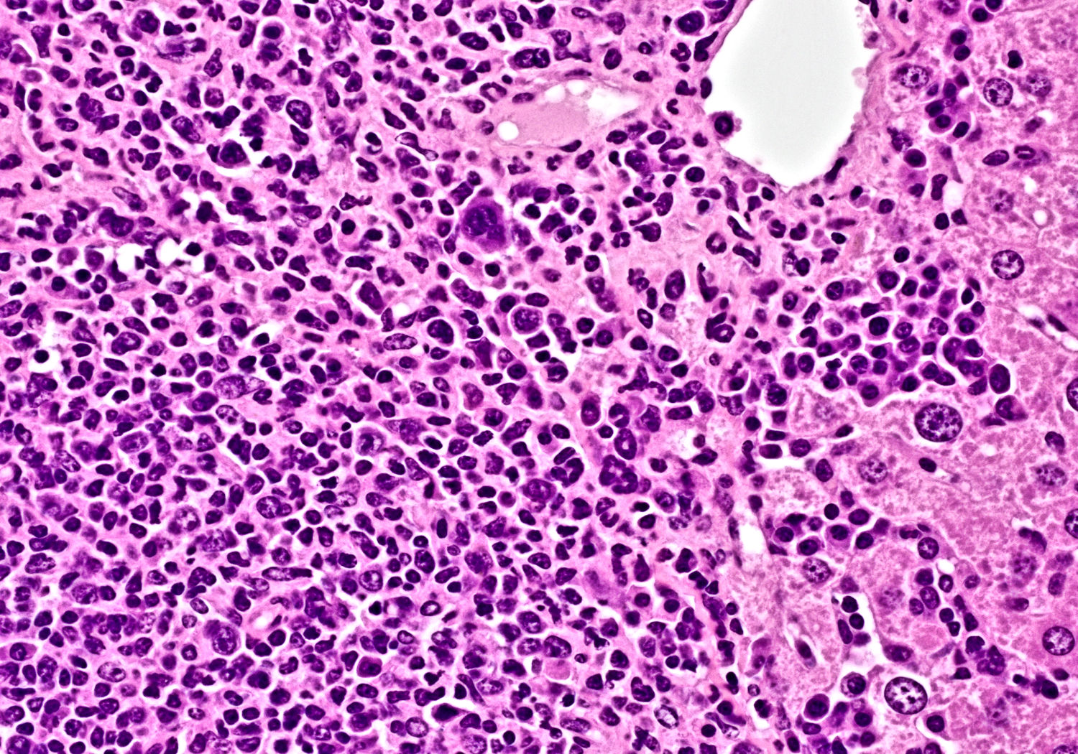
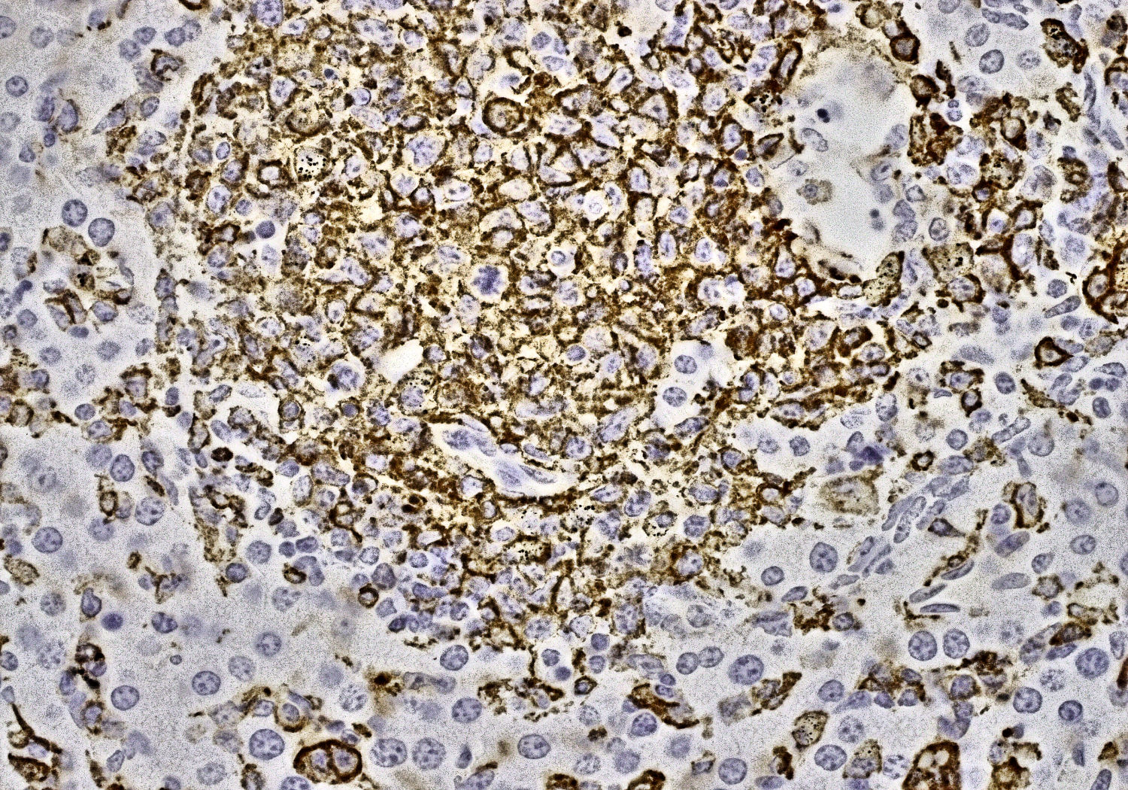
Expansion of Iba1⁺ Monocyte/Macrophages and Cd11b⁺ Dendritic Cells in the Bone Marrow and Liver of ARAF-Mutant Mice
Cre-Araf S214A Control
Mx1-Cre Araf S214A
Bone Marrow
H&E
Iba1
H&E
Iba1
Liver
H&E
Iba1
H&E
Iba1

Slide 14
Conclusions
Araf^{S214A} drives a lethal, myelomonocytic disorder reminiscent of human systemic histiocytosis in vivo
  This occurs with Mx1-Cre or Cd11c-Cre promoters
Expressing Araf^{S214A} at the earliest stages of hematopoietic development results in a more severe disease than in committed monocyte/dendritic cells.
  Mx1-Cre Araf^{S214A} leads to suppression of B-lymphopoiesis and expansion of monocyte/macrophages and CD11b⁺ dendritic cells in bone marrow, spleen, and liver.
Araf^{S214A} conditional knock-in mice may serve as promising pre-clinical models to test single-agent or combinatorial agent therapeutics to determine the ideal treatment for ARAF-mutant histiocytic neoplasms.

Slide 15
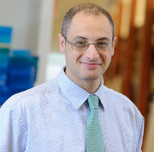
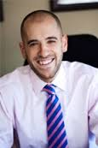







THANK YOU
Memorial Sloan Kettering Cancer Center
New York, NY, United States
(Major Collaborators)
University of Colorado Anschutz,
Aurora, CO
Matthew Witkowski
University of Pittsburgh Children’s Hospital,
Pittsburgh, PA
Jennifer Picarsic
Assuta Medical Centers, Tel-Aviv, Israel
Oshrat Hershkovitz-Rokah
Ofer Shpilberg
Roei D. Mazor
St. Jude Children’s Research Hospital,
Memphis, TN
Tanja Gruber, Former Member
Patrick Campbell
David Ellison
John Choi, Former Member
INSERM Research Unit, Paris, France
Julien Haroche
Jean-Francois Emile
Jean Donadieu
Omar Abdel-Wahab
Eli Diamond
Abdel-Wahab Lab
Alex Lewis
Takeshi Fujino
Michael Singer (former)
Maxim Maron
Salima Benbarche
Nina Fox
Caroline Erickson (former)
Jahan Rahman
Steven Tittley
Hana Cho (Former)
Daniel Cui (Former)
Young Rock Chung (Former)
Neal Rosen Lab
Neal Rosen
Leukemia Service
Raajit Rampal
Funding Sources
Center for Molecular Oncology (CMO)
David Solit
Mike Berger
Hematopathology
Ahmet Dogan
Mariko Yabe
Ksenyia Petrova-Drus
Molecular Diagnostics
Marc Ladanyi
Maria Arcila
Geissmann Lab
Estibaliz Lopez-Rodrigo
Frederic Geissmann

