Slide 1
ECD and the Brain
Eli L. Diamond, MD
Department of Neurology / Early Drug Development Service
Memorial Sloan Kettering Cancer Center
New York, NY

Slide 2
ECD and the Brain: Overview
ECD lesions in the brain and eyes
Spectrum of neurologic symptoms in ECD (regardless of MRI)
Eye manifestations of ECD
Concepts about treating ECD in the brain

Slide 3
ECD and Brain and Eye
75% or more of ECD patients have neurologic symptoms of some kind
Not always explained by scans
~50% of patients with ECD have some finding in the eye, even if not symptomatic
BRAF and MEK inhibitors can affect the eye

Slide 4
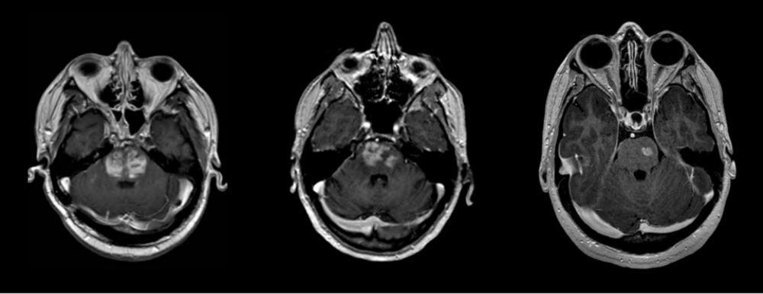
ECD “lesions” in the lower brain

Slide 5
ECD “lesions” in the lower brain
”Classic” ECD brain symptoms
Decrease in speed and clarity of speech
Imbalance because of decreased stability of the trunk and legs
Decreased coordination of the arms and hands
Weakness of the arms and legs
Issues with swallowing
Issues with mood and behavior
Emotionality

Slide 6
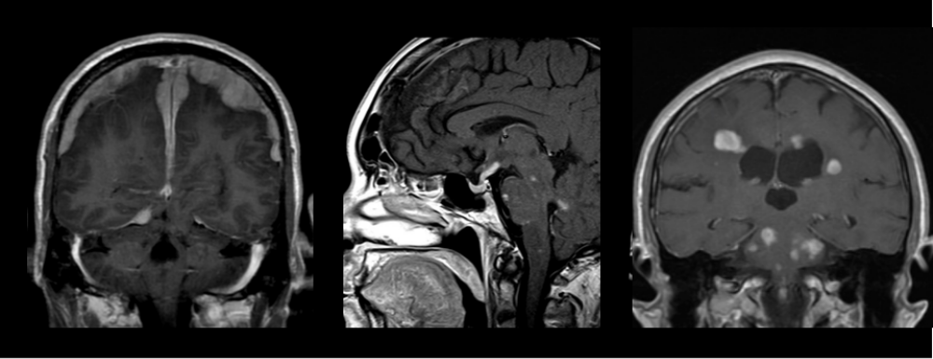
ECD lesions elsewhere in the brain
Hormone deficiencies from ECD in the pituitary (DI / AVP-D, sex hormones, others)
ECD grown of the lining of the brain (meninges)
Other areas less common

Slide 7
Neurologic symptoms not from lesions
Array of brain-related problems not connected to scans
Fatigue (75%!)
Brain fog
Anxiety and depression
  1/3 with anxiety or depression, 1/7 with moderate or severe
  Depression most common in ECD and associated with neurologic involvement and longer undiagnosed illness

Slide 8
Cognitive Problems in ECD
    Very common and under-recognized problem
    Trouble paying attention, trouble remembering things, multi-tasking
    Ability to work can be affected
    Even patients without “ECD in the brain”
    Most commonly reported symptom in ECD Registry

Slide 9
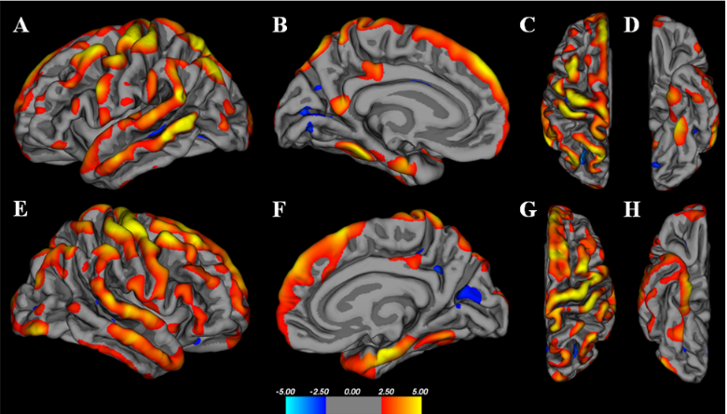
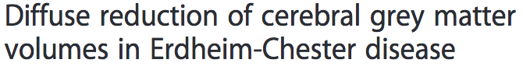
Reduction in Grey Matter Volumes
Diamond et al, Orphanet, 2016

Slide 10
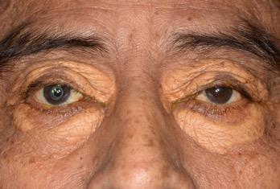
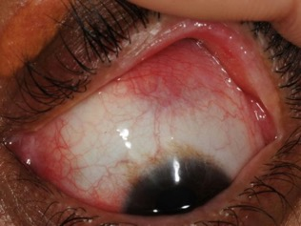
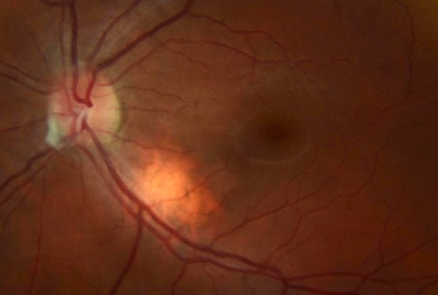
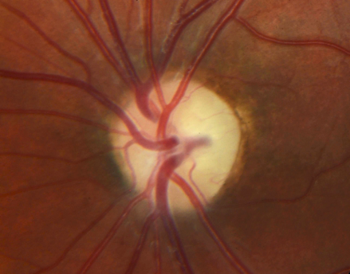
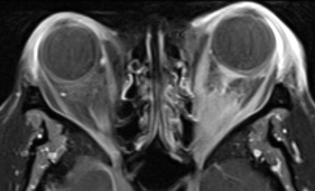
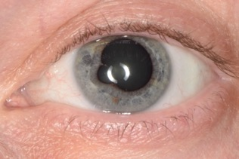
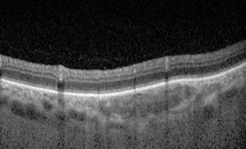
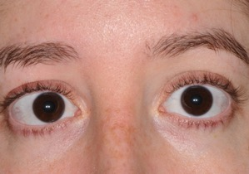
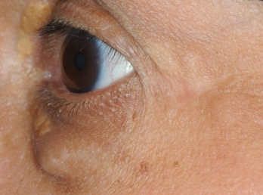
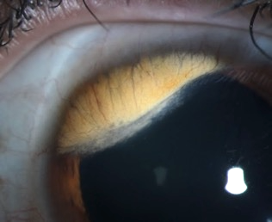
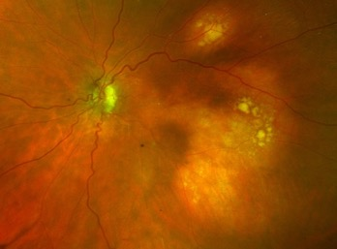
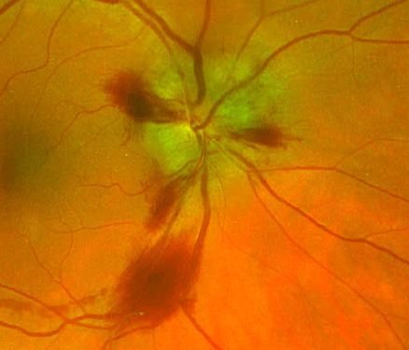
ECD and the Eye
Orbit/Eyelids
Anterior Segment
Choroid
Neuroophthalmic
*
*
*
*

Slide 11
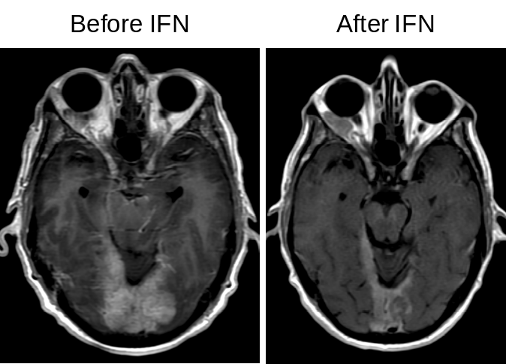
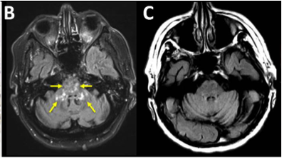
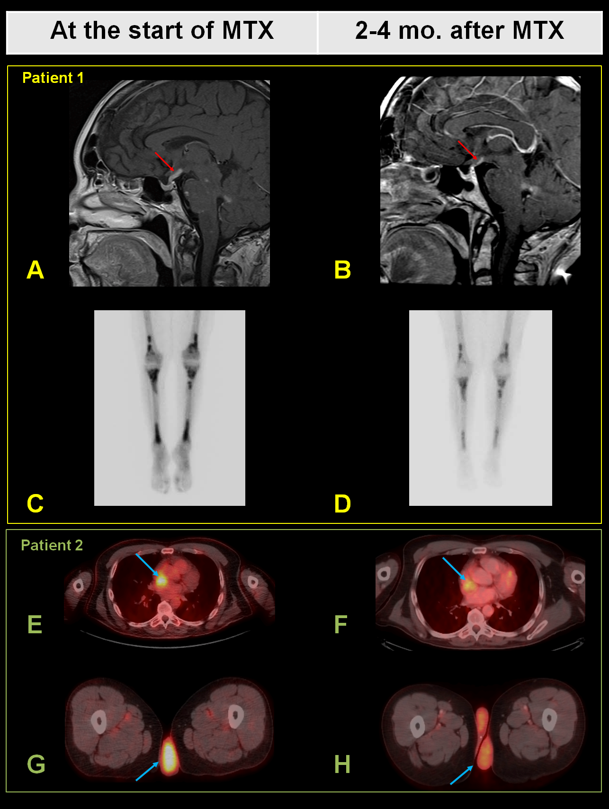

Conventional Therapies for CNS ECD
Effectiveness unpredictable
Likelihood of improvement is unclear but can happen
Most data with high-dose interferon alpha
Anakinra (very little evidence)
Cladribine, chemotherapies

Slide 12
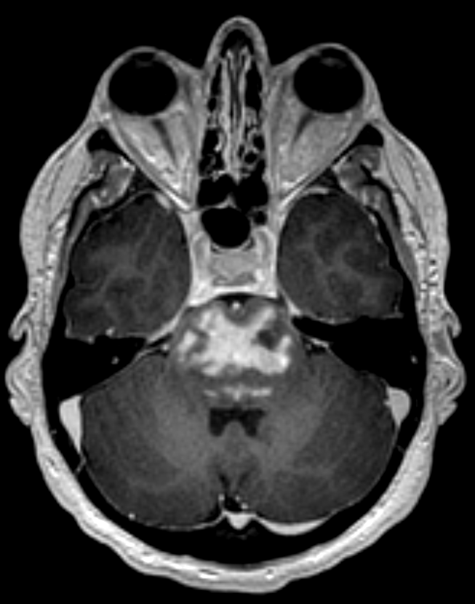
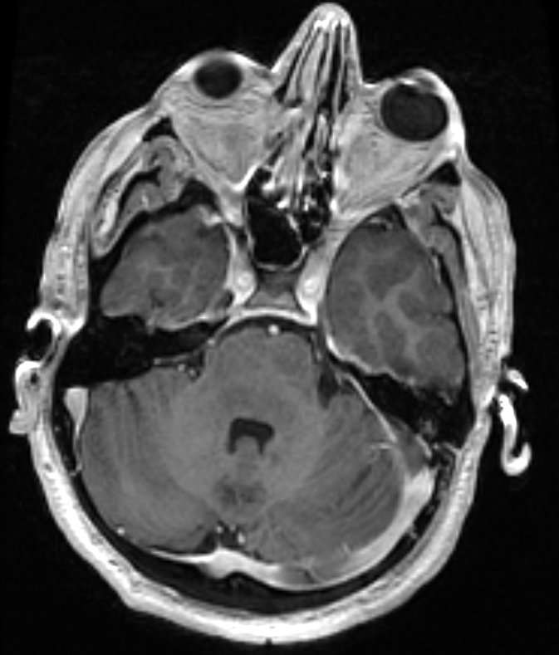
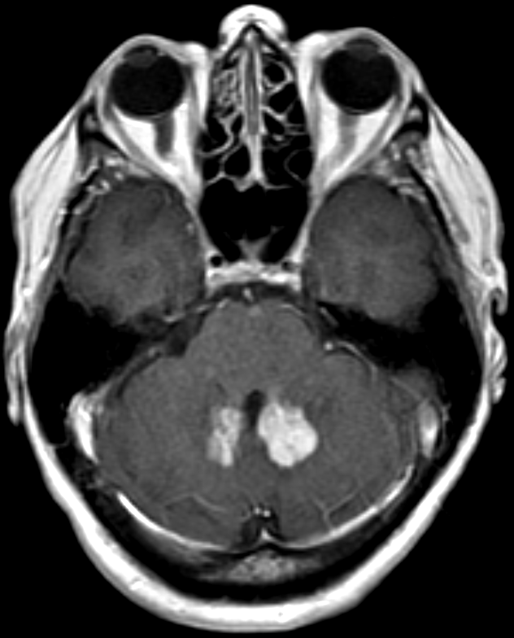
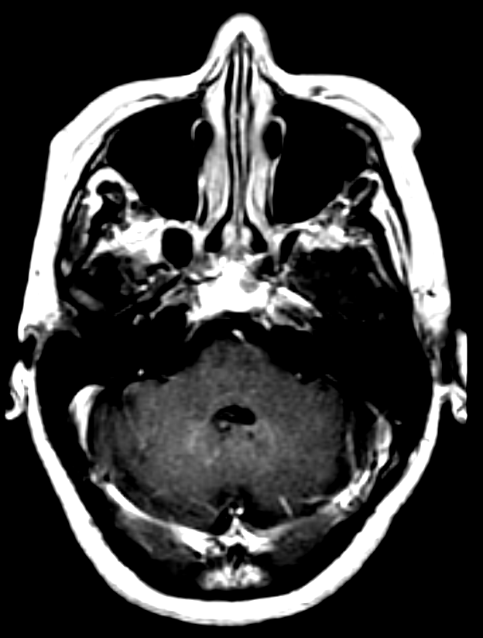
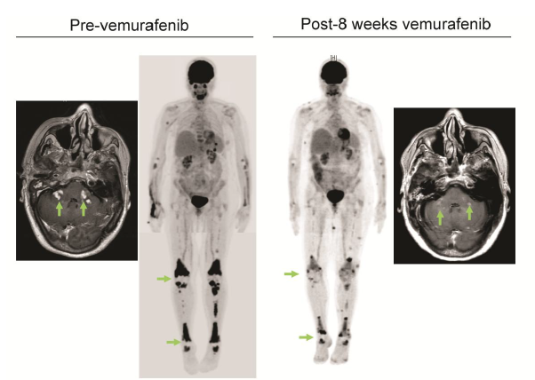
Targeted therapy in brain ECD of brain
ECD
Before Vemurafenib
After Vemurafenib

Slide 13
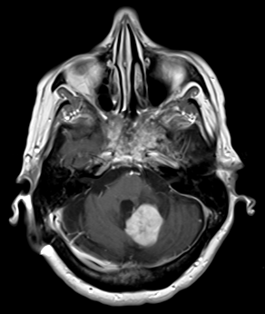
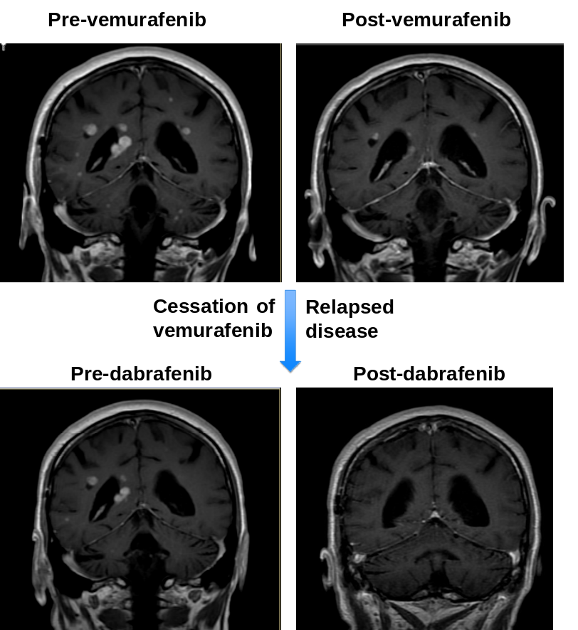
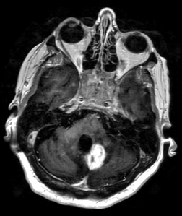
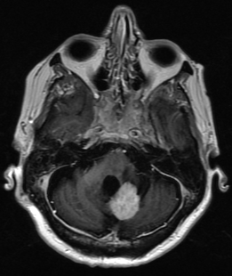
Challenges of BRAF inhibitors
Many side effects of BRAF inhibitors
Relapse with cessation of treatment
Pre-vemurafenib
vemurafenib
Off vemurafenib

Slide 14
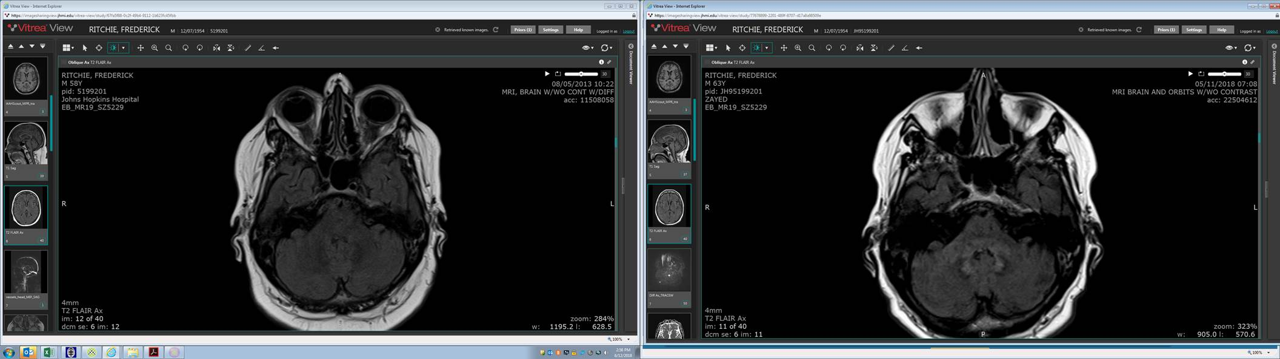
Low dosing may or may not work
Pre-vemurafenib
Chronic low-dose vemurafenib

Slide 15
Current state of Brain ECD
    Spectrum of outcomes
    Some lasting and dramatic responses to targeted therapy
    Some partial improvement (unclear if “damage done” or drug not getting to brain)
    Some with very slow worsening over time
    New brain-penetrating treatments

Slide 16
Eye side effects of BRAF/MEK inhibitors
    Best evaluated by ophthalmologist
    Uveitis (BRAF inhibitors)
    Retinal fluid, retinal swelling (MEK inhibitors)
    Retinal vein occlusion (MEK inhibitors, rare)
    Nearly always manageable with supportive treatments and dose modification

Slide 17
What can we do?
No one knows what is best to treat the brain but minimize chronic side effects
Very low dosing (for some patients)
Intermittent higher dosing?
Treatment holidays to help with side effects?
What works for one patient may not work for another
New treatments needed

Slide 18
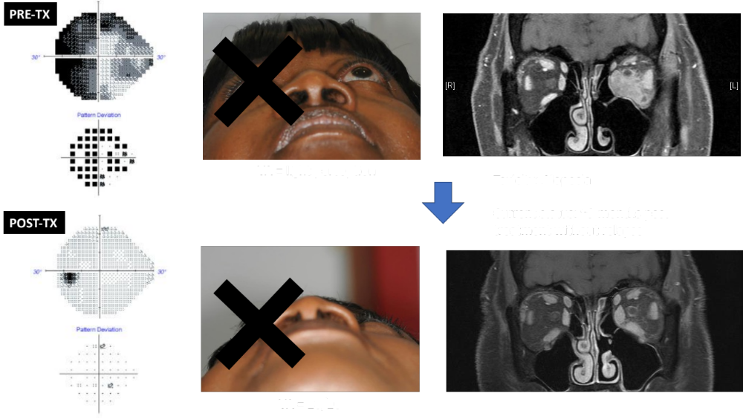
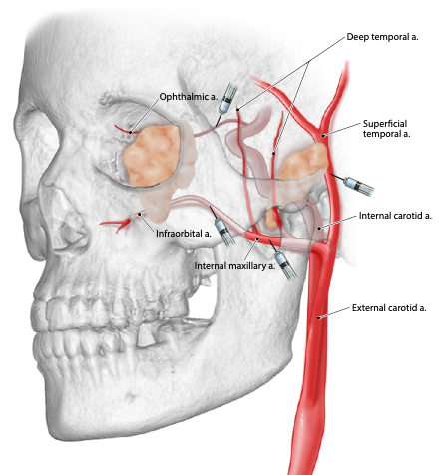
Intra-arterial chemotherapy (IAC)
Orbit
Maxillary sinus
Temporalis muscle
infusion # | week # | Ophthalmic | Infraorbital | Internal maxillary | Superficial temporal
1 | 0 | 15mg
2 | 5 | 7mg
3 | 12 | 7.5mg
4 | 19 | 7mg | 5mg
5 | 24 | 7.5mg | 3.75mg | 3.75mg
6 | 35 |  | 15mg*
7 | 47 | 5mg | 10mg*
8 | 55 |  |  | 15mg**
9 | 59 |  |  | 15mg**
10 | 66 |  |  | 15mg**
* dose divided between both infraorbital and internal maxillary arteries, ** dose divided between internal maxillary and superficial temporal artery

Slide 19

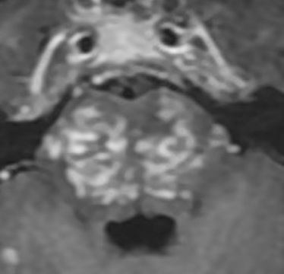
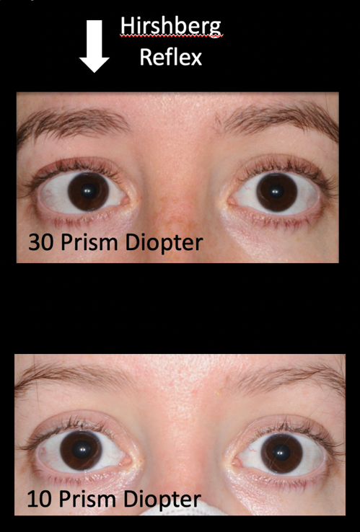
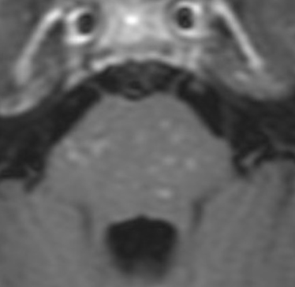
Brain and eye response to IAC
.
Francis JH
Baseline
Post- IA
Notes:
Finally, a young woman in her 20s had ECD and 30 prism diopters of abduction deficit secondary to brainstem disease. Following 6 infusions of intraarterial melphalan to her vertebral arteries, she had functional improvement in dysarthria and balance, and improved symptoms and measurements of esotropia (to 10 diopters). Now, she has been disease free for 4 years and is pregnant

Slide 20
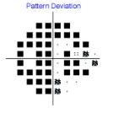
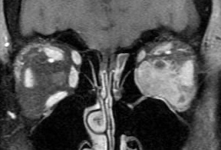

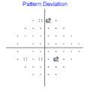
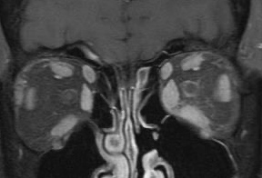
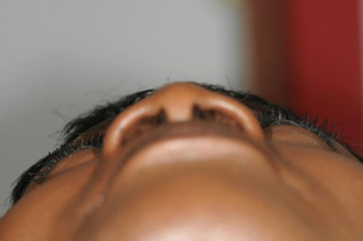
Eye response to IA chemo
Francis JH
Baseline
CF
Post- IA
20/20
Notes:
One woman in her 50s had orbital RDD resulting in a compressive optic neuropathy and vision of count fingers. Uncontrolled diabetes prohibited long-term use of steroids, and a juxtafoveal area of subretinal fluid contraindicated MEK inhibitor use. She had a profound and sustained response to 6 intraarterial melphalan infusions, and at 5-year follow up her vision remains 20/20 in that eye.⁷²

Slide 21
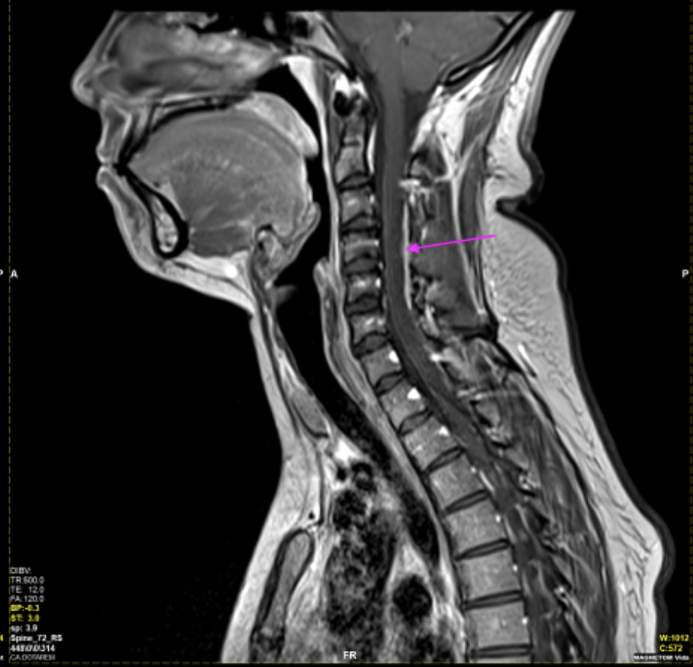
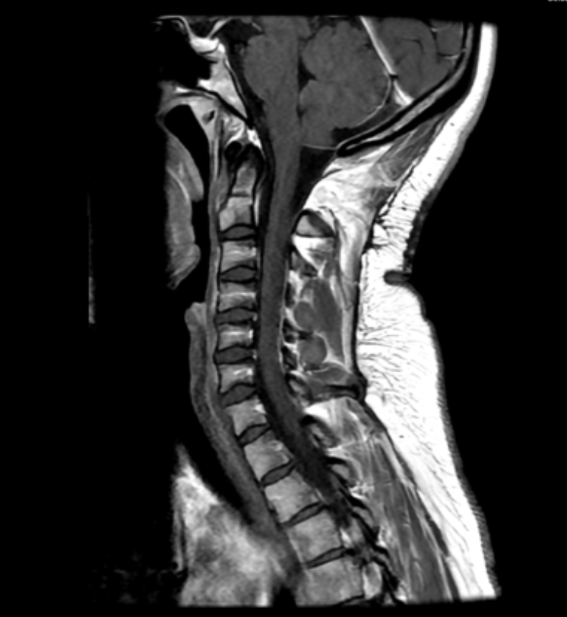
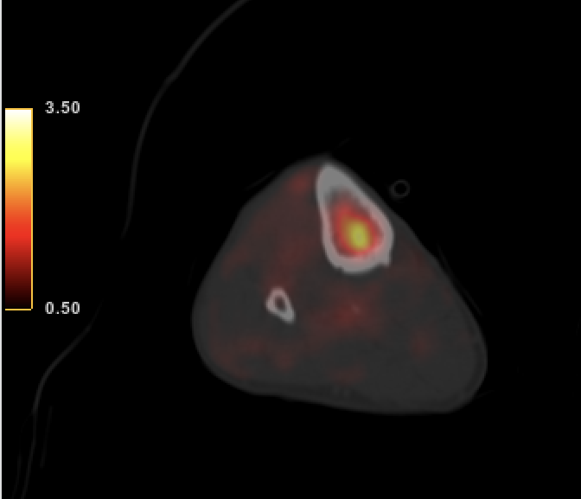
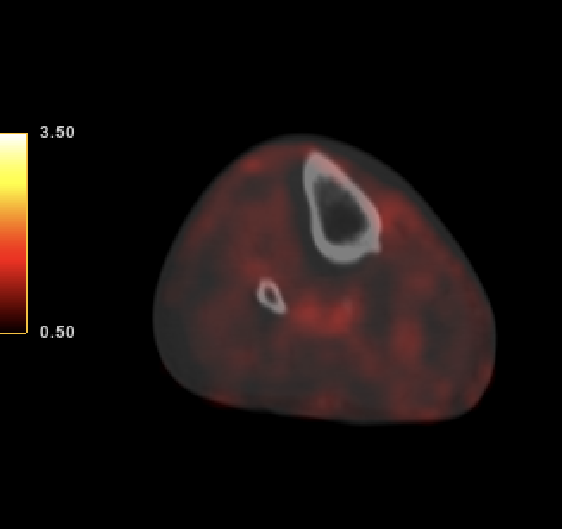
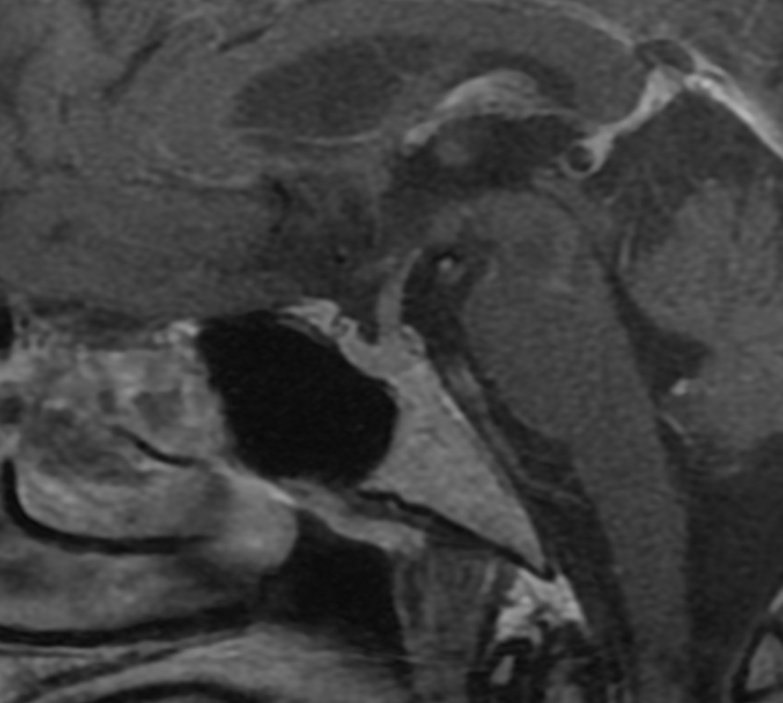
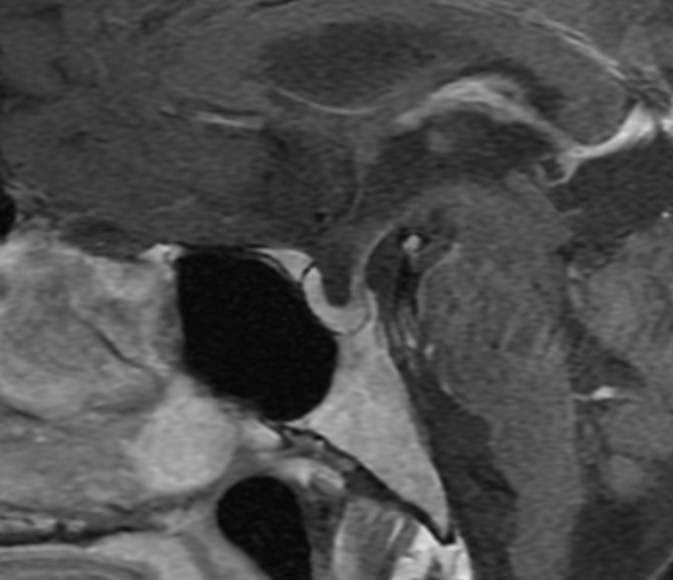
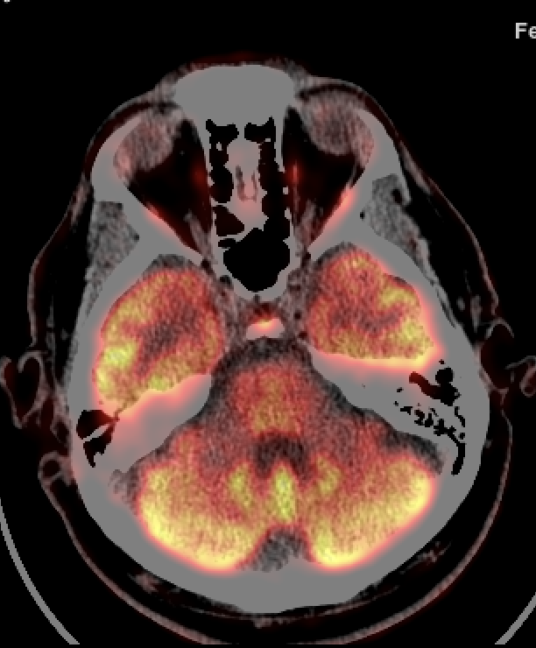
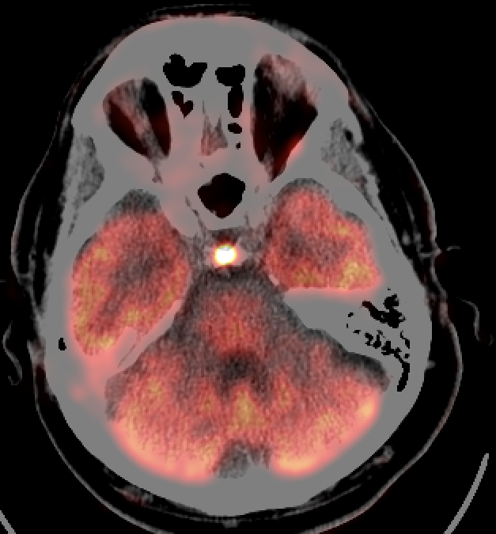
Brain-penetrant Mirdametinib
ECD
RDD
LCH

Slide 22
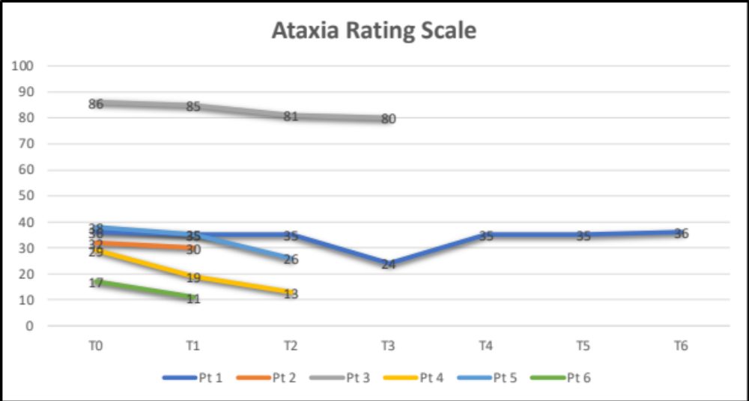
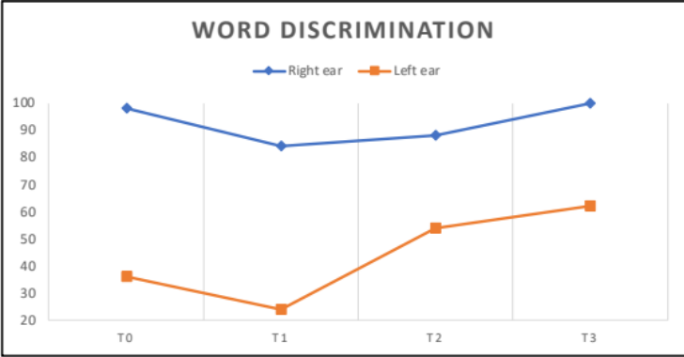
Functional Improvement
*fall with fracture
Right eye: HM → CF → CF
Left eye: CF → 20/400 → 20/100

Slide 23
ECD and the brain – Summary
Difficult manifestation of ECD with more and less obvious manifestations
More ECD patients affected than scans would estimate
Constellation of delayed diagnosis, lasting symptoms, poor energy, struggles with mood
Current treatments have solid but limited benefit
Need more effective treatments and earlier diagnosis

Slide 24
THANKS

