Slide 1


Movement as Medicine
Lizzy Bohorfoush, DPT
UAB Supportive Care and Survivorship Clinic

Slide 2
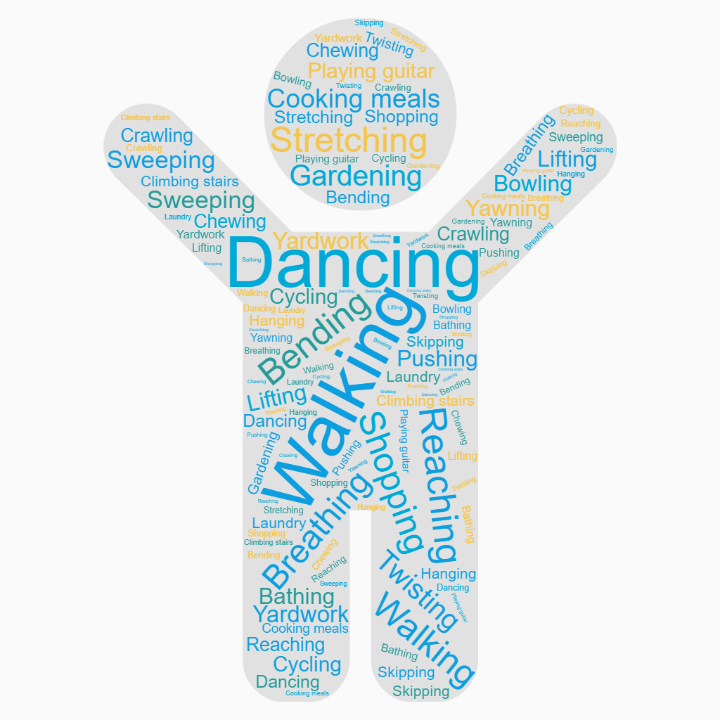
How have you moved today?
It all counts!
Notes:
Some of these are considered “exercise” but the majority of the day presents opportunities for moving mindfully. Avoid inactivity. Start where you are currently and build slowly and frequently.

Slide 3
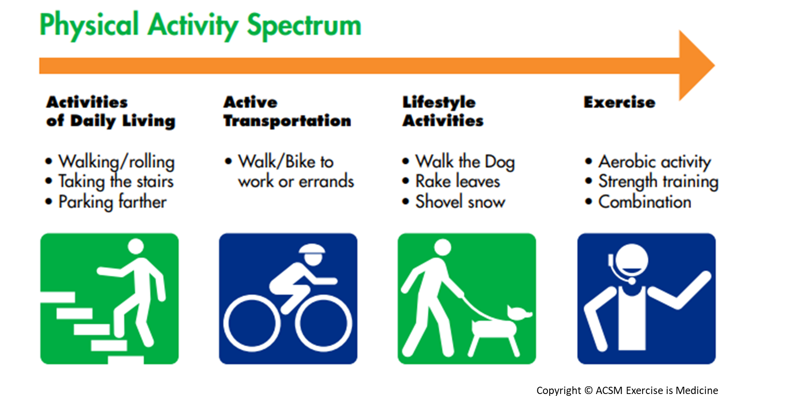
Copyright © ACSM Exercise is Medicine
Notes:
ACSM Exercise is Medicine. Currently establishing a PAVS (Physical Activity Vital Sign). How many days per week do you get
On average, how many days per week do you engage in moderate to vigorous physical activity (like a brisk walk)? _____ days
On average, how many minutes do you engage in physical activity at this level? _____ minutes Total minutes per week of physical activity (multiply #1 by #2) _____ minutes per week?

Slide 4
Physical and Psychological side effects of Chronic Disease on Patients and Caregivers
Frustration
Negativity
Isolation/Withdrawn
Depression
Loss of empathy
Loss of emotional energy
Physical symptoms like headache, nausea, dizziness
Fear of new pain or issues
Chronic stress and caretaking can be emotionally and physically taxing.
Notes:
For caregivers of loved ones, fatigue is a major side effect. Anger and resentment are also common, and they are very often suppressed since people do not feel like they should outwardly complain about taking care of a loved one.
Frustration and negativity, self-isolation/withdrawal, depression, relationship conflicts, loss of empathy and emotional energy, and even physical symptoms like nausea, dizziness, and headaches, can all take their toll when caring for a loved one.
When the immune system is impacted, the physical and psychological side effects go hand in hand. According to Ms Mackie, anger weakens the liver, fear hurts the kidneys, grief weakens the lungs, and worry affects the stomach.
Up to two-thirds of caregivers report clinically significant symptoms of insomnia, and one of the major contributors to insomnia is the chattering brain. We all experience thought and chatter in our heads, but when it becomes disruptive, it can overwhelm and lead to anxiety, depression, and stress.
But according to Ms Mackie, there are ways to deal with the chattering brain. First, quiet the mind with a concentrated focus (ie, reading, meditating, walking, doing a puzzle). Spend more time in the present, and focus on staying right here, right now.
Emotional Labor

Slide 5









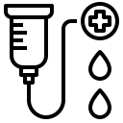
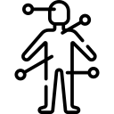




Benefits of Physical Activity for Cancer and Caregivers
Reduce fatigue
Decreases overall symptom burden
Improves cognitive function
Improves sleep
Increases treatment tolerance
Increase lean body mass
Increases insulin sensitivity
Improves lymphatic function
Decrease incidence of hospitalizations and/or ED visits
Reduces central adiposity
Reduce/prevent long-term effects from treatment
Reduces systemic inflammation
Combats anxiety & depression
Prevent/delay cancer recurrence
Notes:
Highlight just some. Long term side effects (mention bone density and falls)
But, it’s still hard to adopt this lifestyle.
LYMPHATIC FUNCTION: Garbage removal system (lymph) parallel to circulatory system. Compression garments partially useful but aren’t activating anything inside the systems. Its just real estate at that point. Exercise along with Manual Lymph Drainage therapy and self care/compression is Complete Decongestion Therapy. Muscles act as a “pump”. Diaphragmatic breathing can also stroke the thoracic duct.
ANXIETY/DEPRESSION – Stress suppresses natural killer cells. CBT concept -> what you do affects how you feel.
RECURRENCE” Healthy weight/Activity/Varied diet/ Limit alcohol
INFLAMMATION - adipose tissue -> chronic inflammation -> produces cytokines that are immune suppressive. Also adipose tissue -> home for hormones that promote cell growth
TREATMENT TOLERANCE: muscle tissue increase can help to metabolize the chemo drugs (Carla Prado ref?); increased circulation can deliver drugs more easily. Exercise boosts the immune response -> better able to handle post-operative surgical stress response. Exercise improves tumor vasculature (delivery of drugs enhanced.
Tumor vasculature: A tumor’s vasculature is very disorganized. Regions of the tumor are getting very little circulating blood. Aerobic exercise can increase the delivery of immune cells (natural killer cells) and chemo drugs (less intense treatments, less time to treat, more effective)
LEAN BODY MASS: Cancer is a highly catabolic disease and requires a lot of energy. So do muscles though. Muscles are the first to go. there are consequences of low LBM (poor function, poor outcomes) Think of your fighting weight. Cancer cachexia can happen with or without fat loss/gain. Quality of the tissue, not the quantity.
COGNITIVE FUNCTION – more circulation to brain, neuroplasticity/rewiring/stimulation/growth in hippocampus. Stimulates angiogenesis which increases cerebral blood flow -> improves connectivity of the vascular network, facilitating neurogenesis (learning and memory; growth factors)
CENTRAL ADIPOSITY - linked to cancers like breast, endometrial and prostate (hormonal) Obesity becoming a major focal point of research (environment includes increased inflammation, lowered immunity, higher circulating hormones (estrogen and insulin), increased tumor growth
FATIGUE: most often reported side effect. PA can help to reverse the deconditioning that occurs from the perfect storm of muscle loss, inactivity, reduced calorie intake, stress, interrupted sleep, low blood counts, etc.
TREATMENT TOLERANCE: muscle tissue increase can help to metabolize the chemo drugs (Carla Prado ref?); increased circulation can deliver drugs more easily. Exercise boosts the immune response -> better able to handle post-operative surgical stress response. Exercise improves tumor vasculature (delivery of drugs enhanced.
LEAN BODY MASS: Cancer is a catabolic disease; requires a lot of energy. Muscles do too so they are the first to go. Consequences of low LBM (poor function, poor outcomes) Cancer cachexia can happen with or without fat loss & gain. Quality of tissue, not quantity. More muscle makes it metabolically harder for your cancer to grow (helping with gluco-regulation, lowering insulin levels, lowering Insulin growth factor IGF).
COGNITIVE FUNCTION – more circulation to brain, neuroplasticity/rewiring/stimulation/growth in hippocampus
INSULIN SENSITIVITY: glucose uptake to muscle improves
LYMPHATIC FUNCTION: Garbage removal system (lymph) parallel to circulatory system. Compression garments partially useful but aren’t activating anything inside the systems. Its just real estate at that point. Exercise along with Manual Lymph Drainage therapy and self care/compression is Complete Decongestion Therapy. Muscles act as a “pump”. Diaphragmatic breathing can also stroke the thoracic duct.
CENTRAL ADIPOSITY - linked to cancers like breast, endometrial and prostate (hormonal) Obesity becoming a major focal point of research (environment includes increased inflammation, lowered immunity, higher circulating hormones (estrogen and insulin), increased tumor growth. Maintain weight. More fat cells = more estrogen.
ANXIETY/DEPRESSION – Stress suppresses natural killer cells. CBT concept -> what you do affects how you feel.
RECURRENCE” Healthy weight/Activity/Varied diet/ Limit alcohol -- up to 40% reduced risk for Br/Pros/Colon
INFLAMMATION - adipose tissue>chronic inflammation>produces cytokines (adipokines) that are immune suppressive. Also adipose tissue is home for hormones that promote cell growth. Exercise produces myokines (made by muscles)>anti-inflammatory Muscles chemicals block the ability of the fat chemicals to talk to the tumor microenviroment.
IMMUNITY: Exercise is an acute stressor. The reaction of the body during the rest phase is where the magic happens. The troops are called in to repair and reinforce. If we don’t move, this doesn’t happen as easily and leaves room for invaders to take hold.
BONE LOSS: hormonal txs that accelerate loss(aromatase inhibitors, androgen deprivation therapies-ADTs,steroid use)
Biomarkers: Decreases estrogens and androgens (inhibits growth)
Divert energy from cancer cells in 4 ways:
ENERGY – energy spent on PA is energy NOT spent on cancer cell reproduction
SUGAR – High blood glucose chronically fuels cells. Starve the cancer cells
INFLAMMATION – Chronic inflammation causes cellular damage. More adiposity = more inflammation
ANTIOXIDANTS & IMMUNE FUNCTION – PA stimulates the body to spend energy on repair and maintenance systems to mop up the “damage” that exercise causes. Non-extreme exercise boosts the immune system.

Slide 6
Let’s Get Moving!

Slide 7
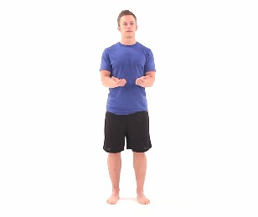
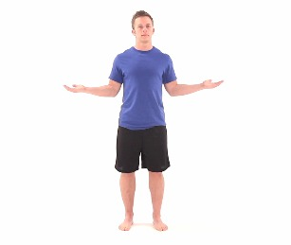
Shoulder Blade Squeeze with External Rotation

Slide 8
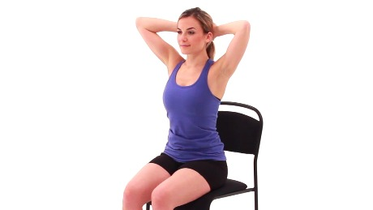
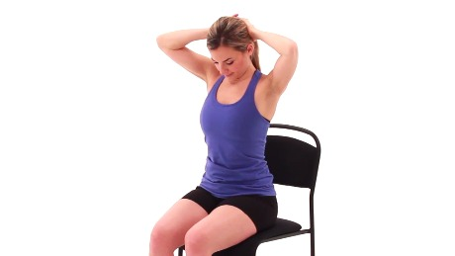
Seated Neck Flexion Stretch
Notes:
Weight of your hands***

Slide 9
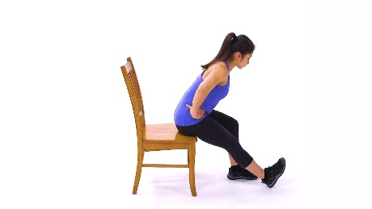
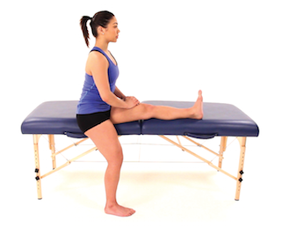
Seated Hamstring Stretch- 2 ways

Slide 10
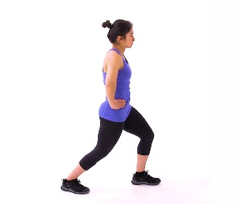
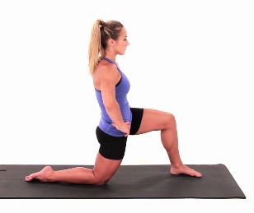
Hip Flexor Stretch – 2 ways

Slide 11
Thank you!

