Slide 1


Erdheim Chester Disease Treatment:
Overview on Treatment Options within the Landscape of Histiocytic Neoplasms
Samuel B. Reynolds, MD
Clinical Assistant Member in Hematology
ECDGA Cancer Center Lead
Moffitt Cancer Center
Notes:
Hi everyone and welcome. My name is Sam Reynolds and I’m a malignant Hematologist at the Moffitt Cancer

Slide 2
Outline
Erdheim Chester Disease (ECD) Overview
ECD amongst histiocytic neoplasms
Clinical heterogeneity in ECD and impact on therapy
Molecular diversity and the challenge in selecting a targeted agent in ECD
Q&A

Slide 3
HSPC’s, also known as stem cells
Platelets
White blood cells***
RBC’s
Essential in oxygen binding, transport and delivery
Primary hemostasis
Diverse, multifaceted
Myeloid
Monocytes
Granulocytes
HSPC
T
Lymphoid
B
Notes:
In terms of where histiocytic disease originates, every white blood cell comes from the bone marrow, which is home to stem cells. When stem cells are maturing, they will differentiate into monocytes, some of which later leave the bone marrow and deposit in various tissues as resident macrophages.

Slide 5
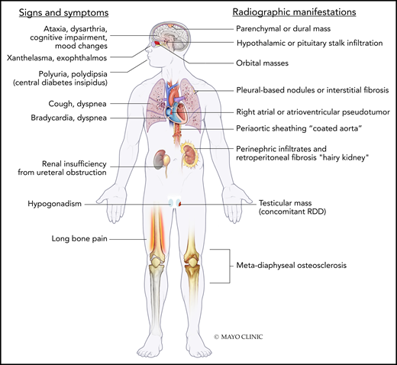
Erdheim Chester Disease
Non-Langerhans cell histiocytic neoplasm
Proliferation of tissue-resident macrophages (histiocytes) proliferate
Sclerosis/fibrosis in various end-organs
Goyal et al., Blood 2020
Notes:
These macrophages within tissues are better known as histiocytes, which as we know proliferate.
As we’ve heard, Erdheim Chester Disease arises when these histiocytes in various tissues proliferate.
The disease can look very different from person to person depending o where these clusters of cells are found
So to begin, as I know many of you are new to Erdheim Chester and to this community, I’ll start by saying that no two people with ECD are alike.
People with disease in the brain or pituitary gland might present with confusion, issues with speech or even difficulty walking or with fine motor coordination. Visual impairment has been described as well
Patients with scarring or fibrosis in the center of the chest or heart, what we call the mediastinum, may develop difficulty breathing or issues with circulation
Those with disease around the kidneys can present with urinary impairment or retention
And of course osseous disease, specifically affecting the long bones, can lead to debilitating pain

Slide 6
How do we treat a disease that looks different in every patient?
We begin with a framework for approaching ECD

Slide 7
ECD Diagnosis
Disseminated (multi-system disease)
Body imaging by PET +/- bone scan
Localized (single-site/limited) disease
Life-threatening symptoms or organ dysfunction?
Consider:
Surgical resection
Radiation
Observation in select cases
No
Yes
Symptomatic
Yes
Refer to ECDGA care center if possible
No
Consider observation

Slide 8
ECD affecting multiple systems or critical structures
Refer to ECDGA Care Center →Hematology/Oncology
→Hematopathology
→Advanced diagnosticians/radiologists
Comprehensive assessment →DNA/RNA abnormalities
→Endocrinopathies
→Additional imaging if needed
Consider clinical trial enrollment early and often throughout care
Is a targetable mutation or fusion present?
No
Yes
Systemic Therapy
Mutation/fusion guided targeted therapy
Consider alternative therapy, clinical trial if progression
Progression or intolerable adverse effects
Re-assess genomic data. If present, treat as per above. If not, move to non-targeted therapy.

Slide 9
Why isn’t it this simple in practice?
What else must we consider?

Slide 10
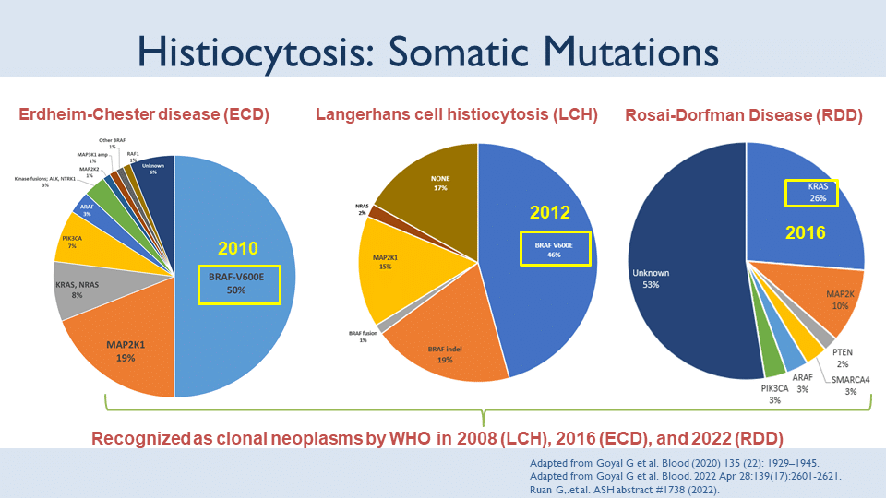

Slide 11
ECD affecting multiple systems or critical structures
Refer to ECDGA Care Center →Hematology/Oncology
→Hematopathology
→Advanced diagnosticians/radiologists
Comprehensive assessment →DNA/RNA abnormalities
→Endocrinopathies
→Additional imaging if needed
Consider clinical trial enrollment early and often throughout care
Is a targetable mutation or fusion present?
No
Yes
Systemic Therapy
Mutation/fusion guided targeted therapy
Consider alternative therapy, clinical trial if progression
Progression or intolerable adverse effects
Re-assess genomic data. If present, treat as per above. If not, move to non-targeted therapy.

Slide 12
ECD affecting multiple systems or critical structures
Refer to ECDGA Care Center →Hematology/Oncology
→Hematopathology
→Advanced diagnosticians/radiologists
Comprehensive assessment →DNA/RNA abnormalities
→Endocrinopathies
→Additional imaging if needed
Consider clinical trial enrollment early and often throughout care
Is a targetable mutation or fusion present?
No
Yes
Systemic therapy
→Cladribine
→Pegylated IFN
→Sirolimus
BRAFV600E Mutation
Vemurafenib (preferred)
Dabrafenib
Other MAP Kinase pathway variant
Cobimetinib
Trametinib
Selumetinib
ALK fusion
Alectinib
Brigatinib
Ceritinib
Crizotinib
Lorlatinib
CSF1R Mutation
Pexidartinib
NTRK fusion
Entrectinib
Laroptrectinib
Repotrectinib
PIK3CA Mutation
Everolimus
Sirolimus
RET fusion
Selpercatinib
Consider alternative therapy, clinical trial if progression
Progression or intolerable adverse effects
Re-assess genomic data. If present, treat as per above. If not, move to non-targeted therapy.

Slide 13
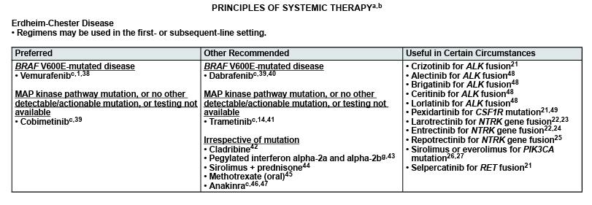
NCCN Guidelines on Histiocytic neoplasms. 2026

Slide 14
References
Gaurav Goyal, Mark L. Heaney, Matthew Collin, Fleur Cohen-Aubart, Augusto Vaglio, Benjamin H. Durham, Oshrat Hershkovitz-Rokah, Michael Girschikofsky, Eric D. Jacobsen, Kazuhiro Toyama, Aaron M. Goodman, Paul Hendrie, Xin-xin Cao, Juvianee I. Estrada-Veras, Ofer Shpilberg, André Abdo, Mineo Kurokawa, Lorenzo Dagna, Kenneth L. McClain, Roei D. Mazor, Jennifer Picarsic, Filip Janku, Ronald S. Go, Julien Haroche, Eli L. Diamond. Erdheim-Chester disease: consensus recommendations for evaluation, diagnosis, and treatment in the molecular era. Blood, Volume 135, Issue 22, 2020, Pages 1929-1945, ISSN 0006-4971.
Haroche J, Arnaud L, Cohen-Aubart F, Hervier B, Charlotte F, Emile JF, Amoura Z. Erdheim-Chester disease. Curr Rheumatol Rep. 2014 Apr;16(4):412. doi: 10.1007/s11926-014-0412-0. PMID: 24532298.
Wilcox SR, Reynolds SB, Ahmed AZ. Erdheim-Chester Disease: Investigating the Correlation between Targeted Treatment Therapy and Disease Outcomes. Cancers (Basel). 2024 Mar 27;16(7):1299. doi: 10.3390/cancers16071299. PMID: 38610977; PMCID: PMC11010843.
NCCN Guidelines for Histiocytic Neoplasms, 2026 [Available from https://www.nccn.org/professionals/physician_gls/pdf/histiocytic_neoplasms.pdf; accessed 22 Apr 2026]

Slide 15

Thank you to all the patients and families who support ECDGA , our research and ongoing efforts to improve and save lives
ECDGA
Gaurav Goyal
Paul Hendrie
Diane Shriner
Jerome Henson
Moffitt Cancer Center
Lubomir Sokol
Ling Zhang
Amisha FNU
David Pottinger
Corbin Wright
Pujan Patel
University of Michigan
Asra Ahmed
Xi Yang
Sabrina Wilcox
Haadi Ali
Weill Cornell
Rebecca Denson
Mayo Clinic
Jithma Abeykoon
Ronald Go

Slide 16
Additional slides if needed

Slide 17
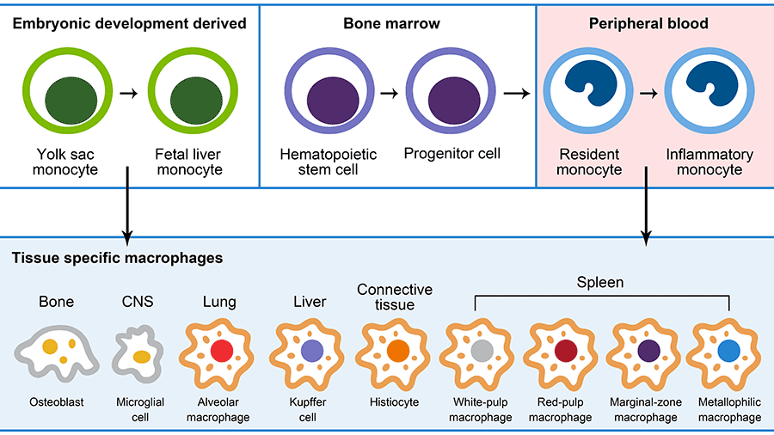
Thermo Fisher, 2025

Slide 18
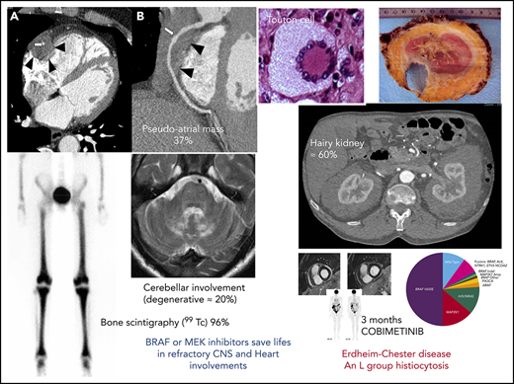
Haroche et al., Blood 2020

Slide 19
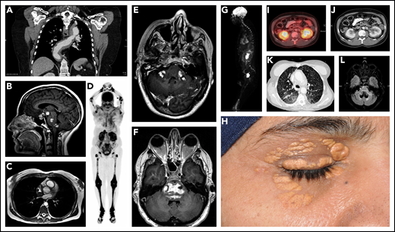
Goyal et al., Blood 2020

