Slide 1
Erdheim-Chester Disease Global Alliance
Wi-Fi Information:
Step 1: Connect to the “UABStartHere” Network.
Step 2: Open a web browser and navigate to any URL. You will be redirected to a page with options. Select “Register for Guest Access”
Step 3: Enter your Name, Email Address, accept the terms of use, and click “Register”.
Step 4: You will then receive a registration receipt. This information is also emailed to your email address. Click “Log In” to connect to the network.

Slide 2

Erdheim-Chester Disease Global Alliance
11th Annual ECD Medical Symposium
Welcome!

Slide 3
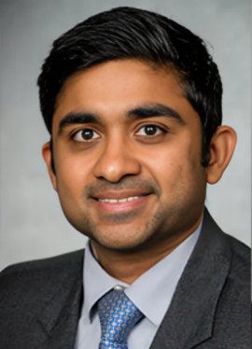
Erdheim-Chester Disease Global Alliance
Host of the
11th Annual Medical Symposium
Gaurav Goyal, MD
University of Alabama at Birmingham
ECDGA Medical Advisory Board

Slide 4

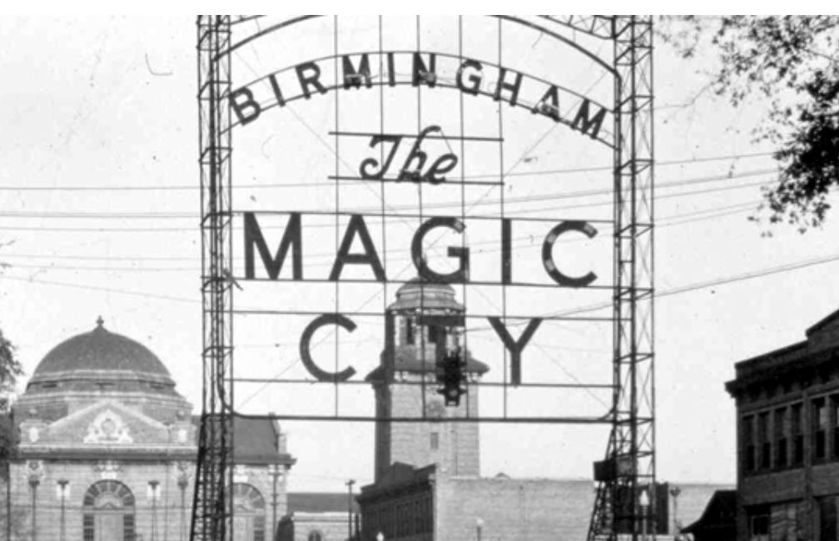
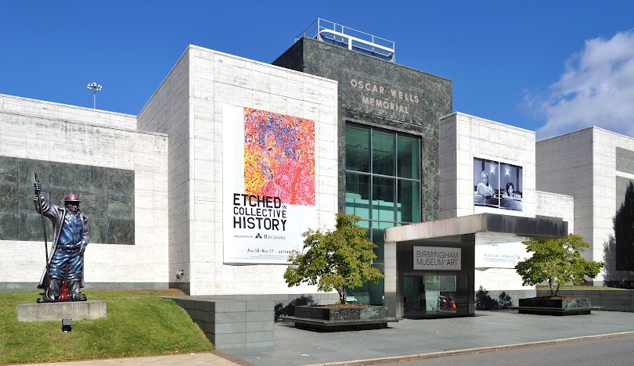
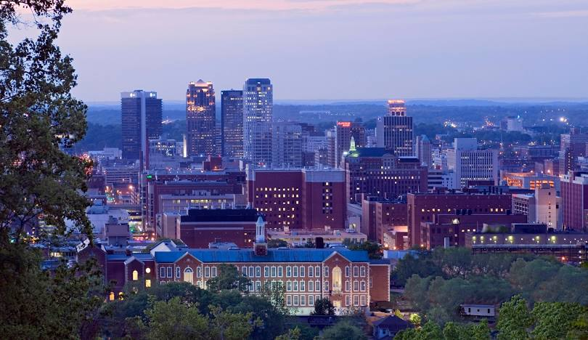
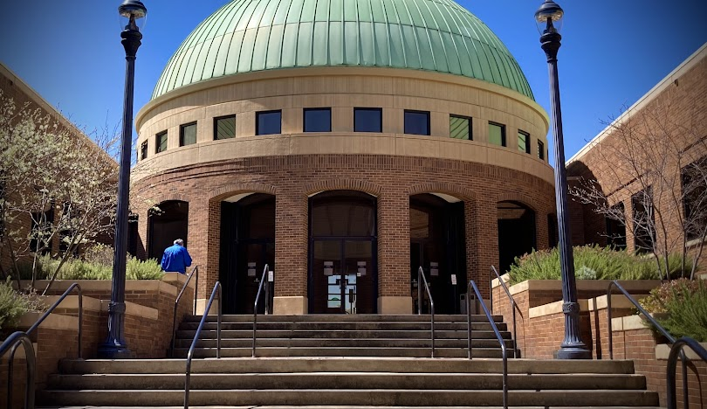

Erdheim-Chester Disease Global Alliance
Notes:
Welcome to Birmingham, a city known for courage, creativity, and community. From the Civil Rights Institute to the art museum and botanical gardens, this is a place that honors the past while looking forward. We’re grateful you’ve chosen to spend this time together here.

Slide 5
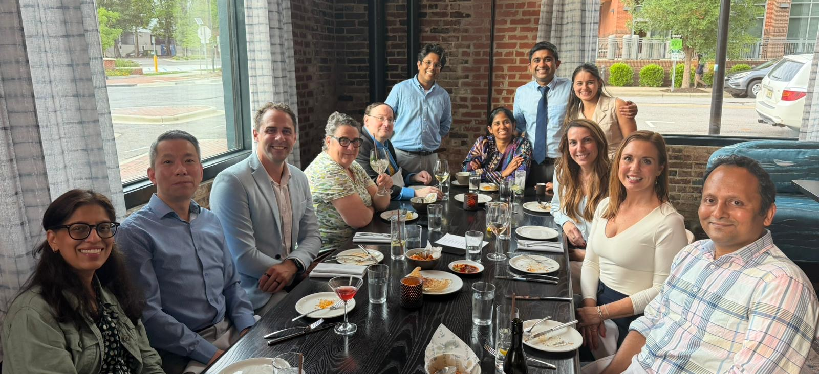
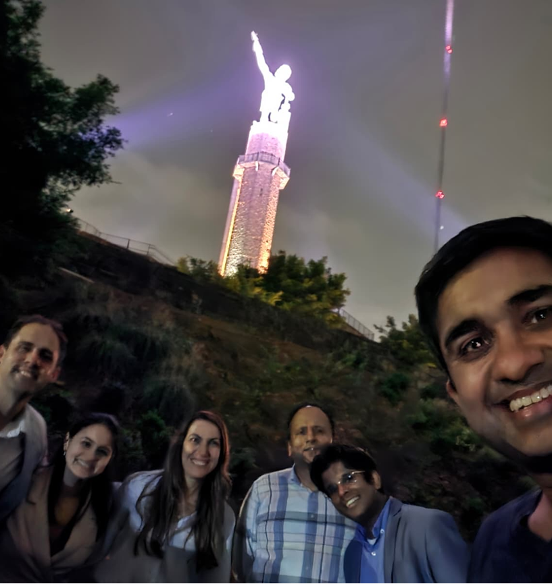
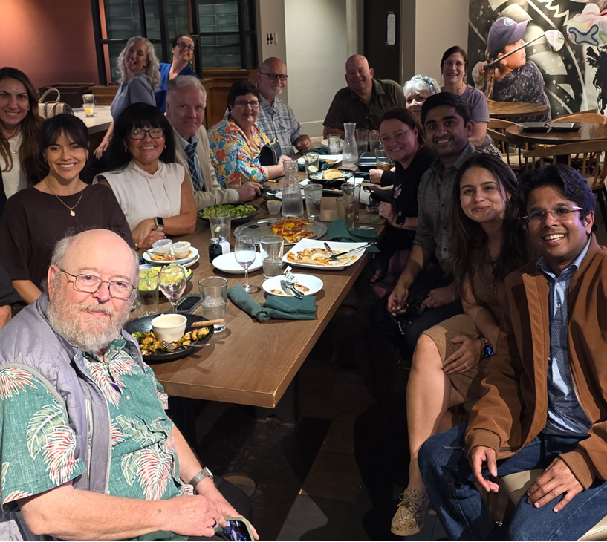
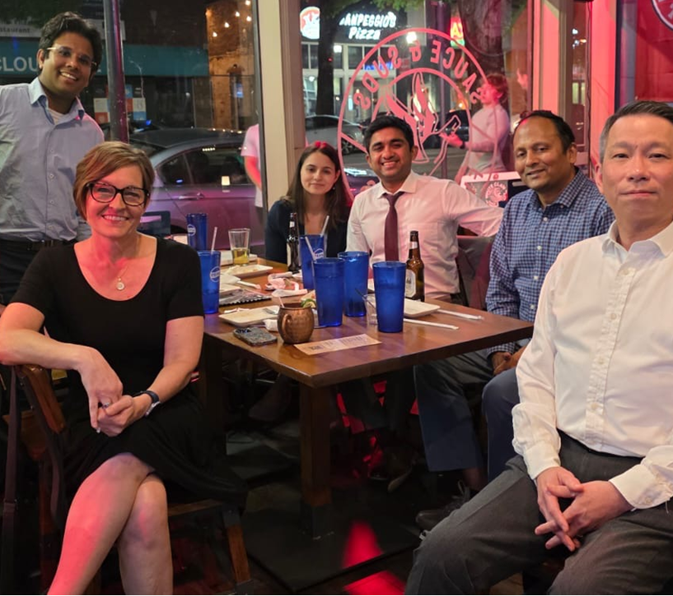
Erdheim-Chester Disease Global Alliance
Notes:
Welcome to Birmingham, a city known for courage, creativity, and community. From the Civil Rights Institute to the art museum and botanical gardens, this is a place that honors the past while looking forward. We’re grateful you’ve chosen to spend this time together here.

Slide 6




Erdheim-Chester Disease Global Alliance
E
Special Thanks to this Year’s Sponsors

Slide 7












Erdheim-Chester Disease Global Alliance
2007
1st Treatment: Interferon
ECDGA Founded
2011
Natural History
2012
2013
2014
1st ECD Conference
Registry Created
2008
Mutation Discovered
E
2015
2016
2017
2021
2022
Future
Care Centers
ECD = Cancer
US: FDA Approval - Vemurafenib
NCCN Guidelines
US: FDA 2 Approval - Cobimetinib
Improved Health

Slide 8
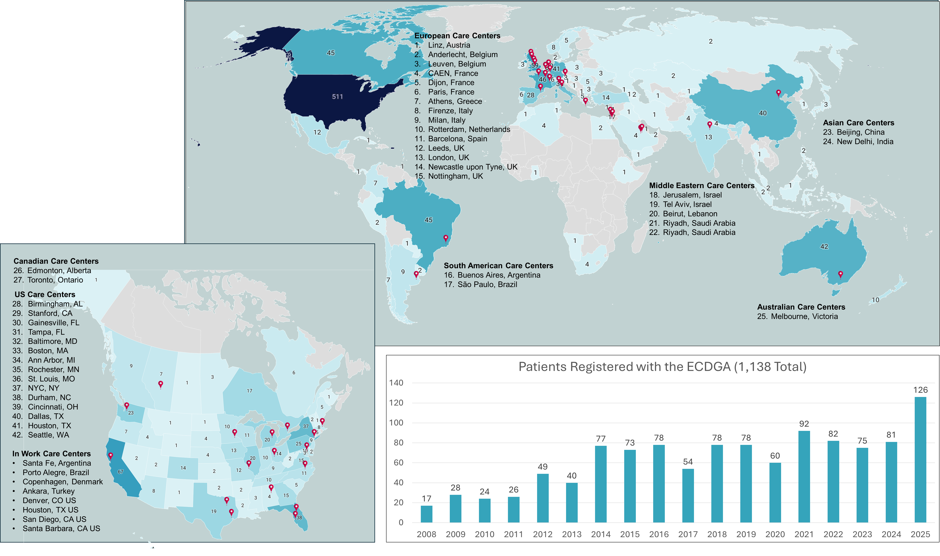

g
Number Registered ECD Patients by Country/State & 41 Care Centers

Slide 9










ECDGA Programs
E
Patient Navigator
Annual
Conference
Online Chats
Webinars
Care Center
Referral Network
Research
Funding
Research
Recruitment
Education
Awareness

Slide 10

Erdheim-Chester Disease Global Alliance
E
Door Prize tickets
(In your conference bag)
Drawing at the end of the day

Slide 11
Erdheim-Chester Disease Global Alliance
Reminders:
  Group Picture at: 11:45 am (Just before lunch)
  Medical Reception at: 6:00 pm
  (Roof-Top Terrace – 3rd Floor)
  Care Center Meeting – Saturday 8:00am-11:00am
  (Wallace Tumor Institute – Room# WTI 101)

Slide 12






Today’s Focus
Build Collaborations
Offer Ideas
Be Part of the
Community
Listen
Learn
Ask Questions

Slide 13
How to ask great questions?
Start by listening
Ask open-ended questions
Curiosity > critique
Ask questions, rather than making comments
What do you want to know more about?
Don’t feel the need to summarize or give a long preamble
Don’t be afraid to ask for clarification

