Slide 1

Challenging case study:
All that glitters: retro-orbital xanthogranuloma or ECD?
3:45 pm | All that glitters: retro-orbital xanthogranuloma or ECD? | Matthew Collin Newcastle University
Notes:
challenging case for me maybe not for you guys
Hope that’s not Elon Musk on the podium

Slide 2
Clinical timeline
2018 2020 2022 2024 2026
Background
46 years store manager two grown children
DM Type 2
‘no blood pressure’ L arm
myeloid NGS NAD
2018 presented with
watery eyes
proptosis
diplopia
‘feeling of pressure’ behind my eyes’
CT, MRI head
biopsy

Slide 3
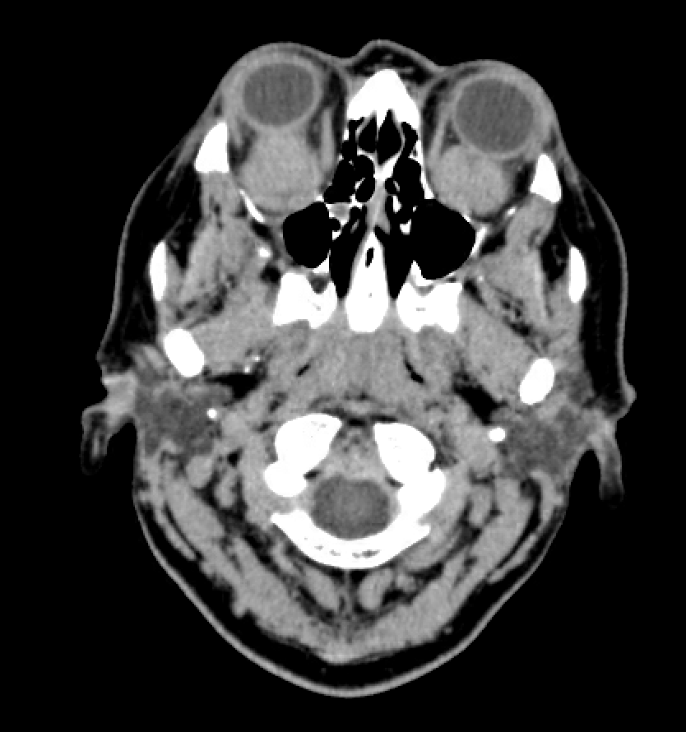
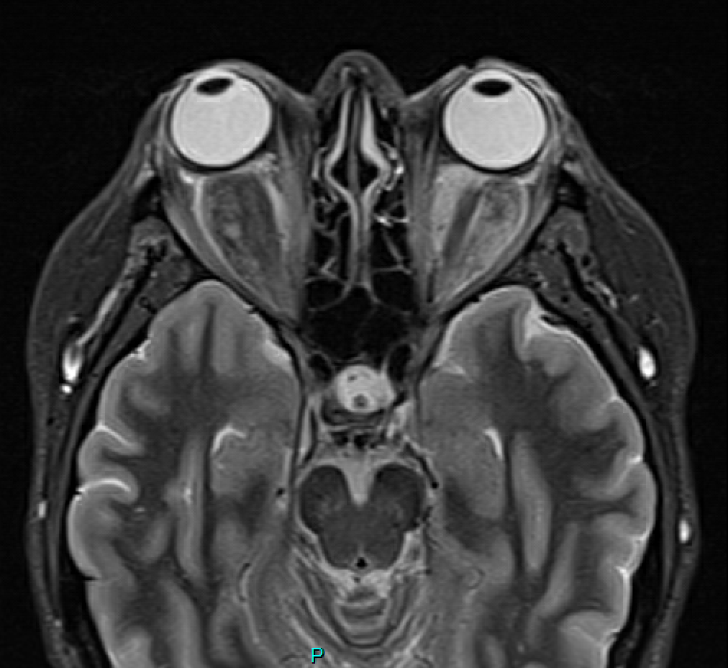
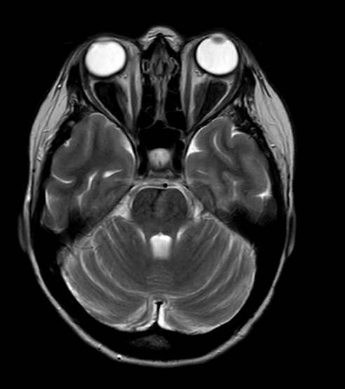
CT post contrast 2018
MRI STIR (fat suppression) 2018
[Normal MRI STIR]
[+ pituitary stalk thickening - DI excluded and stalk settled]

Slide 4
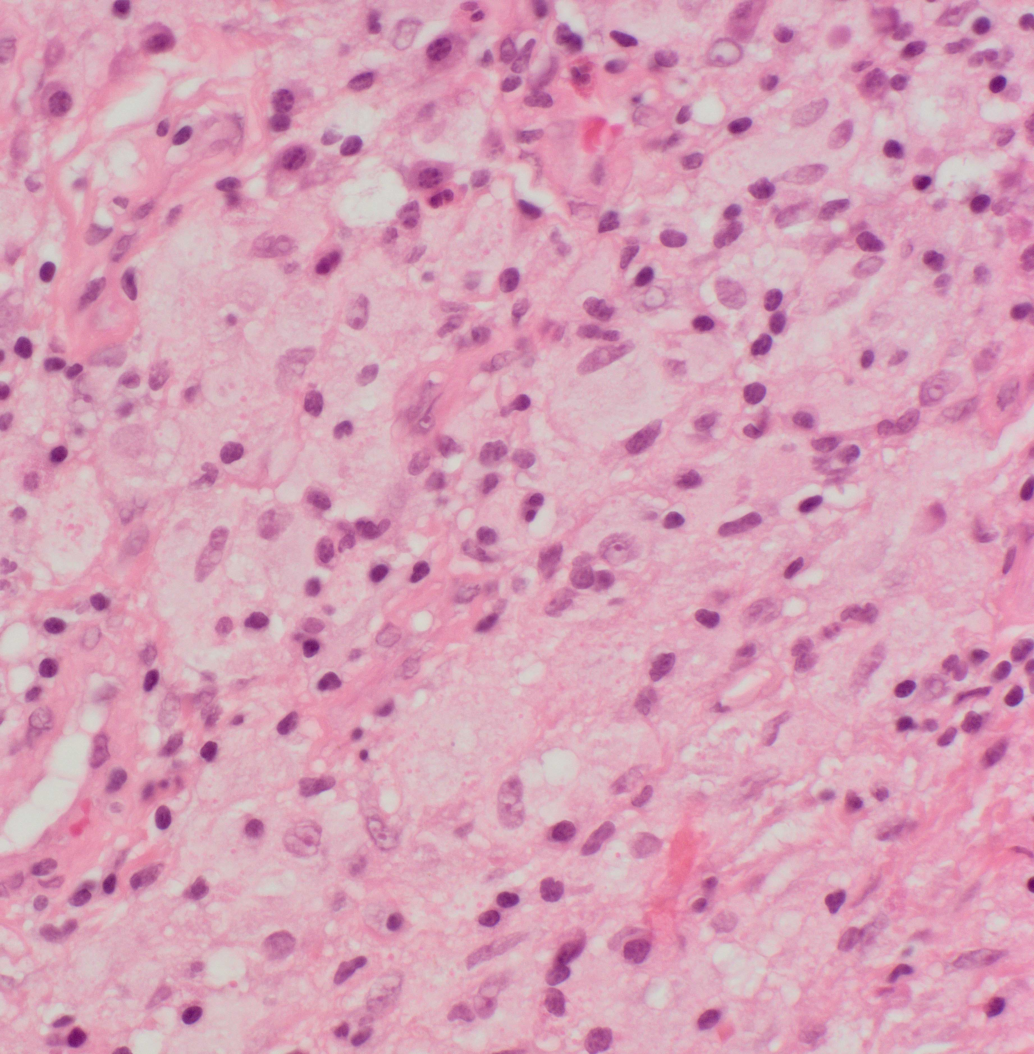
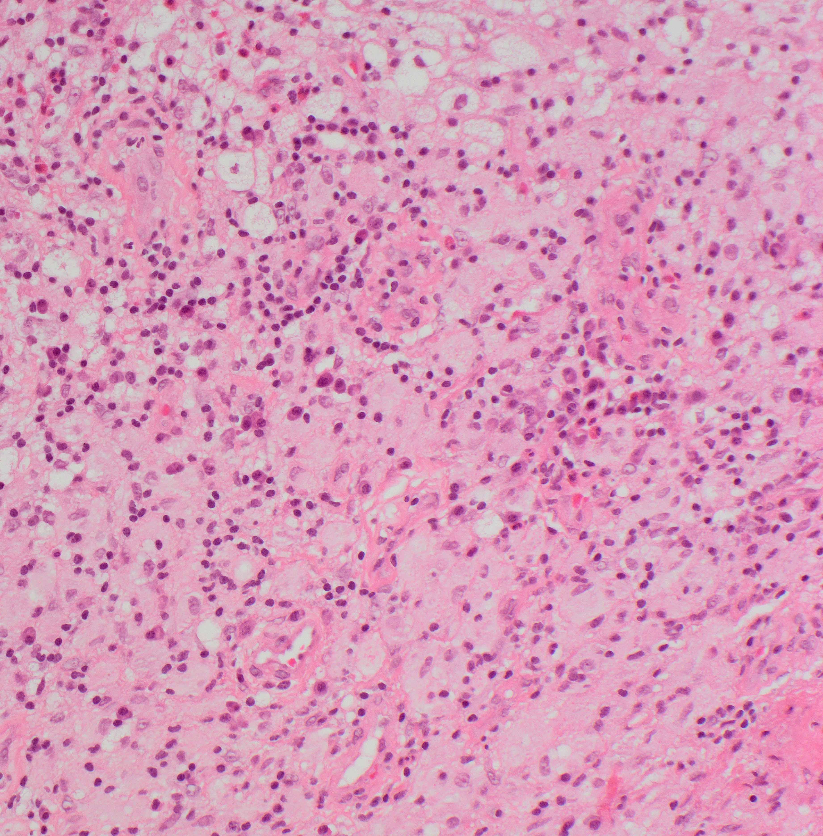
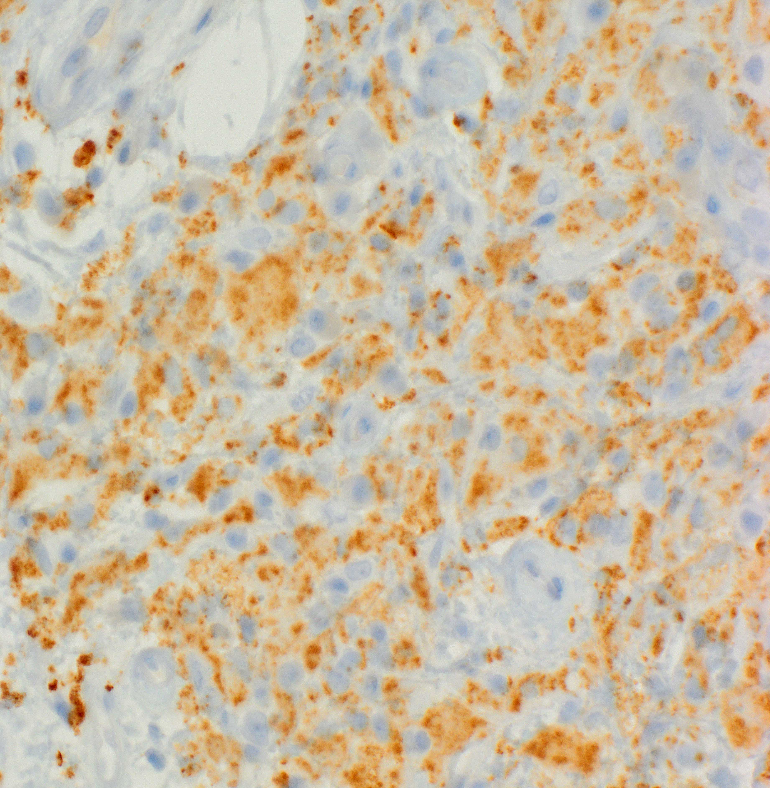
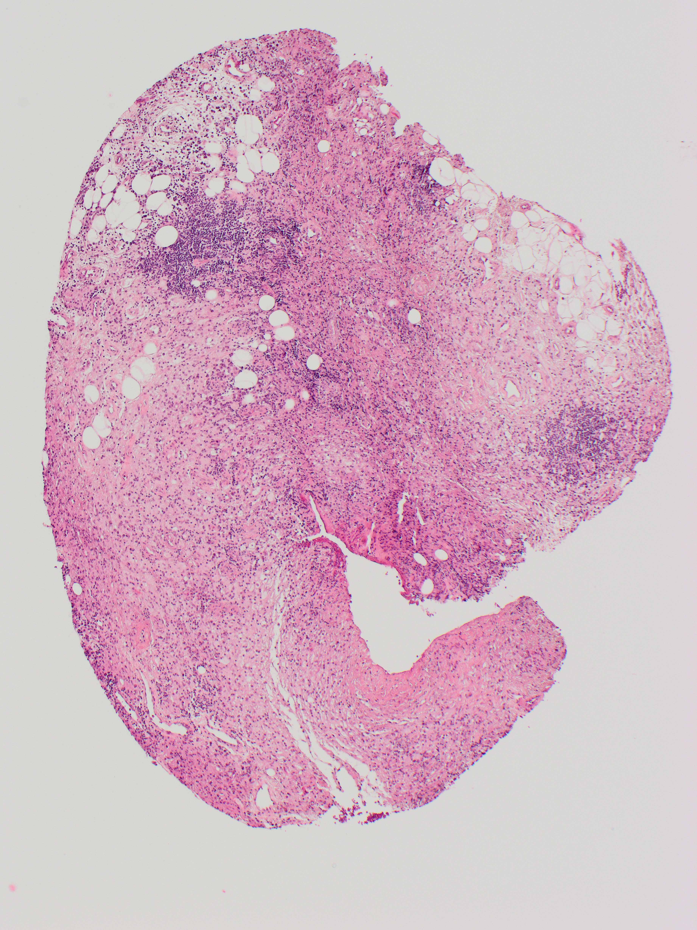
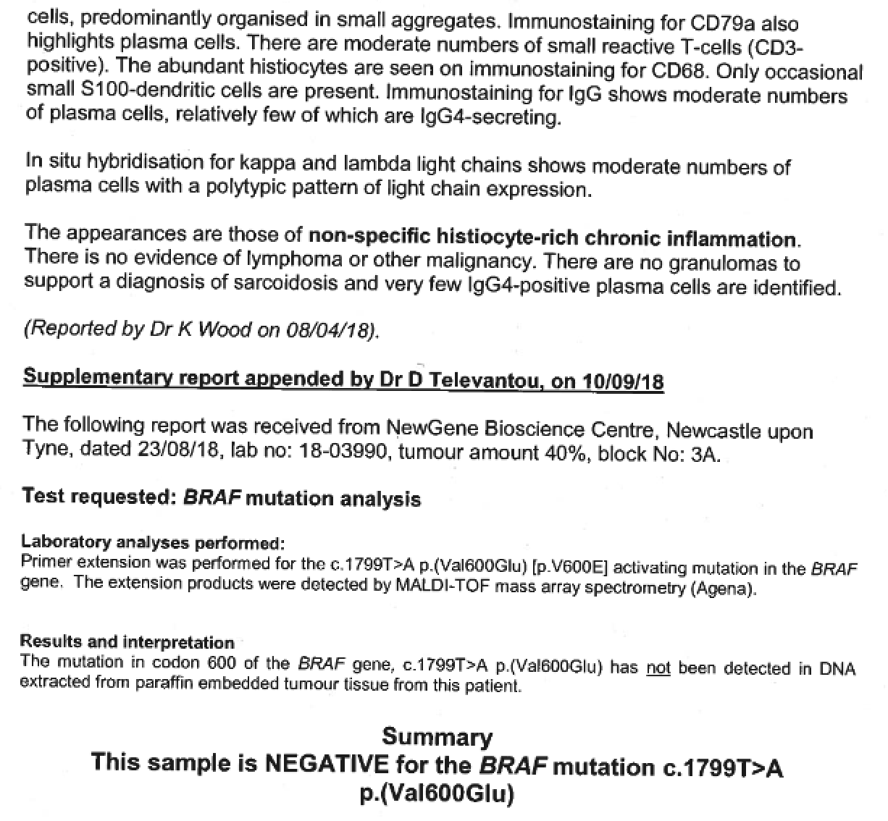
Biopsy
CD68
(MALDI-TOF MS)
Notes:
Well educated in our centre so sent for BRAFV600E

Slide 5
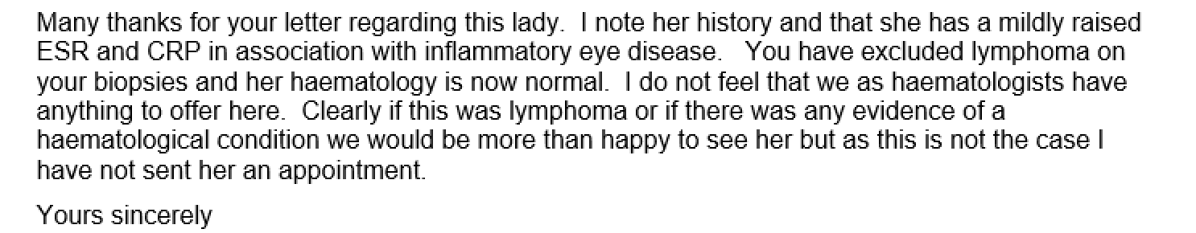
Referred to a colleague

Slide 6
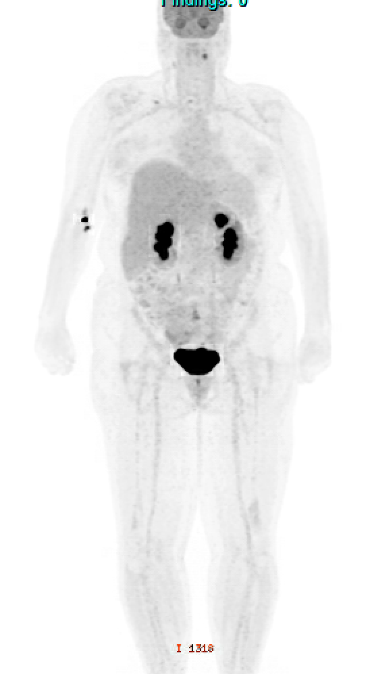
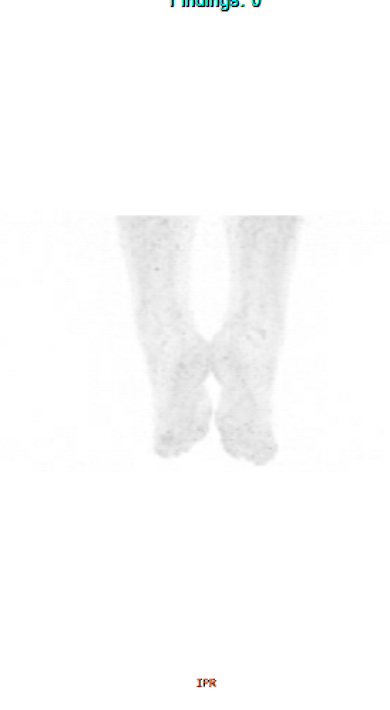
CT post contrast 2018
MRI STIR (fat suppression) 2018
PET-CT
Prednisone 30mg from ophthalmology
likely high glucose

Slide 7
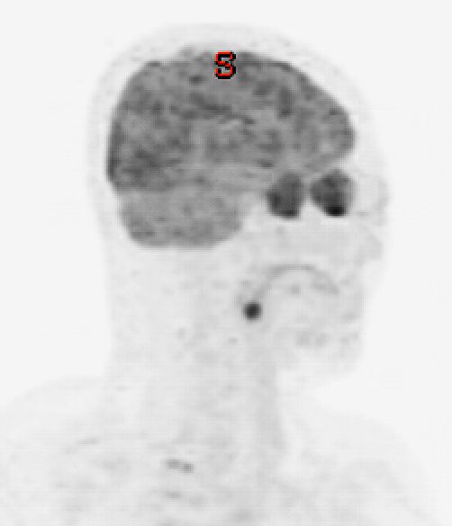
CT post contrast 2018
MRI STIR (fat suppression) 2018
orbits at 45º

Slide 8
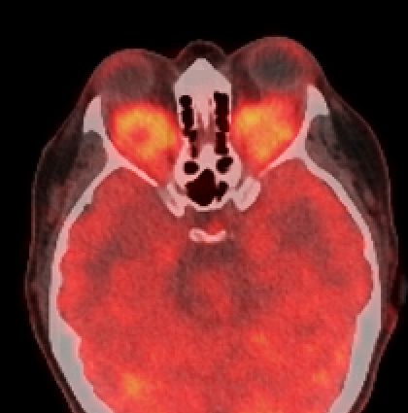
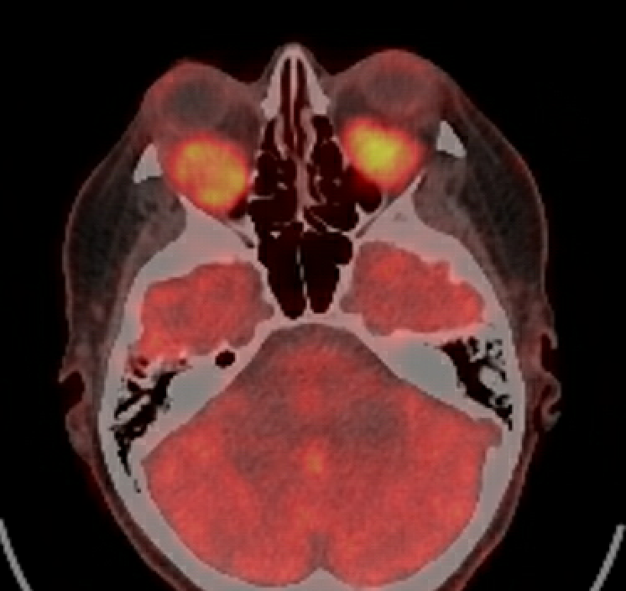
CT post contrast 2018
MRI STIR (fat suppression) 2018
PET-CT

Slide 9
1. Adult onset xanthogranuloma (AOX/AOXG/AOXGD) or ECD?
Type* | Location | Immune dysfunction | Internal organs | Path features | mutations**
AOX | Anterior |  |  |  | 2/11 KRAS, BRAF
AAPOX | Anterior | +++ |  | Lymphocytic aggregates | 2/6 NRAS, KRAS, PIK3CA
NBX | Anterior | +++ | + | Necrosis | 0/7
ECD | Intraconal | + | +++ | Diffuse lymphocytic infiltrates with fibroblasts | 4/4 KRAS, BRAF
*adult onset xanthogranuloma (AOX); adult-onset asthma and periocular xanthogranuloma (AAPOX); Necrobiotic xanthogranuloma (NBX); Erdheim-Chester disease (ECD), and
**Detinger 2024
Sivak-Callcott JA, Rootman J, Rasmussen SL et al. Br J Ophthalmol. 2006;90 (5):602-608.
Notes:
NB differential of orbital granuloma (as opposed to XG) is MUCH broader

Slide 10
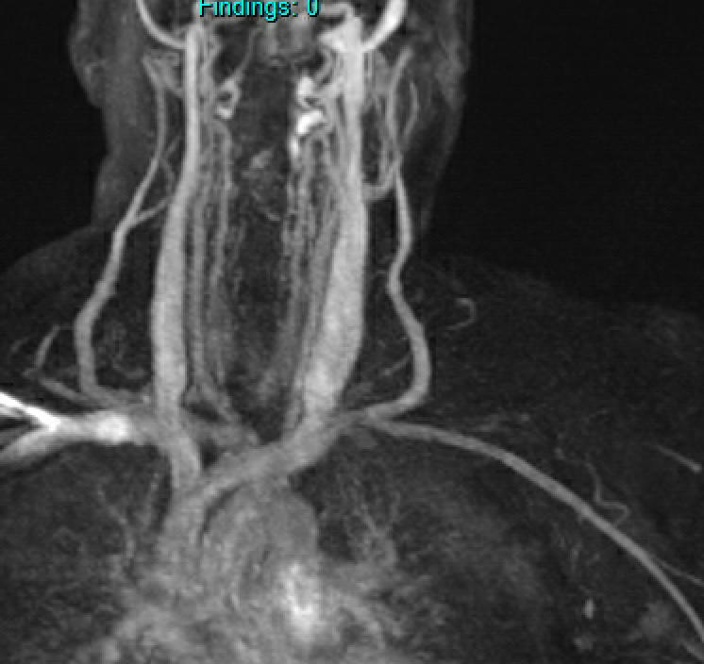
2. Absent pulse in the left arm – is this a feature of ECD?
MRA 2024 – almost completely occluded

Slide 11
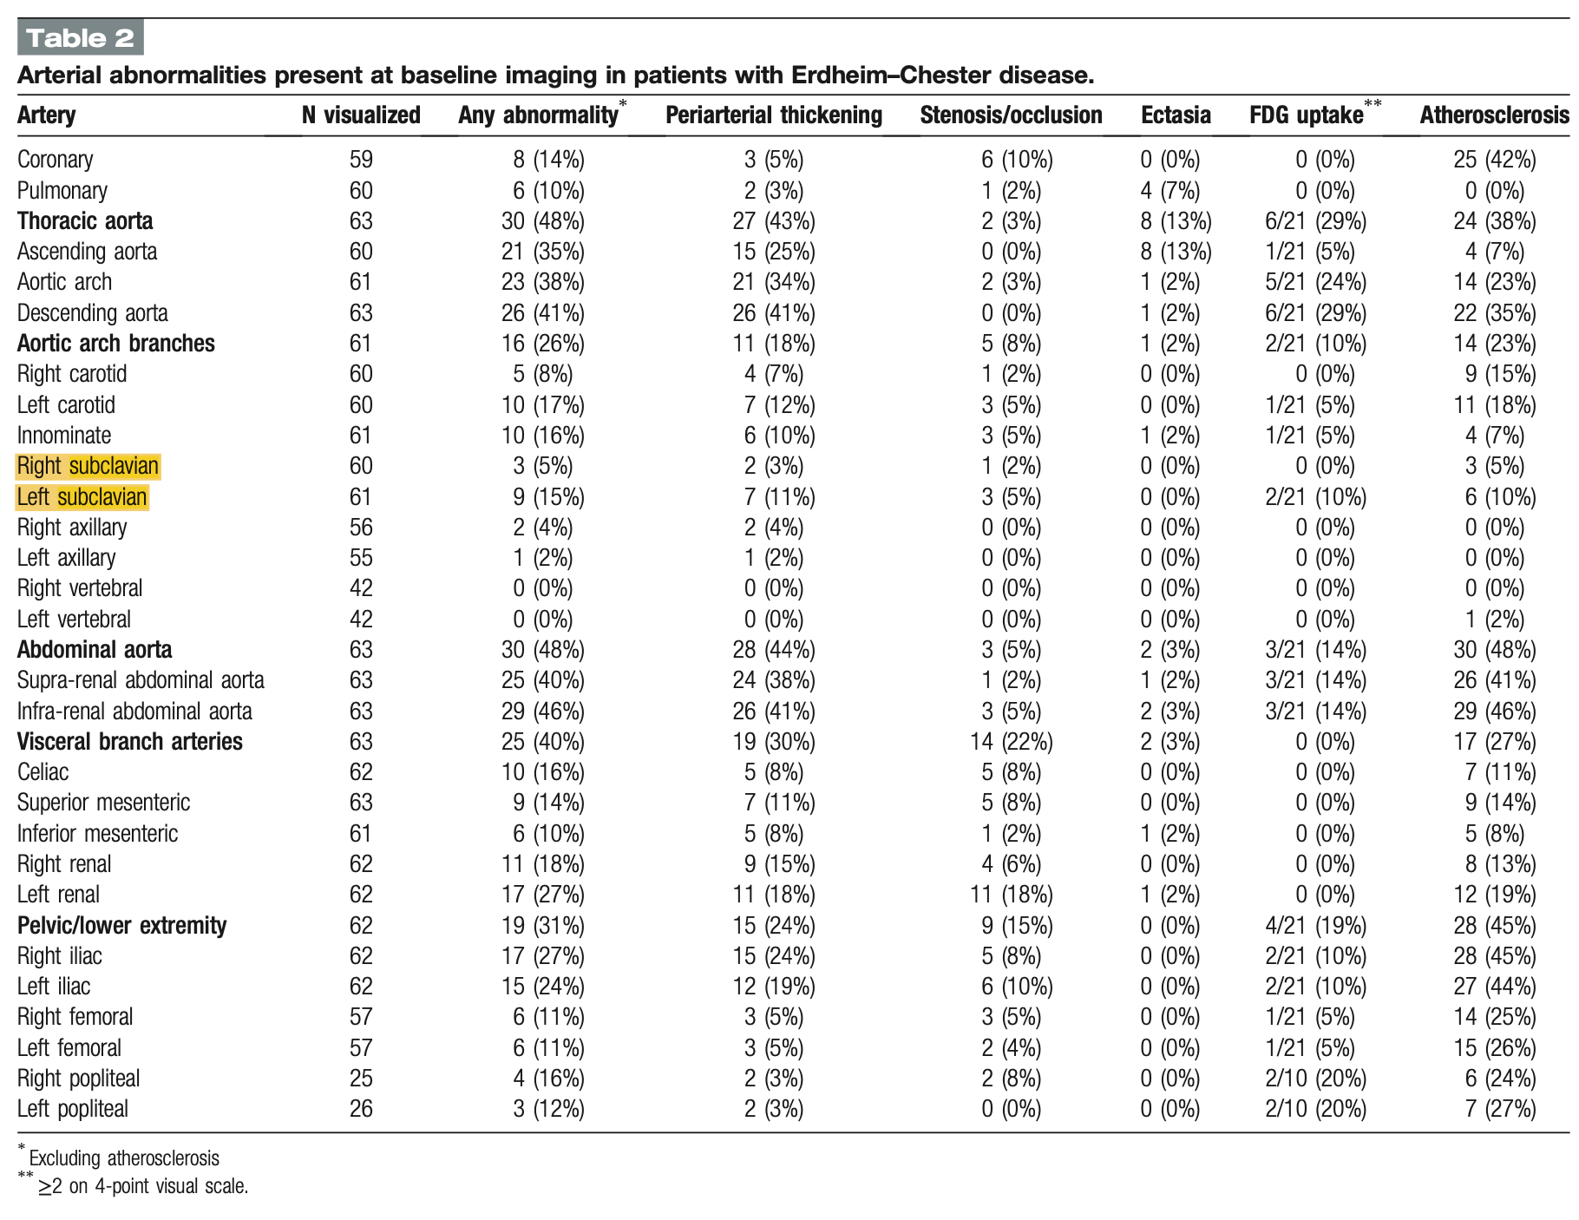
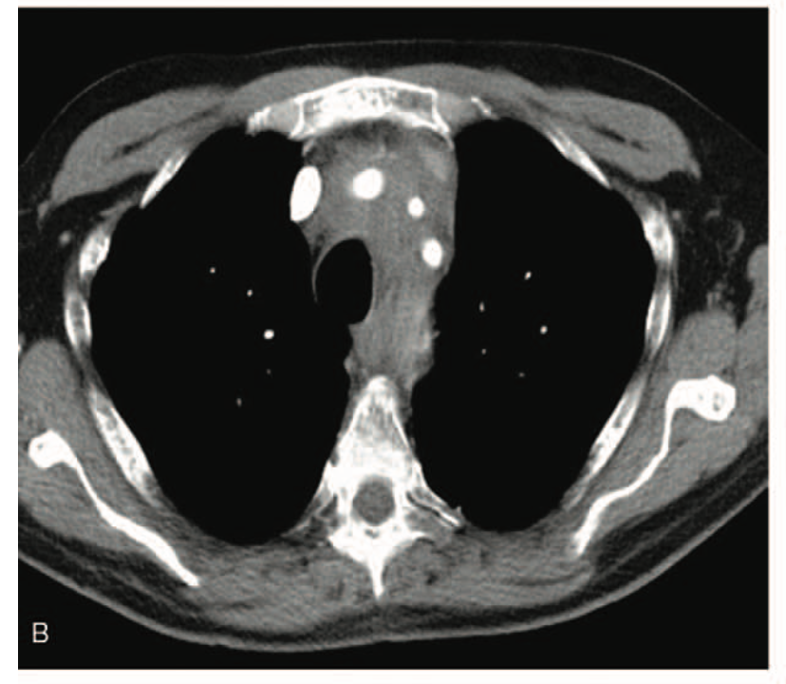
2. Absent pulse in the left arm – is this a feature of ECD?
Periadvential thickening of the left subclavian, left carotid and innominate arteries (contrast enhanced computed tomography angiography, axial view).
Villatoro-Villar M, Bold MS, Warrington KJ et al. Arterial involvement in Erdheim-Chester disease: A retrospective cohort study. Medicine (Baltimore). 2018;97 (49):e13452.

Slide 12
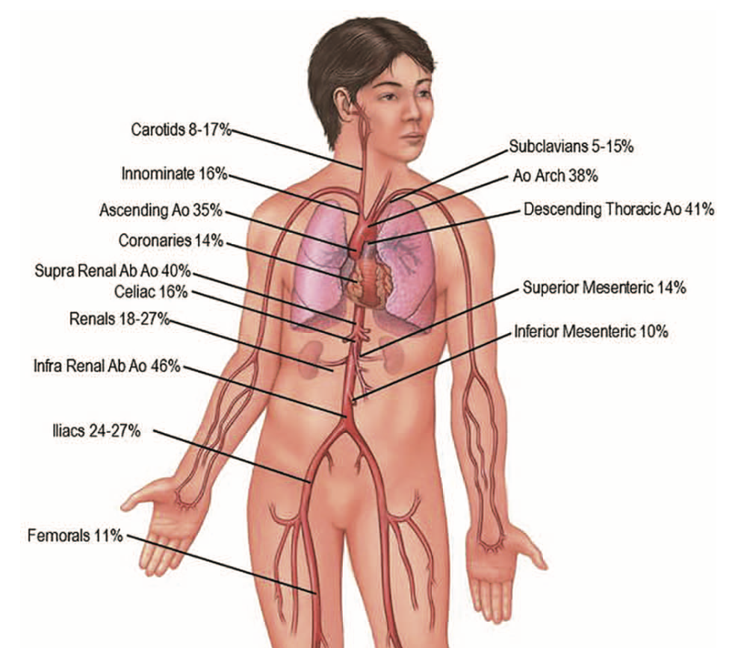
2. Absent pulse in the left arm – is this a feature of ECD?
Arman F, Shakeri H, Nobakht N, Rastogi A, Kamgar M. Erdheim-Chester Disease Presenting with Secondary Hypertension as a Result of Bilateral, Proximal Renal Artery Stenosis: A Case Report. Case Rep Nephrol Dial. 2017;7 (2):55-62.
Lakhani PM, Borysiewicz C, Mason J. Erdheim-Chester disease: a rare cause of bilateral renal artery stenosis, mimicking large vessel vasculitis. BMJ Case Rep. 2022;15 (3):e242393.
Azoulay LD, Bravetti M, Cohen-Aubart F et al. Prevalence, patterns and outcomes of cardiac involvement in Erdheim-Chester disease. Eur Heart J. 2022ehac741.
Villatoro-Villar M, Bold MS, Warrington KJ et al. Arterial involvement in Erdheim-Chester disease: A retrospective cohort study. Medicine (Baltimore). 2018;97 (49):e13452.
Notes:
Gaurav posed naked – anything for the Mark Heaney award

Slide 13
3. Treatment options?
Eyes well-controlled on steroids but needs something steroid-sparing
Referral to vascular surgery – no evidence of upper limb ischaemia or subclavian artery steal syndrome
No other high-risk features of disease
Working full-time

Slide 14
3. Treatment options?
Eyes well-controlled on steroids but needs something steroid-sparing
Referral to vascular surgery – no evidence of upper limb ischaemia or subclavian artery steal syndrome
No other high-risk features of disease
Working full-time
interferon alpha
methotrexate
trametinib on patient access (must fail first-line)

Slide 15
Clinical timeline
2018 2020 2022 2024 2026
Treatment
IFN 135mcg
dizzy, palpitations, alopecia
MTX 20-30mg/week
PET-CT
Notes:
Compassionate access scheme was closing so we went for it

Slide 16
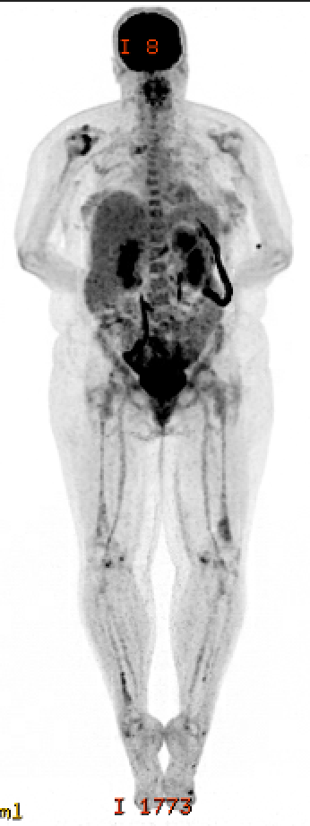
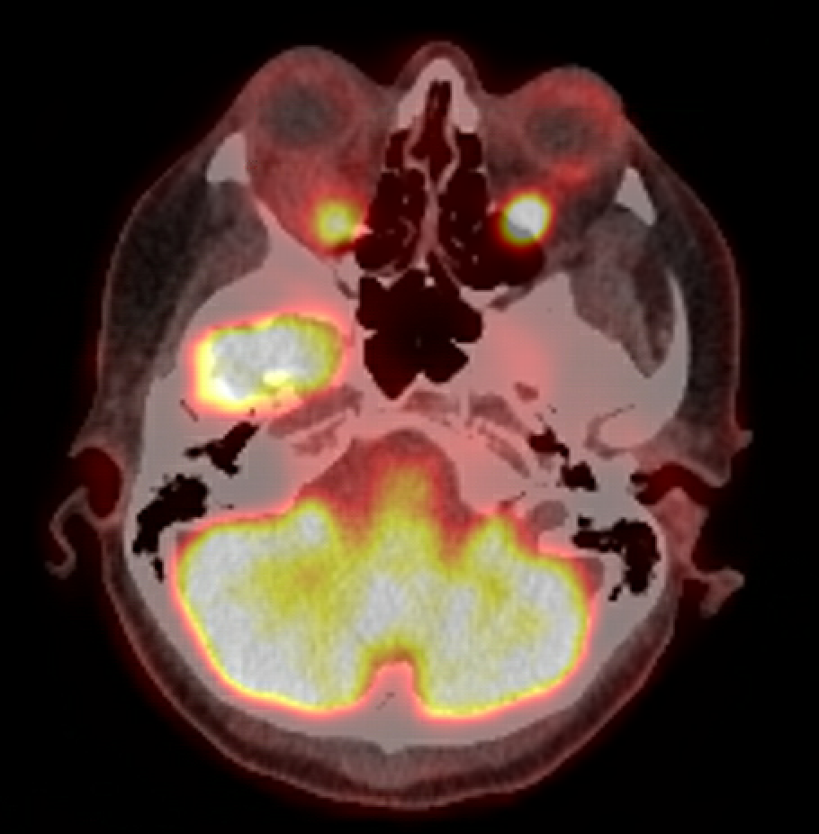
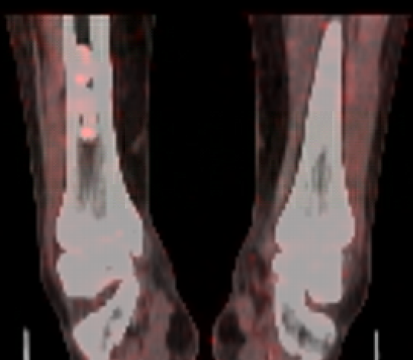
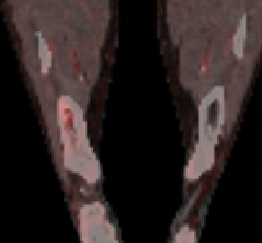
2020: Mixed response
Still working full-time good and bad weeks
2018
2020
2018
2020
retrobulbar infiltrates
SUVmax
5.7/7.2 to 3.0/3.0
tiny sclerotic focus R distal tibia visible
SUVmax increased
1.9/2.3 to 2.8/3.3
Notes:
PET-CT of legs shown in 2018 looks like this one . .
something going on in the neck

Slide 17
Clinical timeline
2018 2020 2022 2024 2026
Treatment
IFN 135mcg
dizzy, palpitations, alopecia
MTX 20mg/week
nausea, fatigue, neuropathy
23.3.23
Trametinib
Notes:
Compassionate access scheme was closing so we went for it

Slide 18
Clinical timeline
2018 2020 2022 2024 2026
Treatment
IFN 135mcg
dizzy, palpitations, alopecia
MTX 20mg/week
nausea, fatigue, neuropathy
23.3.23
Trametinib
Multiple interruptions
Max dose 0.5mg or 1mg alt days/weeks
abdo pain
vomiting
muscle weakness with raised CK
joint pain
peripheral neuropathy
neutrophilic dermatosis
Notes:
Compassionate access scheme was closing so we went for it

Slide 19
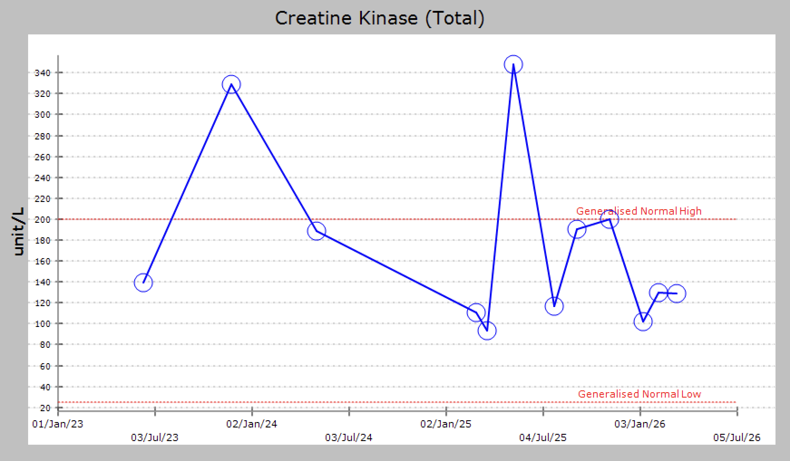
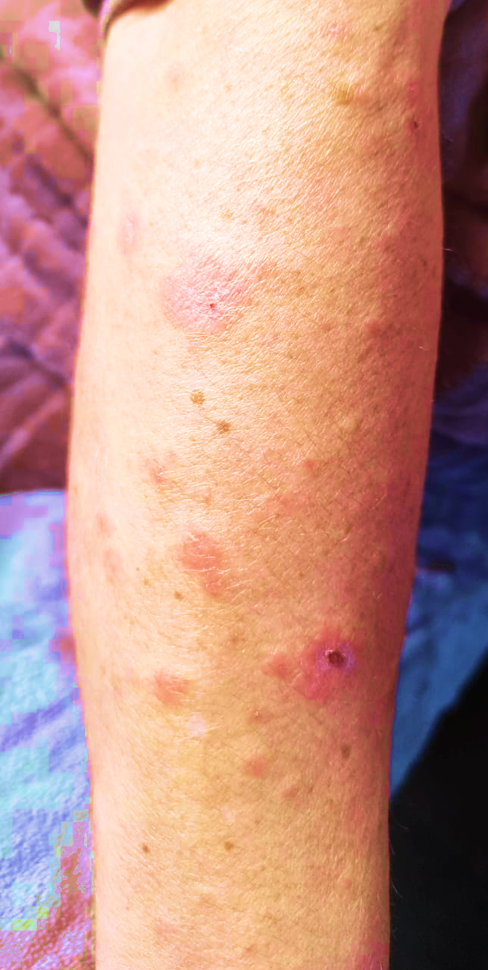
Side effects problematic
Treatment saga
Interferon alpha – intolerant
Methotrexate 20mg weekly 2021-2023
Trametinib started at 1mg daily 23.03.23
Trametinib reduced to 0.5mg 30.03.23 owing to vomiting and abdo pain
Trametinib 1mg daily from 1.6.23
Trametinib 1mg daily alternate weeks from 14/11/24
Trametinib suspended 24/7/25 for muscle weakness - restarted when eyes became swollen and painful
Trametinib 1mg daily continuous August 2025

Slide 20
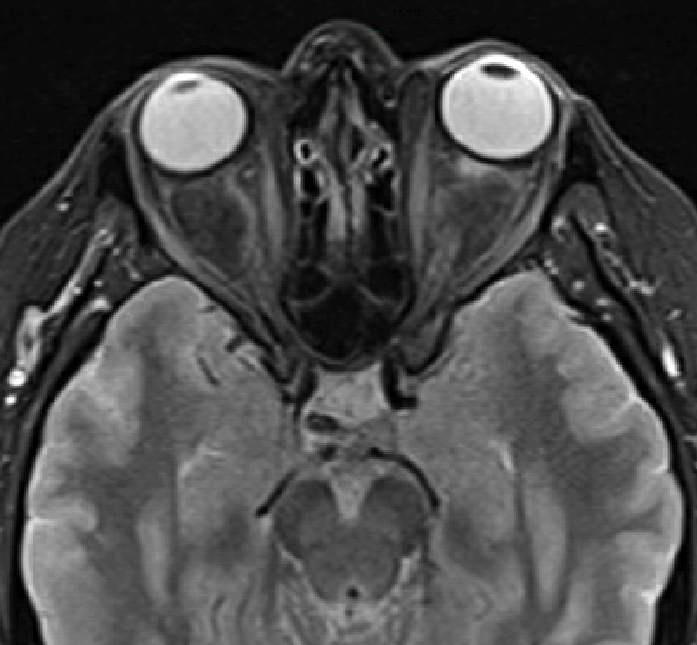
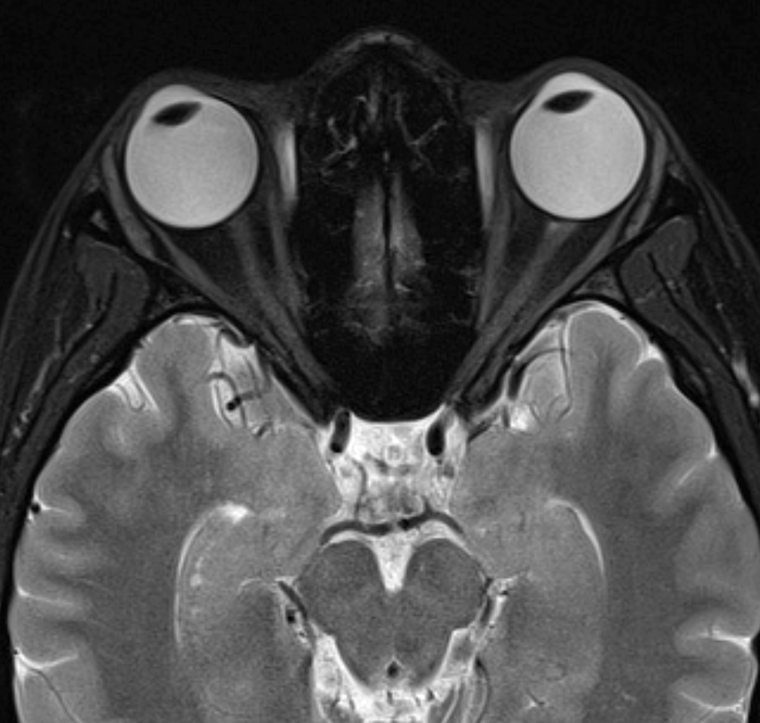
Partial response to Trametinib
2018
2024
normal
MRI STIR

Slide 21
4. What next?

Slide 22
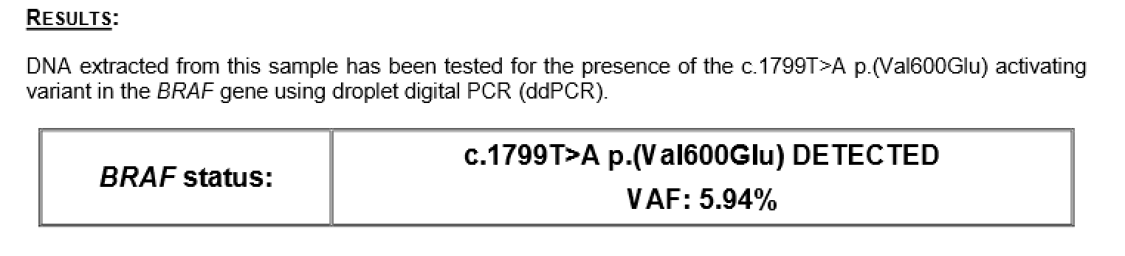
Notes:
Was also detected on the NGS panel at 5%

Slide 23
Clinical timeline
2018 2020 2022 2024 2026
Treatment
IFN 135mcg
dizzy, palpitations, alopecia
MTX 20mg/week
nausea, fatigue.
23.3.23
Trametinib
5.2.26
Dabrafenib
Notes:
Compassionate access scheme was closing so we went for it

Slide 24
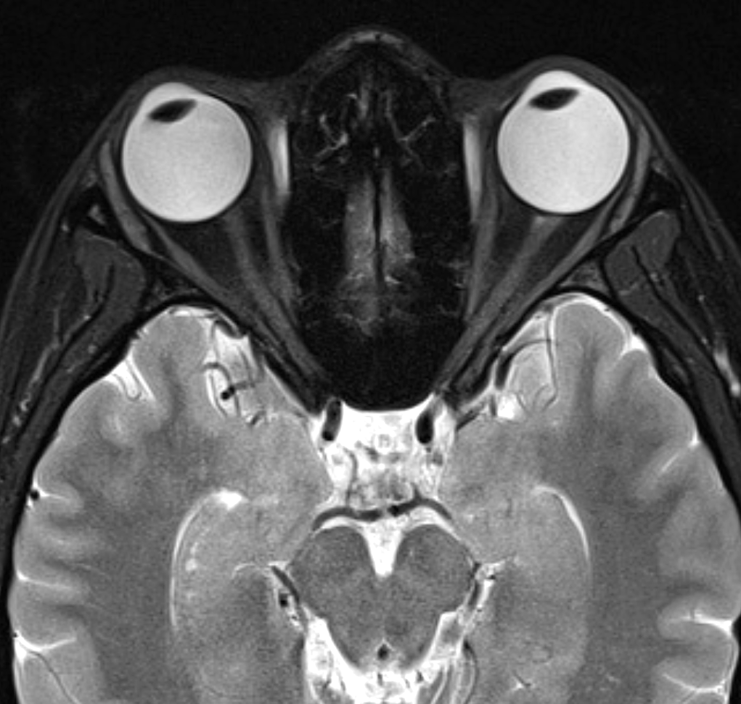
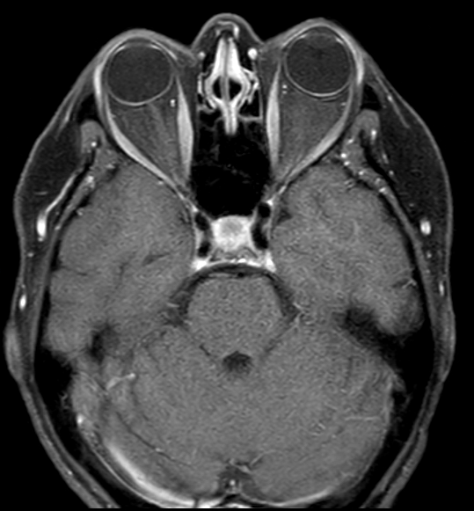
Finally
April 2026
normal
April 2026 post gad no enhancement
Notes:
Radiologists in their wisdom have done a different type of scan – not reported yet but looks normal to me

Slide 25
Or is it . .
2018 PET-CT showed small metabolically active lesion adjacent to L carotid
surveillance scans: likely slowly growing schwannoma

Slide 26
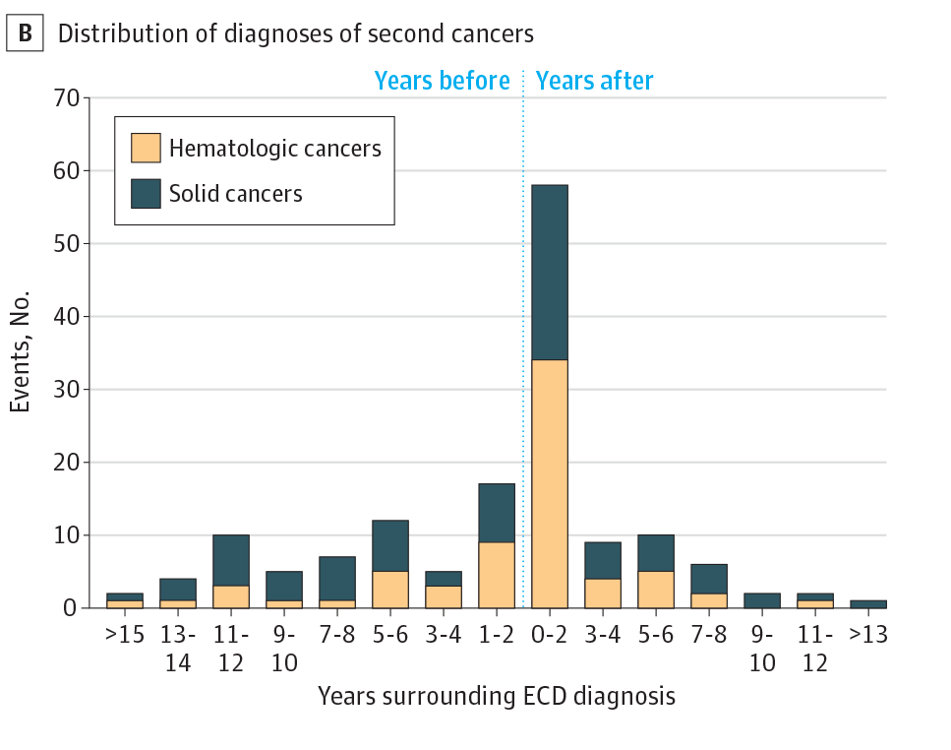
5. Is this also ECD? Would you biopsy?
2018 PET-CT showed small metabolically active lesion adjacent to L carotid
surveillance scans: likely slowly growing schwannoma
Pegoraro F, Peyronel F, Errahmani M-Y et al. Risk of Second Cancer in Erdheim-Chester Disease. JAMA Oncol. 2025;11 (4):429-433.

Slide 27
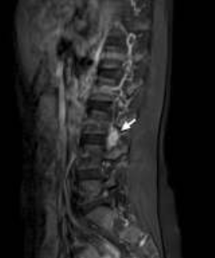
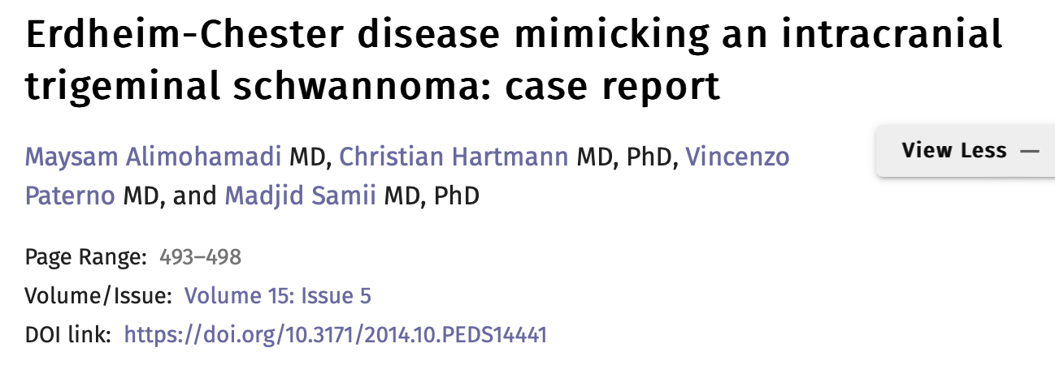
Risk of another malignancy vs ‘just part of the disease’
Huang Z, Li S, Hong J et al. Erdheim-Chester disease mimicking lumbar nerve schwannoma: case report and literature review. Spinal Cord Ser Cases. 2019;5 90.
Will it respond to dual inhibitors? . . . PET-CT 4th May
Notes:
Most common question - had two renal cell carcinomas one in a 30 year old with LCH

Slide 28
Thanks to
Dr Chris Bacon Consultant Pathologist
Iona Gillespie Clinical Nurse Specialist
THE END

