Slide 1

Burden of chronic health conditions after diagnosis of Erdheim–Chester disease
Early results from the Histiocytic Disorder Survivor Study
Gaurav Goyal¹, Elise Fitzgerald¹, Caroline Cannon¹, Luqin Deng¹, Brinda Shukla¹, Ronald Go², Jithma Abeykoon², Lindsey Hageman¹, Deanna Fournier³, Kathleen Brewer⁴, Belinda Cobb⁴, Smita Bhatia¹
¹University of Alabama at Birmingham, Birmingham AL; ²Mayo Clinic, Rochester, MN; ³Histiocytosis Association, Pittman, NJ; ⁴Erdheim-Chester Disease Global Alliance, DeRidder, LA
11th Annual Medical Symposium
Erdheim-Chester Disease Global Alliance
May 1st, 2026
Notes:
In 10 minutes: what histiocytic disorders are, why precision therapy created a survivorship gap, and where you can plug in for collaborative research

Slide 2
MAPK TARGETING IN HISTIOCYTOSIS
BRAF and/or MEK mutations(s)
drives cancer cell growth
  High responses with BRAF/MEK inhibition: 90-100% response rates
  Approvals: Vemurafenib (ECD, 2017); Cobimetinib (all histiocytoses, 2022)
  Not curative: most need chronic/indefinite therapy
Normal cell growth
EGFR
EGFR
Mutate
RAS
RAS
Wild-type
RAF
BRAF
Constitutively
active
Vemurafenib
MEK
MEK
Constitutively
active
Cobimetinib
  Precision oncology succeeded—but created a survivorship problem
ERK
ERK
Normal cell
proliferation
↑ Cell proliferation
Diamond EL et al. JAMA Oncol. 2018 Mar 1;4(3):384-388
Diamond EL et al. Nature 2019 Mar;567(7749):521-524
Image courtesy Jithma Abeykoon (Mayo)
Notes:
There have been drastic advances in the field of histiocytic neoplasms due to the discovery
In children, the late effects are further amplified

Slide 3
Precision Oncology Success Does Not Eliminate Survivorship Burden
What We See and Celebrate
What Patients Continue to Live With
High response rates
Chronic treatment exposure
THE
PARADOX
Targetable biology
Organ dysfunction / late effects
Durable disease control
Symptom burden / healthcare needs / second cancers
Tumor response alone can under-describe long-term patient burden
Notes:
I think this is the paradox quite simply: the biology is tractable, the responses are often excellent, and yet the long-term burden remains substantial and often under-measured.

Slide 4




HISTIOCYTIC DISORDER SURVIVOR STUDY (HDSS)
Retrospective cohort of children and adults with histiocytosis
Burden of morbidity
Healthcare utilization
Burden of mortality
Chronic health conditions
Psychological outcomes
Pain
Health-related quality of life
Hospitalizations
Clinic visits
All-cause mortality
Cause-specific mortality
Factors associated with M&M
Clinical
Therapeutic
Demographic
Lifestyle
NCT05915208
Notes:
In 2022, we launched the histiocytic disorder survivor study in collaboration with HA and ECDGA.
This study entails creation of a national database of people with histiocytosis and examine the chronic health conditions, psy

Slide 5
Study procedures
Recruitment
(ECDGA and Histio Association partnership)
Multi-modal outreach (phone, email, mail)
Participant survey
(health conditions + timing)
Medical record linkage/abstraction and validation of diagnosis/outcomes
Severity grading
CTCAE v5.0-aligned rubric (Grades 1 - 4)
Grade 1, mild; Grade 2, moderate; Grade 3, severe;
Grade 4, life-threatening or disabling
Analysis endpoints:
Prevalent burden at last follow-up
Incident morbidity after diagnosis (exclude <1 year)
dctd.cancer.gov

Slide 6
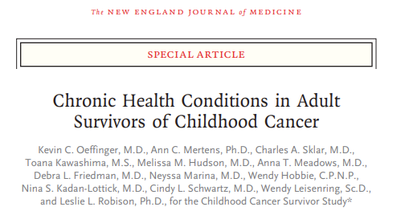
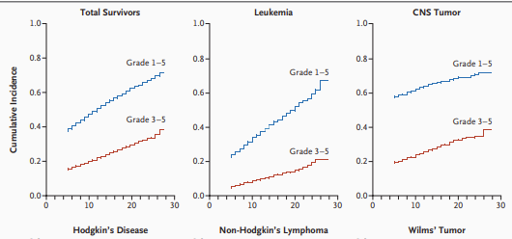
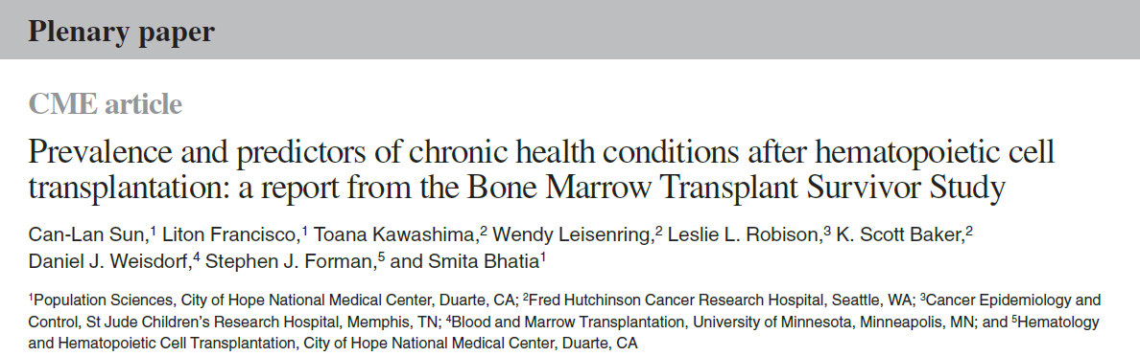
Prior studies

Slide 7
Results: Analytic cohort (ECD) for preliminary report
Total surveys as of Jan 2026 (N=908)
Diagnosis ECD (N=159)
No histiocytosis diagnosis age (N=3)
Duplicate records (N=1)
Follow-up years unknown because of missing DOB or follow-up date (N= 29)
Study Cohort (N=126)
Alive: 111; Deceased: 15
Notes:
Alive 111, NOK 15

Slide 8
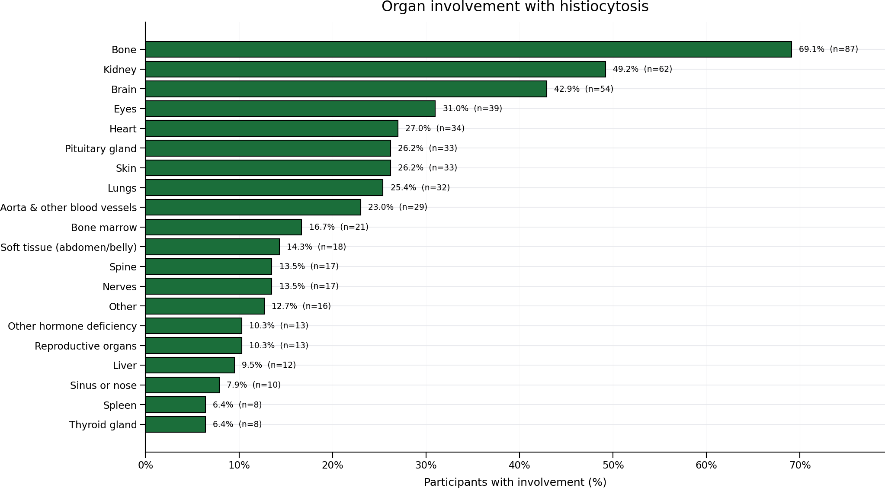
Results (baseline characteristics)
Follow-up years since diagnosis, median (IQR) | 5 (2 - 9)
Median Age at ECD diagnosis (IQR) | 54 (46 - 60)
Male Sex | 81 (64.3%)
Race
White | 113 (89.7%)
Black | 2 (1.6%)
American Indian | 1 (0.8%)
Chinese | 1 (0.8%)
Indian Subcontinent | 1 (0.8%)
Japanese | 1 (0.8%)
Vietnamese | 3 (2.4%)
Other Asian | 1 (0.8%)
Other Race | 2 (1.6%)
Decline | 1 (0.8%)
Ethnicity
Hispanic, Latino or Spanish | 8 (6.4%)
Not Hispanic, Latino nor Spanish | 112 (88.9%)
Unknown | 6 (4.7%)
BRAF V600E
Yes | 76 (60.3%)
No | 27 (21.4%)
Unknown or untested | 23 (18.3%)

Slide 9
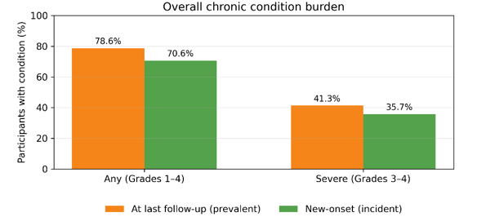
Results: Burden of morbidities
*Incident morbidities excludes those occurring <1 year from diagnosis
Notes:
Overall morbidity burden at last follow-up was substantial: 78.6% reported at least one chronic condition (grades 1–4) and 41.3% reported a severe/life-threatening condition (grade 3–4). The incidence of new/additional morbidity after ECD diagnosis was high: 70.6% developed ≥1 any grade chronic health condition and 35.7% developed a grade 3–4 condition.

Slide 10
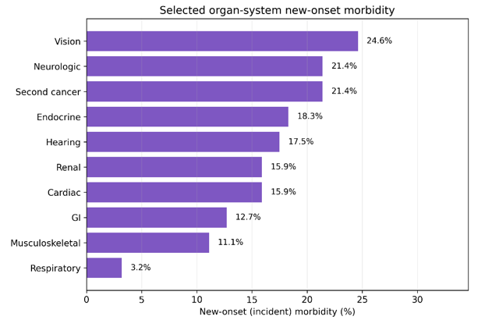
Results

Slide 11
Second cancers
Cancer grouping (total N=27) | N (%)
Cutaneous squamous cell carcinoma | 12 (41.4%)
Basal cell carcinoma | 3 (10.3%)
Melanoma | 3 (10.3%)
Prostate cancer | 3 (10.3%)
CMML | 2 (6.9%)
Breast cancer | 1 (3.4%)
Renal cancer (unspecified) | 1 (3.4%)
Other carcinoma (unspecified) | 1 (3.4%)
LCH | 1 (3.4%)

Slide 12
limitations
Retrospective cohort
Recall bias
Validation of outcomes ongoing
Participation bias
Enrollment of next of kin of deceased participants
Aggressive outreach

Slide 13
next steps
Target enrollment ~300
Recruitment of non-histiocytosis population (controls; ongoing)
Survivorship recommendations
Intended outputs
Interventions to reduce health conditions
Validation of outcomes against medical records (ongoing)
Risk-stratification based on exposures (e.g., BRAF- and MEK-inhibitors)
Notes:
We already have momentum, and here’s where enrollment stands and what comes next.

Slide 14
conclusions
ECD survivors experience a high burden of chronic health conditions (~41% reported grade 3-4 morbidity at last follow-up)
Substantial incidence of new-onset morbidities (~36% reported new-onset grade 3-4 health condition after diagnosis)
Cohort expansion and linkage to treatment exposures critical to identify high-risk subgroups and inform tailored survivorship screening
Notes:
We already have momentum, and here’s where enrollment stands and what comes next.

Slide 15



Acknowledgements
Patients and families
Mentors/collaborators:
UAB:
Smita Bhatia
Mayo Clinic:
Ronald S. Go
Jithma Abeykoon
MSKCC:
Eli L. Diamond
Research team (UAB)
Caroline Cannon
Brinda Shukla
Elise Fitzgerald
Lindsey Hageman
Tanmayee Buchi
Disha Patel
Vyshi Rallapalle
Megan Maier
Luqin Deng
ECD Global Alliance
Kathy Brewer
Belinda Cobb
Funding/support:
ECD Global Alliance
Blood Cancer United
American Cancer Society
Walter B. Frommeyer Jr. Fellowship in Investigative Medicine Histiocytosis Association
UAB start-up funds
Uplifting Athletes/ECDGA Young Investigator Award
ASH CRTI
📞 1-866-438-1640
📧 histio@uabmc.edu; ggoyal@uabmc.edu
🌐 https://curehistio.org

