Slide 1
S Y S T E M A T I C R E V I E W | M S K I M A G I N G
Musculoskeletal System Imaging Abnormalities in Erdheim-Chester Disease
Defining the Spectrum of Skeletal, Tendon, and Muscle Involvement in a cohort of 1,940 Patients.
ERDHEI M- CHESTER DI SEASE ( ECD) SYSTEMATI C REVI EW
SLI DE 01

Slide 2

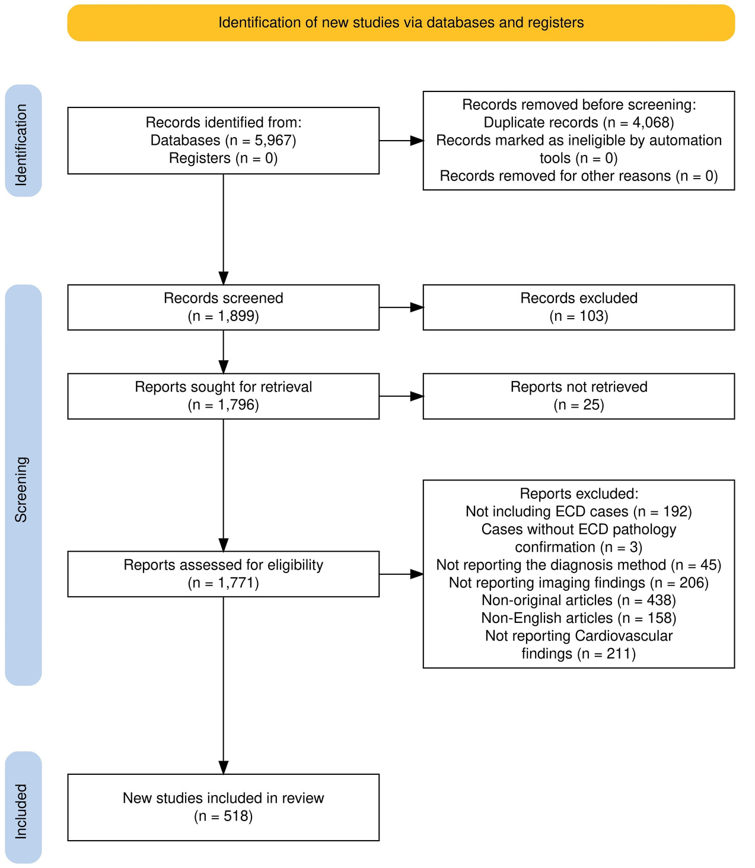



REVIEW SCOPE & METHODOLOGY
Conducted according to PRISMA guidelines across PubMed, Embase, Web of Science, and Scopus.
540
STUDIES INCLUDED
1,940
TOTAL PATIENTS
Note on Detection: 41.3% of PET and 40.6% of MRI studies showed no MSK abnormalities, highlighting modality-specific variability.
Visual study workflow based on the reported search across PubMed, Embase, Web of Science, and Scopus.
MATERI ALS & METHODS
SLI DE 02

Slide 3

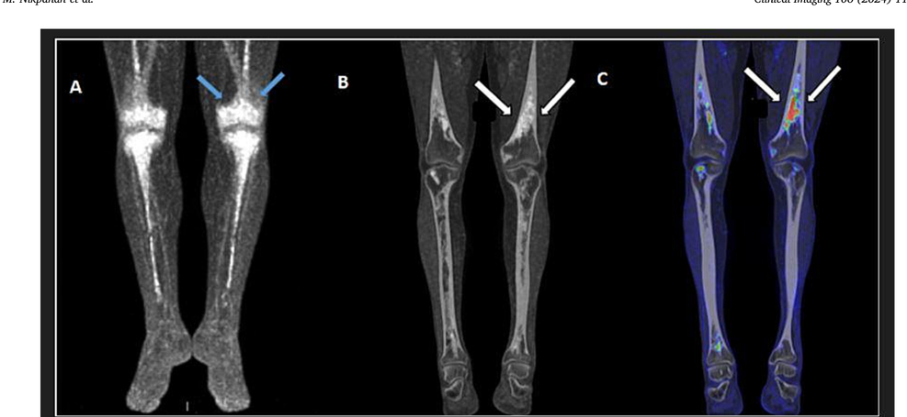

DOMINANT PATTERN: LONG BONE DISEASE
Lower-Extremity Predilection:
Femur: 174 PET / 240 Bone Scan cases. Tibia: 145 PET / 244 Bone Scan cases.
Localization: Concentrated around the knee region (distal femur & proximal tibia).
Hallmark Finding: Bilateral, symmetrical osteosclerosis involving the diaphysis and metaphysis.
Representative femoral and tibial involvement on (A) 18F-FDG PET, (B) CT, and (C) fused 18F-FDG PET/CT.
APPENDI CULAR SKELETON FI NDI NGS
SLI DE 03

Slide 4

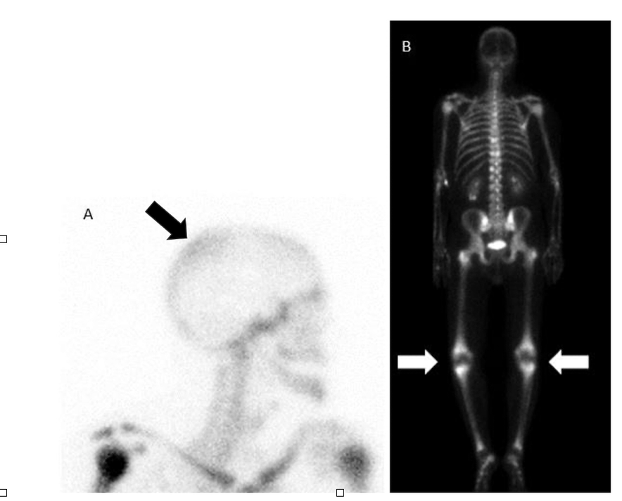
AXIAL & CRANIOFACIAL DISEASE
While appendicular disease is classic, axial disease is frequent on multimodality imaging:
SITE MODALITY HIGHLIGHTS
Lesions in 68 MRI cases; patchy Bone Scan activity
Skull
Mandible
Notable involvement in 12 cases
Thoracic & Lumbar predilection (CT 34)
Spine
Pelvis
Seen in 42 CT and 32 PET cases
Bone scan showing patchy increased skull activity with bilateral femoral and tibial uptake.
AXI AL SKELETON REVI EW
SLI DE 04

Slide 5

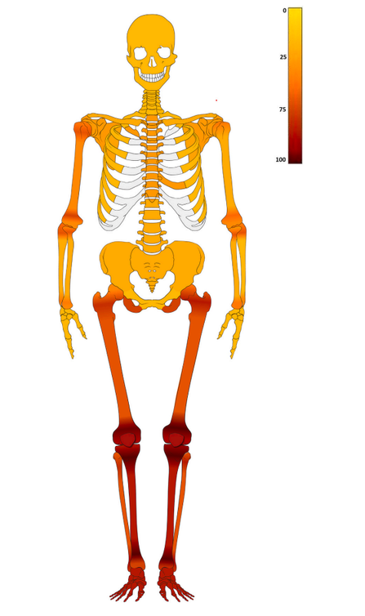
LESION TYPES & SOFT TISSUE
Lesion Morphology
Osteosclerotic: Predominant (246 X-ray; 80 CT).
Mixed: Lytic-sclerotic (41 X-ray; 25 CT).
Lytic: Purely destructive (rare; 26 X-ray; 14 CT).
Soft Tissue Highlights
Achilles: Fusiform thickening & hypermetabolic activity.
Muscle: T2 hyperintensity & marked contrast enhancement.
Figure shows the distribution of the skeletal findings as observed on CT scans in the 50 ECD patients included in this study. Colors and corresponding scale show the prevalence of each finding
MORPHOLOGY & MUSCLE I NVOLVEMENT
SLI DE 05

Slide 6
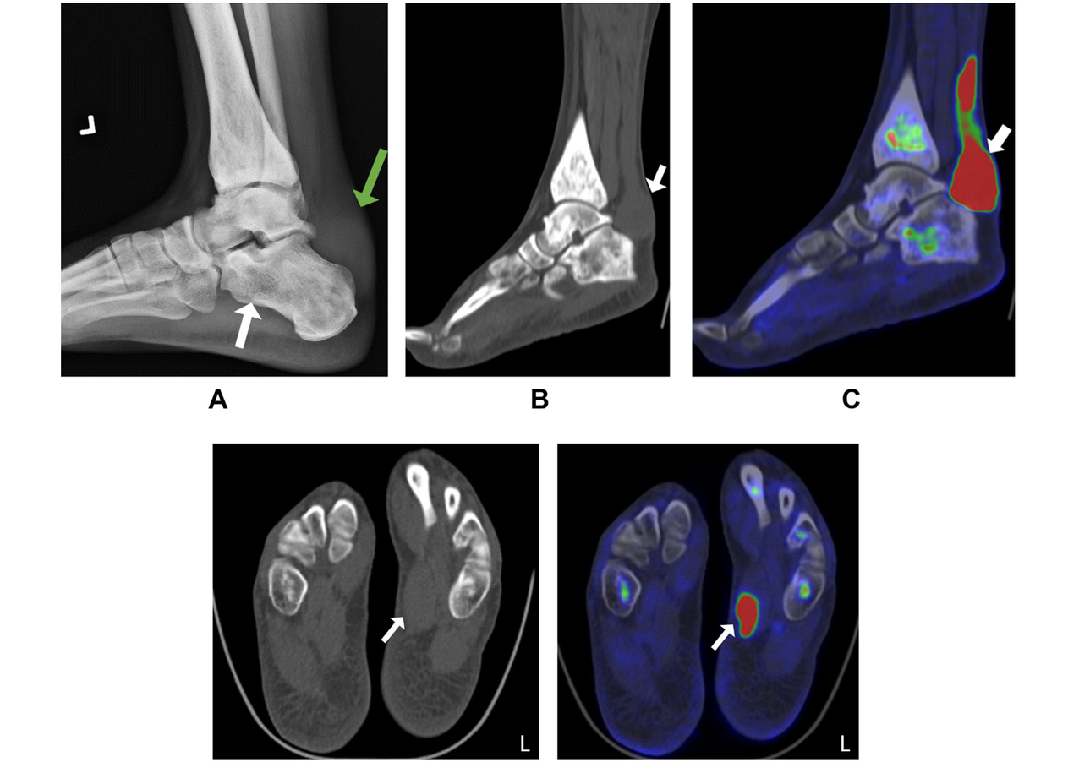
Tendon involvement:
Achilles
tendon involvement.

Slide 7
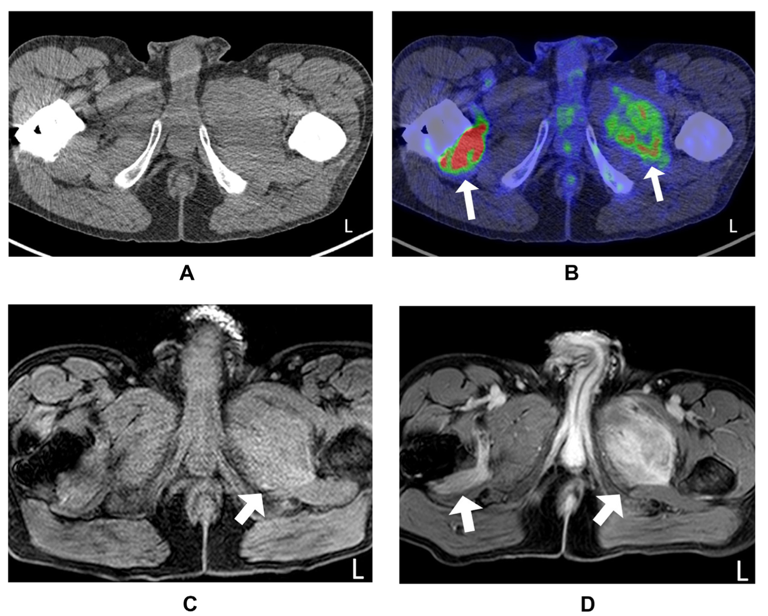
Muscle Involvement:
Thigh muscle involvement.

Slide 8

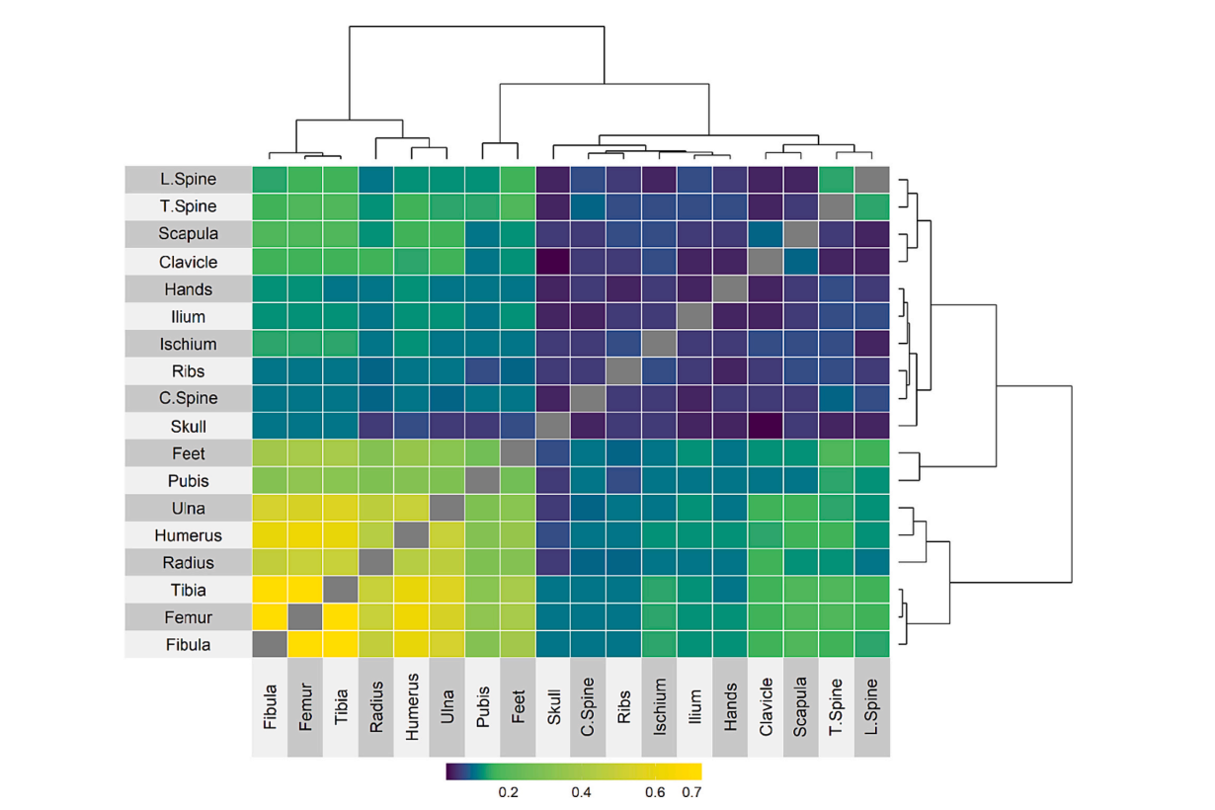

CO-OCCURRENCE & GENETICS
High probability (>0.7) of lesion co-occurrence between long bones of upper and lower extremities.
Clustering: Correlation between Femur, Tibia, Fibula, and Humerus involvement on CT skeletal mapping.
BRAFV600E Status: Significantly correlated with femoral and tibial involvement on PET/Bone Scan (p < 0.05).
Heatmap shows probability of co-occurrence of skeletal involvement across different bones in our ECD cohort as observed on CT scan. The dendrogram depicts the clustering of skeletal involvement based on probability of co-occurrence.
STATI STI CAL DI STRI BUTI ONS
SLI DE 06

Slide 9
Conclusion
SYMMETRICAL OSTEOSCLEROSIS IS PATHOGNOMONIC
Bone Scintigraphy and PET most consistently detect long-bone disease, whereas CT and MRI provide superior characterization of lesion morphology. A multimodality approach is essential for accurate clinical trials and patient management.
MSK SYSTEMATI C REVI EW FI NAL REPORT
SLI DE 07

