Slide 1
Cyclin D1 Overexpression Drives Replication Stress and Creates Therapeutic Vulnerabilities in Histiocytic Neoplasms
the 11th Annual ECDGA Medical Symposium
Dongni Yi, M.D.
Hematology/Oncology Fellow, Clinician Investigator Track
Mayo Clinic
Rochester, MN
5.1.2026

Slide 2
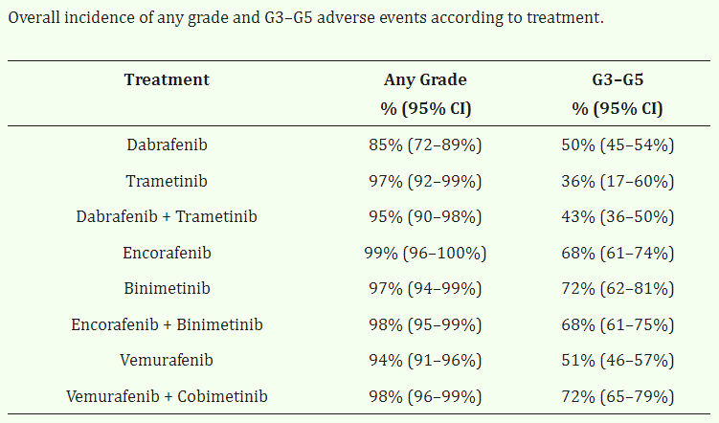
Background
Histiocytic Neoplasms (HN)
A group of heterogeneous malignancies derived from monocytes, macrophages, and dendritic cells from the myeloid lineage
Current mainstay of treatment is BRAF inhibitors and MEK inhibitors
Adverse events are notably common^{[1]}
77% of patients experienced disease relapse following treatment interruption^{[2]}
Unmet need for more tolerable treatment
Garutti, Bergnach et al. 2022
Reiner, Durham et al. 2023
Notes:
Important to discover new treatment targets

Slide 3
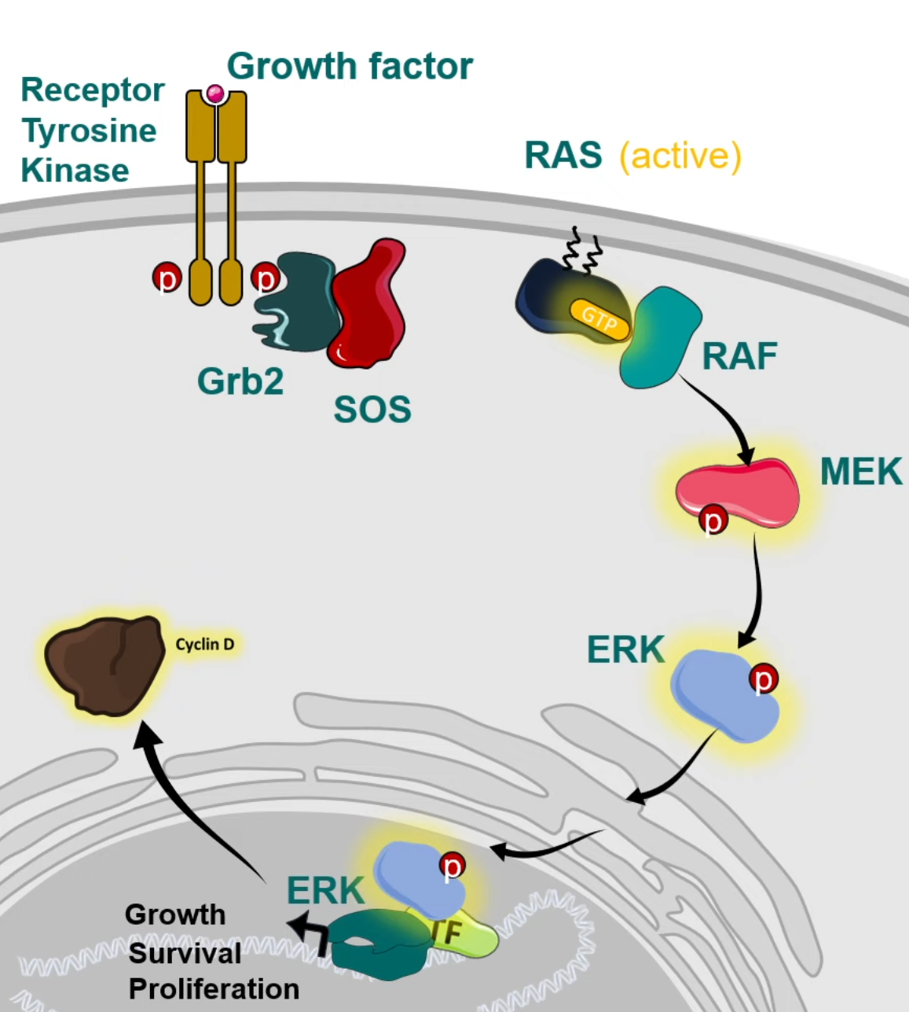
Background
CCND1 Overexpression in Histiocytic Neoplasms (HN)
One of the most commonly overexpressed genes in cancers, such as breast cancer, melanoma, and lymphoma
Mechanisms:
  t(11;14) translocation in mantle cell lymphoma
  Gene amplification in breast cancer and NSCLC
  Oncogene pathway activations such as MAPK pathway
CCND1 overexpression (OE) is present in the majority of LCH, ECD, RDD and MH ^{[1-4]}
  CCND1 OE is absent in reactive histiocytes
  CCND1 OE is utilized in diagnosis of HN
Biological significance of CCND1 OE remains unknown in HN
Chatterjee, Vishwajeet et al. 2019
Ravindran, Dasari et al. 2023
Garces, Medeiros et al. 2022
Shanmugam, Craig et al. 2017
Notes:
We like to think about lymphoma but it actually exists in many other cancers

Slide 4
Goals of the study
To define the biological role of CCND1 overexpression in histiocytic neoplasms
To identify novel therapeutic strategies for histiocytic neoplasms

Slide 5
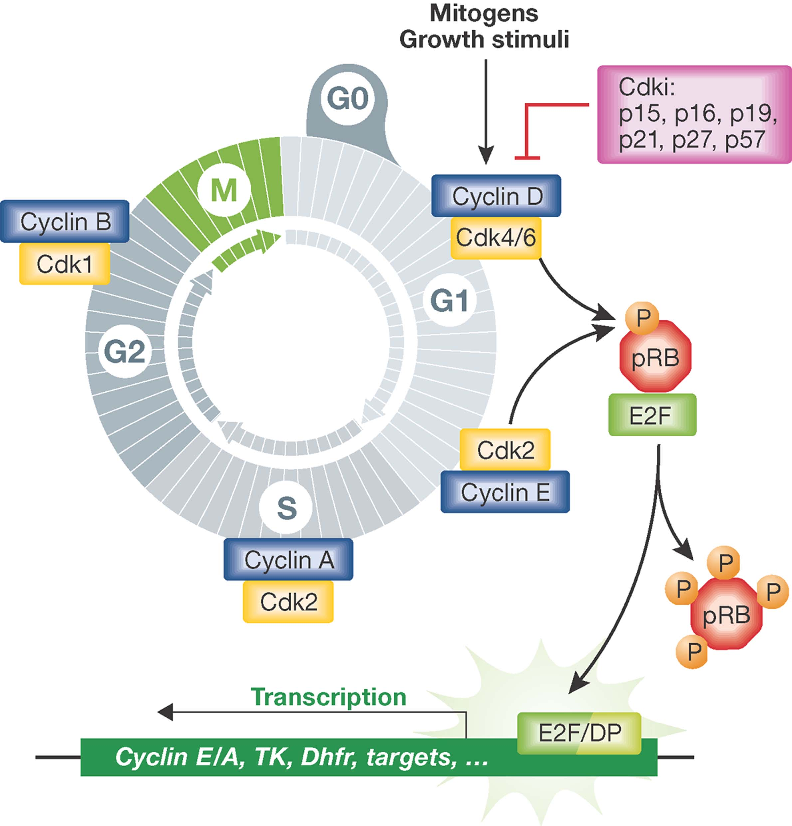
Background
Notes:
Cyclin D1 assembles with CDK4 or CDK6 to form an active holoenzyme complex. [1][7]
The cyclin D1–CDK4/6 complex phosphorylates the retinoblastoma protein (Rb), partially inactivating it. Phosphorylated Rb releases E2F transcription factors, which activate transcription of genes required for S-phase entry

Slide 6
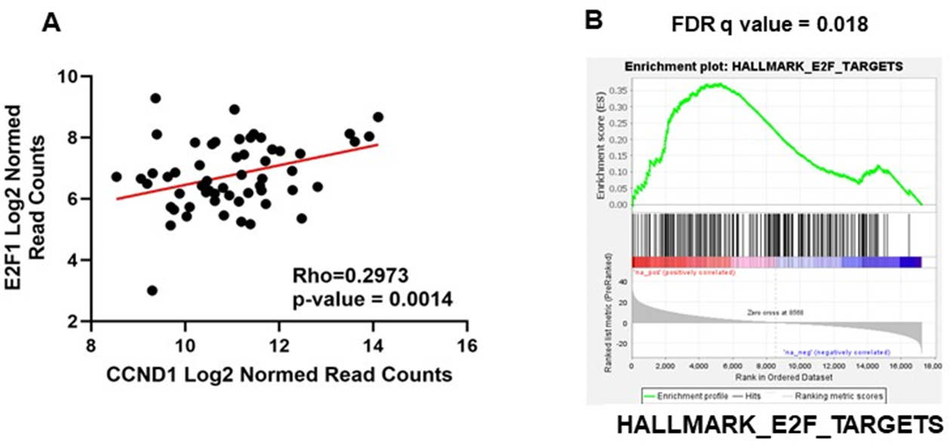
CCND1 OE in HN Is Associated With
Increased Expression Of E2f1 And E2f1-Mediated Transcription
RNA sequencing on 75 patients with ECD, RDD, and LCH
CCND1 OE significantly correlates with increased E2F1 expression (A) and E2F-mediated gene transcription (B)

Slide 7

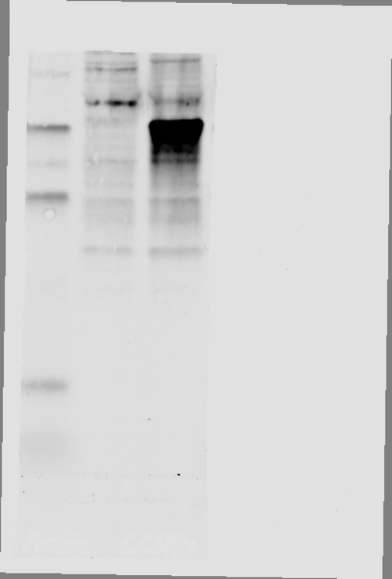


Cell line models
THP-1 EV
THP-1 CCND1 OE
β-Actin
Question: Is there any biological relevance?
Challenge: No histiocytic cell lines or mouse model available
Cyclin D1
THP-1:
A monocyte cell line isolated from peripheral blood from an acute monocytic leukemia patient
From same lineage of HN
Has a low expression of endogenous CCND1
U-937 EV
U-937 CCND1 OE
U-937:
U937 is a human myeloid leukemia cell line that is widely used as a model for studying monocytes and macrophages
β-Actin
Cyclin D1
Unpublished data, confidential
Notes:
Lentiviral transduction

Slide 8
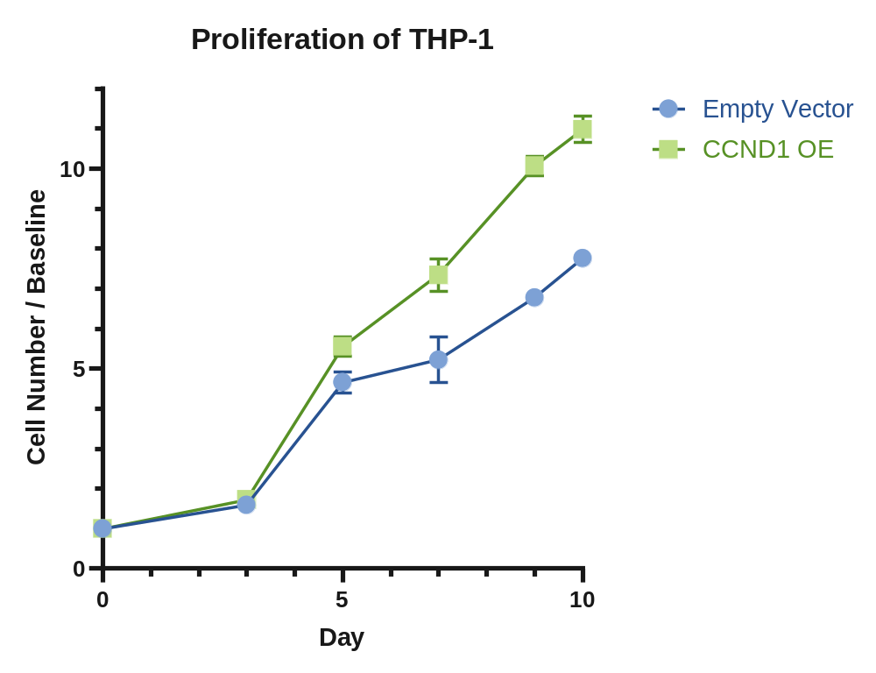
CCND1 OE promotes cell proliferation
Question: Does increased DNA replication cause increased DNA replication stress (RS)?
What is replication stress?
Unpublished data, confidential

Slide 9
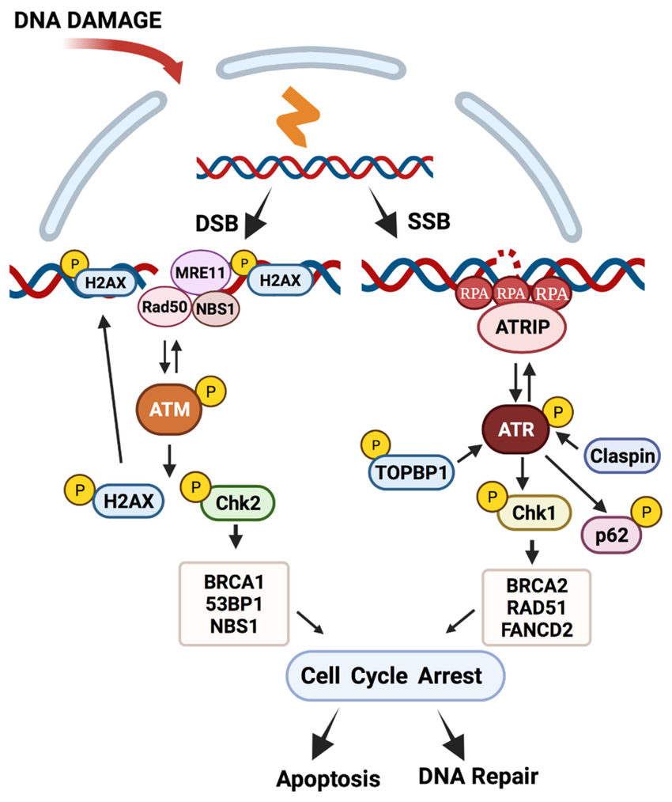
Background
What is replication stress (RS)?
Although the DNA replication is highly accurate, the fidelity of this process is often threatened by stresses of both exogenous and endogenous origins, resulting in altered replication fork progression, reduced replication fidelity, and DNA breaks.^{[1]}
RS is an important source of DNA damage and genome instability
RS is a hallmark of cancer cells
What happens when cells are dealing with increased RS?
Saxena and Zou 2022
Kobayashi, Tauchi et al. 2009
Notes:
When DNA double-strand breaks occur, ATM gets recruited and undergoes to become active. [1] Active ATM then phosphorylates histone H2AX (generating γ-H2AX), which recruits downstream effectors to retain more activated ATM at the break site, creating a positive feedback loop that amplifies and sustains the damage signal. [2-4] Simultaneously, ATM directly phosphorylates Chk2, triggering Chk2 dimerization and full activation. [5-6] Activated Chk2 then phosphorylates key effectors — most notably p53
When replication forks stall or single-stranded DNA is generated by damage processing, RPA rapidly coats the exposed ssDNA, serving as the critical platform that initiates ATR-Chk1 signaling.
Both signaling pathways lead to cell cycle arrest

Slide 10
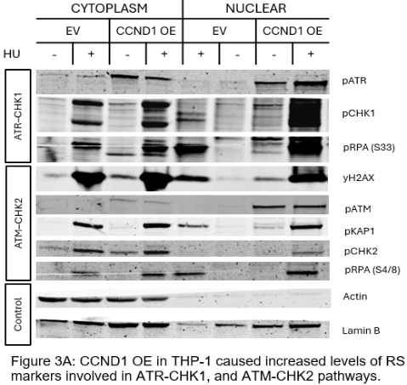
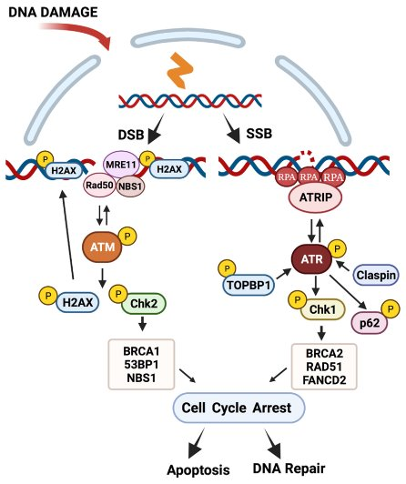
CCND1 OE Increases Replication Stress
Unpublished data, confidential
Notes:
DOI instead

Slide 11
CCND1 OE INCREASES REPLICATION STRESS
DAPI
γH2AX
Phospho-RPA2 (Ser33)
Empty Vector
CCND1 OE
Unpublished data, confidential

Slide 12
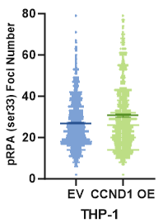
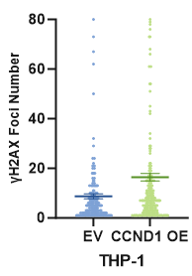
CCND1 OE Increases Replication Stress
Unpublished data, confidential
Notes:
The bars showed the mean Standard Error of the Mean

Slide 13
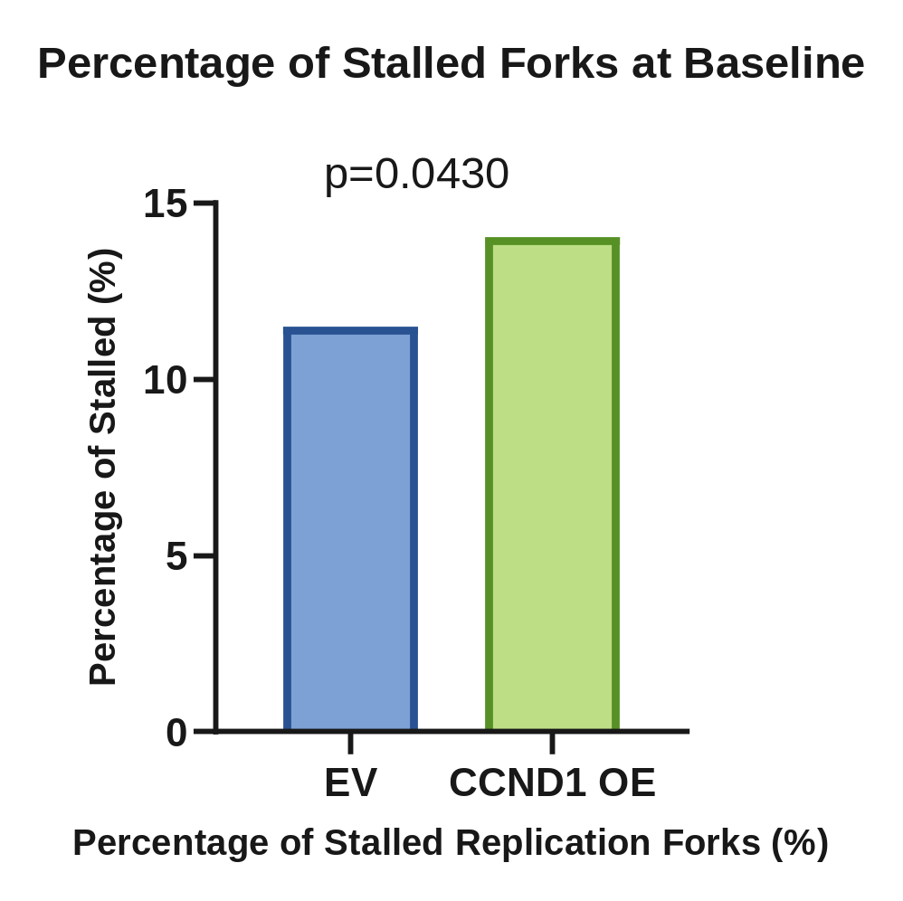
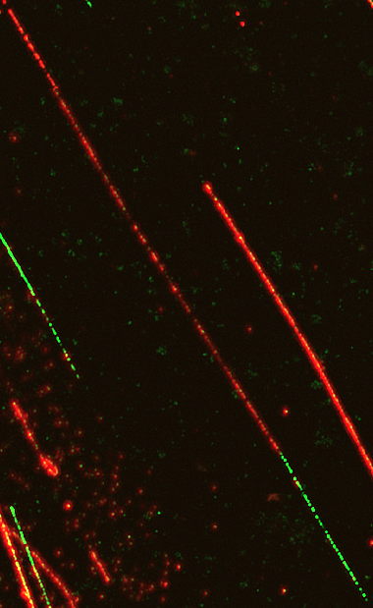
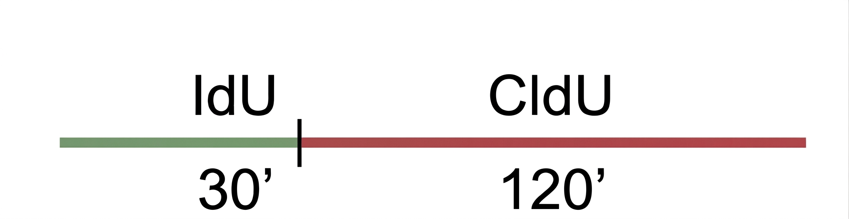

Ccnd1 OE Increases stalled replication forks
Ongoing Fork
Stalled Fork
Unpublished data, confidential
Notes:
CCDN1 increases RS. What’s the biology of the RS? Looked into forks. To look into forks, we did DNA fiber assay. Stalling, stability, and ssDNA (pending)

Slide 14
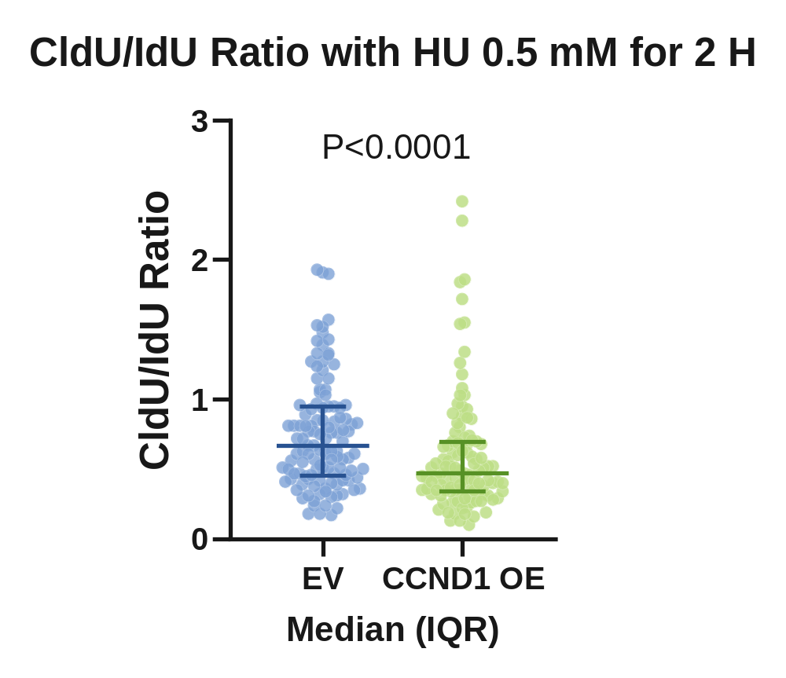
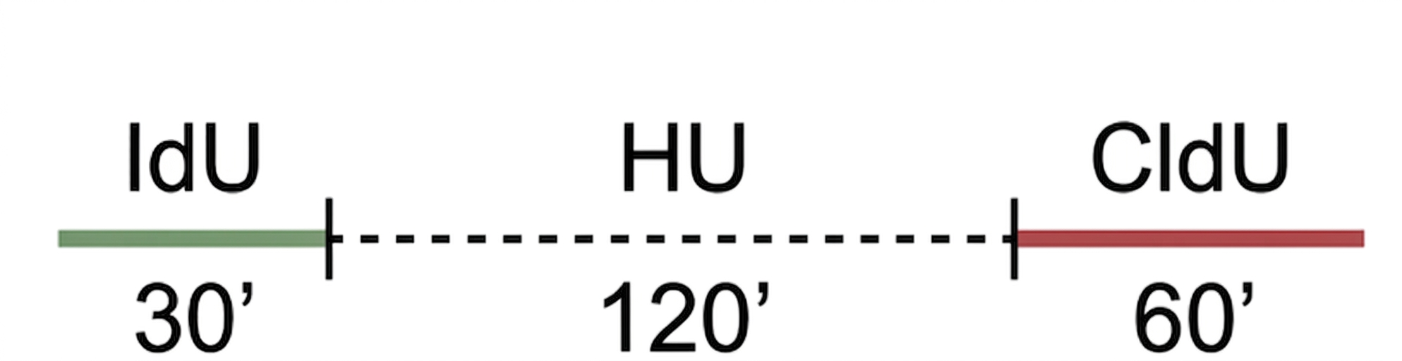
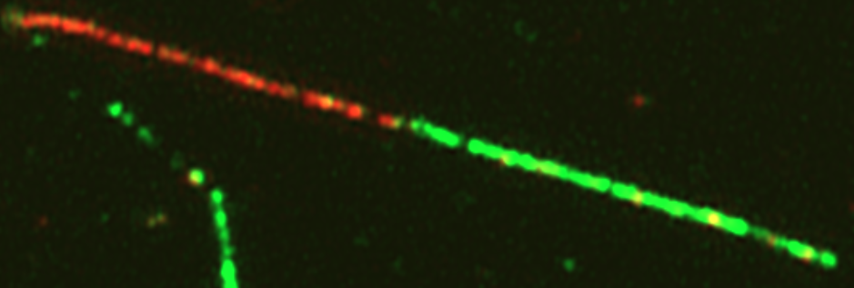

Ccnd1 OE impairs fork restart after stalling
EV
CCND1 OE
Question: What if we inhibit these DNA damage signaling and repair pathways?
Unpublished data, confidential

Slide 15
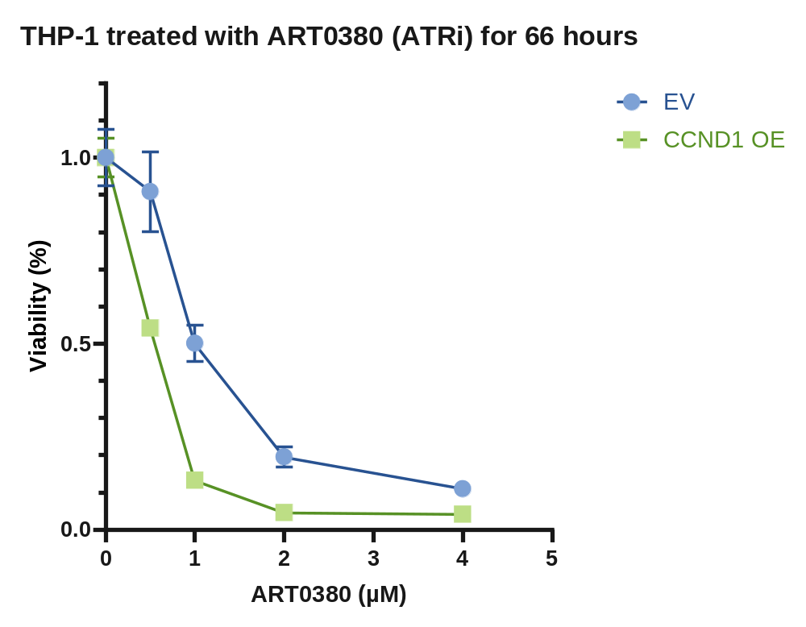
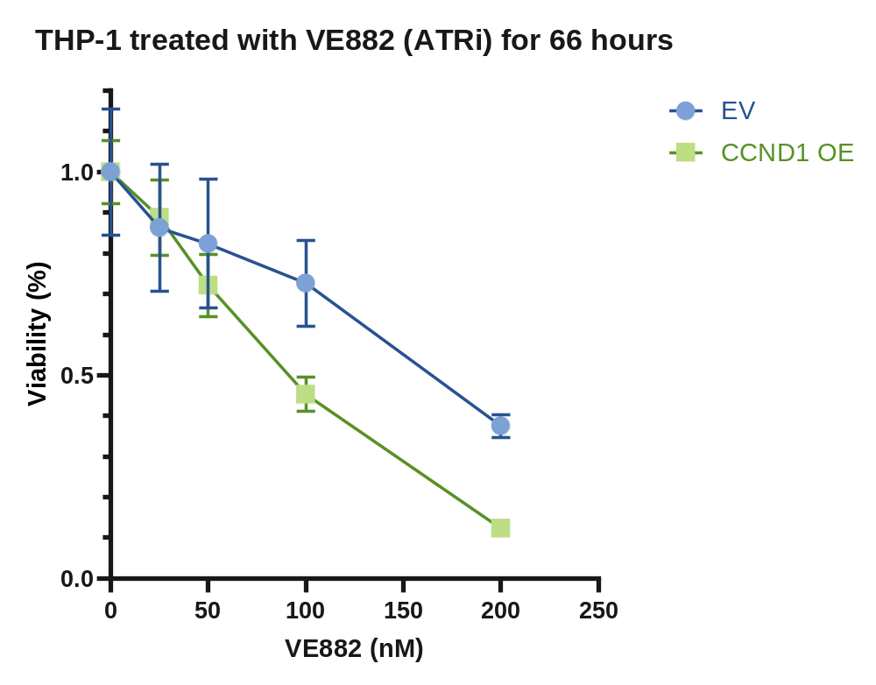
CCND1 OE Increases Sensitivity To Treatment
Targeting ATR DNA Damage signaling pathway
Unpublished data, confidential
Notes:
A drug in clinical drug in solid tumor from ARTIOS

Slide 16
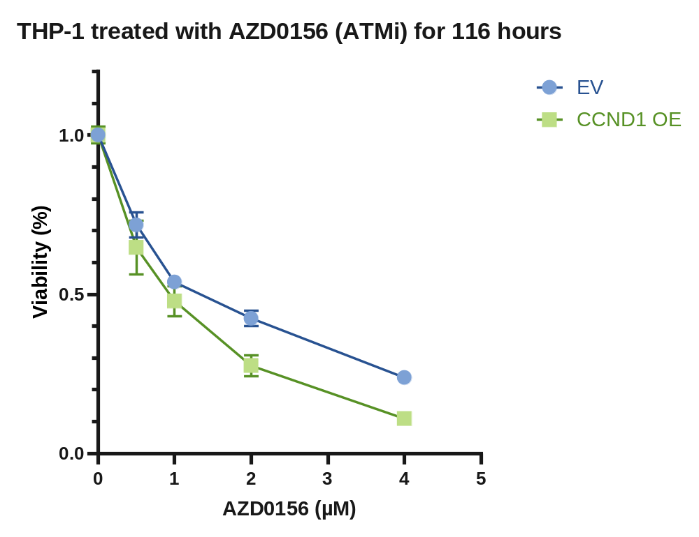
CCND1 OE Increases Sensitivity To Treatment
Targeting ATM DNA Damage signaling pathway
Unpublished data, confidential
Notes:
U of Michigan H sarcoma cell line

Slide 17
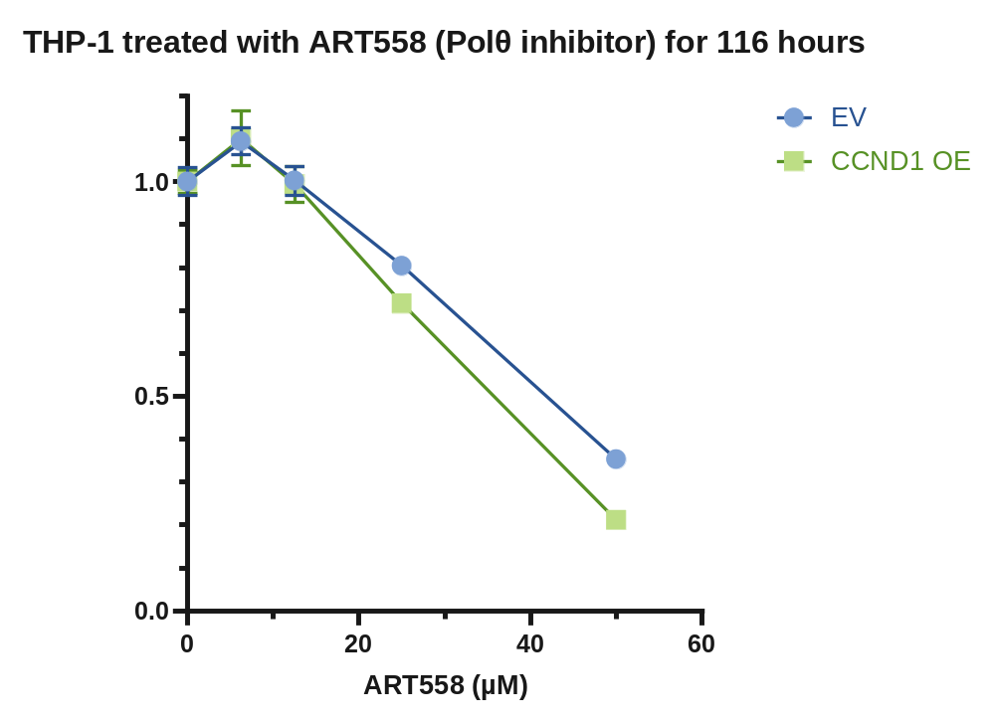
CCND1 Overexpression Increases Sensitivity To Treatment Targeting DNA Repair

Slide 18
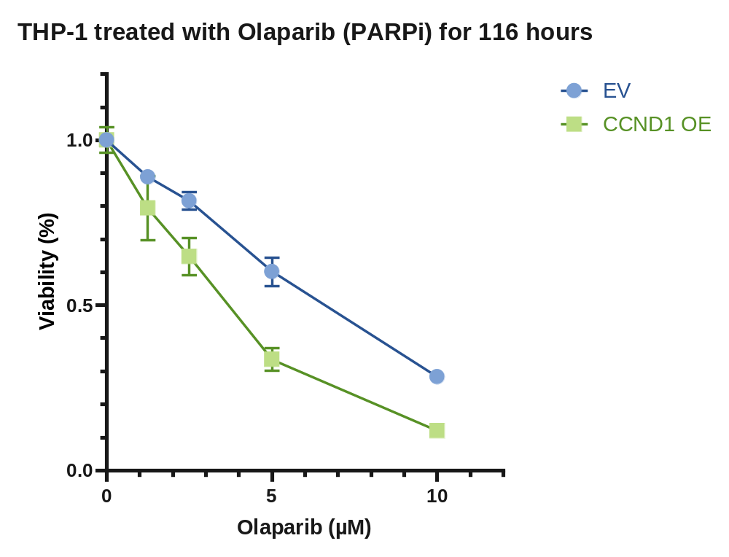
CCND1 OE Increases Sensitivity To Treatment
That Further Increases Replication Stress
Unpublished data, confidential

Slide 19
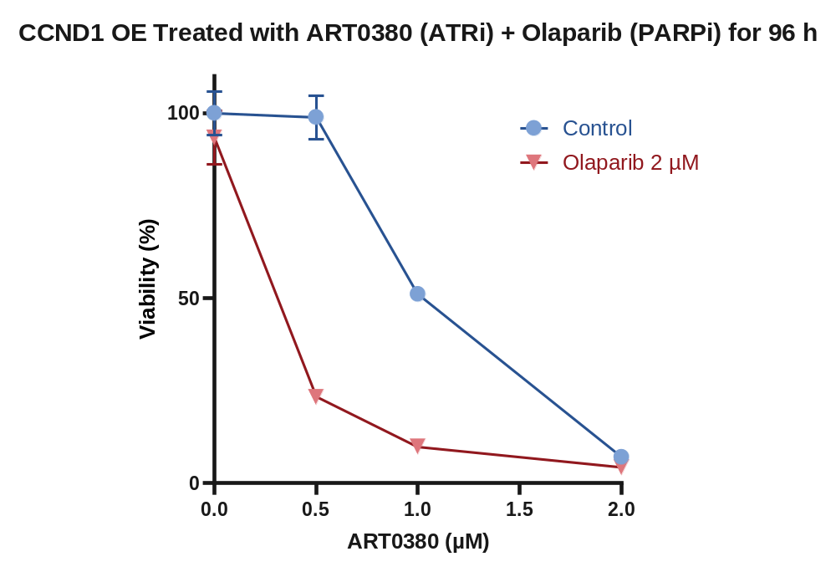
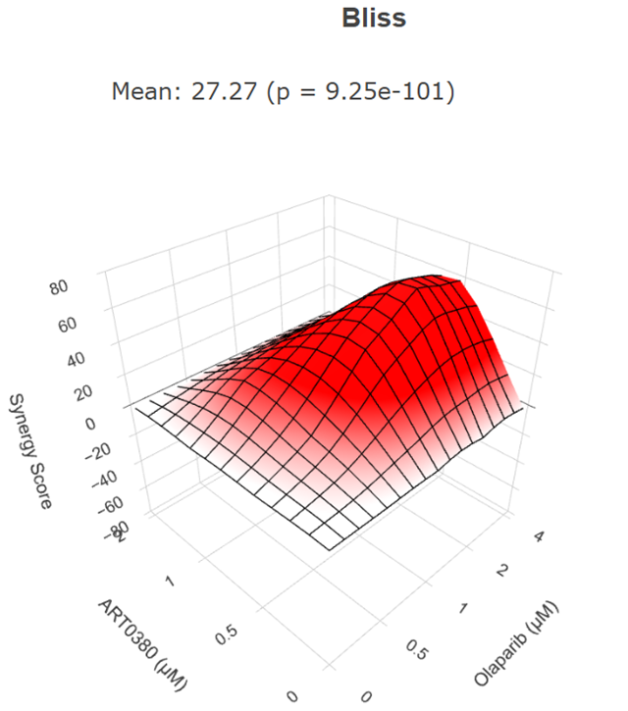
Synergy Between ATR and PARP inhibition
Unpublished data, confidential

Slide 20
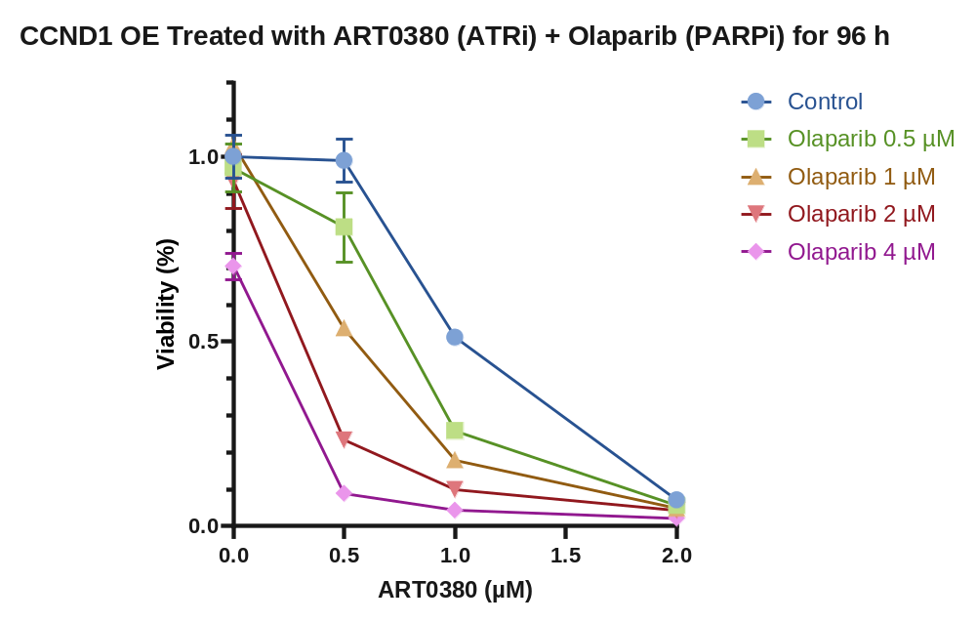
Synergy Between ATR and PARP inhibition

Slide 21
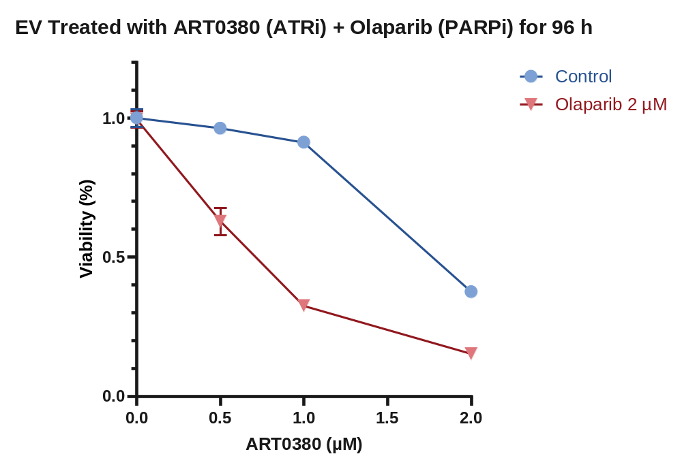
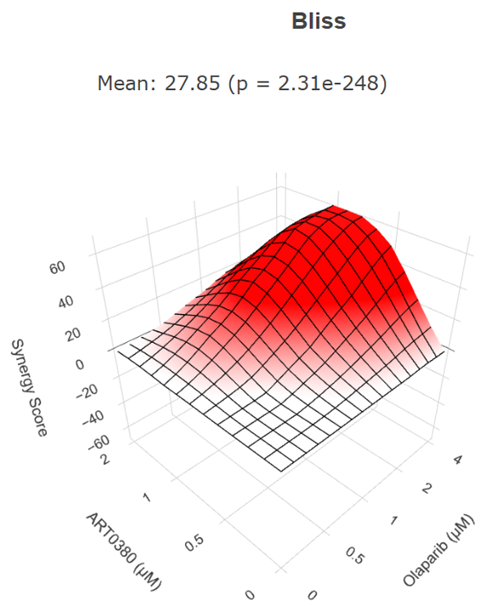
Synergy Between ATR and PARP inhibition

Slide 22
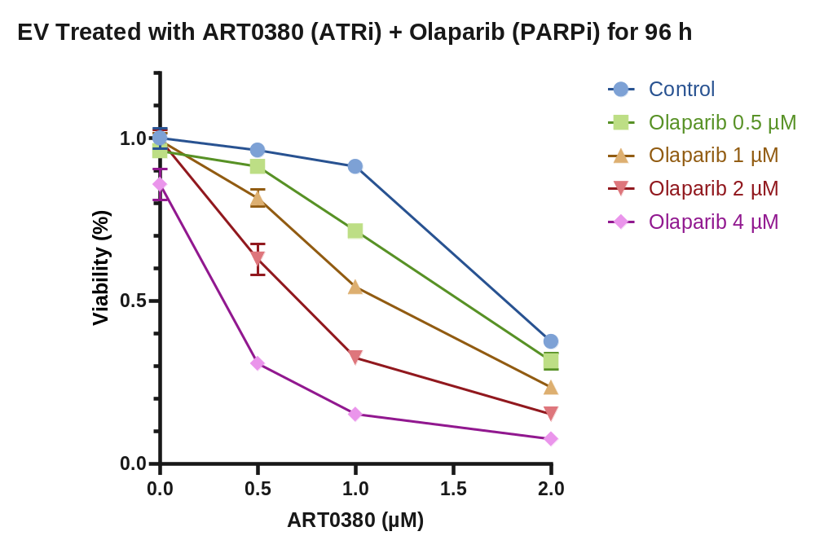
In Vitro Responses to Combinations
Synergy Between ATRi and PARPi

Slide 23
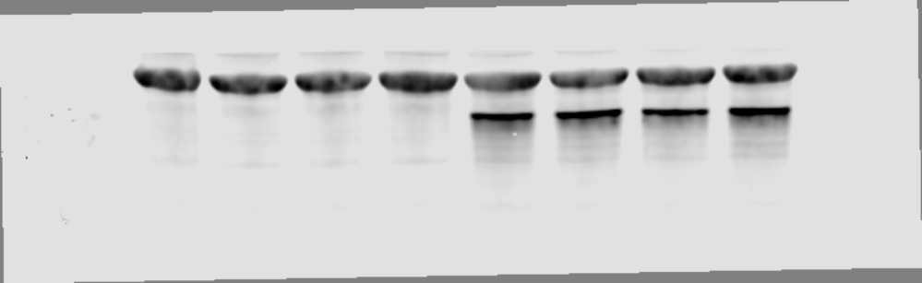
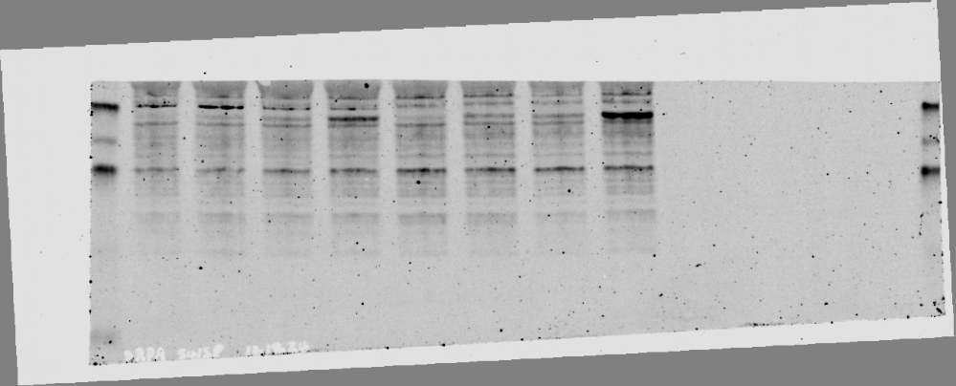
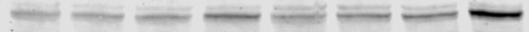
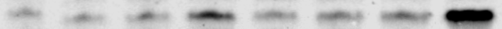
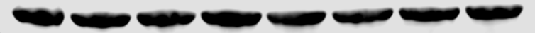
Increased Sensitivity linked to
Enhanced Replication Stress
EV
CCND1 OE
No treatment
Olaparib 1 µM
No treatment
Olaparib 1 µM
ART0380 0.5 µM
ART0380 0.5 µM
ART0380 0.5 µM + Olaparib 1 µM
ART0380 0.5 µM + Olaparib 1 µM
Cyclin D1
pRPA32 p-s4/s8
KAP1 p-S824
p-Histone H2A.X
β-Actin
Replication stress (RS) increased following 48-hour treatment with the combination of the ATR inhibitor ART0380 and the PARP inhibitor olaparib, particularly in CCND1-overexpressing (OE) THP-1 cells compared to empty vector (EV) controls. This was evidenced by the enhanced signals of pRPA32, pKAP1, and p-histone H2A.X.

Slide 24
IN VIVO Experiments on xenograft models
12/1/2025
Inoculation of THP-1 CCND1 OE Cells
12/29
32/34 NRG mice had successful engraftment
1/4/2026
100% NRG mice had successful engraftment
12/16
15/40 NRG mice had successful engraftment
Started treatment with
Vehicle
olaparib 50 mg/kg daily
ART0380 100 mg/kg daily
ART0380 100 mg/kg daily and olaparib 50 mg/kg daily
Notes:
We took the THP-1 cells and injected
Ascites was not expected

Slide 25
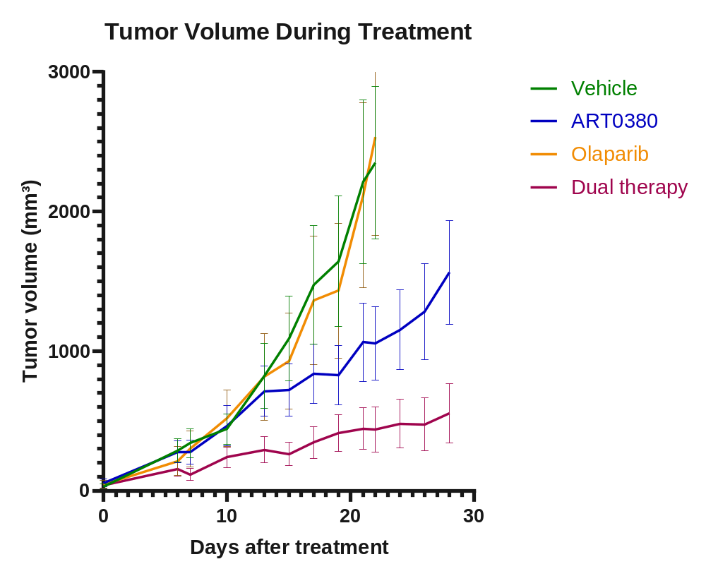
Dual Therapy Provides Superior Tumor Control
Unpublished data, confidential

Slide 26
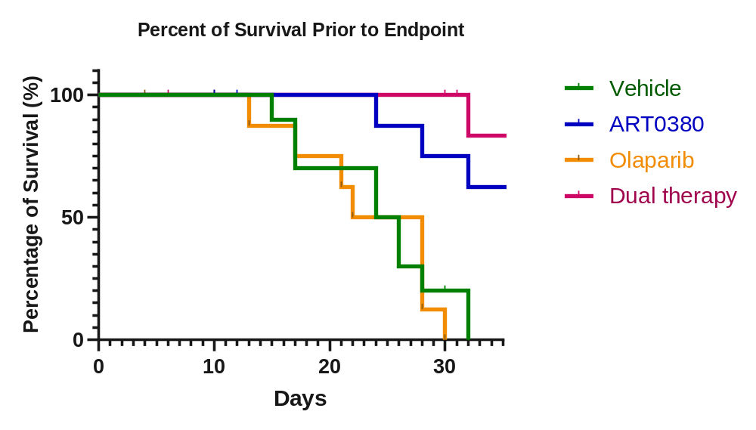
Dual Therapy Improves Overall Survival
Endpoint:
The cumulative tumor size reaches 2500 mm³
A tumor that ulcerates or loses the integrity of the skin covering the tumor for any reason.
In animals with ascites-producing tumors: 20% increase in body weight from baseline or abdominal distention great enough to cause distress or interfere with normal activity
Unpublished data, confidential

Slide 27
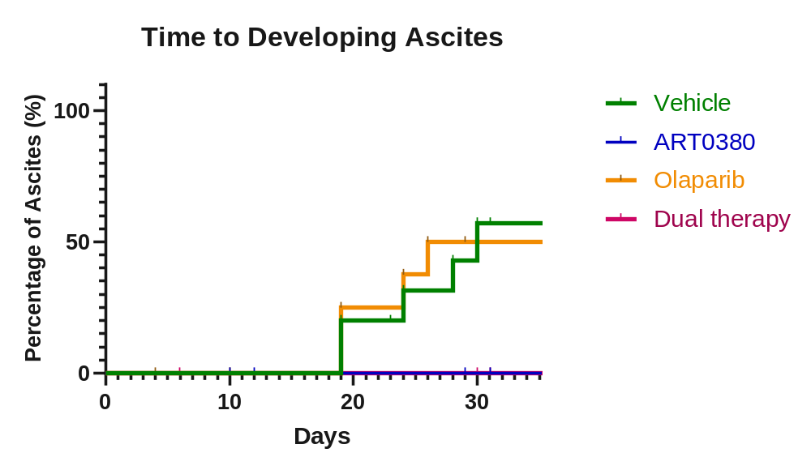
ATR inhibition Prevents Ascites Formation

Slide 28
Summary
CCND1 overexpression increases replication stress in our cell line model, leading to enhanced sensitivity to ATR and PARP inhibition both in vitro and in vivo.
These findings may be expanded to other hematologic malignancies and solid tumors with CCND1 overexpression.

Slide 29
Future Directions
More mechanistic studies to characterize the fork progression and to understand the replisome.
Conduct CRISPRi (CRISPR interference) screens to uncover additional therapeutic targets.
Translate findings into early-phase clinical trials.
Expand findings to other hematologic malignancies with CCND1 overexpression.
Notes:
Before I close, I want to thank our division for the grant, which made many of the work possible, and the people who supported me throughout my work, Dr. Jithma Abeykoon, Dr. Witzig, Dr. Go, and Dr. Wu for their guidance, And to Michelle, Kim, and Cecilia for their tremendous help in the lab.

Slide 30
Acknowledgments
Mentors
  Jithma P. Abeykoon, M.D.
  Ronald S. Go, M.D.
  Thomas E. Witzig, M.D.
  Key Collaborators
  Karen L. Rech, M.D.
  Aishwarya Ravindran, M.B.B.S
  Gaurav Goyal, M.D.
  Richard Kandasamy, Ph.D.
  Surendra Dasari, Ph.D.
  Arvind Panday, Ph.D.
  Lab Members
  Xiaosheng Wu, M.D.
  Cecilia Ayala-Zambrano, Ph.D.
  Michelle K. Manske, M.S.
  Kimberly A. Gwin
  Miles D. Del Busso
  Funding
  Hematology Small Grant (Mayo)
  Dr. Kenneth Mann Classical Hematology Research Grant (Mayo)
  Haub Foundation Grant (Mayo)

