Slide 1
KRAS Mutations in Histiocytic Neoplasms:
Mutation Spectrum and Response to MEK Inhibition
the 11th Annual ECDGA Medical Symposium
Dongni Yi, M.D.
Hematology/Oncology Fellow, Clinician Investigator Track
Mayo Clinic
Mayo Clinic, Rochester, MN
5.1.2026
Notes:
Today I’ll be presenting our work on KRAS mutations in histiocytic neoplasms, focusing on the mutation spectrum and how these alterations relate to response to MEK inhibition.

Slide 2
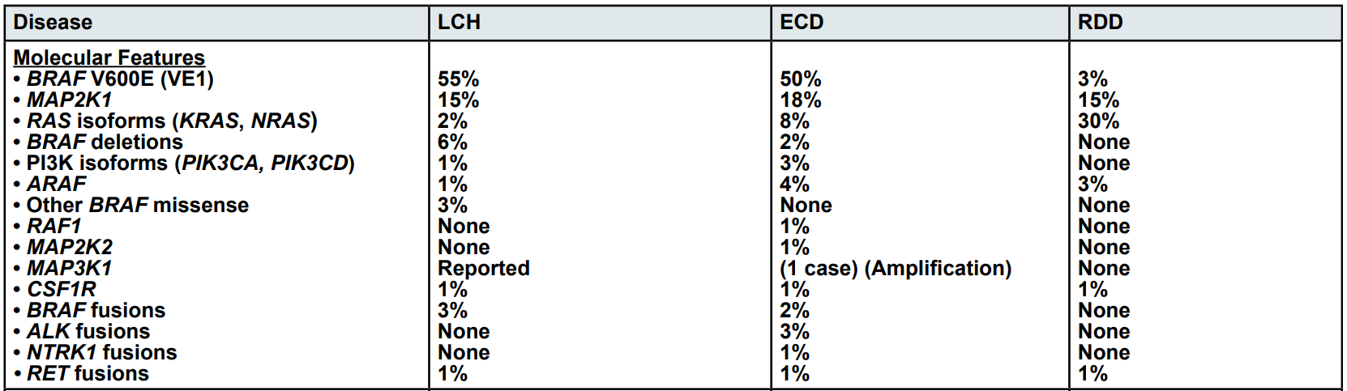
NCCN Guidelines Version 2.2025
Histiocytic Neoplasms
Notes:
Purpose of the study

Slide 3
Goals of the study
To identify patients with histiocytic neoplasms and KRAS mutations
To learn the types of KRAS mutations in histiocytic neoplasms
To relate the types of KRAS mutations to response to MEK inhibition

Slide 4
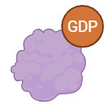
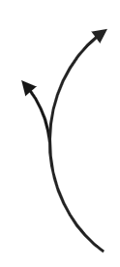






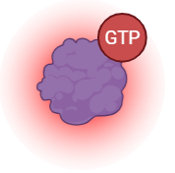
KRas is active when bound to GTP
Inactive KRAS
Active KRAS
GEF: Guanine nucleotide exchange factor
GAP: GTPase-activating protein
Notes:
KRAS is GTPase, cycling between an inactive GDP-bound state and an active GTP-bound state.
Guanine nucleotide exchange factors (GEF) promote release of GDP and loading of GTP, activating KRAS.
KRAS returns from the GTP-bound state to the GDP-bound (inactive) state through GTP hydrolysis, a process that involves both intrinsic enzymatic activity and GAP-mediated catalysis.
Oncogenic mutations disrupt this cycle through three biochemical mechanisms: impaired GTP hydrolysis, accelerated nucleotide exchange, or both.

Slide 5
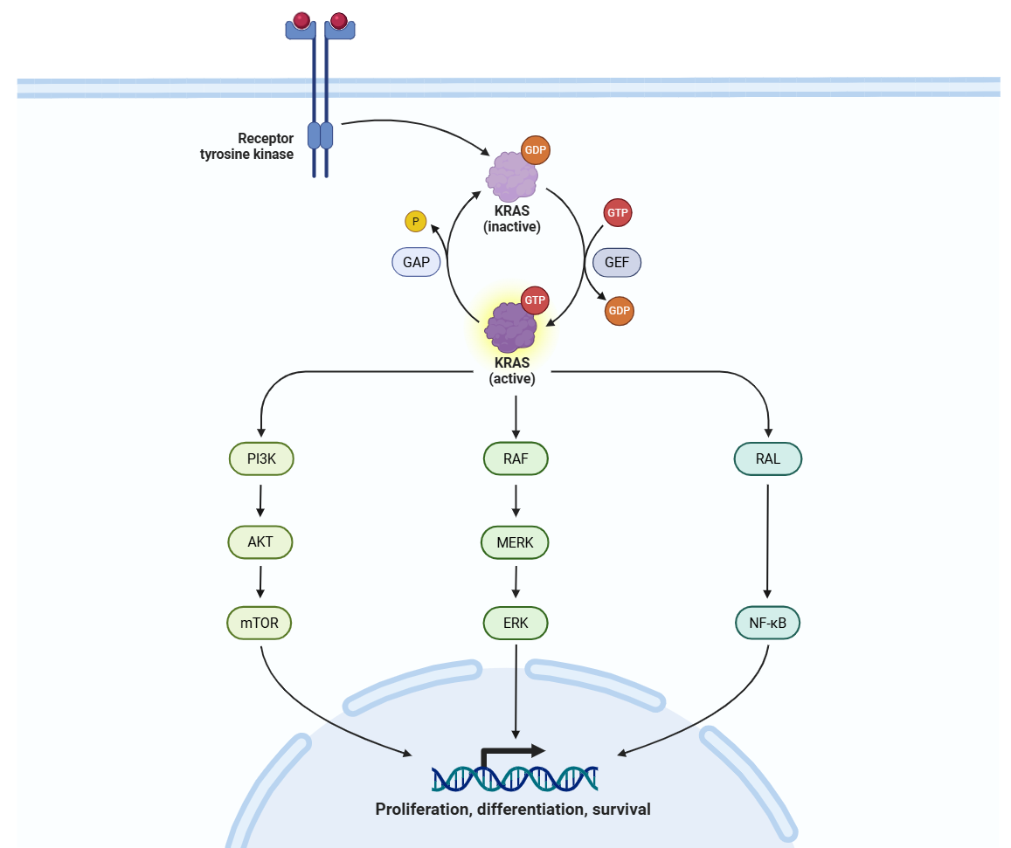
Ras-raf-mek-erk pathway
Notes:
Active KRAS functions as a central signaling hub that activates multiple downstream effector pathways, driving cell proliferation, survival, metabolic reprogramming, etc. The two dominant pathways are RAF-MEK-ERK (MAPK) and PI3K-AKT-mTOR, but several additional effector arms contribute to the full oncogenic program.

Slide 6
Demographic and Clinical Characteristics
Characteristic | N=36
Median age at diagnosis (range) — yr | 64 (20-86)
Female sex — no. (%) | 23 (63.9%)
Institution of enrollment — no. (%)
Mayo | 33 (91.7%)
UAB | 3 (8.3%)
Diagnosis
RDD | 20 (55.6%)
ECD | 6 (16.7%)
LCH | 2 (5.6%)
Histiocytic Sarcoma | 3 (8.3%)
Xanthogranuloma | 2 (5.6%)
Others | 3 (8.3%)
Treated with MEKi | 16 (44.4%)
Cobimetinib | 15 (41.7)
Trametinib | 2 (5.6%)
Notes:
To study the mutation spectrum and treatment response, we performed a retrospective review of patients with histiocytic neoplasms evaluated at Mayo Clinic or the University of Alabama at Birmingham, with KRAS mutations identified by next-generation sequencing. In total, 36 patients were identified with median age at 64. Around 2/3 of the patients were females. Over 50% patients had the diagnosis of Rosai Dorfman disease. 44% of patients were treated with MEK inhibitors. Among treated patients, the majority received cobimetinib and only 5.6% patients received trametinib, including one patient who was switched from cobimetinib to trametinib.

Slide 7
All patients had KRAS Gain-of-function mutations
31.6%
13.9%
11.1%
11.1%
Notes:
16 mutations
All patients in our cohort had at least 1 GOF KRAS mutations. The only mutation that has not been functionally characterized in the published literature was Leucine to Valine at position 6. However, the patient with L6V also had G12F, which is a GOF mutation.
The most common mutation was K117N, which was found in 30.6% of patients, followed by G12D, G13D, and A146T.

Slide 8
Codons 117 and 12 Are the Most Commonly Mutated
31.6%
25.0%
19.4%
19.4%
Notes:
When we group mutations by location, codons 117, 12, 13, and 146 are the most frequently mutated, which also captures the major mechanisms of KRAS activation

Slide 9
Codon 117 mutations accelerate nucleotide exchange
31.6%
Located in the guanine nucleotide binding pocket
Mutations at K117 accelerate nucleotide exchange by promoting rapid GTP loading
Hunter, Manandhar et al. 2015
Smith, Neel et al. 2013
de Borja, Hao Lin et al. 2025
Notes:
K117 is located in the guanine nucleotide binding pocket
Mutations at K117 accelerate nucleotide exchange by promoting rapid GTP loading

Slide 10
Codon 12 mutations impair GAP-mediated GTP hydrolysis
25.0%
Glycine 12 is located in the phosphate-binding loop
Substitution at this position disrupts GAP binding and positioning within the active site, thereby impairing GTP hydrolysis
Hunter, Manandhar et al. 2015
Smith, Neel et al. 2013
Song, Rabara et al. 2025
Notes:
Glycine 12 is located in the phosphate-binding loop, or P-loop, which cradles the phosphate groups of GTP. Because glycine is the smallest amino acid, substitution at this position introduces steric hindrance that disrupts GAP binding and positioning within the active site, thereby impairing GTP hydrolysis

Slide 11
Codons 13 and 146 mutations
promote rapid nucleotide exchange kinetics
19.4%
G13D accelerates intrinsic nucleotide exchange approximately 10-fold
Codon 146 mutations dramatically accelerate nucleotide exchange up to 1,000-fold acceleration
Hunter, Manandhar et al. 2015
Smith, Neel et al. 2013
Johnson, Lin et al. 2019
Feig and Cooper 1988
Notes:
Codons 13 and 146 both activate KRAS primarily through accelerated nucleotide exchange. G13D accelerates intrinsic nucleotide exchange approximately 10-fold. G13C is a weaker activating mutation than G13D. In contrast, codon 146 mutations dramatically accelerate nucleotide exchange up to 1,000-fold acceleration.

Slide 12
Codons 59 and 58 mutations impairs GTP hydrolysis and enhances nucleotide exchange
5.6%
2.8%
Hunter, Manandhar et al. 2015
Smith, Neel et al. 2013
Iwata, Masuhara et al. 2016
Johnson, Oladimeji et al. 2026
Notes:
Codon 59 mutations, along with adjacent T58I mutation, impair GTP hydrolysis and also enhances nucleotide exchange, with one variant (A59T) exhibiting a truly neomorphic enzymatic activity of autophosphorylation

Slide 13
substitutions at Q61 abolish both intrinsic and GAP-mediated hydrolysis
2.8%
Hunter, Manandhar et al. 2015
Smith, Neel et al. 2013
Song, Rabara et al. 2025
Notes:
Codon 61 also disrupts GTP hydrolysis. Any substitution at Q61 abolishes both intrinsic and GAP-mediated hydrolysis.

Slide 14
Codon 22 mutations decrease GTP hydrolysis
2.8%
Q22K or Q22R
Partial constitutive activation of the KRAS GTPase with weaker transforming potential compared to G12 and Q61
Hunter, Manandhar et al. 2015
Smith, Neel et al. 2013
Tsukuda, Tanino et al. 2000
Notes:
The KRAS codon 22 mutation (Q22K or Q22R) is a rare, "atypical" activating mutation that substitutes the wild-type glutamine (Gln/Q) at position 22 with lysine (Q22K) or arginine (Q22R), resulting in partial constitutive activation of the KRAS GTPase with weaker transforming potential compared to mutations at codons 12 and 61.
The next q is what it means to response

Slide 15
Response to MEK inhibitor by mutation types
Overall response rate: 62.5%
ID | Sex | Mutations | Other Altered Genes | Diagnosis | 1st MEKi | Response | Time to Best Response | 2nd MEKi | Response
1 | F | p.K117N | FANCD2; IDH1; MAP3K1; MLL; NOTCH2; PDGFRB | RDD | Cobimetinib | CR | 13 mo | -
2 | M | p.K117N | DNMT3A; BCL2L11, KIT, NOTCH1, NTRK1, SETBP1, SETD2, ZFHX4 | RDD | Cobimetinib | PR | 5 mo | -
3 | F | p.K117N | MUTYH | RDD | Cobimetinib | PR | 4 mo | -
4 | F | p.K117N | ASIC5, ASXL1, C15orf57::CBX3, IGKV2D-28::IGKJ5, PCDHGC5 | RDD | Cobimetinib | No response | 2 mo | -
5 | F | p.K117N | - | RDD | Cobimetinib | No response | 22 mo | -
6 | F | p.K117N | - | RDD | Cobimetinib | No response | 5 mo | Trametinib | PR in 2 mo
7 | F | p.G12D | MAP2K1; GEN1; RAD51D | ECD | Cobimetinib | CR | 23 mo | -
8 | F | p.G12D | - | RDD | Cobimetinib | No response | 3 mo | -
9 | F | p.G13C | FANCA | RDD | Cobimetinib | PR | 10 mo | -
10 | F | p.G13D |  | RDD | Cobimetinib | No response | 3 mo | -
11 | F | p.A146T | NBN | RDD | Cobimetinib | PR | 5 mo | -
12 | F | p.A146T | - | RDD | Cobimetinib | PR | 6 mo | -
13 | F | p.A146P | - | RDD | Cobimetinib | PR | 4 mo | -
14 | M | p.A146V | NRAS; TET2; TRAF7; CBL; GLI1; FOXA1 | ECD | Cobimetinib | PR | 3 mo | -
15 | M | p.A146T | NOTCH1, BCOR, FANCA, | LCS | Trametinib | No response | 2 mo | -
16 | F | p.T58I | CDKN2A/B; BRCA2; CUX1; DNMT3A; HDAC7; KMT2C, PCLO; RET; SDHA; SUFU; ZNF217; ATM | RDD | Cobimetinib | CR | 2 mo | -
Notes:
codon 146 mutations dramatically accelerate nucleotide exchange up to 1,000-fold acceleration.
Overall response rate 62.5%
146 mutations might be a favorable type

Slide 16
Response to MEK inhibitor by mutation types
ID | Sex | Mutations | Other Altered Genes | Diagnosis | 1st MEKi | Response | Time to Best Response | 2nd MEKi | Response
1 | F | p.K117N | FANCD2; IDH1; MAP3K1; MLL; NOTCH2; PDGFRB | RDD | Cobimetinib | CR | 13 mo | -
2 | M | p.K117N | DNMT3A; BCL2L11, KIT, NOTCH1, NTRK1, SETBP1, SETD2, ZFHX4 | RDD | Cobimetinib | PR | 5 mo | -
3 | F | p.K117N | MUTYH | RDD | Cobimetinib | PR | 4 mo | -
4 | F | p.K117N | ASIC5, ASXL1, C15orf57::CBX3, IGKV2D-28::IGKJ5, PCDHGC5 | RDD | Cobimetinib | No response | 2 mo | -
5 | F | p.K117N | - | RDD | Cobimetinib | No response | 22 mo | -
6 | F | p.K117N | - | RDD | Cobimetinib | No response | 5 mo | Trametinib | PR in 2 mo
7 | F | p.G12D | MAP2K1; GEN1; RAD51D | ECD | Cobimetinib | CR | 23 mo | -
8 | F | p.G12D | - | RDD | Cobimetinib | No response | 3 mo | -
9 | F | p.G13C | FANCA | RDD | Cobimetinib | PR | 10 mo | -
10 | F | p.G13D |  | RDD | Cobimetinib | No response | 3 mo | -
11 | F | p.A146T | NBN | RDD | Cobimetinib | PR | 5 mo | -
12 | F | p.A146T | - | RDD | Cobimetinib | PR | 6 mo | -
13 | F | p.A146P | - | RDD | Cobimetinib | PR | 4 mo | -
14 | M | p.A146V | NRAS; TET2; TRAF7; CBL; GLI1; FOXA1 | ECD | Cobimetinib | PR | 3 mo | -
15 | M | p.A146T | NOTCH1, BCOR, FANCA, | LCS | Trametinib | No response | 2 mo | -
16 | F | p.T58I | CDKN2A/B; BRCA2; CUX1; DNMT3A; HDAC7; KMT2C, PCLO; RET; SDHA; SUFU; ZNF217; ATM | RDD | Cobimetinib | CR | 2 mo | -

Slide 17
Summary
Frequency of the different KRAS mutations
Most are gain-of-functions with different mechanisms
Trend towards better response rate in codon 146 mutations
Future directions: to confirm these findings in a larger patient cohort for potential clinical implications
Notes:
daraxonrasib?

Slide 18
Acknowledgments
Mentors
  Jithma P. Abeykoon, M.D.
  Ronald S. Go, M.D.
  Thomas E. Witzig, M.D.
  Key Collaborators
  Gaurav Goyal, M.D.
  Karen L. Rech, M.D.
  Aishwarya Ravindran, M.B.B.S
  Carla I. Borre, M.D., M.P.H.
  Mia Poleksic, M.D.
  Organization
  Histio-Care Network
  The University of Alabama at Birmingham

