Slide 1
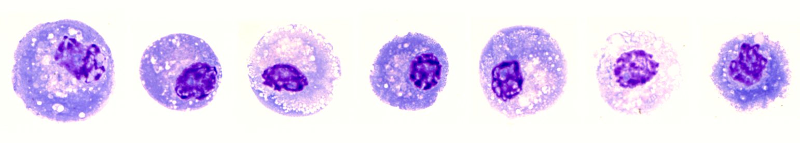
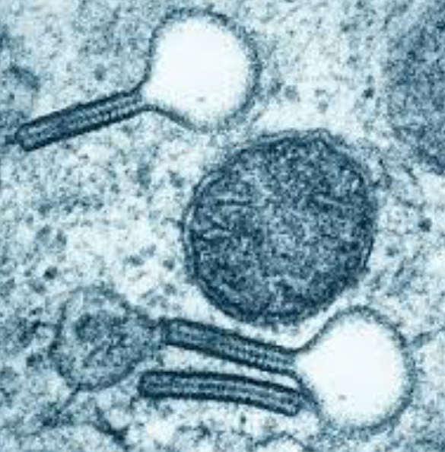
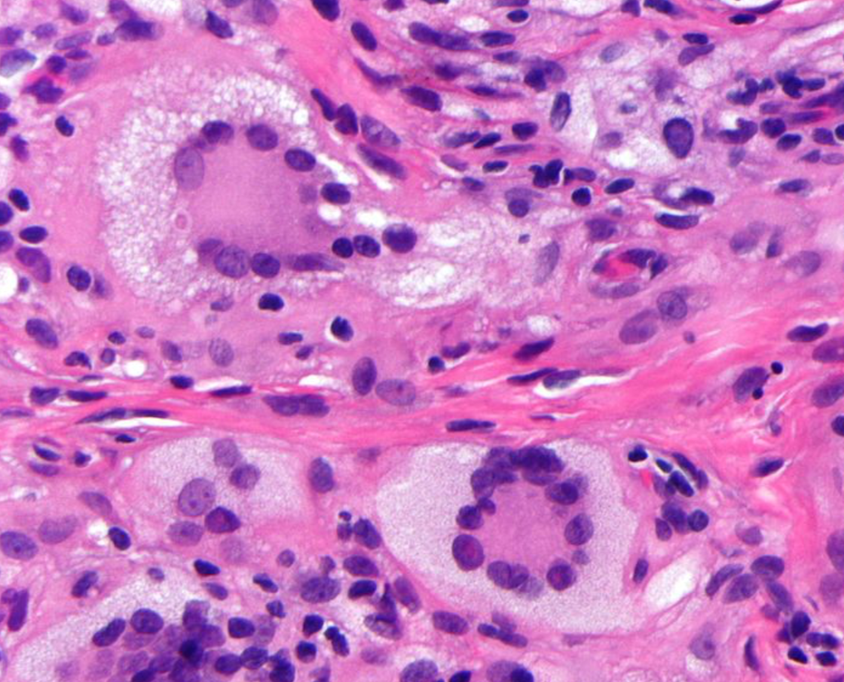
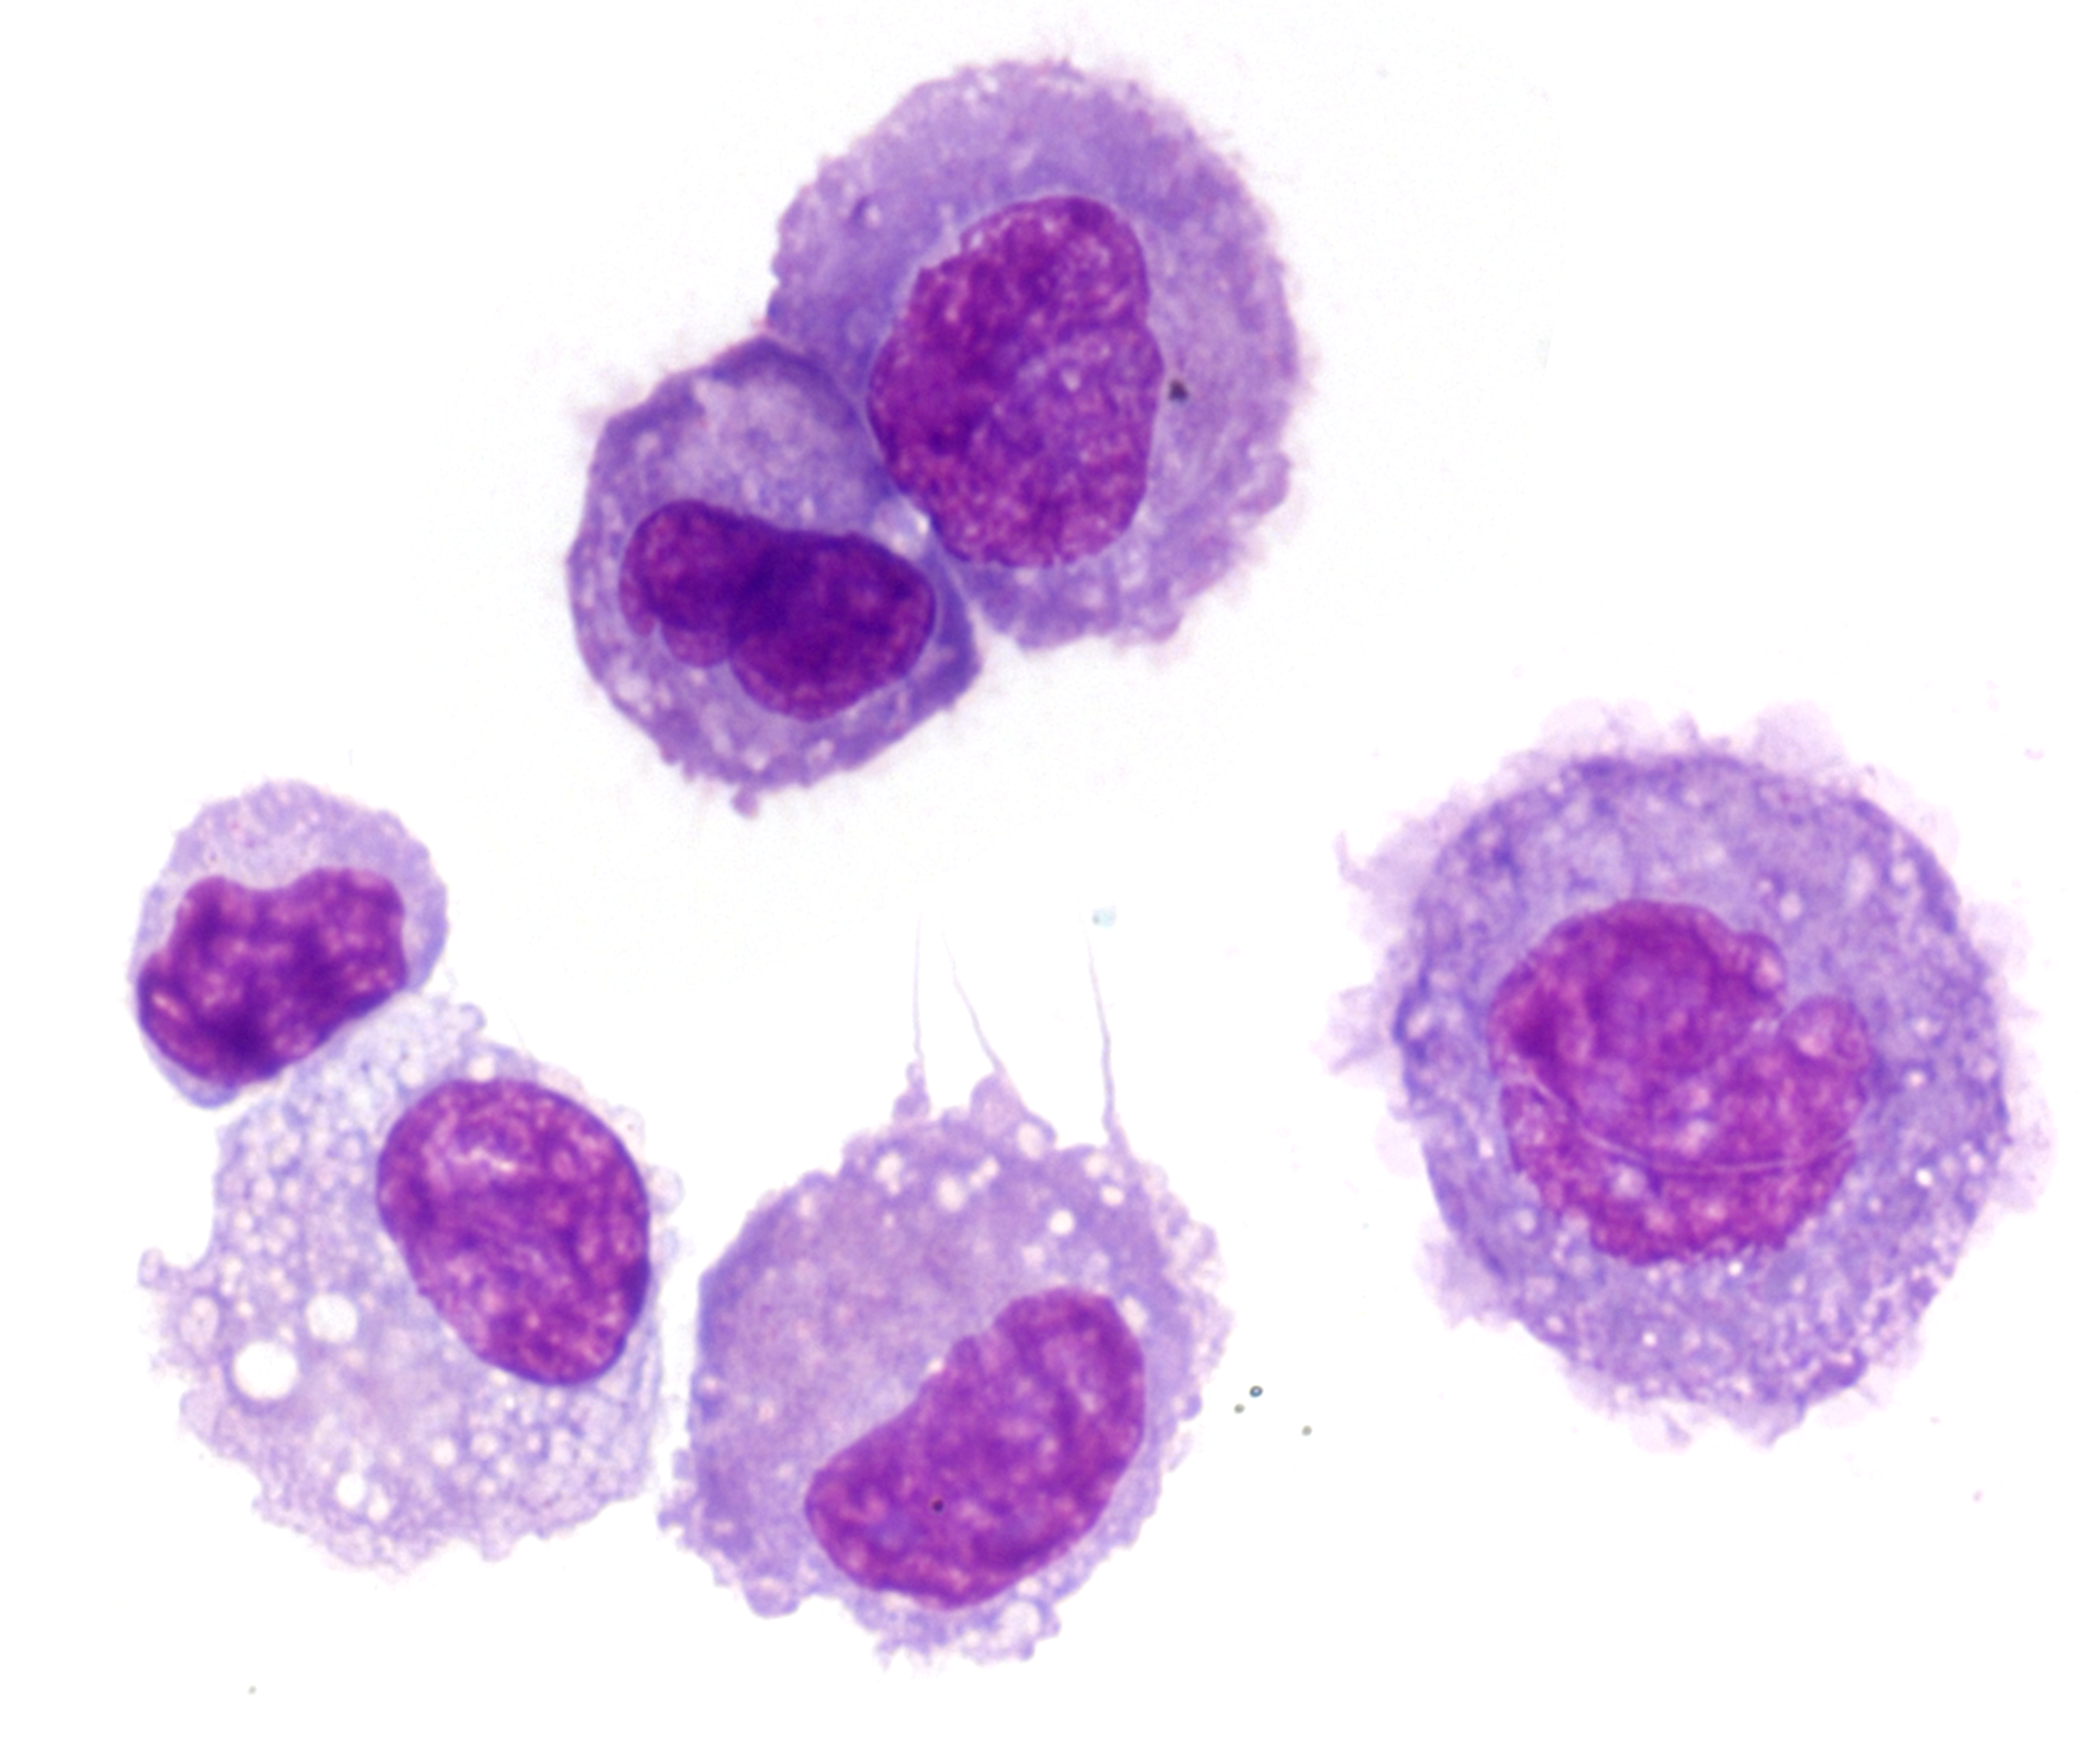
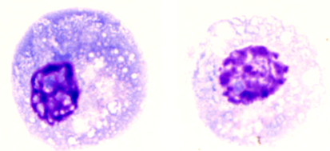
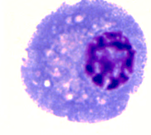

The clonal origin and evolution of high risk histiocytosis in adults
Matthew Collin

Slide 2
Question:
How does mutation in a haematopoietic stem cell cause multisystem histiocytosis?
When did it start?
What is the sequence of events?
How do mutations interact and evolve?
How could this be useful?
Surveillance
Early diagnosis
New therapeutic approaches to suppress clonal advantages

Slide 3
Phylogenetic mapping
ROOT
(common ancestor)
Inferred ancestral cells
PHYLOGENY
BRANCH PIONTS
(‘nodes’ or ‘coalescences’)
3 single genomes from one individual
TIPS
(data)
Cell 1
Cell 2
Cell 3
Cell 1
Cell 2
Cell 3
Notes:
Within an individual all cells arise from a single ancestor – the zygote
Somatic mutations occur at a predictable rate in all cells and accumulate with ageing.
Mostly intergenic and harmless.
Initial burst of ~50 pre-birth
15-20/year (immune cells)
At cell division and DNA replication, mutations are immortalized in subsequent generations
How do we build these phylogenetic trees? Well, imagine 3 cells from an individual, each harbouring its own set of somatic mutations.
You can see that Cells 1 & 2 both share the blue circle & red star mutations. Therefore, these cells must have had a common ancestor that already had these 2 mutations. However, Cell 3 has no mutations shared with the other cells and therefore is unrelated until you go back to an ancestor with no mutations. So these are ancestors that we haven't directly observed, but can infer.
You can represent this as a phylogeny, where each tip is a cell that you have sequenced, the branch points (or nodes) are ancestor cells that you can infer, and the mutations can be assigned to branches - representing the ancestral lineages in which they were acquired, and we generally scale the branch length to be proportional to the number of mutations assigned to that branch. And because the rate of mutation acquisition is fairly constant throughout life, the branch length is approximately proportional to the amount of time passed in that lineage.

Slide 4
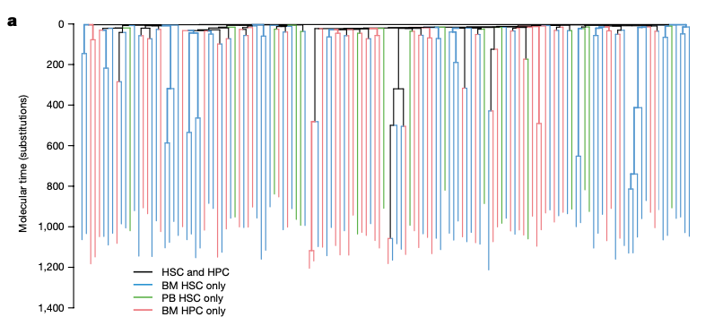
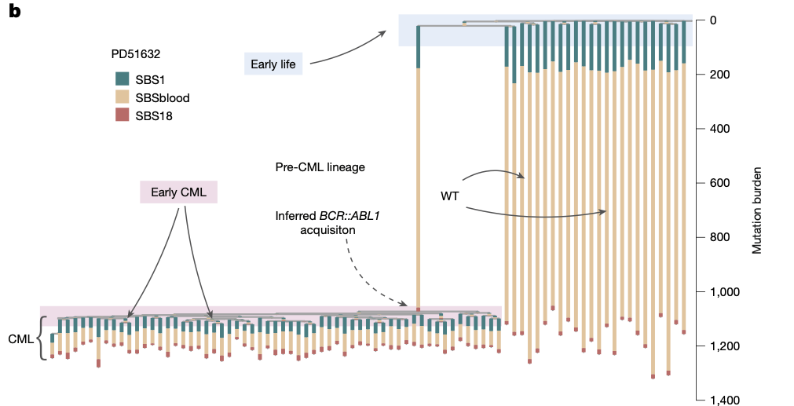
Healthy 63-year old
Patient with CML
onset
mutational signature
clonal advantage
Lee-Six H, Nature. 2018;561 (7724):473-478.
Kamizela AE, Nature. 2025;640:982-990.

Slide 5
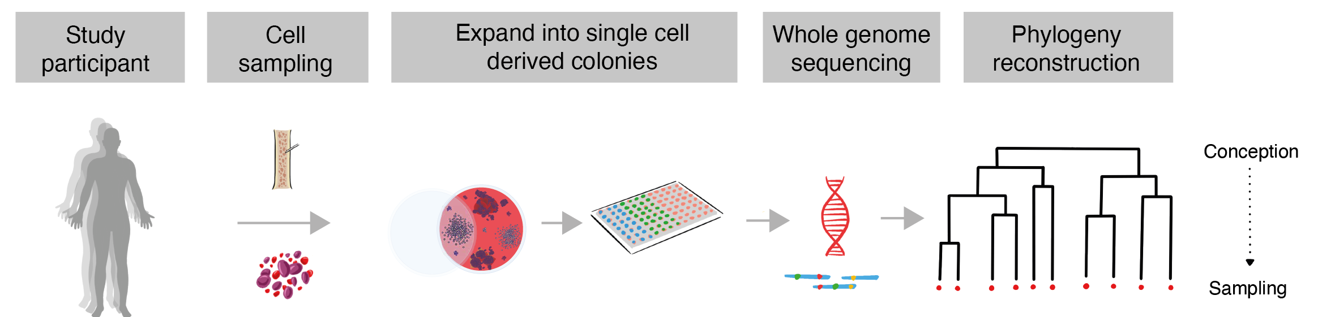
Experimental workflow
Coorens THH, Spencer Chapman M, Williams N, Martincorena I, Stratton MR, Nangalia J, Campbell PJ. Reconstructing phylogenetic trees from genome-wide somatic mutations in clonal samples. Nat Protoc. 2024
Notes:
Have to have mutations in the tree

Slide 6
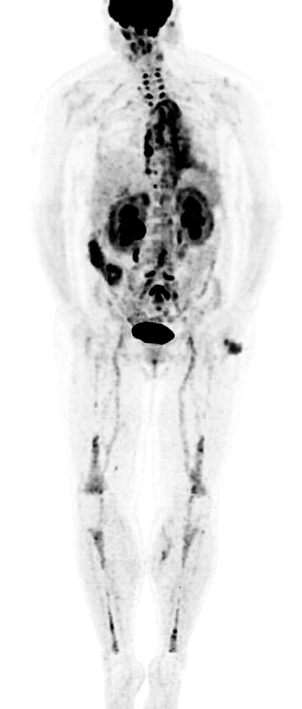
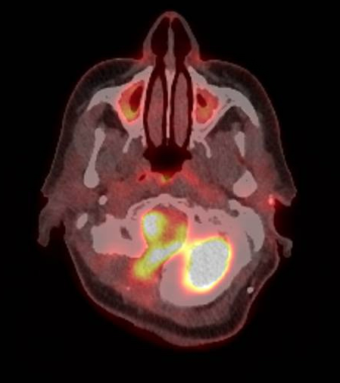
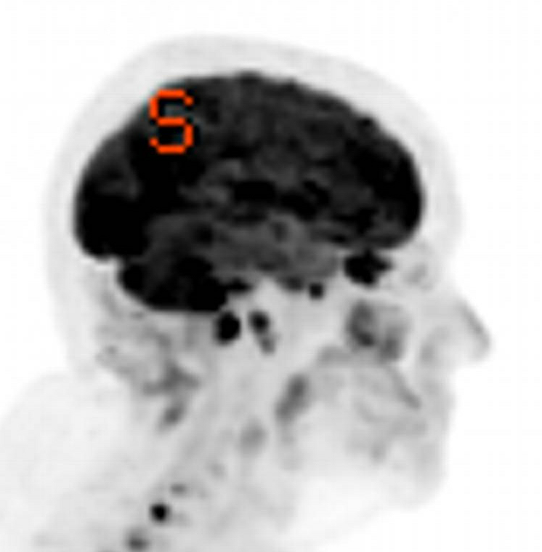
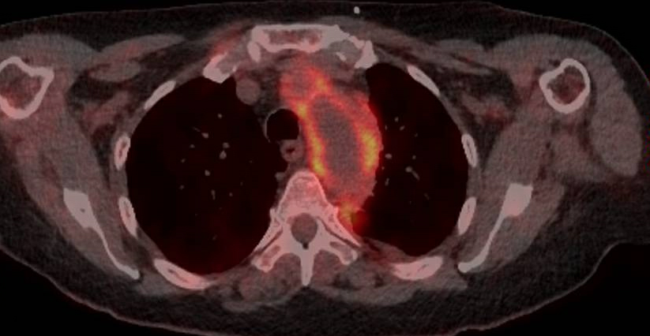
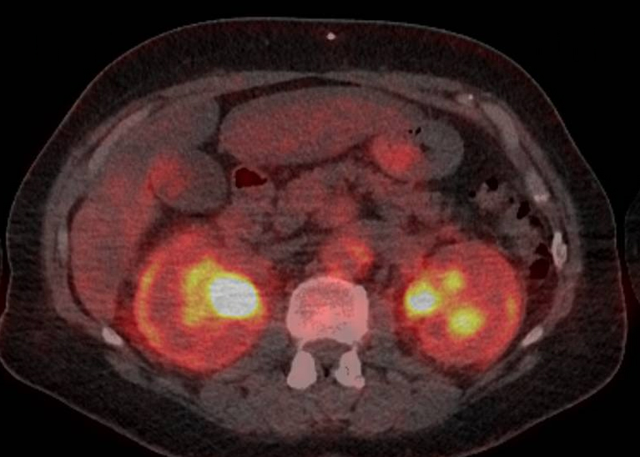
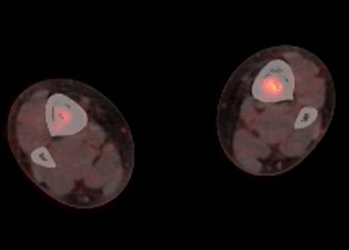
Mutations are rare even with high disease activity
A10033
PBMC 0.07%
CD34 0.10%
(18% ASXL1 mutation)
1 in 1,000 mutated cells
>4,000 colonies to capture 2 with mutation

Slide 7
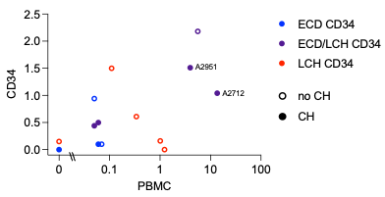
Typical range in CD34+ progenitors ≈ 1%, even with clonal haem (filled symbols)
% BRAF^{V600E}
Notes:
Mutations are rare in ECD, roughly proportional to PBMC mutation level, and our two patients although at the high end, are not complete outliers

Slide 8
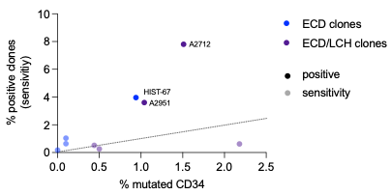
Experimental workflow
>8,000 single cells sorted
plus 12 CFU assays
4,724 colonies grown
2,237 screened for mutation
23 BRAF^{V600E} from 3 donors
Notes:
Range of BRAF VAFs. Paul grew over 1000 colonies and we got 14 with BRAF mutation in these two patients
Quite heavily loaded with clonal haematopoiesis – which we found out in retrospect but which did not play a part in the selection of the patients
BRAF mutation does not impair clone growth in vitro

Slide 9

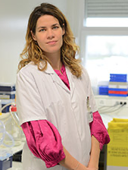
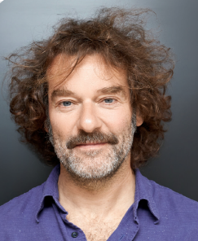

Experimental workflow
HIST-67 team
Notes:
Range of BRAF VAFs. Paul grew over 1000 colonies and we got 14 with BRAF mutation in these two patients
Quite heavily loaded with clonal haematopoiesis – which we found out in retrospect but which did not play a part in the selection of the patientrs

Slide 10
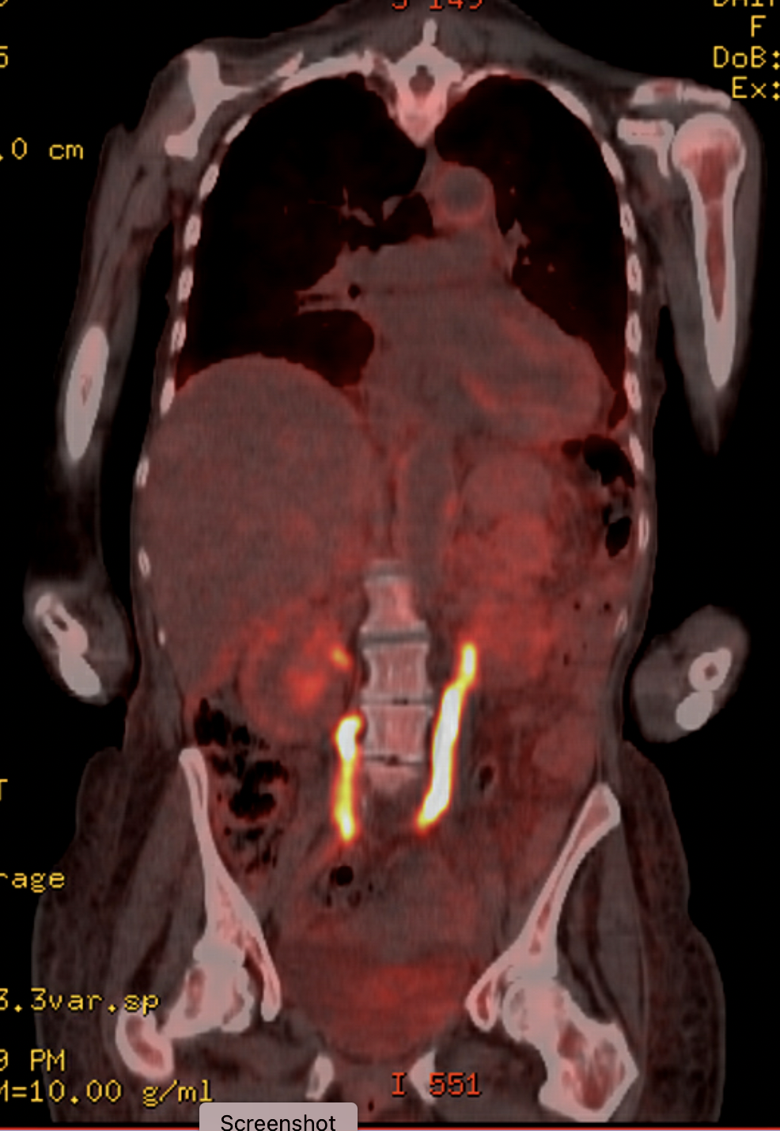
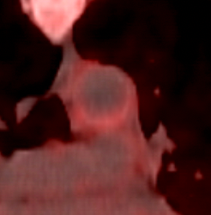
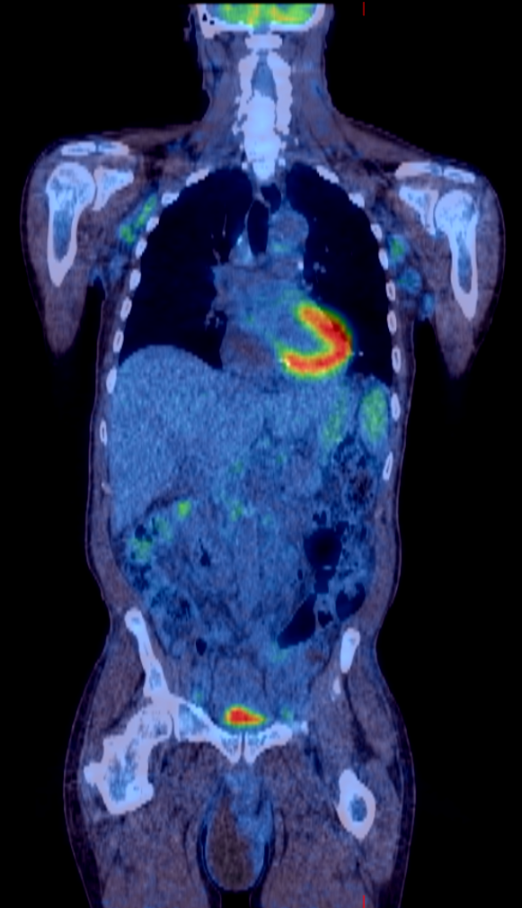
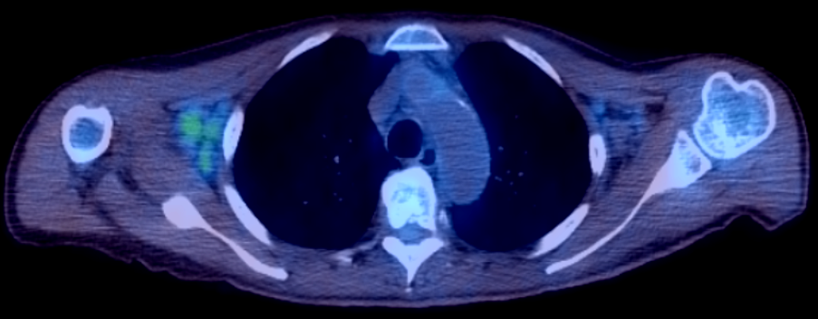
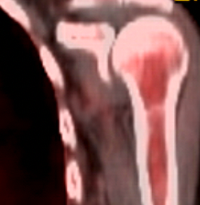

A2712 (female)
A2951 (male)
57.5 skin rash, mild leukocytosis
58.5 skin biopsy: LCH
58.9 basilar artery stroke
58.9 CT: bone, aortitis, peri-renal
59.3 bone and peri-renal biopsy: ECD
59.5 died
62.0 mild autoimmune neutropenia
62.0 BM – mild dysplasia
72.4 skin rash, fever, LN, spleen
72.4 CT: bone, LN, spleen, pericardial effusion
72.6 skin, LN, gut: LCH; bone: ECD
72.8 died

Slide 11
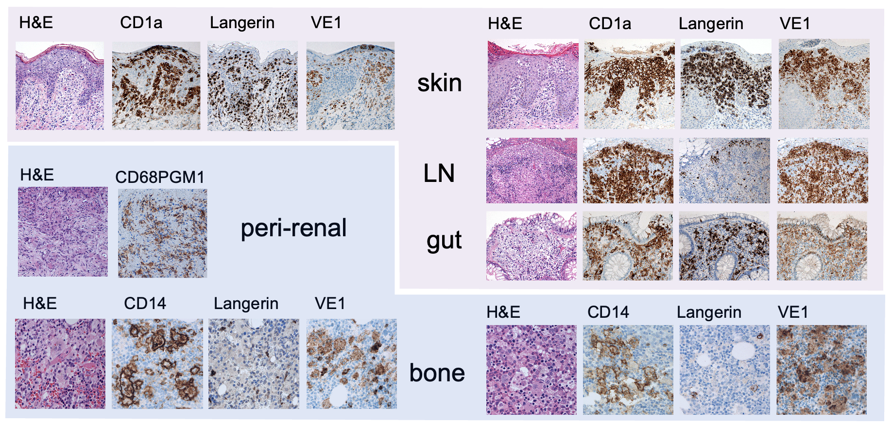
A2712
A2951
LCH
ECD
low res

Slide 12
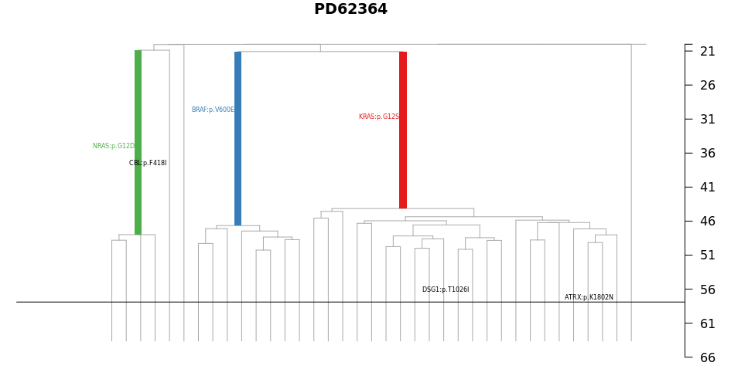
A2712
TET2:p.? essential splice
conception
57.5 skin rash, mild leukocytosis
58.5 skin biopsy: LCH
58.9 basilar artery stroke
58.9 CT: bone, aortitis, peri-renal
59.3 bone and peri-renal biopsy: ECD
TET2:p.I1873T
TET2-/- 20s
BRAF:p.V600E
KRAS:p.G12S
NRAS:p.G13D
triple hit within 5 years
Years
(assuming typical mutation rate)
presentation
Notes:
Data to here*
Sequencing the germline to confirm
Acquired bi-alleleic TET2 mutation in early adulthood from which around mid-40s there emerged 3 MAPK-mutated clones, NRAS, BRAFV600E and KRAS within five years of life
Then over a decade or so evolved to LCH and ECD
Genome still evolving with additional mutations at v low VAF

Slide 13
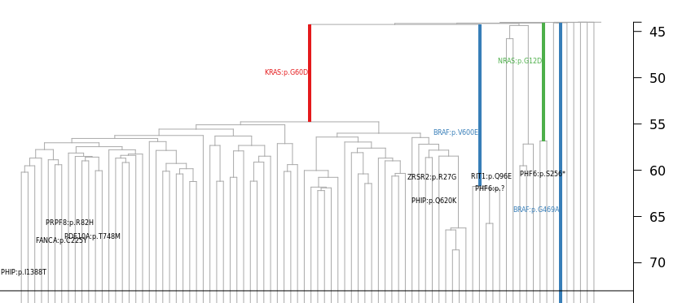
A2951
62.0 mild autoimmune neutropenia
62.0 BM – mild dysplasia
72.4 skin rash, fever, LN, spleen
72.4 CT: bone, LN, spleen, pericardial effusion
72.6 skin, LN, gut: LCH; bone: ECD
conception
TET2:p.? essential splice
4qLOH
NRAS:p.G12D
TET2-/- 40s
KRAS:p.G60D
BRAF:p.V600E
triple hit within 7 years
presentation
Years
(assuming typical mutation rate)
Notes:
By mid 40s had acquired bi-allelic loss of TET2 through splice site mutation and LOH through loss of 4q
Between 55 and 60 acquired KRAS, NRAS and BRAF mutated subclones
Another decade later developed LCH and ECD
Triple hit within 7 years
Still evolving with many other mutations at low VAF

Slide 14
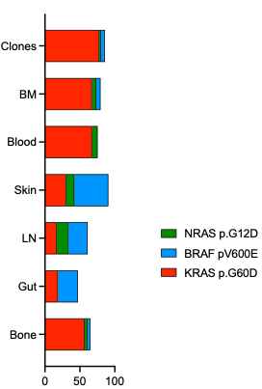
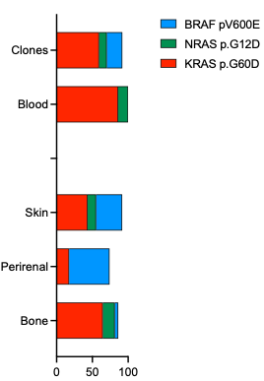

Proportion of MAPK mutations in lesional tissue
A2712
A2951
LCH
ECD
VAF of MAPK mutations normalized to number of TET2 -/- genomes

Slide 15
Summary:
Low mutation frequency makes phylogenetic mapping tough
High risk mixed ECD/LCH evolved over decades from bi-allelic TET2-/-
Convergent evolution of triple MAPK mutations
ECD and LCH pathology contains all MAPK mutations (BRAF enriched in LCH)
Difficult to treat (2012/3 pre-inhibitor era)
Retrospective diagnosis of CMML-MP (cytopenia, monocytes >0.5, NGS)
Unanswered questions:
  ECD without clonal haematopoiesis?
  Overlap with CMML – distinct entity?

Slide 16
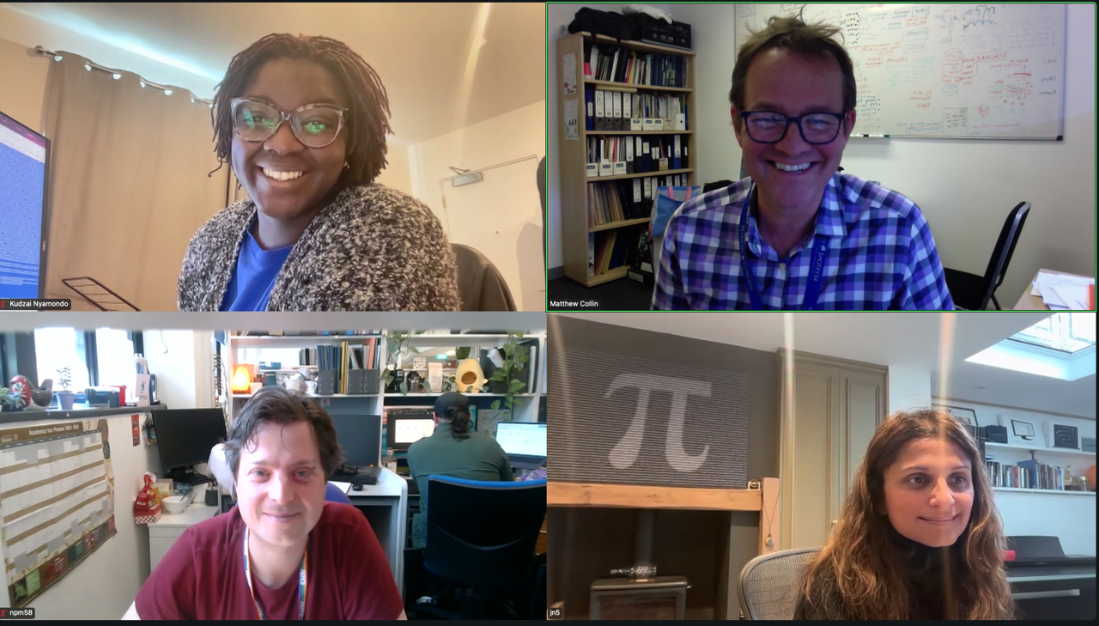
Acknowledgement
Haematopoiesis and Immunity Lab
Newcastle University
Paul Milne
Wing Leung
Sarah Pagan
Venetia Bigley
Newcastle University Centre for Cancer
Newcastle Hospitals
Chris Bacon
Lewisham and Greenwich Hospitals
Ana Duran Maestre
Cancer, Ageing and Somatic Mutations
Wellcome Sanger Institute
Kudzai Nyamondo
Nicholas Williams
Daniel Leongamornlert
Jyoti Nangalia
MSKCC
Eli Diamond
Paris
Camille Bigenwald
Julien Haroche

Slide 17






This work was funded by

Slide 18
sensitivity vs. mutation rate in CD34+ progenitors
grow more clones to achieve higher sensitivity
unlikely to yield positive clones
borderline
negative with adequate number of clones
experimentally untractable
(0.3% = 3 clones /10 plates)

Slide 19
Figure 1. Colony isolation work-flow
Step | Number
Patients | 14
Sorted single CD34+ progenitors + CFU assays | 8,519 + 12
Colonies formed | 4,724
Adequate to harvest | 3,212
Screened for BRAF^{V600E} | 2,237
BRAF^{V600E} (n patients) | 19 (2)
Frequency of mutated colonies/screened | 0.84%

Slide 20

It is hard to do this experiment
HIST-67 is ‘plain’ ECD from Paris but a BM sample
HIST-67 team
expected frequency if BRAF^{V600E} is neutral
‘sensitivity’ = 1/[number clones] when all were negative

Slide 21
Experimental workflow
UPN
age
%BRAF^{V600E}
(blood)
colonies (BRAF^{V600E})
sequenced
phylogeny
BRAF | TET2 | TET2 | NRAS | KRAS | ASXL1
A2712
A2951
A7502
A7578
A7640
A7791
A10033
59.2
73.3
48.7
87.8
58.1
59.9
63.2
1.47
15.98
5.62
0.15
0.11
0.06
0.07
52 (8)
191 (6)
133 (0)
96 (0)
221 (0)
210 (0)
~100 Growing
Yes
Yes
Yes
No
Yes
Yes
No
***
***
Coorens THH, Spencer Chapman M, Williams N, Martincorena I, Stratton MR, Nangalia J, Campbell PJ. Reconstructing phylogenetic trees from genome-wide somatic mutations in clonal samples. Nat Protoc. 2024
Notes:
Range of BRAF VAFs. Paul grew over 1000 colonies and we got 14 with BRAF mutation in these two patients
Quite heavily loaded with clonal haematopoiesis – which we found out in retrospect but which did not play a part in the selection of the patientrs

Slide 22
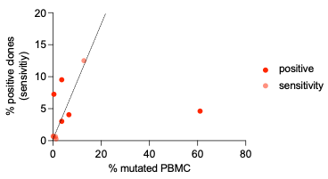
LCH clones vs PBMC (CD34+ VAF not available yet)
BRAF^{V600E} is neutral
A8955
more clones
expected no of clones
fewer clones
A8955 is 2.5 years may have vials left – interesting if this mutation came prenatal

Slide 23
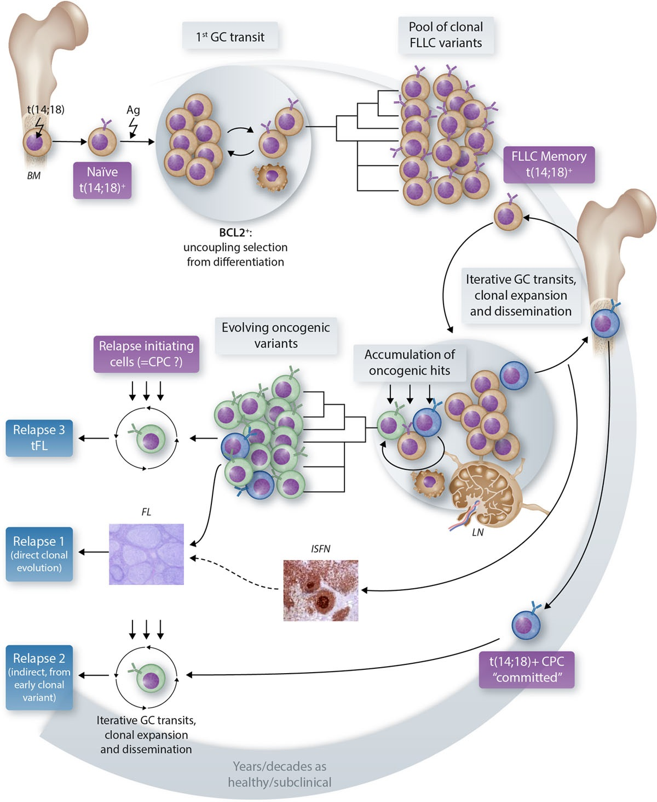
Brisou, Gabriel; Nadel, Bertrand; Roulland, Sandrine. The Premalignant Ancestor Cell of t(14;18)+ Lymphoma. HemaSphere 5(6):p e579, June 2021. | DOI: 10.1097/HS9.0000000000000579

