Slide 1

What should I know about ECD & my heart?
Carrie Geisberg Lenneman MD, MSCI

Slide 2


Objectives
Review common issues in the heart that may be presents in ECD
How should I look for heart issues with ECD?
What are the potential side effect of treatment that can affect my heart?
What tests should I have done to monitor my heart?

Slide 3
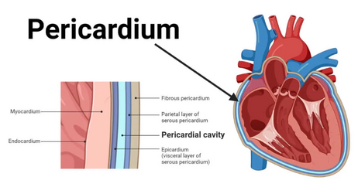
Anatomy of the heart

Slide 4
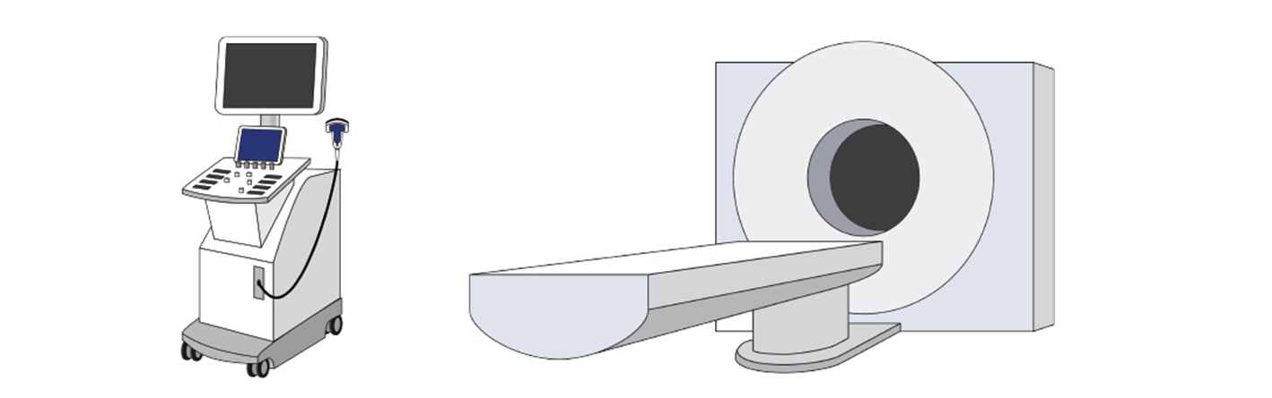
ECD and the heart
Heart involvement may occur in 40-60% of ECD patients
Atrial infiltration
Pericardial thickening / fluid around heart
Coronary artery / blood vessel wall infiltration
Cardiac MRI is most sensitive for looking for ECD involvement
Cardiac involvement is present in 48% of patients with BRAF V600E mutation
DOI: 10.1093/eurheartj/ehac741 July 2023

Slide 5
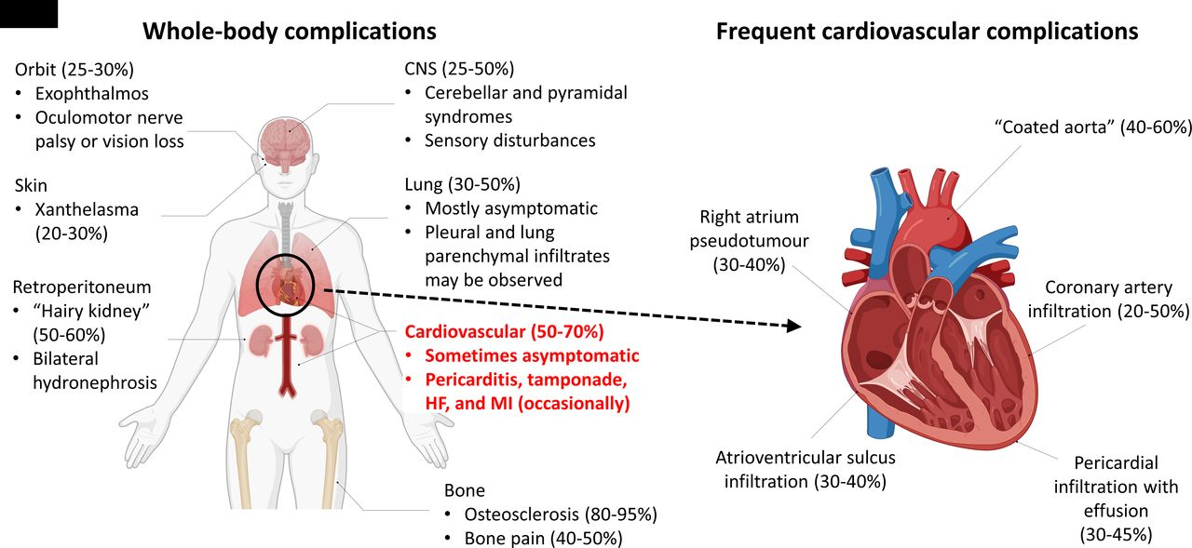
Effects of ECD
doi.org/10.1136/heartjnl-2024-324061

Slide 6
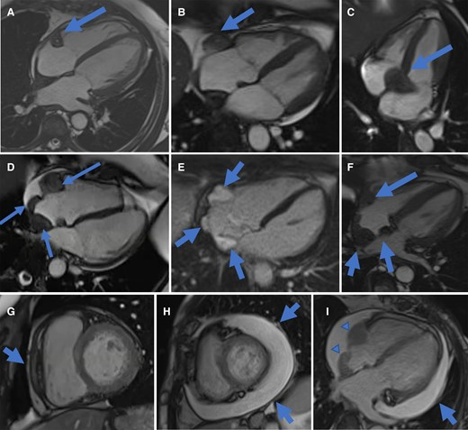
Cardiac MRI examples of ECD
A. & B. right atrioventricular sulcus infiltration, C intratrial infiltration (37%)
5% cardiac tamponade
G. pericardial thickening, H. pericardial effusion was seen in 24% of patients
I. pericardial effusion and right atrial infiltration
DOI: 10.1093/eurheartj/ehac741
Notes:
Sample of 37 patients with ECD were screened for ECD nd 70% haad cardiac involvement.
Atrial and pericardial infiltration in Erdheim–Chester disease on CMR imaging. (A–F) Four-chamber CMR cine images showing atrial infiltration at multiple sites. (A) Right atrioventricular sulcus infiltration in the pericoronary fat of the right coronary artery. (B) Right atrioventricular sulcus pseudomass. (C) Interatrial infiltration. (D) Right, posterior and median right atrial wall infiltration before contrast administration. (E) Right, posterior and median right atrial wall enhancing on late gadolinium enhancement sequences (F) Association of right atrioventricular sulcus and right atrial pseudomasses. (G–I) Mid short-axis cine CMR images. (G) Circumferential pericardial thickening (arrow). (H) Diffuse pericardial effusion (arrow). Four-chamber cine CMR images demonstrating (I) Pericardial effusion (arrow), and right atrial pseudomasses (arrowheads). Abbreviations: CMR cardiac magnetic resonance.

Slide 7
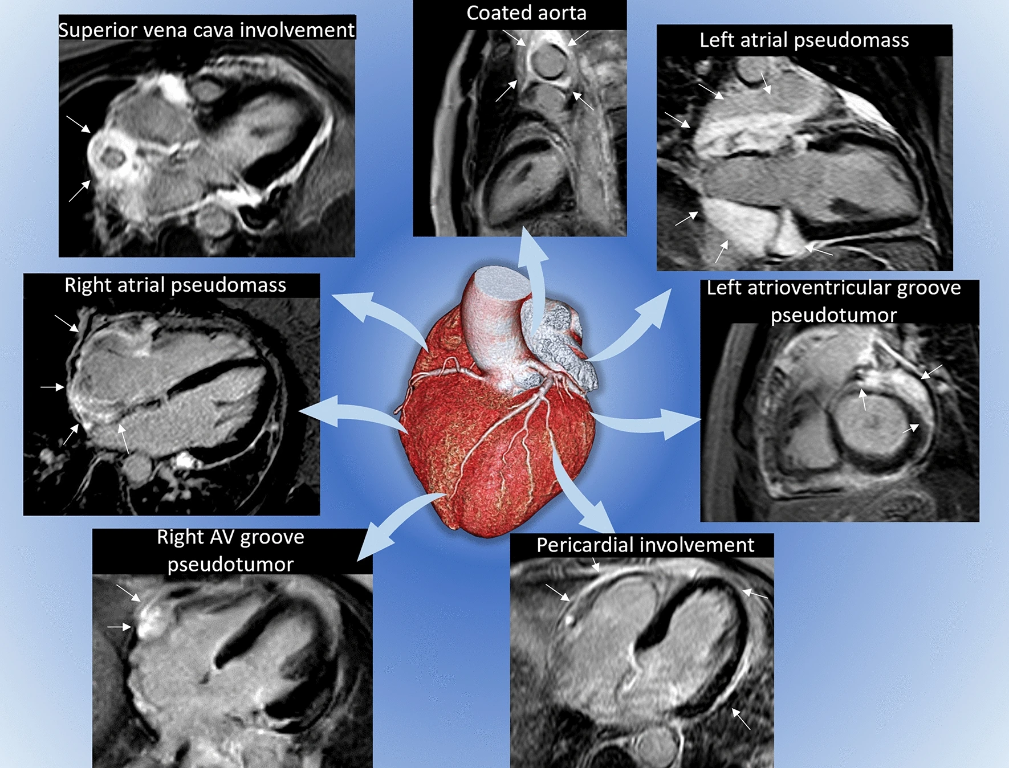
doi.org/10.1007/s11547-023-01616-7. 2023

Slide 8
What to do if my heart is involved?
Heart involvement may be asymptomatic or cause significant arrhythmias heart conduction problems.
May cause acute pericarditis / tamponade
Heart blockage / myocardial infarction
Cause shortness of breath and swelling
Targeted therapy with BRAF / MEK inhibitors are often first-line treatment for patients with cardiac involvement, frequently improving prognosis, which was previously quite poor.

Slide 9
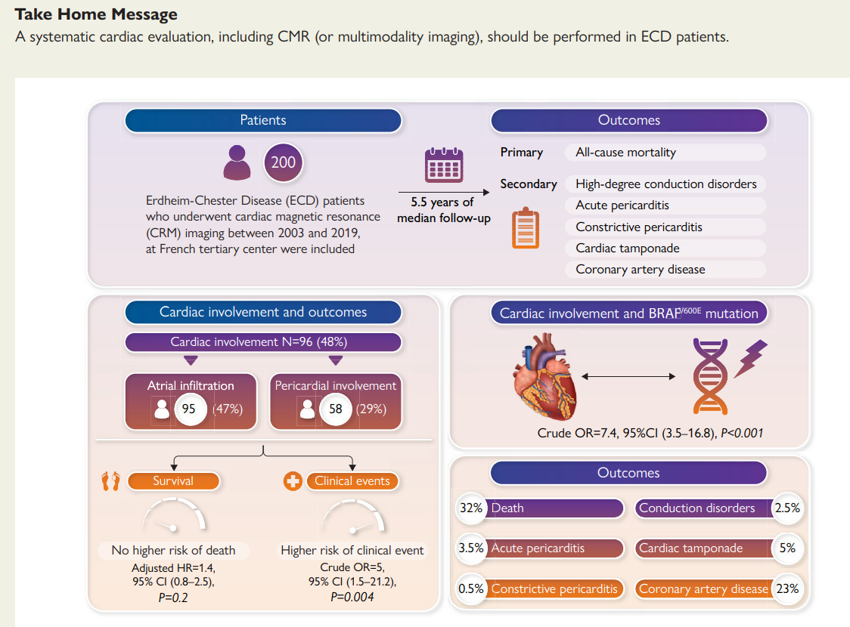
DOI: 10.1093/eurheartj/ehac741 July 2023

Slide 10
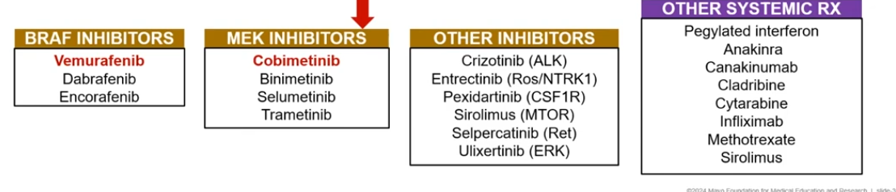
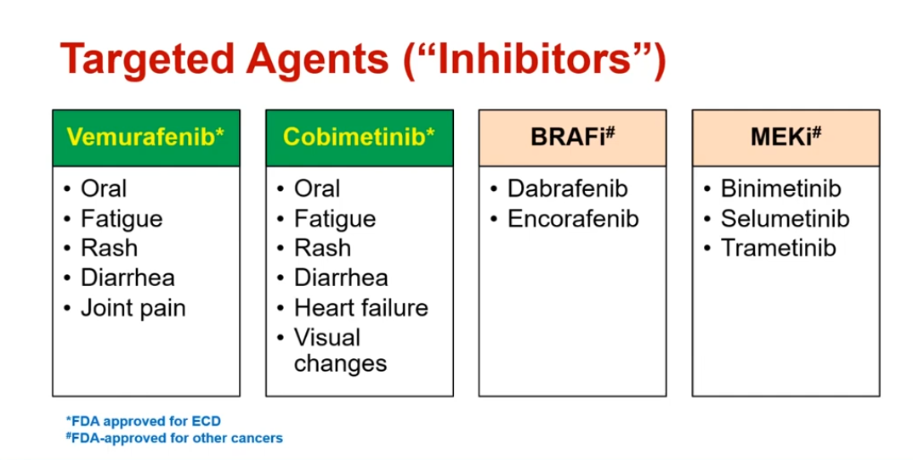
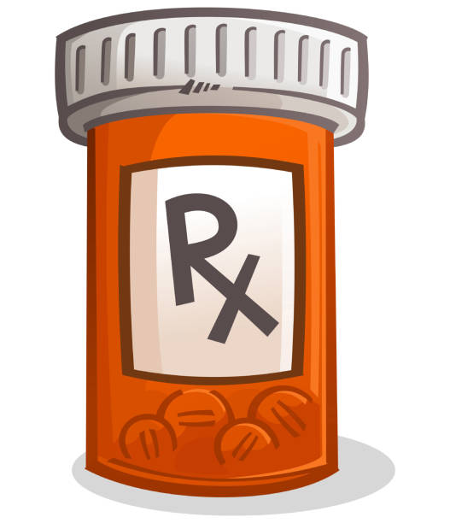
Treatment options

Slide 11
BRAF and MEK Inhibitors
Rapidly accelerated fibrosarcoma B-type (BRAF) and mitogen-activated extracellular signal-regulated kinase (MEK) inhibitors have revolutionized treatment.
  melanoma with have mutations
  Also non-small cell lung Ca (3-5%), anaplastic thyroid Ca, metastatic colon Ca (10%), Erdheim-Chester disease.
Targeting this pathway with BRAF and MEK blockade results in control of cell proliferation
Blocking it alters heart muscle and blood cell repair / growth / homeostasis

Slide 12
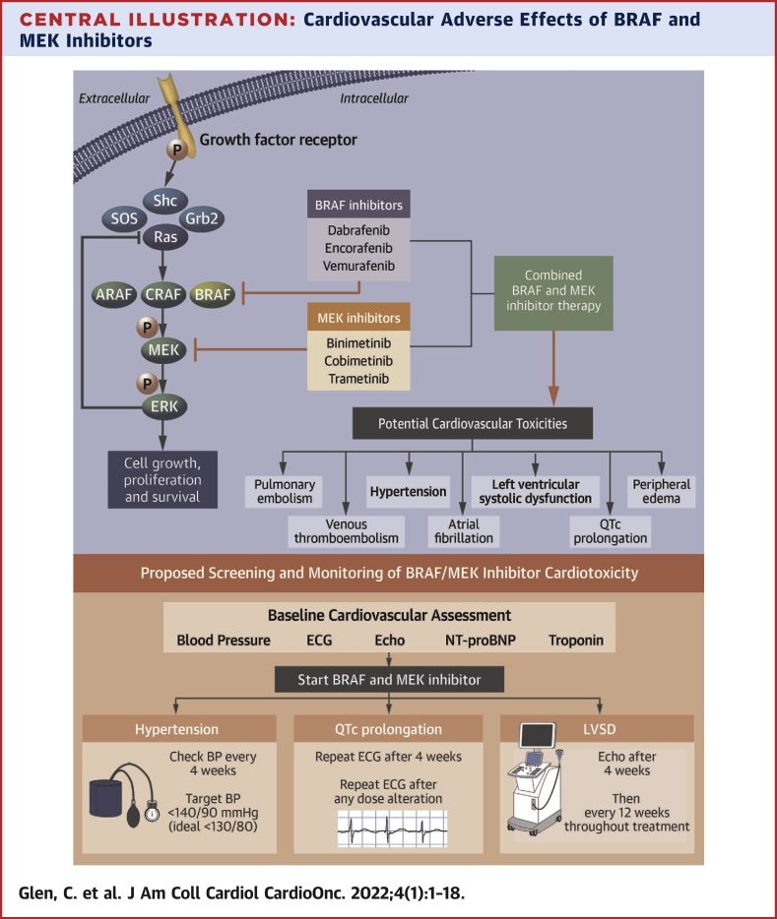
BRAF and MEK Inhibitors - Mechanism

Slide 13
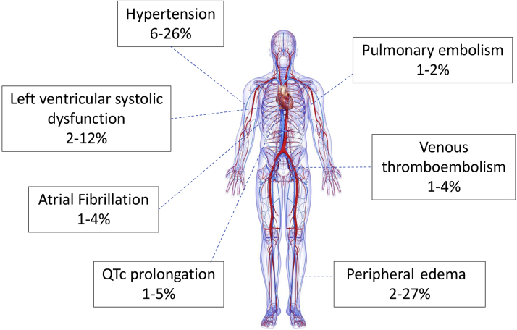
Incidence of BRAF Inhibitor/MEK Inhibitor–Associated Cardiovascular Adverse
JACC CardioOncol. 2022 doi:10.1016/j.jaccao.2022.01.096.

Slide 14
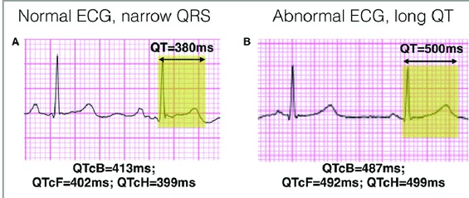
Targeted Treatment options
Cobimetinib – MEKi – monitor for QTc monitoring
Vemurafenib – BRAFi – monitor for QTc monitoring
Be careful with other drugs added:
Nausea meds
Antibiotics
Depression meds

Slide 15
Monitoring that is important for my heart
Baseline BP and every 4 wks (goal <130/80 mmHg)
Baseline Echo, then 1 mo, and 3 mo after thru Rx
Baseline EKG at 4 wks and then with any dose escalation

Slide 16

Take Home Points
Heart involvement in ECD is common ~ 50%
ECD may be found in the atrium / pericardium
Cardiac MRI is helpful to look for heart involvement
Targeted Rx with MEK / BRAF – inhibitor is common
Monitoring your BP, EKG and heart function are important
Notes:
https://www.jacc.org/doi/10.1016/j.jaccao.2022.12.007

Slide 17
Thank you
Carrie Lenneman, MD, MSCI
Director, Cardio-Oncology Program
Associate Professor of Medicine
UAB Division of Cardiovascular Disease
Clenneman@uabmc.edu

Slide 18
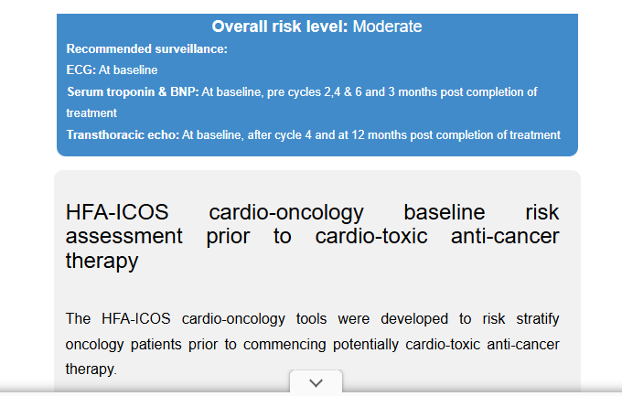
HF-ICOS Calculator
Risk score to discern risk and surveillance:
https://www.cancercalc.com/hfa-icos_cardio_oncology_risk_assessment.php
Info Chemo:
Anthracycline, Her2 targeted therapy, VEGF-I, MEK/RAF inhibitor, CML TKI, MM therapy
Cardiac hx:
Output: Surveillance

Slide 19
ECD treatment
BRAF mutation — For symptomatic ECD with BRAF V600E, we suggest vemurafenib or cobimetinib, (algorithm 1), rather than interferon or cytotoxic agents, based on the balance of efficacy and toxicity.
Both vemurafenib and cobimetinib are effective agents with significant adverse effects (AEs), but they have not been directly compared in patients with ECD. The choice is individualized by toxicity, comorbidities, availability, and patient preference. Among other toxicities, vemurafenib can cause QT interval prolongation and increased risk for second cutaneous cancers, while cobimetinib is associated with left ventricular dysfunction and retinal changes. The risks and benefits of treatment should be carefully discussed with the patient. Administration, AEs, and outcomes with vemurafenib and cobimetinib follow.

Slide 20
Targeted Treatment options
Cobimetinib – MEKi – monitor for QTc monitoring

Slide 21
ECD
Recognized as a clonal hematopoietic neoplasm that is associated with mutations of BRAF or other components of the MAPK pathway.

